Slide 1
2013 Floods LAQ Response and Lessons Learned
Presented by
Paul Davey
29 April 2013

Slide 2
What I will cover
What happened?
Where did it happen?
What initial actions did we take?
What are the longer term actions?
Who else was involved?
Numbers and type of assistance provided?
What did we learn?

Slide 3
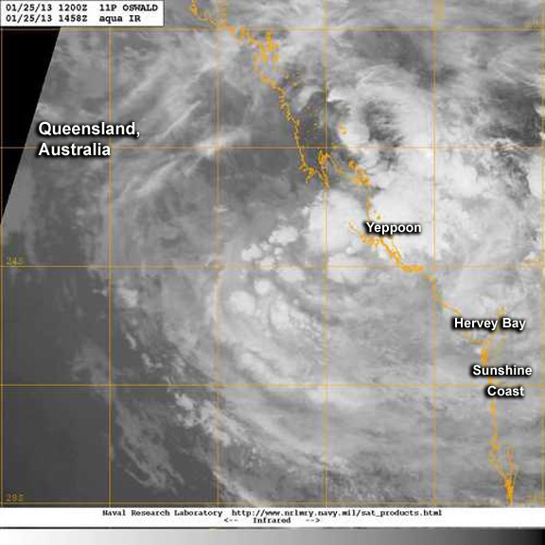
Ex Tropical Cyclone OSWALD
Notes:
EX-TROPICAL CYCLONE OSWALD WAS A SHORT-LIVED STORM, AT JUST 12 HOURS, BUT IT LIVED ON FOR MORE THAN A WEEK UNDER THE INFLUENCE OF DISTANT SYSTEMS TO CUT A 3000KM PATH OF DESTRUCTION.
THE STORM, FORMED IN THE HOT WATERS (30C-PLUS) OF THE GULF OF CARPENTARIA ON JANUARY 21 2013.
OSWALD CROSSED THE WEST CAPE YORK COAST AND HEADED EAST, TAKING A RIGHT TURN AT THE CORAL SEA COAST TO TRACK INLAND ALONG THE QUEENSLAND COAST, SUCKING IN TROPICAL MOISTURE AND DUMPING IT AS RAIN AS IT SPUN SOUTHWARDS.

Slide 4
Numbers of properties affected
Twenty-two areas of Queensland were affected by flood and storm damage from ex-tropical cyclone Oswald.
The areas most affected include; Bundaberg, Gladstone, Rockhampton, Gympie, Fraser Coast, North Burnett and Lockyer Valley.
In these areas, a total of 2,339 properties suffered severe or catastrophic damage and of these 1,608 properties are uninhabitable. 1,321 of these were in Bundaberg.

Slide 6
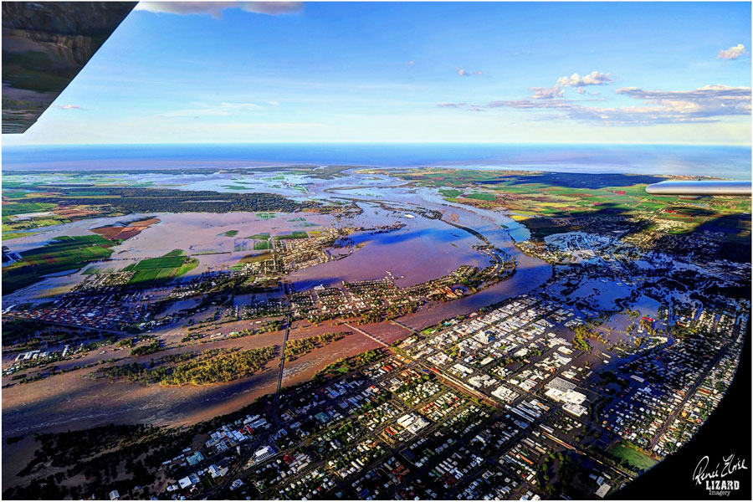

Slide 7
Bundaberg Situation
North Bundaberg
7,000 people directly affected
1,000 evacuated by Helicopter
Evacuation and Recovery centres
3 Evacuation Centres – 320 requiring emergency accommodation (2 weeks after flood)
3 Recovery Centres – essential services
Tent City
Health Issues
Insurance
Notes:
North Bundaberg suffered major damage to a large number of private dwellings and small businesses. The area was covered in mud and the clean took a considerable amount of time and still continues today. Approximately 7,000 people were directly affected with more that 1,000 having to be emergency evacuated by helicopter on Sunday 27 and Monday 28 January.
Evacuation/Recovery centres
There were 3 Evacuation centres operating with approximately 320 people still requiring emergency accommodation as at mid February.
There were 3 recovery centres operating in Bundaberg. Each recovery centre had staff from essential community services such as housing, centerlink (to provide emergency funding), counsellors and QH Mental health.
The local council established a camp at the Bundaberg show grounds. This camp had a number of 10m X 12 m tent dormitories erected, each accommodating 20 - 25 people in double bunks. The tents were air conditioned with galley cooking facilities available in separate tents.
The people staying in this camp were primarily those who have lost homes in North Bundaberg and surrounding towns such as Monto, Eidsvold, Mundubbera and Gayndah.
There were some backpackers also accommodated in the camp who were working on local farms.
23 elderly people who are in emergency accommodation were housed in the local YMCA as the dormitory accommodation was suitable.
Health issues
There were a number of health problem in the area including an outbreak of viral gastroenteritis which is highly infectious.
QH also commenced providing tetanus vaccinations to residents and mud army volunteers.
A mosquito problem also developed with spraying being concentrated around schools.
QH Mental health staff were attending evacuation and recovery centres and providing counselling and assessment services. As at 4 February they identified over 170 people suffering emotional distress/ high level of stress/anxiety.
Insurance
The majority of people in North Bundaberg who suffered damage to their homes were uninsured.

Slide 8
Insurance is the Problem
There is a serious community issue around the availability and affordability of flood insurance.
When floods occur, individuals and the community often suffer severe economic and social losses.
These losses are exacerbated by the fact that many policyholders do not have flood cover, leading to financial hardship that impedes personal and community recovery.
(Natural Disaster Insurance Review – John Trowbridge 30 September 2011)
Notes:
Through research I have obtained information that insurance premiums in flood affected areas have dramatically increased since 2011. Examples of premiums rising from $900 per year before the flood to $11,000 after the flood. Another example is a householder whose insurance rose to over $19,000 per year. This man elected to take a non-flood policy at a cost of $3,300 per year. Bundaberg is a predominately low socio-economic area and residents simply can not afford flood insurance.

Slide 9
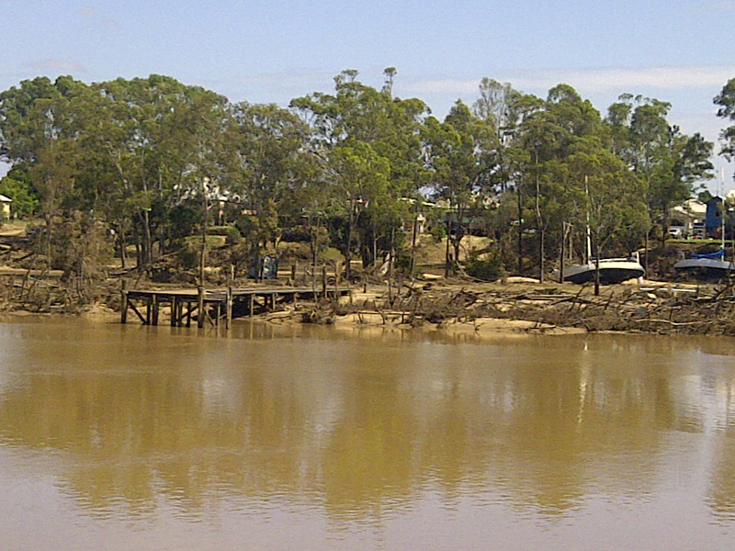

Slide 10
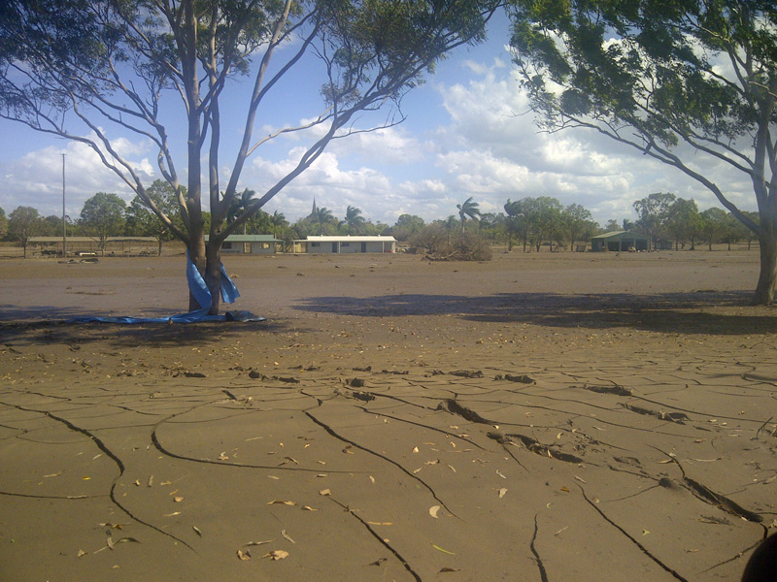

Slide 11
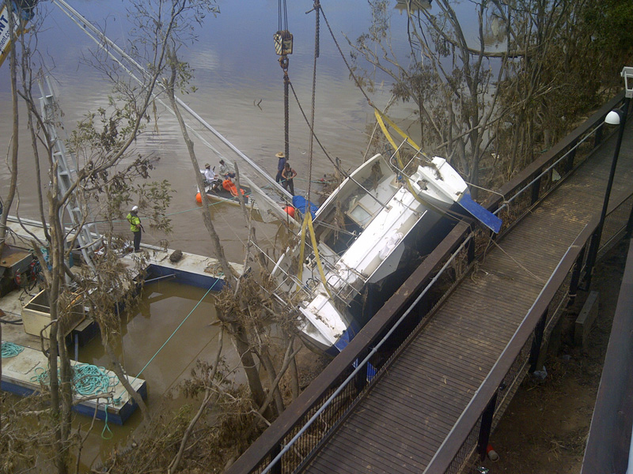

Slide 12
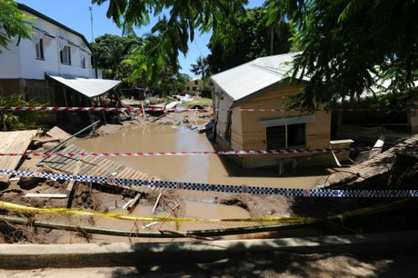

Slide 13
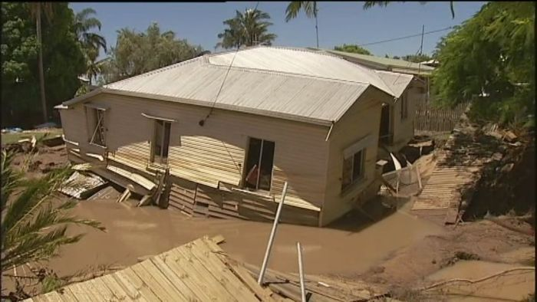

Slide 14
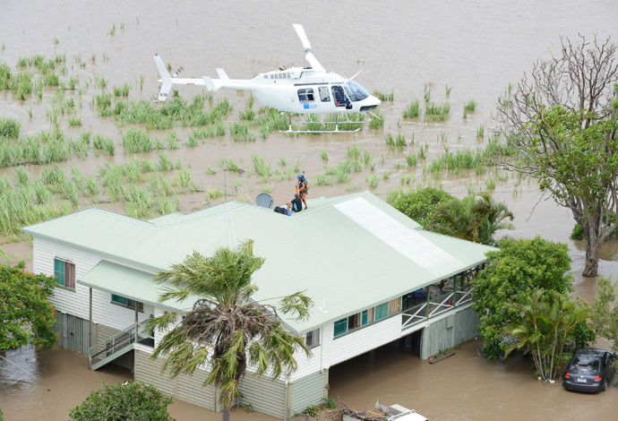

Slide 15
Initial Actions
The LAQ call centre established as the first point of contact.
Posters distributed to recovery centres in the affected areas.
Media announcements - local newspapers and radio stations.
The call centre issued with updated information sheets on flood response and insurance issues
Notes:
The LAQ call centre was established as the first point of contact for flood legal help.
Posters informing the community of the availability of legal information and advice services through the Legal Aid Queensland call centre were distributed to recovery centres in the affected areas throughout the state.
DOC staff who serviced these centres were briefed on the services we could provide.
Media announcements informing the community of the services available were distributed to local newspapers and radio stations.
The call centre has information sheets on flood response and insurance issues which were developed as part of our response to the 2011 flood and cyclone events. These resources were updated as necessary.

Slide 16
Initial Actions
Priority booking system developed for advice services.
data collection by call centre.
Legal Aid Queensland’s website updated on flood issues.
Links to legal information resources.
Link provided to the Queensland Law Society for placement on their website.
Notes:
For clients who require flood related legal advice, a priority booking system was developed to connect clients with lawyers of Legal Aid Queensland’s consumer protection unit and first advice contact team.
The call centre has been collecting data about the calls for assistance from people affected by the floods to inform future resource allocation for follow on stages of the response and to inform planning for future natural disasters.
Information on Legal Aid Queensland’s website relating to floods was updated with links to legal information resources, including information and fact sheets. This link was also provided to the Queensland Law Society for placement on their website.

Slide 17
Co-ordinated Services Delivery
Partner Organisations
QAILS
QPILCH
DJAG
ATSILS
TASC
TUQ
QLS
BAQ
TSCLS
Bridget - Caxton
Notes:
Legal Aid Queensland organised a coordinated response by legal assistance services across Queensland to the 2013 Queensland floods to ensure that people who have been affected by this disaster can obtain legal information and advice about their situation and representation where necessary.
Meetings were held with partner organisations to determine the services LAQ could provide and how partner organisations could supplement these services or provide services LAQ could not.

Slide 18
Legal Areas we could assist in
Insurance claims relating to home and contents.
Insurance claims relating to motor vehicles.
Problems with telephone and/or utilities services being cut.
Mortgage and debt advice.
Notes:
Some of the legal issues we expected to arise, based on our previous experience in providing services to people affected by serious flooding and extreme weather events, include:
Insurance claims relating to home and contents at all stages of the claims process including through internal and external dispute resolution stages of the process.
Insurance claims relating to motor vehicles at all stages of the claims process.
Problems with telephone and/or utilities services being cut.
Mortgage and debt advice – hardship following loss of house or loss of job following floods.

Slide 19
Legal Areas we could assist in
Family law issues.
Criminal law.
Small business insurance information and initial advice.
Damage to dividing fences.
Damage caused by falling trees.
Notes:
Family law issues – breaches of court orders due to inability to carry out the terms of an agreement.
Criminal law – clients who cannot reach Court or where the Court is closed.
Small business insurance information and initial advice.
Damage to dividing fences.
Damage caused by falling trees including trees on one property falling and damaging fences and buildings on adjacent property

Slide 20
Refer clients to partner organisations
Information, advice or representation in relation to personal injuries claims - QPILCH.
Information, advice or representation to small business owners and farmers in relation to insurance claims – QPILCH.
Other legal issues relating to businesses –QPILCH.
Notes:
Legal Aid Queensland could not provide assistance in relation to the following legal issues but made arrangements to refer clients to partner organisations who had agreed to provide this service:
Information, advice or representation in relation to personal injuries claims arising out of the natural disaster – people seeking these services will be referred to QPILCH.
Information, advice or representation to small business owners and farmers in relation to insurance claims – will be referred to QPILCH.
Other legal issues relating to businesses – will be referred to QPILCH.
Lost documents – people will be referred to Legal Aid Queensland’s Factsheet which gives details of the Government agencies to contact.
Tenancy issues – people will be referred to the Tenants Union of Queensland or one of the community legal centres that has offered to provide this service.
Employment issues – people will be referred to one of the community legal centres that has offered to provide this service
Conveyancing and property issues – people will be referred to the Queensland Law Society.

Slide 21
Refer clients to partner organisations
Lost documents –referred to LAQ Factsheet.
Tenancy issues –Tenants Union of Queensland or CLC.
Employment issues – CLC.
Conveyancing and property issues – Queensland Law Society.
Notes:
Lost documents – people will be referred to Legal Aid Queensland’s Factsheet which gives details of the Government agencies to contact.
Tenancy issues – people will be referred to the Tenants Union of Queensland or one of the community legal centres that has offered to provide this service.
Employment issues – people will be referred to one of the community legal centres that has offered to provide this service
Conveyancing and property issues – people will be referred to the Queensland Law Society.

Slide 22
A-G hails Legal Aid’s $100K top-up
ATTORNEY – GENERAL Jarrod Bleijie has welcomed the decision by Legal Aid to provide an additional $100,000 in assistance to flood-affected Queenslanders………….
Notes:
Taylor St Community Legal Centre (in Hervey Bay) which services the Fraser Coast, Bundaberg and Burnett regions to provide legal information and advice services directly to members of the community affected by the floods in those regions. $50K
The Queensland Public Interest Law Clearing House (QPILCH) to coordinate the provision of legal information, advice and representation to small business owners and farmers across Queensland who are affected by the floods and who have on-going insurance and other legal issues arising from the disaster. $50K

Slide 23
Community Legal Centres
Eight community legal centres volunteered to provide employment, tenancy and general civil law advice.
Call centre are referring people to these services.
Notes:
Eight community legal centres volunteered to provide employment, tenancy and general civil law advice (face to face and by telephone) to affected members of the community. Legal Aid Queensland’s call centre will refer people to these services.
LAQ had to directly contact these CLCs and co-ordinate their response to clients.

Slide 24
Community Meeting Bundaberg
Meeting held 20 February 2013 in Bundaberg.
In conjunction with the Insurance Council of Australia and Financial Ombudsman Service.
Lawyers from CPU and Bundaberg.
Provided Information, advice and referral services to affected members of the public.
Only people who were insured could attend the meeting.
Notes:
On 20 February 2013 we attended a community meeting in Bundaberg in conjunction with the Insurance Council of Australia and Financial Ombudsman Service.
Myself along with Catherine Uhr and Paul Holmes of the Consumer Protection Unit and Nick Later and Jan Dwyer from the Bundaberg office attended the meeting and provided Information, advice and referral services to affected members of the public.
Only people who were insured could attend the meeting.

Slide 25
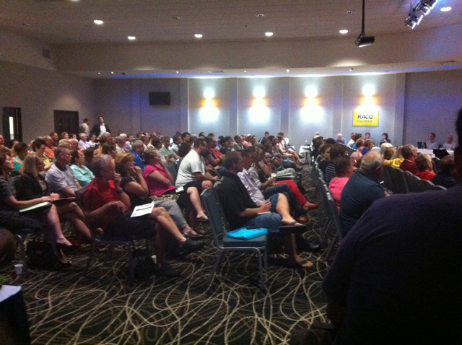
Questions?
Notes:
Photo of the meeting.
Approx 180 people attended
27 couples sought Legal advice – many of these could be helped on the night of via follow up advice.
12 were also given referrals to other service providers.
Call centre has received approximately flood related 80 calls
And CPU currently has 10 insurance files with this expected to increase to about 50.

Slide 26
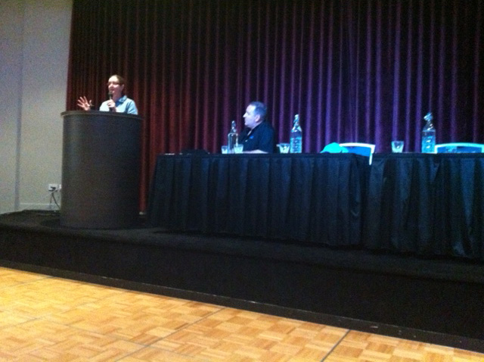
Notes:
Catherine Uhr

Slide 27
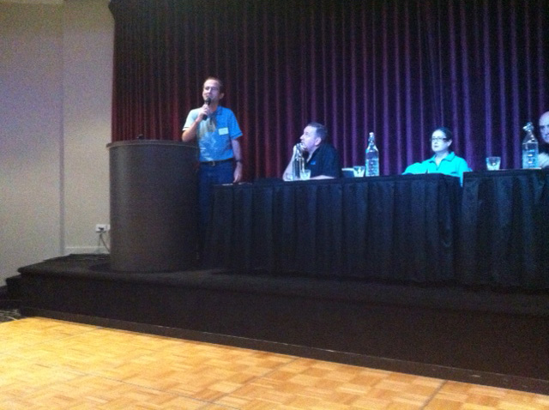
Notes:
Paul Holmes – Note the stylish LAQ Polo Shirts

Slide 28
Lessons Learned
Ensure Fact Sheets are up-to-date (on-going)
Meet with Stakeholders early (Standard List)
Clearly identify what LAQ can do and what we can’t
Brief AG – DJAG (early and keep informed)
Liaise with DOC staff early (and supply them with material)
Posters in Recovery Centres

Slide 29
Lessons Learned
Meet with Local Council
Do not attend Recovery/Evacuation Centres
Directly organise Partner Organisations (CLCs etc)
Use media to get message out
Record call centre data
Put the response team together
Use local Regional Office as POC in local area

Slide 30
Questions?

