Slide 1
Queensland Indigenous Family Violence Legal Service
“CLC assisting Aboriginal and
Torres Strait Islander Clients”
'No Way,
It's Not Our Way'
Marja Elizabeth – Chief Executive Officer
Wynetta Dewis – Policy and Projects Manager
Jessica Shuttleworth– Supervisory Solicitor
Notes:
Firstly we would like to take the opportunity to thank the QAILS for hosting this event and for the opportunity to present at today's conference. My name is XXXX and I am a XXXX in the XXXX QIFVLS office.

Slide 2
Our Vision
“Aboriginal and Torres Strait Islander people and communities in Queensland are supported to live free from family violence and/or sexual assault”.
Our Mission
Address domestic and family violence and sexual assault of women, children and men by providing free legal and casework services and more broadly through community education, law reform and advocacy.
Ensuring services are reflective of the cultural values of each community.
Notes:
We are a legal and support service which provides a wrap around service for our clients who are Aboriginal and/or Torres Strait Islander people who have been or are victims of domestic violence, family violence or sexual assault.
Mission – culturally appropriate service
Our session today is about how we structure our service to deliver culturally appropriate services to clients, as well as how we strengthen our staffing in a culturally appropriate way. We will further explore what QIFVLS is, what we do, how we do it, and what we found works for us and our clients when providing remote and regional service delivery.

Slide 3
Service Areas
Funded Areas |  |  | Unfunded Service Areas
Aurukun | Dajarra | Normanton | Cairns | Mareeba
Bamaga | Doomadgee | Old Mapoon | Atherton | Seisa
Bedourie | Hope Vale | Palm Island | Ayr | Townsville
Birdsville | Hughenden | Pormpuraaw | Biloela | Tully
Boulia | Injinoo | Richmond | Bowen | Woorabinda
Brisbane (CBD) | Julia Creek | Rockhampton LGA | Deeragun | Yarrabah
Burketown | Kowanyama | Umagico | Djaringa | Yeppoon
Camooweal | Lockhart River | Urandangie | Gladstone
Charters Towers | Mornington Island | Weipa | Home Hill
Cloncurry | Mount Isa LGA | Wujul Wujul | Ingham
Coen (part) | Napranum |  | Innisfail
Cooktown | New Mapoon |  | Kuranda
Notes:
Total communities serviced - 58
Communities serviced funded - 34
We also service areas outside our funded areas (19) such as Yarrabah, Innisfail, Tully, Kurunda, Atherton Tablelands, Woorabinda, Gladstone, Cairns CBD and Townsville CBD.

Slide 4
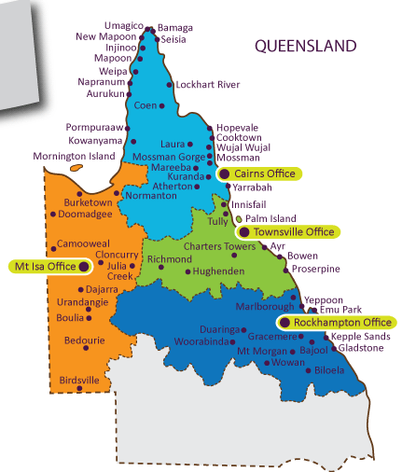
Origin
78.9% Aboriginal
12.9% Torres Strait Islander
8.2% Both
Now servicing Brisbane CBD
Notes:
Office locations and staffing;

Slide 5
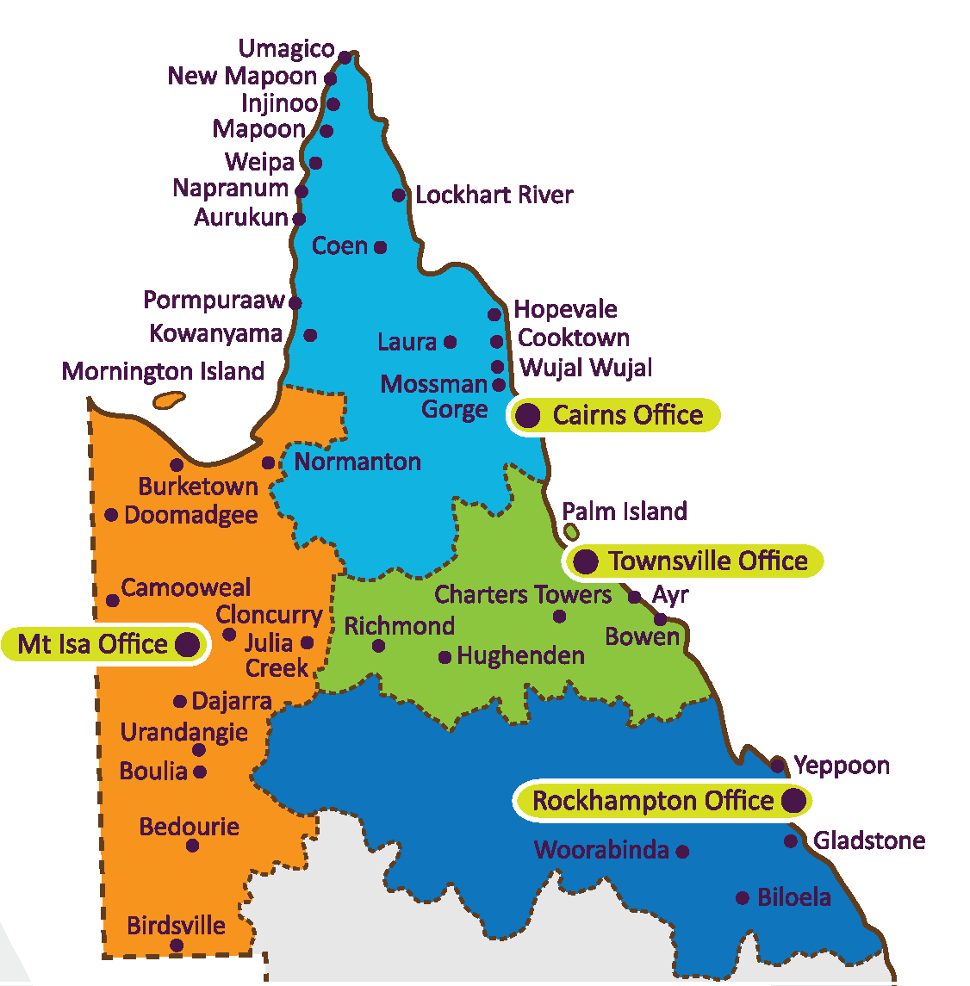
By Air
By Road
Now servicing Brisbane CBD
2011 census 3.6% of the Qld population identify ATSI that is an increase of 22.1% since 2006.
34.2.% live in the Brisbane region
41.5% live in the regions from Cairns to Atherton, Townsville to Mackay and Rockhampton
Two-thirds of the Aboriginal population of Australia live outside capital cities with 23% living in remote or very remote areas.
Notes:
Emphasis on how remote some of our communities are.
We service a large majority of Queensland. QLD has an Indigenous population of 72.6% living in the regional and remote areas. There are large concentrations of Indigenous people living in the areas considered ‘large QLD towns’ of Cairns, Townsville and Mount Isa with high proportions of Indigenous people are living in communities clustered around the Gulf of Carpentaria and in the Qld areas such as Doomadgee, Aurukun, Pormpuraaw, Kowanyama.

Slide 6
Organisational Structure
The QIFVLS Board consists of eight Indigenous Regional Directors who are key community members from within our service areas. This ensures the service is Indigenous controlled, and that the communities can provide feedback through their local Board member.
There are two Specialist Directors in the areas of Legal and Financial.
Additional Regional Directors will be appointed for the Brisbane region.

Slide 7
Service Model
Role of Solicitor and Client Support Officer (CSO)
  CSO roles within the organisation are ATSI identified positions
Client centred holistic support
  We provide practical and welfare support, court support and advocacy along with legal support and representation
Culturally appropriate staff
  Cultural awareness training for all staff (indigenous and non-indigenous)
  Regular contact with communities to remain engaged and to keep abreast with what is happening in the communities

Slide 8
The average Aboriginal person has 70 discrete experiences of racism annually.
42% experience racism in their workplace. 79% of Aboriginal cope by avoiding situations where they predicted racism would occur.
The more people in organisations that are cultural competent the less racist society becomes.

Slide 9
Cultural Competence
Cultural awareness – knowing
Cultural sensitivity – appreciating
Cultural competence – practising, demonstrating
Cultural proficiency – embedding as organisational practice
Cultural competence must be obtained at both the individual and organisational levels in order to ensure effect practice with Aboriginal people.

Slide 10
How do you maintain a culturally appropriate service?
Indigenous and non Indigenous staff
Non tokenistic Indigenous roles
Community Development Officer role/s
Don’t be culture blind when supervising Indigenous staff
Cultural training as an ongoing
Participation in community activities with all staff
Cultural mentors from communities
Cultural handbook
Induction
Specific training for Supervisors and Managers in how to supervise Indigenous staff
Indigenous Board of Directors
Board meetings across the state
Connection with community from the Board down

Slide 11
Retaining Indigenous staff
Family and cultural obligations
Absenteeism for cultural reasons
Humbugging
Longing for country and cultural grieving
Lack of career path
Policies and procedures fail to take cultural differences into account e.g. cultural leave

Slide 12
In Australia, Indigenous women report a rate of family violence which is six times higher than that of non-Indigenous women.
Indigenous people are less likely to take action on legal problems and consult on legal advice in remote areas i.e. 22.8% in major cities compared to 5.6% in remote areas.
Indigenous women are 35.1 times as likely to be hospitalised as a result of family violence related assaults and are almost 10 times as likely to die as the result of assaults than non-Indigenous women.
Indigenous women’s imprison rate is 16.5 times that of general family population and higher then for Indigenous men which is (13.4 times).

Slide 13
Issues in servicing clients
Impact of history and associated trauma
Remoteness of communities
Every community is different
Don’t assume literacy, numeracy, language and culture are an issue
Facilities – don’t expect an office
Complexity of legal issues with Indigenous clients
Complexity of non legal issues
Lack of education and access to basic services like health, therapy, food, government services particularly in remote areas
Lack of choice of services remote versus urban
Gender issues

Slide 14
Working with Indigenous clients
Face to face in preference to telephone
Advice and not action
Understanding the different parenting styles of Indigenous people
Family has a different/extended concept
Role of support person
Good communication – English may not be the first language of clients
Having someone who understands the language and can relay the legal terms (CSO)
Body language, eye contact
Engage by using visually based techniques

Slide 15
Working with Indigenous clients
Yes might not mean yes
Be flexible about where you meet – not in offices
Take time – stories are often told narratively and with a lot of background
Listen and don’t speak too often
Respect
Expect long silences
How to engage instant rapport
Aboriginal language is relational rather then descriptive
Non verbal communication is preferred – voice tone, facial expression, eye movement

Slide 16
Indigenous parenting styles
Aboriginal | White Australian
Child caring shared by the large extended family group. Children have the capacity to demand what they want i.e. cry if hungry. | Nuclear family Child’s mother with input from the father. Children seen as helpless.
Children allowed to be independent in self care. | Children not expected to be independent in eating, dressing or washing.
Little oral obedience training. | Oral obedience begins early e.g. ‘No”, “stop’.
Competitive play not encouraged. | Competition often encouraged.
Sleeping can be in any room. Children accept responsibility for each other with no adults. | Sleeping often away from family. Children expected to stay close to adults. Siblings mix but parents in charge.
Children's possessions available to all and not really valued. | Children have their own possessions and encouraged to look after them.
Awareness of shame which often leads to withdrawal. | More practical feelings and behaviours rather than shame.

Slide 17
Indigenous children are 8 times as likely to be the subject of substantiated child abuse and neglect; over 9 times as likely to be on care and protection orders and 10 times more likely to be in out of home care.
FVPLS provide over 220 CLE annually to about 150 communities.
80% of Aboriginal women report that their offending is linked to family violence; 70% report having been sexually assaulted or having suffered other types of childhood abuse; while 44% report being sexually assaulted as adults. A large proportion of these women have also been in the child protection system or institutionalised.
FVPLS services see over 5000 clients each year approximately 90% are women.

Slide 18
Community protocols/starting a service
Connect with the traditional (TO’s) / Elders.
Understanding the difference between Aboriginal and Torres Strait Islander culture.
Understanding each community is different.
Build trust in the community and go slow (Yarrabah /Brisbane).
Have a presence in the community not just fly in and fly out.
Be prepared to get it wrong and take a growling.
Vouching

Slide 19
Thank you for your time
☺

