Slide 1

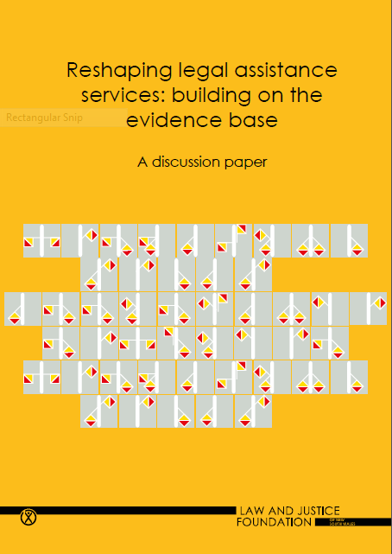
Reshaping legal assistance services:
evidence for the future
Christine Coumarelos and Geoff Mulherin
Presentation to:
Queensland Association of Independent Legal Centres
Brisbane, 26 May 2015
Pleasence, Coumarelos, Forell & McDonald (2014)
www.lawfoundation.net.au/ljf/app/&id=D76E53BB842CB7B1CA257D7B000D5173

Slide 2
Background
The Law & Justice Foundation
Legal needs and ‘what works’ to address that need.
  Much research on legal needs
  Little research about ‘what works’, and at what cost, etc
Purpose of the Discussion Paper
Three audiences (and sources)
  Service providers
  Policy makers / funders
  Researches
Context / Funding
Notes:
GM

Slide 3
Method: Reshaping Legal Assistance Services report
Summary of existing legal needs research: including Legal Australia-Wide (LAW) Survey
Further analyses using LAW Survey data
New fieldwork: consultations with 135 legal and human service providers:
  Sydney and 3 regional/remote areas of NSW
  Legal service providers included ALS, CLCs and Legal Aid
  Key stakeholders in NSW
  Purpose: to provide egs of service innovations, & their
  benefits/challenges
Notes:
CC
The report summarises the existing research here and overseas
We also conducted new analyses to inform the report.
And we went out in the field, and consulted lawyers and other service providers, to gather insights about current service innovations, including their benefits & challenges.

Slide 4
Overview
Evidence base for service reform: summary of key research findings
Implications : 4 key directions for service reform
Each service direction: definition & framework
How do we move forward given current context of legal services and funding?
Notes:
CC - Today’s talk – I will summarise the evidence from decades of research relevant for service delivery.
The evidence suggests 4 key directions for service reform.
I’ll describe each of these service directions.
Finally, Geoff will finish with a discussion about how we move forward from here, given the current context of legal services and current funding situation.

Slide 5
Empirical evidence
26 national legal needs surveys across the world – including Legal Australia-Wide (LAW) Survey
Other access to justice research
Consistent core findings:
Inequality of experience
Multiple problems compound inequality
Inequality of access and capability
Notes:
CC - Legal needs surveys (including the LAW Survey) and other research have provided a broadly consistent picture of legal need across jurisdictions. Core findings show:
Inequality of experience of legal problems
Legal problems do not exist in isolation & they compound disadvantage
There’s inequality in terms of access to justice and people’s capability to address their problems

Slide 6
Empirical evidence:
Inequality of
experience
Notes:
CC – Looking first at the inequality of experience

Slide 7
Inequality of experience & disadvantage
Problems are not randomly distributed across population:
  LAW Survey: 9% of people = 65% of problems
Disadvantage is pivotal to this elevated prevalence – E.g.
  chronic ill-health/disability, single parenthood, unemployment, disadvantaged housing
Notes:
CC - The LAW Survey, for example, found that about 1/10 of people account for 2/3 of the legal problems.
Importantly, socioeconomic disadvantage appears to be pivotal to the elevated experience of legal problems. The research commonly shows elevated vulnerability for those with chronic illness/disability, single parents, the unemployed and those in disadvantaged housing.

Slide 8
Legal problem prevalence by disability type: LAW Survey
(see Coumarelos, Pleasence & Wei 2013)
N=20,716
Notes:
CC - Looking at the experience of legal problems by disability status…
The green line shows people with no disability – they have the lowest prevalence
People who both a mental and physical disability – the red line – are the most vulnerable.
Also, prevalence is more elevated for people with only a mental disability (the blue line) than for people with only a physical disability (the pink line).

Slide 9
Legal problem prevalence by housing type: LAW Survey
(Coumarelos & People 2013 – LAW Survey data)
Notes:
CC
Also, LAW Survey respondents WHO HAD BEEN HOMELESS also had much higher prevalence of legal problems
More than half of the homeless group experienced at least 3 legal problems compared to only about one-fifth of those in non-disadvantaged housing
[Those in basic or public housing also had elevated levels of legal problems, but not to the same extent as homeless people

Slide 10
Empirical evidence:
Multiple problems compound inequality
Notes:
CC
Turning now to the experience of multiple legal problems and how that can compound inequality

Slide 11
Legal problems don’t exist in isolation
Legal problems co-occur: defined clusters identified
Disadvantaged people: multiple legal problems
Legal problems coexist with ‘everyday life’ problems: bi-directional link
  Result from broader social problems
  Create/perpetuate broader social problems & disadvantage
Notes:
CC - Legal problems don’t exist in isolation – defined clusters have been identified
Disadvantaged people are more likely to experience multiple legal problems
Legal problems are linked to ‘everyday life’ problems. There’s a bi-directional link between legal problems and broader social problems:
Legal problems can result from broader social problems
And they can create/perpetuate broader social problems & disadvantage

Slide 12
A vicious cycle of vulnerability
(adapted from Tobin Tyler et al 2011, p.236)
Homelessness
Health problems
Inability to work / disruption of work
Eviction
Loss of income/
poverty
Non-payment of rent
Notes:
CC
As legal service providers, you will no doubt be aware of scenarios like this, where legal and other human needs feed off each other.

Slide 13
Multiple disadvantage = multiple legal problems: LAW Survey
(McDonald & Wei 2013 – LAW Survey data)
N=20,716
Notes:
CC
People who suffer multiple disadvantage are particularly vulnerable to multiple legal problems.
The number of legal problems increases with the number of types of disadvantage experienced.
[Similarly, there’s an increase in the number of substantial problems with disadvantage]

Slide 14
Overlap between legal and non-legal
public service needs: LAW Survey
Non-legal public service need | Number | % of all LAW Survey respondents | % reporting 1+ legal problems
Health | 4,095 | 19.8 | 61.0
Housing | 1,235 | 6.0 | 60.9
Unemployment | 1,700 | 8.2 | 59.5
Health + housing | 507 | 2.4 | 66.8
Health + unemployment | 971 | 4.7 | 61.9
Housing + unemployment | 331 | 1.6 | 71.3
Health + housing + unemployment | 233 | 1.1 | 75.1
All LAW Survey respondents | 20,716 | 100.0 | 49.7
Notes:
CC
This table demonstrates the considerable overlap between legal and non-legal public service needs.
On the bottom row, you can see that almost half of the LAW Survey respondents experienced a legal problem in the previous 12 months
But, legal problem prevalence was significantly elevated for those who had health, housing or unemployment needs:
It rose to 75% for respondents who had all 3 of these non-legal needs.

Slide 15
Empirical evidence:
Inequality of
access and capability
Notes:
CC
Turning now to inequality of access and capability

Slide 16
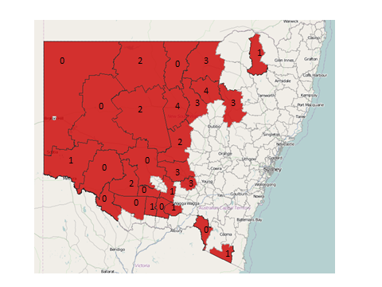
Inequality of access: Geography – RRR study
(Cain, Macourt & Mulherin, 2014)
27 NSW LGAs with declining population: <5 solicitors
Notes:
CC – Firstly, geography. Australia’s vast remote areas are a well-known challenge to accessing justice.
The rate of lawyers is 3 times lower in regional/rural/remote (RRR) areas of Australia compared to capital cities.
This map of NSW shows that 27 Local Government Areas in NSW had fewer than 5 solicitors registered as having their main practice in the area. Many of these areas had none.
They are all areas with declining populations [of at least 5% between 2001 and 2011]

Slide 17
Inequality of access:
Geography & Indigenous status – LAW Survey
(Iriana, Pleasence & Coumarelos 2013 – LAW Survey data)
Use of lawyers by Indigenous status and remoteness
Notes:
This graph shows that there are access problems in particular for Indigenous people in very remote areas:
In urban areas, in keeping with their greater level of disadvantage, Indigenous respondents were more likely than non-Indigenous respondents to consult lawyers.
However, in very remote areas, despite their greater level of disadvantage, Indigenous respondents were significantly less likely to consult lawyers.

Slide 18
Inequality of access: Cost – LAW Survey
(Pleasence & Macourt 2013 – LAW Survey data)
Use of lawyers for family problems by income/Legal Aid eligibility
Notes:
Cost can also be a barrier.
The graph shows the use of lawyers for family problems: for which free public legal assistance is typically available for those on the lowest incomes.
For such problem types, research often shows a u-shaped curve where access to lawyers is highest for those on the lowest incomes & those on the highest incomes.
So, it’s those in the middle that are worst off in terms of accessing a lawyer for family matters.
NOW, IF WE BREAK IT DOWN TO LOOK AT THE TYPE OF LAWYER USED [CLICK!!]

Slide 19
Inequality of access: Cost – LAW Survey
(Pleasence & Macourt 2013 – LAW Survey data)
Use of lawyers for family problems by income/Legal Aid eligibility
Notes:
As you would expect, private lawyers (the green line) are used more often by those on the highest incomes.
And, public service lawyers (blue line) are used more often by those on the lowest incomes.
So the results confirm that public legal services do enhance access to lawyers for those on the lowest incomes.
The analysis was repeated for personal injury problems, where no-win-no-fee arrangements exist, but public legal services are generally not available.
The result was similar rates of accessing private lawyers for all income levels.
So, the results confirm that alternative funding mechanisms also equalise the playing field and allow low income people to access lawyers.
For problems where neither public legal services nor alternative funding mechanisms exist, those on higher incomes are more likely to use lawyers, and access becomes an issue for people on low incomes.

Slide 20
Inequality of capability: knowledge of law and legal services - UK survey
(Balmer et al. 2010 – English and Welsh Civil and Social Justice Survey)
Outcome of legal problem by awareness of legal rights and strategy used
Notes:
People’s legal knowledge can also affect their access to justice.
This graph shows the outcomes people achieved depending on whether they:
knew their legal rights and whether they
used professional advice.
2nd & 4th bars – those who knew their rights - got the best outcomes.
1st and 3rd bars - People unaware of their legal rights:
were less likely to get good outcomes IF they didn’t seek professional advice (3rd bar)
But if they did obtain professional advice, they got much better outcomes (1st bar).
So, as you might expect, professional advice acts as a buffer to assist people who don’t know their rights to achieve good outcomes.
The lesson here is that people with low legal capability need to be directed to relevant services.

Slide 21
Inequality of access/capability: technology – UK survey
(Denvir et al. 2011 – English and Welsh Civil and Social Justice Survey)
Access to and use of internet in resolving legal problems by age
Access does not equal effective usage for legal resolution
Notes:
CC – Although New technology has the potential to broaden the reach of legal services,
it’s not a solution for everyone
Some have no access, others (such as some older people) may not have the skills to use it.
Contrary to what you might expect, although young people are heavy online users, this study showed that they are not great users of online advice services.
So it’s important not to assume too much.

Slide 22
Inequality of capability: reasons for no action – LAW Survey
(McDonald & Wei 2014 – LAW Survey data)
Took no action: More likely to report ‘Didn’t know what to do’
Unaware of free legal services
18-54 years (v. 65+ years)
Non-Indigenous
Had not completed Year 12 (v. post-school qualification)
Had been unemployed
Took no action: More likely to report ‘Would be too stressful’
Female
Disadvantaged housing
Non-English main language
Other variables examined: problem type, problem severity, awareness of nfp legal services, gender age, Indigenous status, disability status, education, employment status, family status, housing type, income, main language, remoteness
Notes:
CC - This analysis examined the reasons people gave for taking no action in response to their legal problems.
You can see that certain disadvantaged groups had lower capability in terms of ‘not knowing what to do’ or feeling that ‘it would be too stressful’ to access justice: [Namely,
people unaware of free legal services
people with low levels of education
the unemployed
those in disadvantaged housing
those with a non-English main language.}

Slide 23
Implications for service delivery
Services should be:
  Targeted to reach the neediest
  Joined-up to address joined-up, complex life problems
  Timely to ensure responsiveness as early as practicable
  Appropriate to the needs and capability of the user
Notes:
CC
The empirical evidence points to 4 key service directions…
Services should be:
Targeted to reach the neediest
Joined up to address joined-up, complex life problems
Timely to ensure responsiveness as early as practicable
Appropriate to the needs and capability of the user.
Let’s look at each of these…

Slide 24
Key service direction:
Targeted services
Notes:
CC

Slide 25
Targeted
Reaching the broader community
Simple legal gateways: well-recognised, effective triage & referral
Non-legal professionals as gateways: routinely the only point of contact for people with legal need. Use them to ‘spot’ legal problems & provide referral to simple legal gateways
Reaching disadvantage people
Often marginalised, multiple problems, complex/chaotic lives, low capability, access barriers
Often don’t front up to a lawyer’s office, so you need to reach out to them
Outreach
Definition: Service providers proactively attempt to reach clients (away from face-to-face delivery in primary office)
typically prioritise the neediest
Notes:
CC To reach the broader community:
Simple legal gateways are important: that are well-recognised, & provide effective triage & referral
Using non-legal professionals as gateways will also broaden the reach of legal services: They are routinely the only point of contact for people with legal need. So they could be used to ‘spot’ legal problems & provide referral to simple legal gateways.
In terms of reaching disadvantage people, as you know:
They are often marginalised, with multiple problems, complex/chaotic lives, low capability, and access barriers
They often don’t front up to a lawyer’s office, so you need to reach out to them.
Outreach
So that means that service providers must proactively attempt to reach these clients
typically prioritise the neediest

Slide 26
Legal outreach models
Dimension | Options
Target | Demographic group (e.g. homeless), location (e.g. courts), geographical area
Legal issue | Criminal, family, civil
Mode | In person (e.g. office & satellite sites, mobile office/circuit) Technology-based (e.g. phone, online, AVL) Inreach
Personnel | Public or private lawyer, paralegal, other
Intervention | CLE, advice clinics, indirect (secondary) consultation, systemic advocacy, law reform
Site/host agency | Public legal service, legal system institution, non-legal service, community organisation, client’s home
Integration | Networking/referral, one-stop shop, case management across agencies
Timeframe/schedule | Once-off, temporary, ongoing
Administration | Drop-in, appointment-based, both
Notes:
CC
The Reshaping report details the different types of outreach models that are possible, depending on factors such as:
Who the target clients, how they can be reached, what legal issues they have,
The most appropriate service delivery and the available resources and infrastructure

Slide 27
Potential challenges of legal outreach
Relates to … | Potential challenge
Geography | Distance, lack of transport, Shortage of RRR lawyers &/or non-legal services
Client engagement | Hard-to-reach clients, Access barriers (cultural, distrust)
Disadvantaged clients | Multiple, complex legal & non-legal needs, Low capability
Staffing and resourcing | Skilled legal/other staff, generalist & specialist lawyers, Staff turnover/training/supervision, Conflict of interest, Resources
Collaboration with host agency, service networks | Many – see chapter on joining up services
Service delivery | High resourcing for in person outreach & inreach Limitations of technology-based outreach Availability of host agency/partner/other services Responsiveness & consistency of service Administration (e.g. intake/conflict checks), Sustainability
Notes:
CC
It also details the types of challenges that practitioners raised in our fieldwork concerning delivering outreach, which we have already touched on, such as distance, availability of lawyers in RRR areas, low capability of disadvantaged clients, challenges with technological strategies

Slide 28
Key features of effective legal outreach
Targeted to meet priority legal need and fill a service gap
Engages clients
Service delivery appropriate to clients
Client-centred services and effective referral
Effective collaboration
Accessibility
Sustainability
Efficient administration and sufficient resourcing
Monitoring and evaluation
Notes:
CC
In addition, the report summarises the key features of effective legal outreach according to research

Slide 29
1. Target clients
High legal need
Service gaps/barriers
2. Needs & demographic analysis
Legal & non-legal issues
Demographics
Competencies (legal capability, culture)
3. Existing infrastructure
Stakeholders, community leaders
Legal & broader human services
Facilitators & barriers of outreach
Planning legal outreach
4. Client engagement
Trusted site/host agency, service provider
Trusted community leader, field officer, problem noticer
Marketing, word-of-mouth
5. Appropriate service delivery
Client needs & capability
Mode & intervention type
Site/host agency: trusted, privacy
6. Administration and sustainability
Skilled, supported legal & support staff
Intake system & client file system
Funding & sustainability
7. Monitoring and evaluation
Reaching & assisting clients
Best practice processes & outcomes
Accountability (& sustainability)
Timeframe/schedule
Accessible, collaborative, flexible
responsive, no duplication
Notes:
CC - And, the report goes through the steps in planning a new legal outreach service,
[including:
identifying and engaging the client group,
designing appropriate service delivery
Building in sustainability, monitoring and evaluation]

Slide 30
Key service direction:
Joined-up services

Slide 31
Joined Up
Potential benefit of joining up – Legal problems:
cluster together
part of a broad set of social, economic &/or health problems
Definition of joined-up services
clients can move swiftly, easily and seamlessly between the services they need
Basis of joining up
physical location, professional links, navigation tools, same client group, etc
Notes:
The research points to the potential benefit of joining up services given that legal problems:
cluster together &
are part of a broad set of ‘life’ problems
In theory, joined-up services mean that
clients can move swiftly, easily and seamlessly between the services they need
The basis of joining up can be
physical location, professional links, navigation tools, same client group, etc

Slide 32
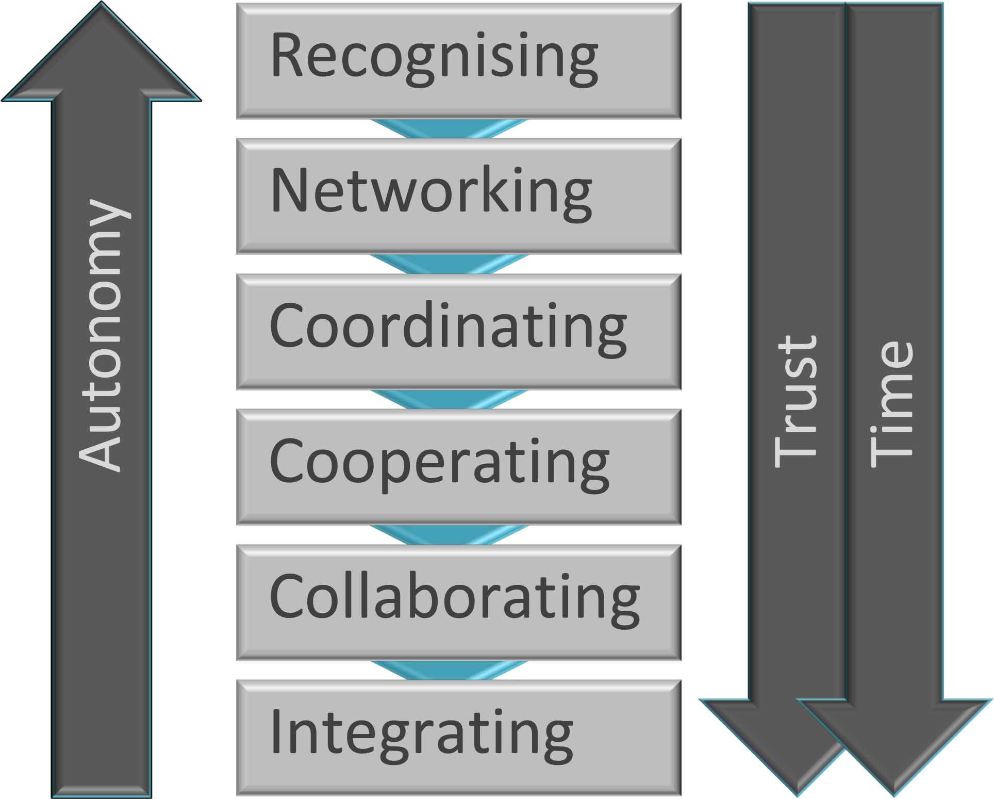
The continuum of joined-up service models
Some egs:
UK: CABs in health setting
US: medical legal partnerships (MLPs)
NSW: Cooperative Legal Service Delivery (CLSD) Program
NSW: Legal Aid NSW & Migrant Resource Centres (MRCs)
NSW: CLCs & Family Resource Centres (FRCs)
Notes:
CC - There are many possible models for joining up services, which fall on a continuum, depending on how much autonomy is maintained by individual agencies, and the amount of trust and time that is required.
At the less intensive end, ‘Recognising’ involves practices such as passive referral, without any information sharing.
[‘Networking’ involves information exchange only
‘Coordinating’ involves information exchange & altering activities
‘Cooperating involves as above but also adding in sharing resources
‘Collaborating’ involves additionally learning from one another]
At the most intensive end, ‘Integrating’ involves the merging of the organisations into a single unit.

Slide 33
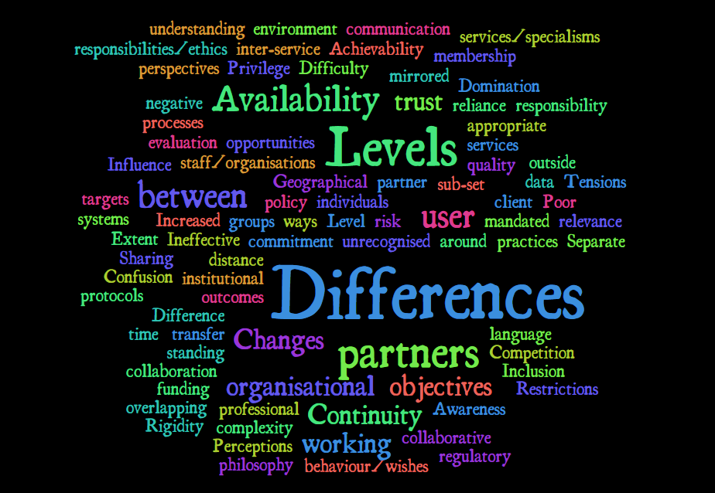
Potential challenges to joining up: many!
“Our message to practitioners and policy makers alike is don’t do it unless you have to.”
Huxham and Vangen (2005, p.13)
Notes:
But, as with legal outreach, there are many potential challenges. [The quote on the right side is from the Victoria Department of Human Services planning for the establishment of 31 Primary Care Partnerships (PCPs), made up of 800 organisations. The timeframe was estimated at 4 years, but took 5 years longer than that]
The report goes through all the ways in which collaboration can fall apart.
[EG, can fall apart if the services:
have different aims, professional ethics
If there’s insufficient resourcing, commitment, communication, trust]
SO THE CHALLENGES NEED TO BE WEIGHED UP AGAINST THE BENEFITS, particularly for more intensive forms of joining up.

Slide 34
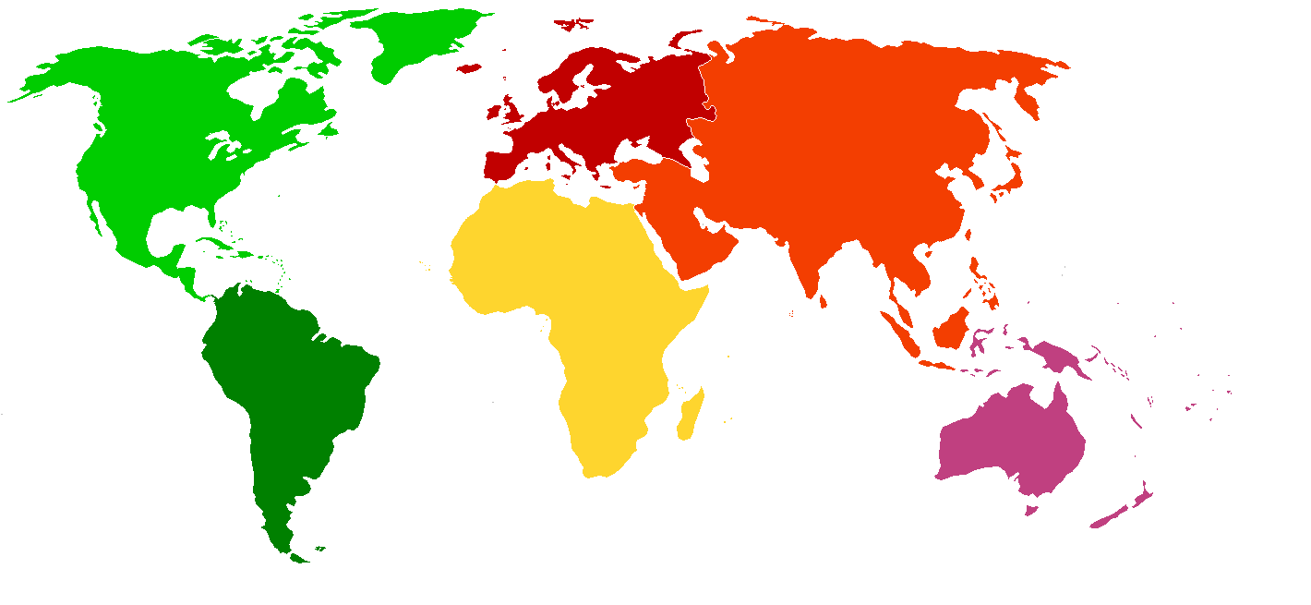
The Australian Human Services Map
Social security 35%
Defence
5.5%
7.5%
Education
Health 16%
Housing/
amenities
2.2%
Public
order 1%
Responsibility for inter-sector joining up?
Difficult for legal sector to lead & resource.
Legal services often provide only a supporting role for human service clients.
Public legal services
0.04%
Notes:
CC – Another challenging question is: Who should have the responsibility and provide the resources for inter-sector joining up of services?
It would be difficult for legal services to do so as:
they have such a tiny proportion of the public purse and
they often provide only a supporting role for clients that are entrenched in the system of human services.

Slide 35
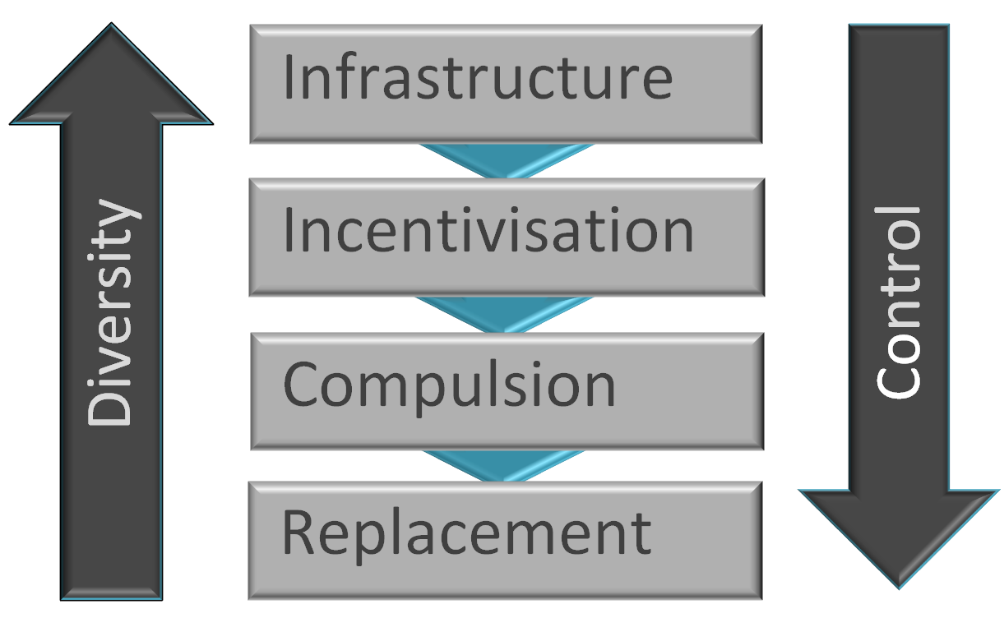
Options for joining up services from outside: i.e. influence by government/funders
Infrastructure:
Resources to support joining (e.g. mechanisms for raising awareness of other services,
co-location, networking, joint planning)
Incentivisation:
Financial or other incentives for joining up
Compulsion:
Mandatory joining up
Replacement:
Replacing existing services with new joined-up services
Notes:
CC – What options are open to government or other funders who want to exert influence for services to join up?
The current service environment means that fully joined-up human services would be difficult to achieve in Australia, and would require overcoming fragmentation of accountability, policy and funding at national, state, regional and local levels…
Nonetheless, the options range FROM:
Providing resources and incentives to support joining up
TO … Making joining-up mandatory or replacing existing services with new joined-up services

Slide 36
Key service direction:
Appropriate services
Notes:
CC

Slide 37
Appropriate
Appropriate services match client need and capability
Legal capability
abilities a person needs to recognise and deal effectively with a legal problem
typically span 3 areas:
  knowledge
  skills
  psychological readiness (& resources)
Legal capability: for disadvantaged people
Notes:
CC - Appropriate services match the client’s needs and capability
Legal capability can be defined as:
The abilities a person needs to recognise and deal effectively with a legal problem
typically these abilities span 3 areas:
Knowledge
Skills
psychological readiness (& resources)
The research shows that legal capability tends to be lower for disadvantaged people – the neediest!

Slide 38
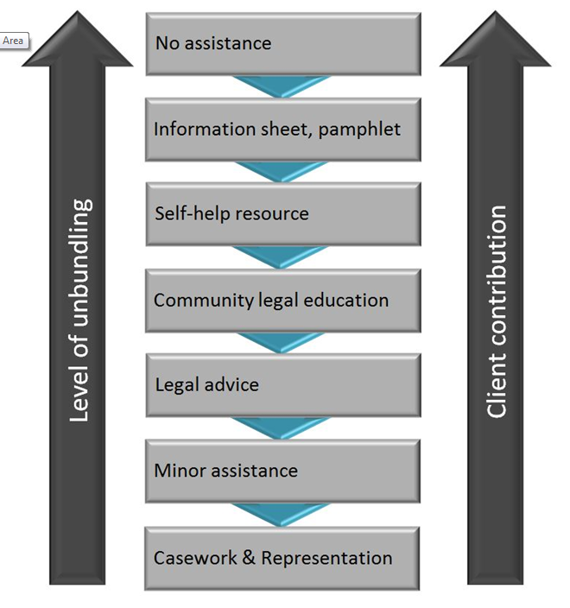
Unbundled legal services & client contribution to outcomes
The greater the unbundling…
the more the client contributes to outcomes…
& the greater the legal capability needed…
People with low capability require more intensive assistance
Notes:
CC - Here you see some of the implications of client capability for service delivery.
It’s now well known that self-help and unbundled services are not appropriate for all legal matters, nor suited to all people.
As you can see here:
the greater the unbundling,
the more the client contributes to the outcome and
the greater the legal capability required to achieve successful outcomes.
SO, people with low capability are likely to require more intensive types of assistance!

Slide 39
Key service direction:
Timely services
Notes:
CC

Slide 40

Early intervention: traditional definition
Less intensive assistance earlier in legal process to resolve problems sooner, at lower cost
i.e. fence at the top of the cliff to avoid ambulance at the bottom
(Susskind 2010)
Notes:
CC
The common or traditional definition of early intervention is that it involves providing less intensive assistance earlier on in the legal process in order to address problems before they escalate and at a lower cost.
So, it’s like building a fence at the top of the cliff in order to avoid needing an expensive fleet of ambulances at the bottom

Slide 41
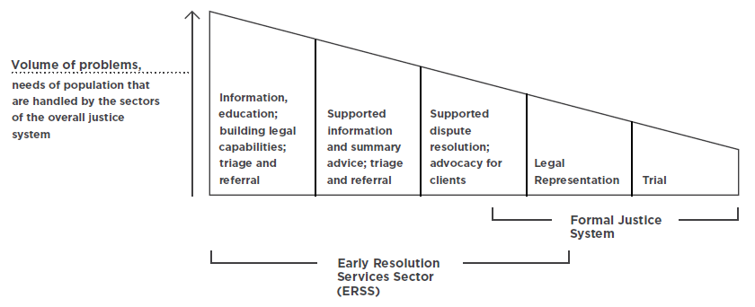

Early intervention:
traditional definition
Canadian National Action Committee on Access to Justice in Civil and Family Law (2013)
This type of early intervention – light services (e.g. CLE, self-help) – suited to the more capable sections of the community.
Notes:
CC - This diagram illustrates this traditional conceptualisation of early intervention
So at the early or ‘fence’ end are less intensive strategies such as CLE & information & self-help strategies, while at the ambulance end there is more intensive intervention including advocacy and legal representation.
As we’ve just discussed, the ‘light’ strategies comprising this type of early intervention are appropriate for the more capable sections of the community.
So, if the focus is on providing broad access to legal services, this ‘early intervention’ may be sensible.

Slide 42
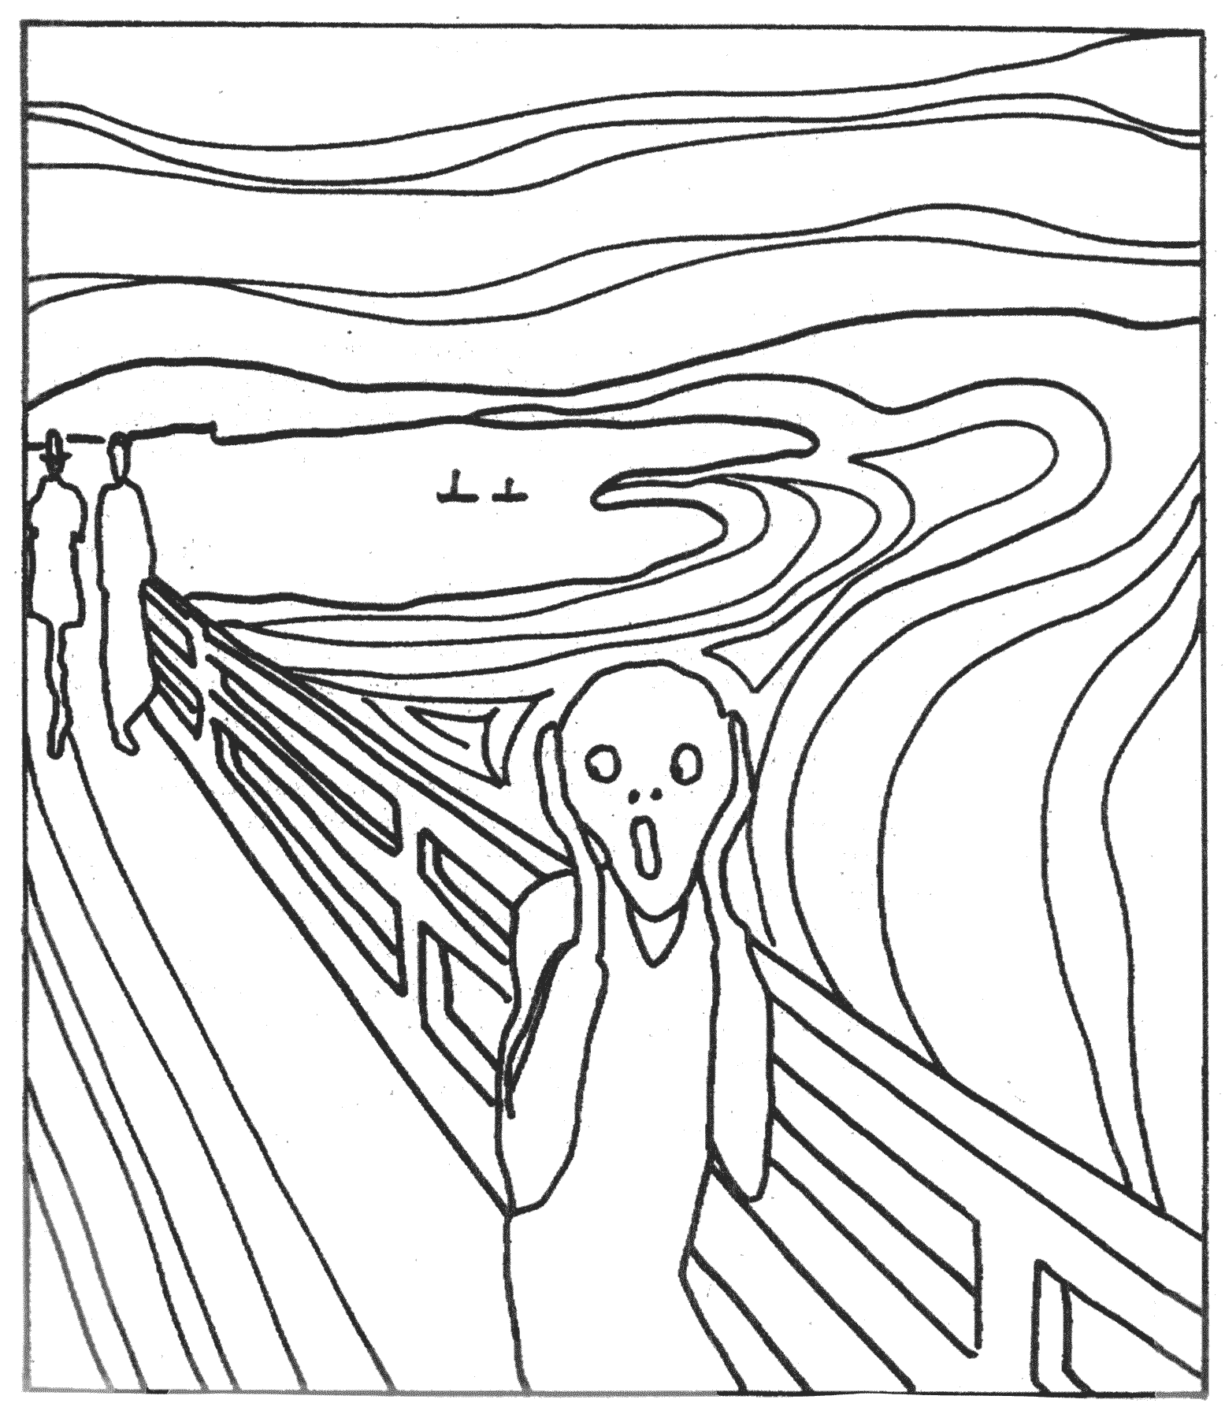
Early Intervention: limits of traditional definition
Light services, early in the life of the problem:
Leave behind the less capable – i.e. most disadvantaged & neediest
LAW Survey: 9% of people (disadvantaged) = 65% of problems
So may have no impact on majority of legal problems
Lower capability clients: hard to identify an “early’’ point for intervention:
problems: may have long & complex histories
non-legal needs (e.g. housing, health) may take priority
may only present at crisis point
require more intensive services
Notes:
CC – The problem is, however, that this definition of early intervention as light services delivered early leaves behind the less capable, who are usually the most disadvantaged sections of the community who are the neediest.
AND, remembering that these groups tend to account for the majority of legal problems, this means that this type of early intervention may have no impact on the majority of legal problems.
For less capable clients, it can be hard to identify an ‘early’ point for intervention, because:
They may have problems with long/complex histories
may have many have non-legal needs that take priority
may present only at crisis point and
may require more intensive services.

Slide 43
‘Timely’ rather than ‘early’ Intervention
Need a new, more nuanced definition for disadvantaged clients:
Timely, responsive legal assistance, provided at the earliest point practicable, relative to the client’s experience of problems and help seeking
“I still see us as early intervention, even when we come in at a really late stage, because for that client it’s the earliest intervention that they’ve had” (Duty solicitor, Forell &Cain, 2012).
Notes:
CC - So, we need a new, more nuanced definition of early intervention for disadvantaged clients … Such as
TIMELY, responsive legal assistance, provided at the earliest point practicable, relative to the client’s experience of problems and help seeking.
The quote demonstrates that, sometimes, late in the life course of the problem or late in the legal process may still be the earliest point at which that client could be assisted.

Slide 44
Given challenges, promising strategies can fail
Monitoring and evaluation are critical
Useful to inform:
  Relevant service models to reach clients and provide quality outcomes
  Efficacy of new programs and program variations/ roll-outs
  Continued improvement of services
  Accountability, continued funding and sustainability
Notes:
The challenges in implementing service changes mean that promising strategies can fail.
Thus, monitoring and evaluation are critical.
They are useful to check whether initiatives are:
reaching clients,
having the desired effect,
can be improved,
are cost-effective, and
They can also help to demonstrate accountability, and help with continued funding and sustainability.

Slide 45
Summary: implementing client-focused services that are targeted, joined-up, appropriate & timely
Legal service gaps/deficiencies?
Target clients? Needs? Capabilities? access barriers?
Which service model will work, meet client needs and match capability of clients?
Resources needed to implement service model?
Available resources & infrastructure?
How will success be demonstrated?
Notes:
CC
In summary, then, client-focused services that are targeted, joined-up, timely and appropriate require working out all of the following:
What are the gaps in services?
Who they are trying to serve?
What might work given client needs & capabilities?
What resources are needed and how can existing resources, services and infrastructure be used?
How will you know if the service was successful?

Slide 46
Context of
service reform
Notes:
I’ll now hand over to Geoff to discuss the context of service reform
GM

Slide 47
The present reality
Life and service delivery within existing socio-economic, geographic, political and service environment
  Reflect history of past decision
  patterns vary greatly
Notes:
GM
While existing services provide a scaffold upon which to build future services, system inertia and limited funding to bring about or sustain change means that significant change will be difficult to realise.
The fragmentation of accountability, policy, funding and delivery presents a particular challenge to coordinating system-wide change
As there is considerable complexity and diversity in client needs and capabilities in different geographic areas and in the forms of legal practice required, flexibility is needed at local, regional and state levels.

Slide 48
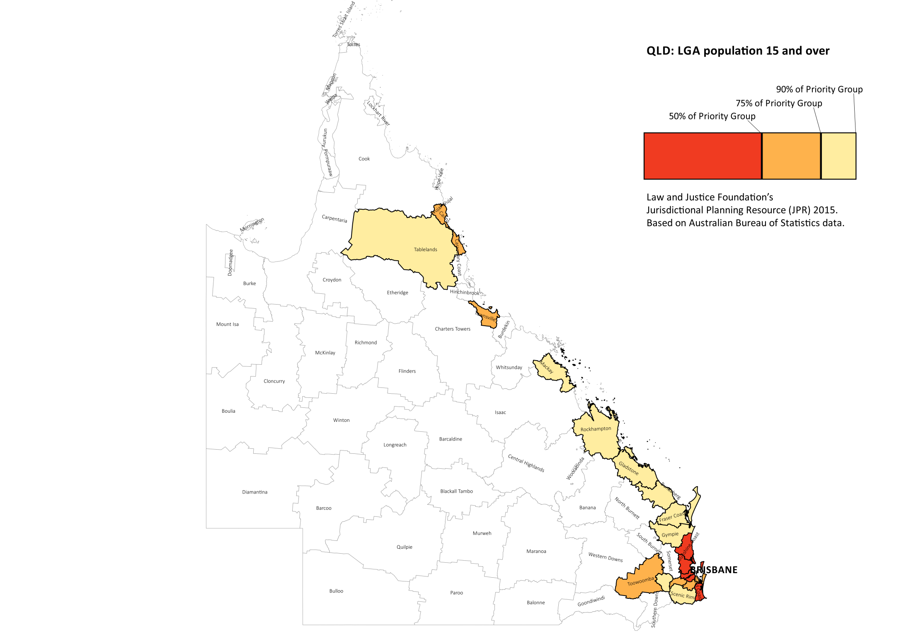

Slide 49
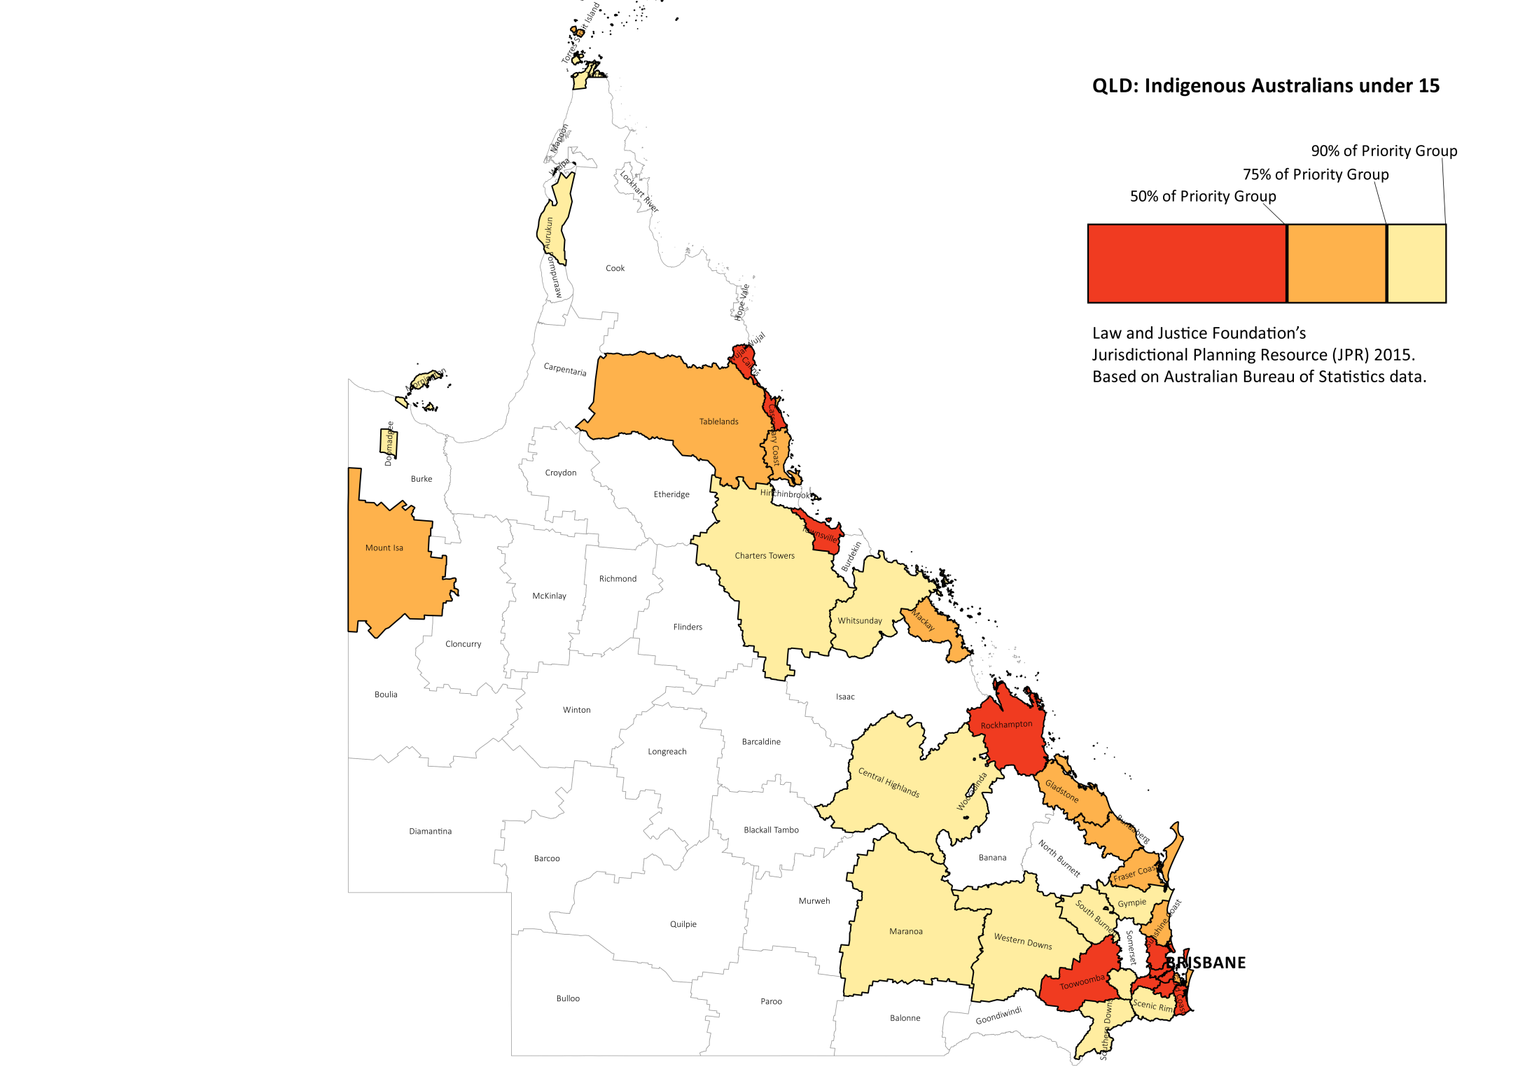

Slide 50


Slide 51
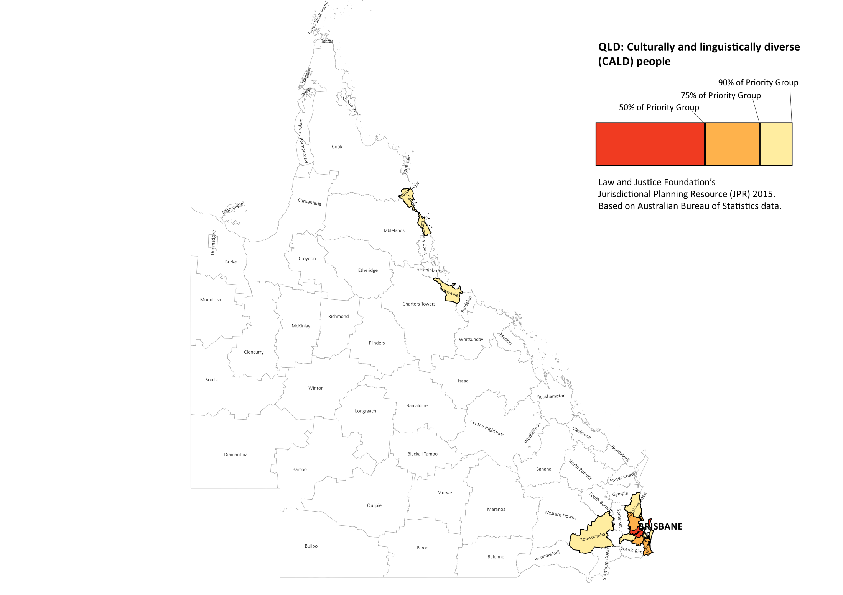

Slide 52
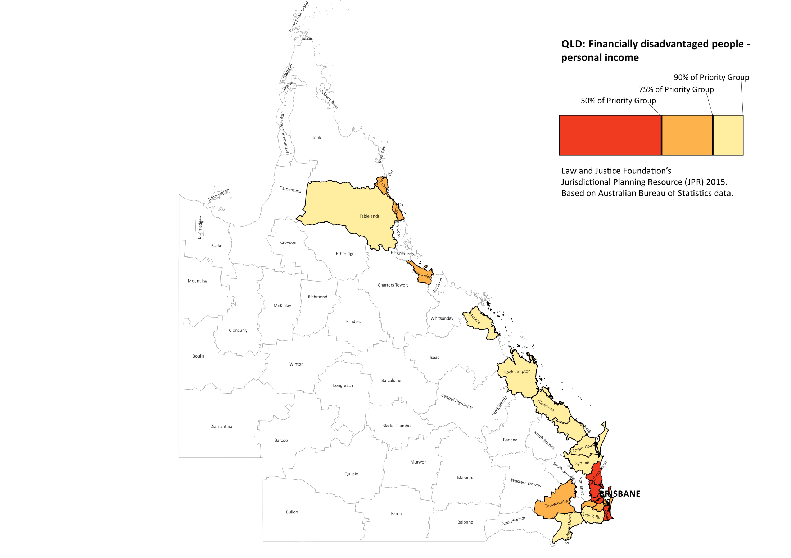

Slide 53
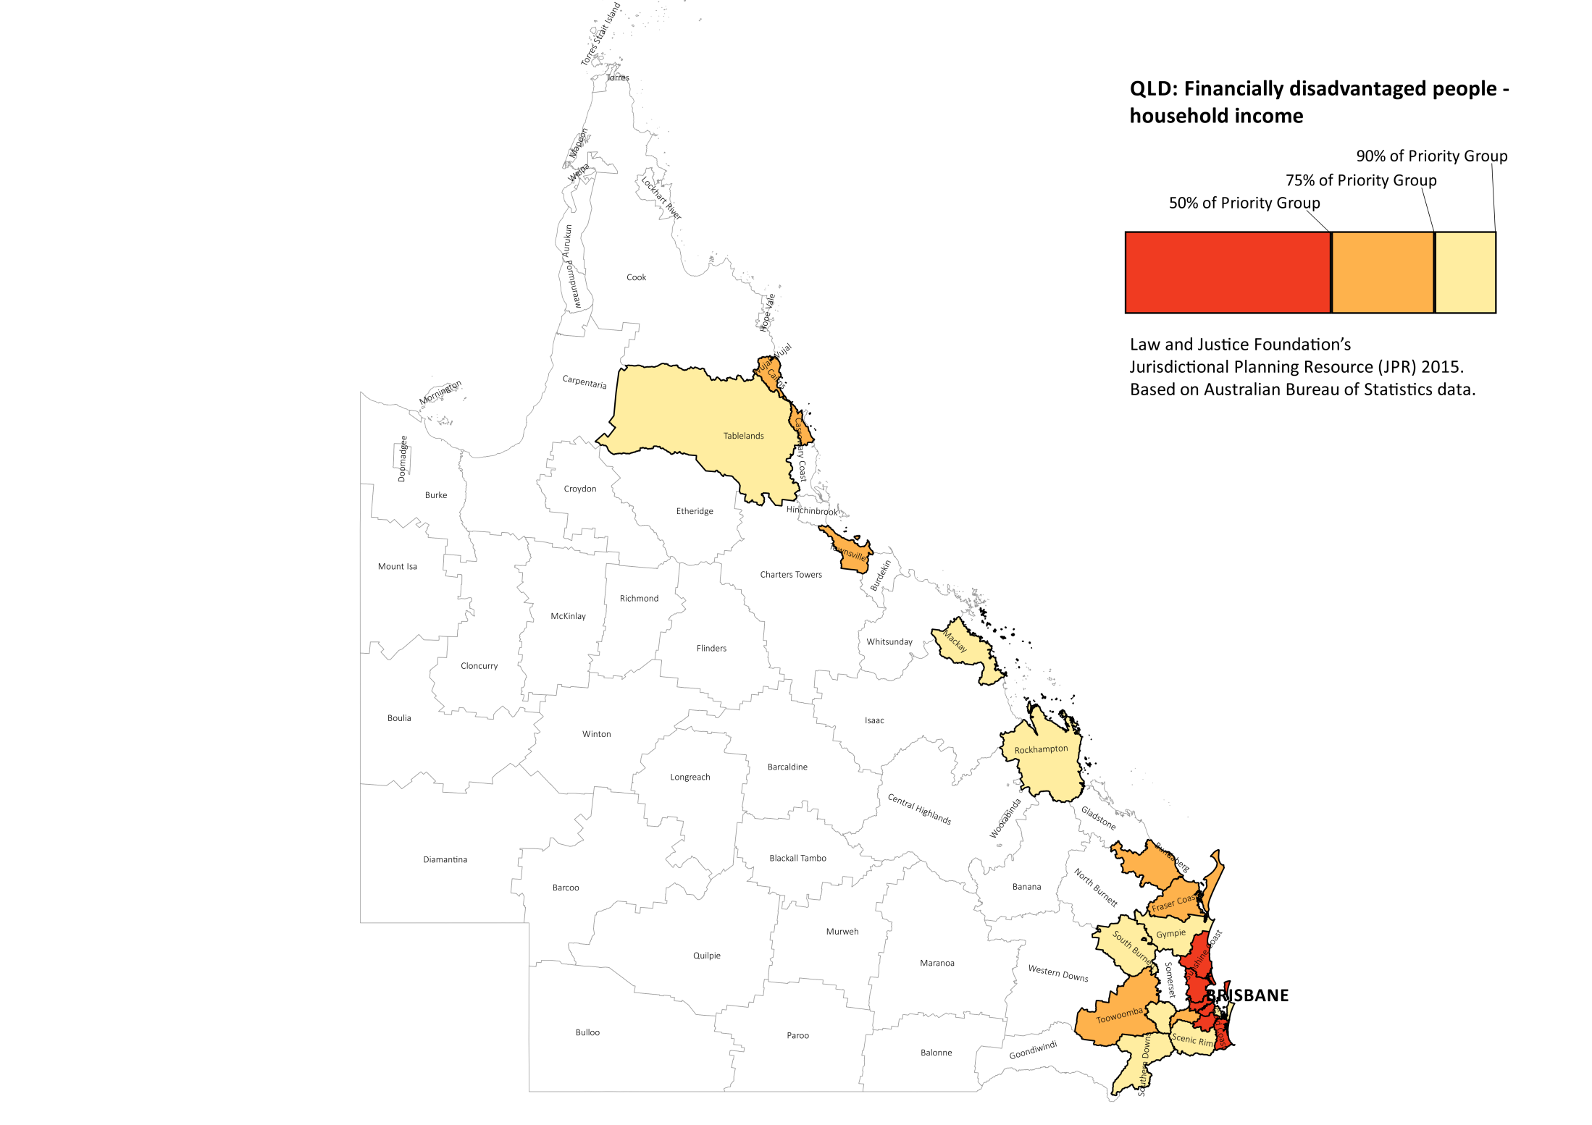

Slide 54
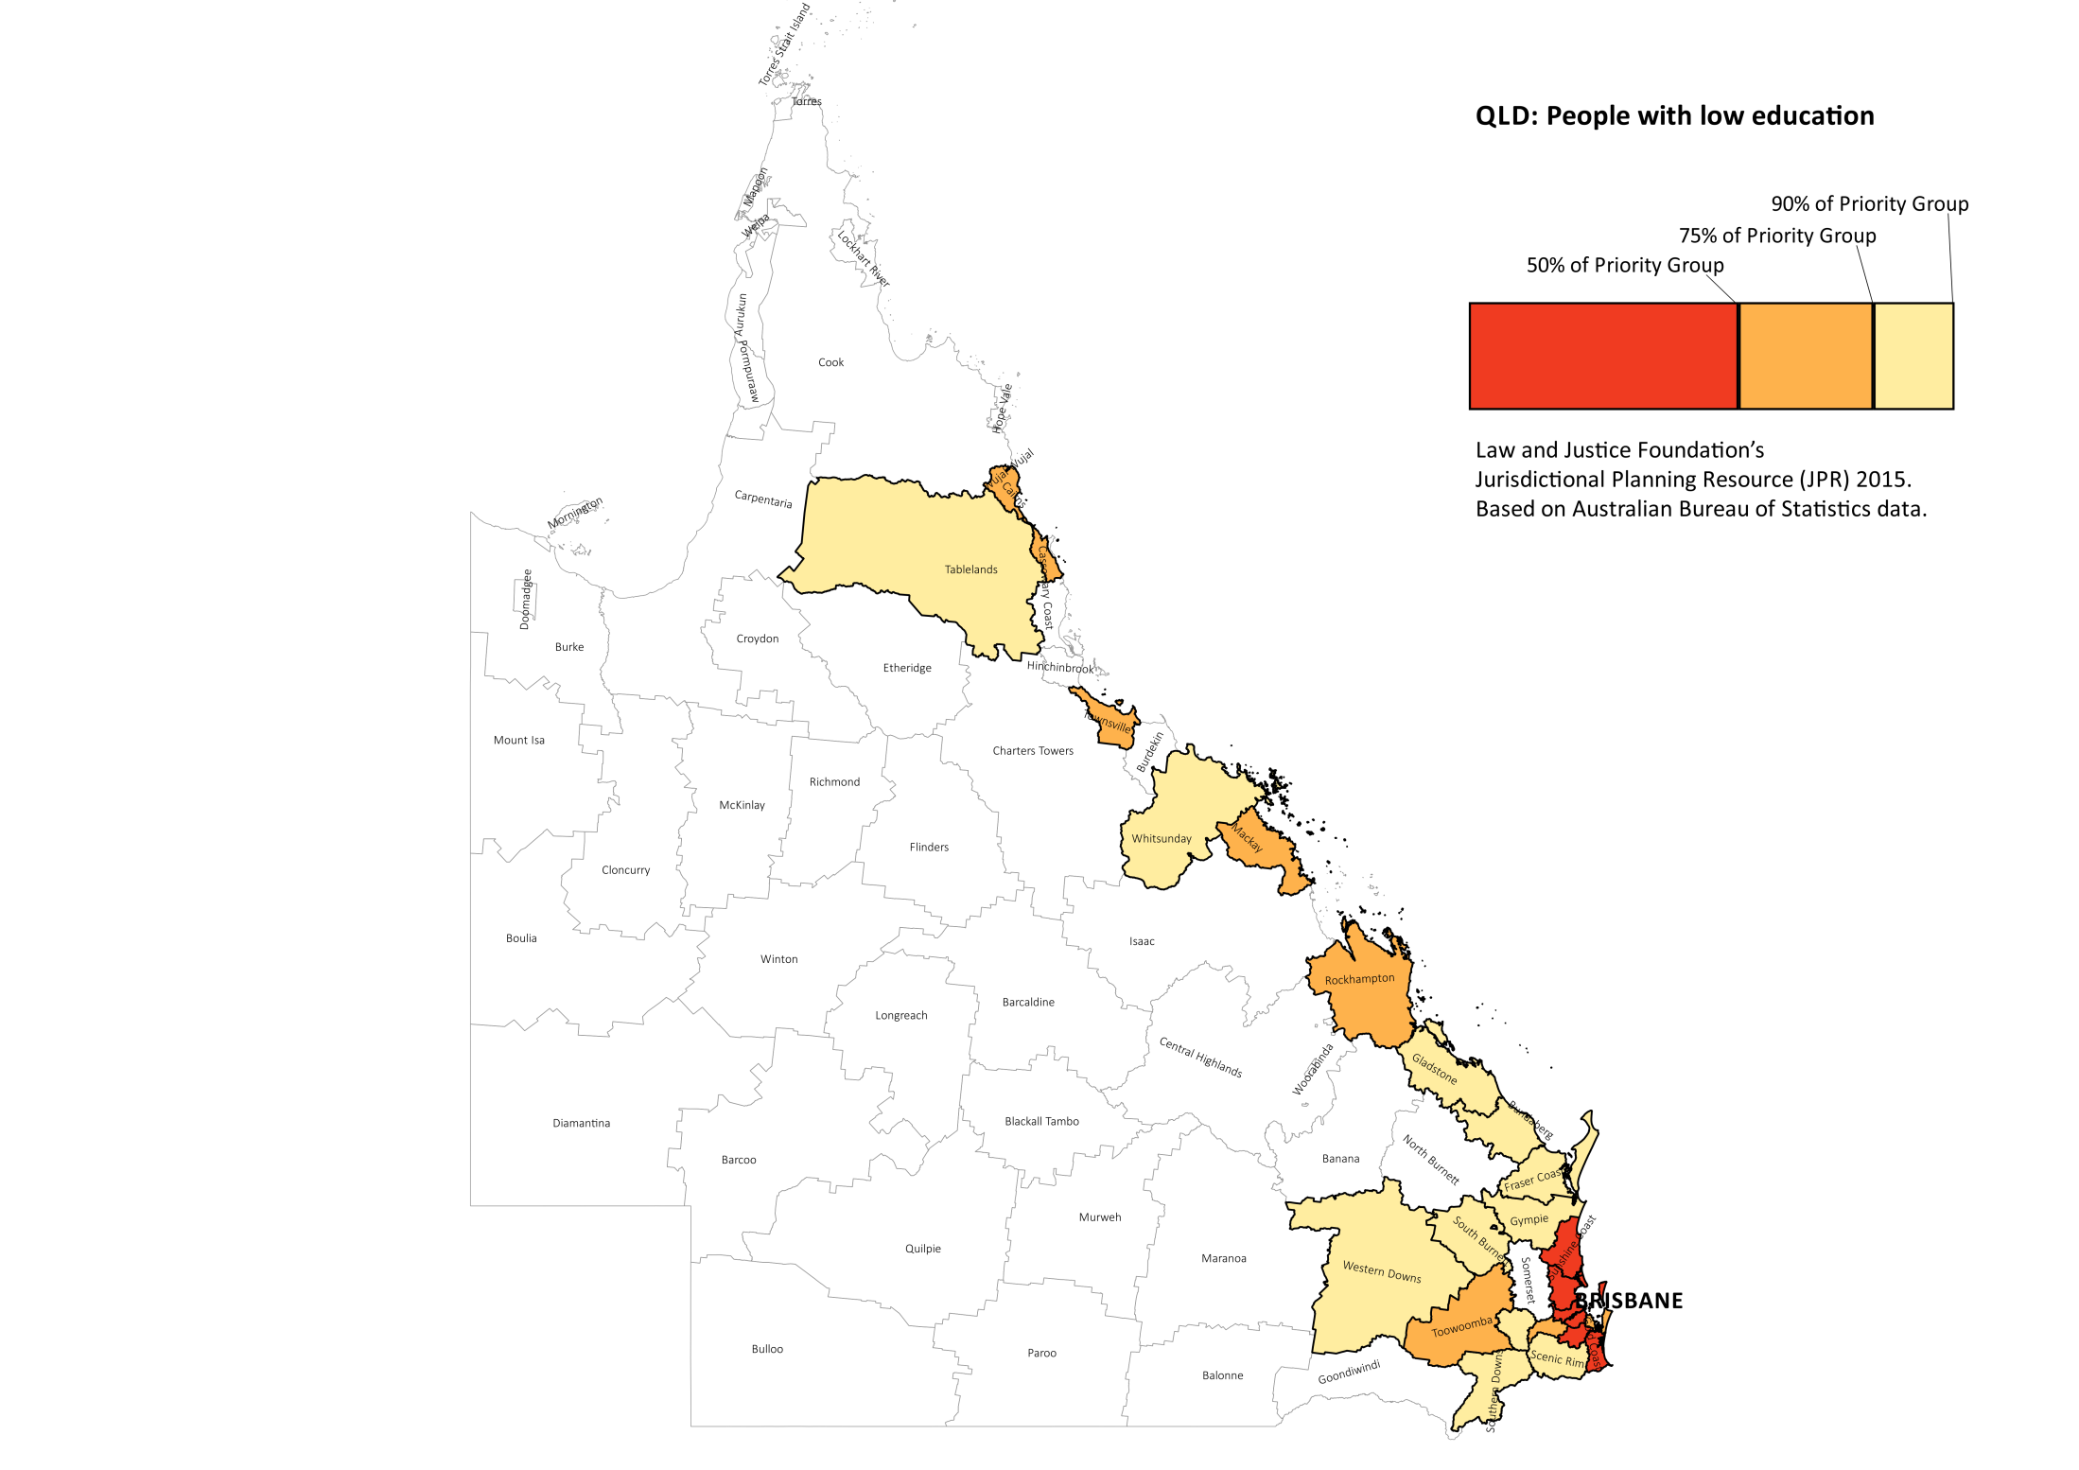

Slide 55
The present reality
Life and service delivery within existing socio-economic, geographic, political and service environment
  Reflect history of past decision
  patterns vary greatly
  remote context (geography and scarcity of human services)
  major city context (population and complex service environment)
Notes:
GM
While existing services provide a scaffold upon which to build future services, system inertia and limited funding to bring about or sustain change means that significant change will be difficult to realise.
The fragmentation of accountability, policy, funding and delivery presents a particular challenge to coordinating system-wide change
As there is considerable complexity and diversity in client needs and capabilities in different geographic areas and in the forms of legal practice required, flexibility is needed at local, regional and state levels.

Slide 56
The present reality (continued)
Existing services are a scaffold
  both opportunity and constraint
  system inertia
Fragmentation of policy, funding and accountability
  inflexibility of portfolio approach
  siloed funding
  “As a CEO of a community organisation, I'm responsible for 18 different funding streams in order to deliver pretty much the same service and it makes it extremely difficult trying to actually deliver services in those silos, and particularly when people of multiple needs need a response that actually is providing a holistic service to people’”
Alison Churchill, CEO of CRC
Can be complex and dysfunctional
  CLC
  ATSILS
56

Slide 57
The present reality (continued)
In a stagnant / declining funding environment?
  Little flexibility to explore innovation and change
  Joining up takes resources, but more:
  “There can be no joining up of services where there are no services”
The place of legal assistance services - realistic
Notes:
GM

Slide 58
Discussion and
moving forward

Slide 59
Where to? (The Future)
Clarify of purpose for individual legal assistance services
Get coordination right
  (level, content) eg CLSD, LAFs
Notes:
GM

Slide 60
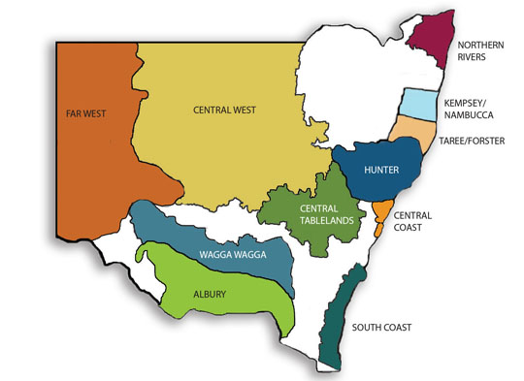
Legal Aid NSW, Cooperative Legal Service Delivery (CLSD) Program Regions
60

Slide 61
Where to? (The Future)
Clarify of purpose for individual legal assistance services
Get coordination right
  (level, content) eg CLSD, LAFs
No ‘universal’ model / simple formula
Clarity about place of LAS within broader human svc sector
Appropriate services for clients
  efficiency
  need to determine legal capabilities
Need for strategic evaluation of “what works”
Notes:
GM

Slide 62
Where to? (The Future)
Facilitating reform
  Target, joined up, timely and appropriate services imply case to case tailoring
  Limited services provide options – need for local engagement
  Collaboration legal: non-legal necessary
Funding model?
  National / jurisdictional agreement on priorities
  High level support for cross sectoral collaboration
  funding allocations / accountability regimes
    based on need
    provide sufficient flexibility for jurisdictional, regional and local planning, collaboration and delivery of services.
Notes:
GM

