Slide 1
Developments in domestic and family violence and the Impact of “Metadata” Legislation
Presenter
Kylie Hillard
Barrister

Slide 2
Appeals Process
UCPR applies to an appeal (s142 DFVPA)
Service - interested parties and Commissioner of Police (ss165 and 167 of DFVPA)
Filing - Notice in the Registry of the Magistrates Court (Rule 783(3) UCPR)
Service - clerk of the court may ask police to serve (s 165 DFVPA)
Substituted service - Court directions needed. Where unable to effect service, not practicable or reasonable to serve (s144 DFVPA, Rule 112 and116 UCPR)
Documents – Magistrates Court sends documents to the District Court. Rules require an appeal book (Rule 758 UCPR; Rule 783(4) UCPR). Need affidavits and liaise with Registrar
Conferences (Rule 753 UCPR)
Certificate of Readiness - may need to apply for direction for waiver or write to Registrar (s 144 DFVPA, Rule 790 UCPR)

Slide 3
Cases addressing test and new or fresh evidence
FCA v Commissioner of the Queensland Police Service [2014] QDC 46
TJA v TJF [2014] QDC 244
GKE v EUT [2014] QDC 248
MDE v MLG & Queensland Police Service [2015] QDC 151
TKG v NKQ [2015] QDC 258

Slide 4
Procedural issues / stay
K v K [2015] QDC
CR v CM [2015] QDC
SGLB v PAB [2015] QMC 8

Slide 5
What we can take from this
When preparing affidavits and submissions:
Adduce all evidence first instance
Address state of mind - future and past
Formulate around words of s 37(1)(c) DFVPA:
risk of future domestic violence
the nature of the risk
the protective needs
how imposing order “necessary or desirable” to meet those needs
why feel its needed
Consider Briginshaw – impact if order made or not made
Family or parenting proceedings - be fair, balanced and consider own steps / compliance

Slide 6
Other points of interest
No indemnity costs - MHH v LAN [2016] QMC 001
Cultural issues
Capacity issues
Metadata

Slide 7
What exactly is “metadata”
Section 172 - No disclosure of the contents or substance of a communication
Divisions 3, 4 and 4A do not permit the disclosure of:
(a) information that is the contents or substance of a communication; or
(b) a document to the extent that the document contains the contents or substance of a communication.
It is:
what it is, that is, the content or substance of a communication
not the document or content itself, except to the extent it comes within these areas

Slide 8
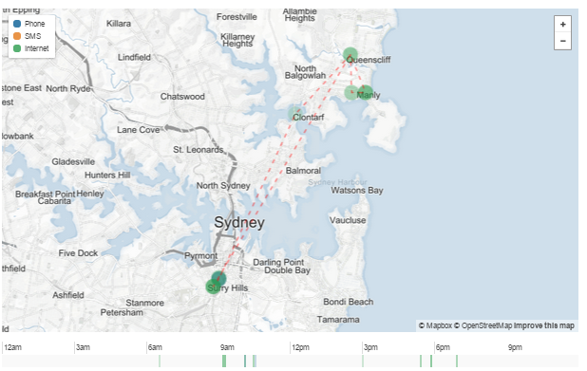
What your data shows
Towers
and
travel
http://www.abc.net.au/news/2015-08-16/metadata-retention-privacy-
phone-will-ockenden/6694152?WT.mc_id=Innovation_News|HowYourPhone
TracksYourEveryMove_GPP|abc and http://www.abc.net.au/news/2015-08-24/
metadata-what-you-found-will-ockenden/6703626

Slide 9
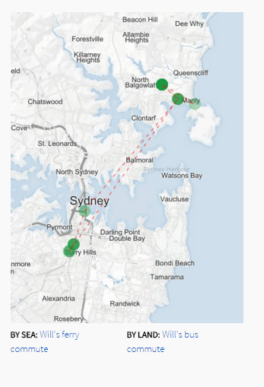
Routes taken
Mode of public
transport

Slide 10
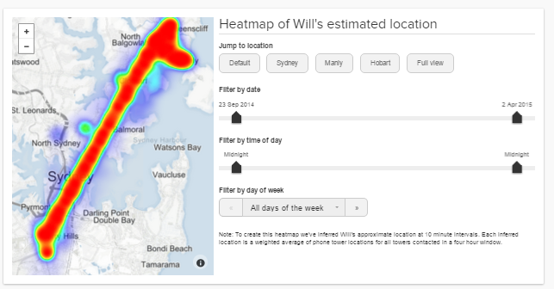
Patterns

Slide 11
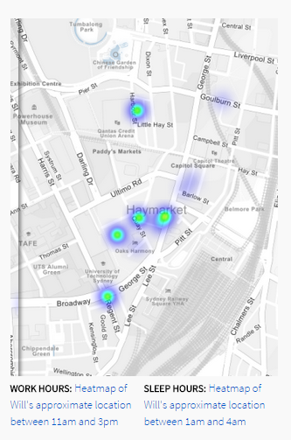
Where you
live and
work
When you
sleep

Slide 12
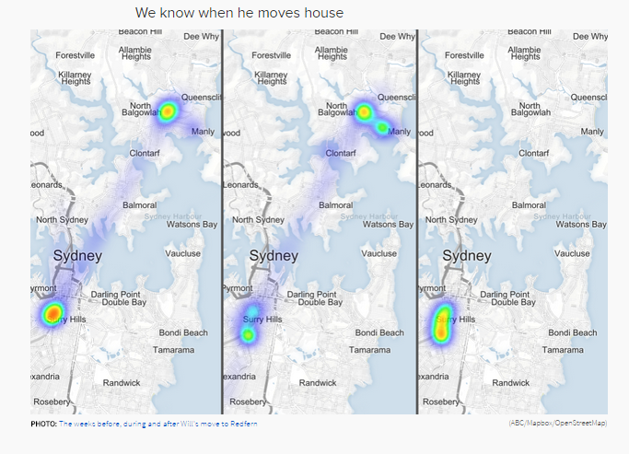
When you
move house

Slide 13
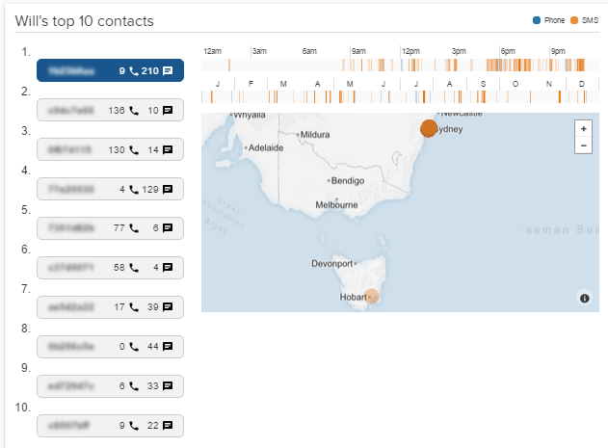
Who you
connect to
and the
frequency

Slide 14
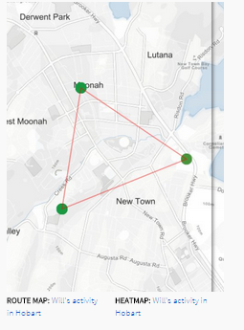
Changes in behaviour

Slide 15
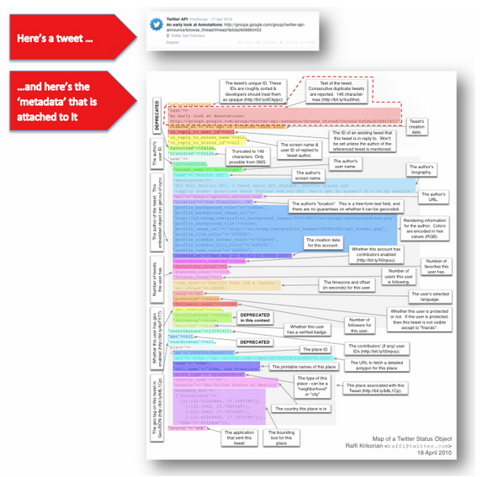
What about tweets?
Dates
Tracks
Attachments
Communications
and more
http://blog.iinet.net.au/protecting-your-privacy/#sthash.49Xrvz8n.dpuf

Slide 16
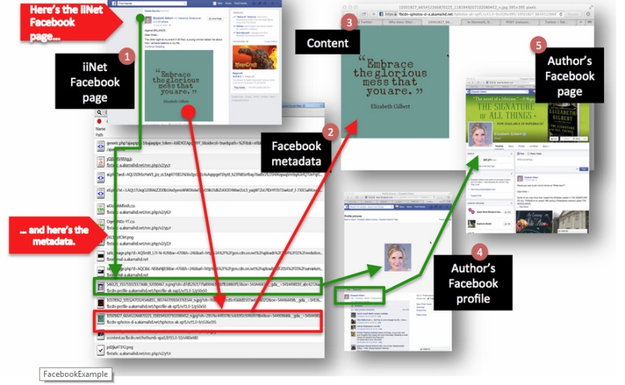
Facebook?

Slide 17
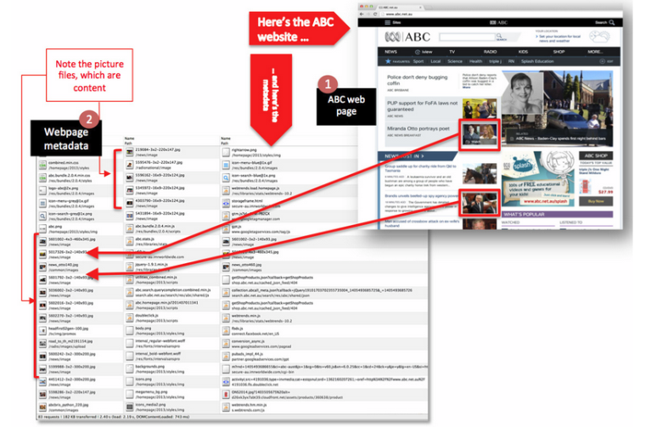
Other posts or forums?
Picture files,
and more

Slide 18
What can you do
“VPN” device
Encrypted messaging;
“Tor”
“Whatsapp”
Google’s web-based Gmail service
But does this manage the risk?

Slide 19
Thank you
Questions ???
Kylie Hillard
Barrister
khillard@qldbar.asn.au
M: 0402 004 283

