Slide 1

Grant Seeking: Strategies for Success
Presented by Harriett Carter
Queensland Manager, Strategic Grants
18th March, 2014

Slide 2
Introductions
Strategic Grants’ mission is to enable non-profit organisations to establish sustainable, cost-effective grant-seeking strategies to deliver projects that fulfil their organisational missions.
Our vision is to build the capacity of non-profit organisations to apply strategic thinking to their service delivery and fundraising programs.
Notes:
Everyone in the room to introduce themselves, their org, where they are at with their grant-seeking

Slide 3
Agenda - What’s needed BEFORE putting pen to paper
Project Wish List and project planning
Is your organisation grant-ready?
Project Matching
Understand the grants climate
Relationship Building
And then back to donor engagement and stewardship
Then…We Write!
Notes:
There are so many things to do before we sit down to write the application. In fact, we advocate that the application is only about 20% of the process.

Slide 4
1. The grants climate in Australia
ACNC reports 600,000 not-for-profit organisations in Australia:
  Hobby clubs and local sporting groups
  Advocacy groups
  Public hospitals/medical research organisations
  Professional associations
  Special schools
  Philanthropic foundations
  Community childcare centres
  Environmental conservation organisations
  Charities providing assistance to the needy & disadvantaged
56,000 of these are charitable.
Notes:
While these are all not-for-profit, not all of these are charitable, not all are for the public benefit, not all are eligible for grants.

Slide 5
Where do grants come from?
Government Grants – Local, State and Federal
Private Foundations – established by individuals –
The Balnaves Foundation
Family Foundations – The Myer Foundation
Corporate Foundations – Honda Foundation and
bankmecu Community Investment Program
Trustee Companies – Perpetual Trustees, ANZ Trustees etc who manage and administer estates established through wills and PAFs
Private Ancillary Funds (PAFs) - funds established by a Will or Trust instrument with Deductible Gift Recipient (DGR) status – James N Kirby Foundation
Community Foundations – Queensland Community Foundation
Government-established Foundations – Office of Liquor and Gaming Regulation Gambling Community Benefit Funds

Slide 6
Definition of
Philanthropic Foundations
A philanthropic trust or foundation (as defined by Philanthropy Australia) is a term generally used to describe a perpetual trust designed to make grants to charities or carry out charitable purposes. Some trusts and foundations are established during the donor's lifetime, others are established by wills or codicils.
Trusts and Foundations are governed by trustees who may be an authorised trustee company, family and friends of the benefactor, qualified professionals, or a mixture of the above.
The majority of Australian trusts and foundations require grant recipients to have DGR 1 status.
Notes:
Philanthropy Australia is the peak body promoting philanthropy in Australia. It’s membership is trusts and foundations.

Slide 7
The lack of mandatory reporting = lack of accurate data.
Philanthropy Australia estimates approximately 5,000 foundations in Australia give between half a billion and one billion dollars per year. This includes 1,071 private ancillary funds (as at May 2013) and approximately 2,000 charitable trusts and foundations administered by trustee companies http://www.philanthropy.org.au/research/fast.html
It is estimated that Australian foundations have total assets of over $10 billion.

Slide 8

Funders still get applications that just don’t meet guidelines!
Reasons for not being successful

Slide 9
Quality of a large percentage of applications is poor. This is feedback from both government and philanthropic entities.
There are more applications being presented. It is HIGHLY competitive.
Some funders have ceased funding rounds since GFC or have lowered the amount they distribute through grants.
Notes:
These points further highlight the need to be strategic and follow best practice processes.
EMF’s role is to help reduce the frustration by helping you identify the most appropriate funding channels, ensuring strong relationships are built with funding bodies and presenting top quality applications to funders.

Slide 10
Current Trends
Queensland Community Foundation:
190 Expressions of Interest in 2013.
36.5% were invited to submit full applications.
8.5% did not have DGR status
55% did not address the capacity-building criteria
FaHCSIA 2012:
12 500 apps, 4 000 funded. 32% success (but there are $5 000 grants!)
Feedback: addressing selection criteria was of paramount importance
nib foundation 2012:
100 apps, 10 grants, 10% success rate
Selected projects that “deliver material change to their local communities”
Perpetual Trustees June 2013 distributions:
Over 1 230 applications, approximately 190 activities funded, 15% success
Many do not satisfactorily address the selection criteria!

Slide 11
Trusts and Foundations are receiving more applications than ever before
We need to be strategic and develop strong relationships with funders

Slide 12
Corporate Partnerships vs Major Gifts vs
Grants
Corporate Partnerships generally require a commercial arrangement where the corporate expects or requires an estimated value of promotional benefit via co-branding etc.
Major Gifts are gifts above a certain value donated by individual donors to a charity.
Grants are made without the expectation of commercial return but instead expect a social return on investment.
Notes:
Grants can be from Trusts, Foundations, PAFs, Corporate Foundations and government. Do corporate foundations sit within a grants or corporate funding area within your organisation? What are the determinants of where they sit?

Slide 13
Government funding…
Government looks for accountable, best-practice organisations with proven track records, to deliver services in areas it has identified as priority needs.
Notes:
This slide is not in their workbooks for Syd workshop!

Slide 14
Grants are generally for time-limited projects,
NOT for recurrent operating costs!
You need to be able to demonstrate to funders how your projects and organisation are going to be sustainable
Common fundraising / revenue raising programs include:
  Direct Mail
  Online campaigns
  Major Donors (individuals and grants)
  Capital campaigns
  Lotteries / Art Unions
  Events
  Corporate partnerships and sponsorships
  Bequests
  Merchandise
  Social enterprises
Notes:
Before clicking: ask the group what other fundraising activities they do.

Slide 15

How do we find the
grants?

Slide 16

The usual suspects
  Philanthropy Australia’s online database www.philanthropy.org.au
  Our Community’s Easy Grants http://www.ourcommunity.com.au/funding/grant_main.jsp
  GrantReady http://www.grantready.com.au/
  PAFs may not advertise – talk to solicitors, accountants and your donors!
  Government websites www.grantslink.gov.au
  Newspapers, other publications, funding briefing sessions, conversations with funders.
  Strategic Grants’ Grants Hub http://client.strategicgrants.com.au/demo/

Slide 17

Where to from here?
Do we want to be proactive, forward planning and organised?
Or reactive, scrambling for projects as deadlines present

Slide 18
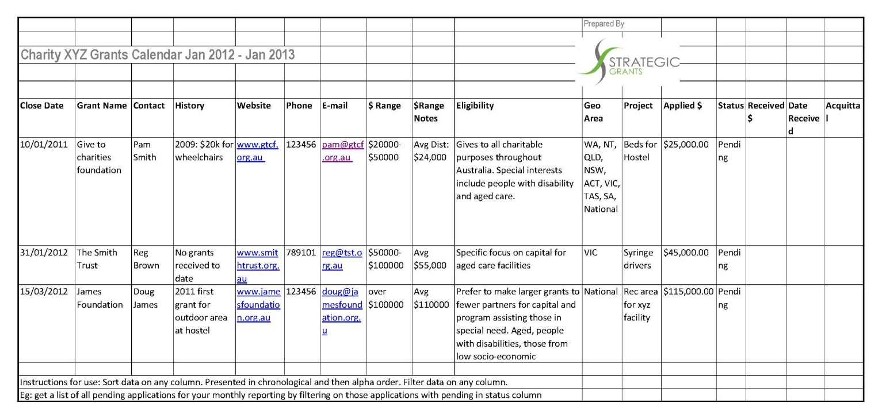
Success = Planned

Slide 19
Does your organisation have a clear mission statement, vision and know what its strategic objectives are?
No matter what size, ALL organisations should have an agreed, clear Mission that articulates WHY your organisation exists.
Strategic Grants’ Mission:
to enable non-profit organisations to establish sustainable, cost-effective grant-seeking strategies to deliver projects that fulfil their organisational missions.

Slide 20
Projects for which you apply for funding need to make sense.
Do NOT make up projects, off-mission, just to receive funding.

Slide 21
Getting your organisation grant-ready
Project plans and budgets?
List of funder deadlines?
Educated project leaders?
Someone to write a strong application?
Clear and current website?
Project evaluation methodologies in place?
Prioritised, approved wish list?
Historical knowledge: have all previous grants have been acquitted on time?
Engagement and stewardship strategies in place?
Recurrent funding strategies?

Slide 22
Look at your history with grants
Who has given to you in the past? Existing donors are your best prospects!
Have all acquittal reports been provided on time?
Are there multi-year grants in place?
What is the relationship status with current and previous grant-makers?
Notes:
Who can provide a detailed history of their organisation’s grants program?

Slide 23
Project wish list and project matching
Does your organisation have a centralised, prioritised project wish list that covers organisational funding needs and focuses on mission delivery?
Project forms?
Sign-off processes?
How are project budgets developed?
Is there a need for organisational education – focussing on funders’ expectations?
Notes:
It is often a lack of well documented project plans that inhibits an organisation’s grants success. Does anyone here have that problem? Missing deadlines because project plans aren’t developed? How do orgs processes work?

Slide 24
How to get our project leaders grant-ready
Aim:
  What is the goal of the project?
  Ensure this aligns both with your organisational mission and the mission of the funding body.
Project Need:
  WHY is the project needed?
  WHAT gap in research / services is it filling?
  HOW do you know this need exists?
  Demonstrate with data, evidence and references.
Notes:
To ensure a project is ready to present to a funder, you should be able to answer these questions – broadly at least, with the capacity to then provide more detail when putting together an actual application.

Slide 25
Key Differentiating Factors:
  How is this project different to others that may be similar?
  How does it contribute to the larger body of research knowledge in your field?
Target Group:
  WHO is this project helping?
  How many people will be assisted?
Objectives:
  Objectives are the measureable outcomes to achieve the aim / goal.

Slide 26
Strategies / Methodologies:
  The tasks that will be implemented to achieve the objectives.
  Each objective generally has its own set of strategies.
Timeframe / Key Milestones:
  Confirm project will be ready to start and won’t already have started before funding becomes available.
Outputs:
  What are the immediate deliverable elements?
Outcomes and Impact Forecast:
  Outcomes are the direct changes.
  Impact results in sustained changes
Notes:
Note on this the difference between outputs, outcomes and impact

Slide 27
Evaluation
Funders expect evaluation!
You should implement relevant evaluation methods for the benefit of your organisation’s mission delivery and to be more effective.
Evaluation methods do not have to be complicated or cost a lot of money.

Slide 28
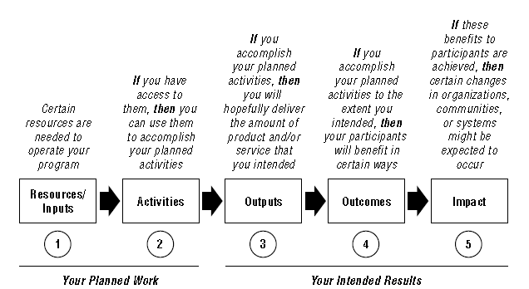
W.K. Kellogg Foundation
Logic Model Development Guide
http://www.wkkf.org/knowledge-center/resources/2006/02/wk-kellogg-foundation-logic-model-development-guide.aspx

Slide 29
Evaluation measures:
  HOW will you be measuring? I.e.: quantitative / qualitative data capture methodologies.
  Pre and post tests for programs are a great example. Has there been a change in thinking and actions as a result of the program delivery?
Who is conducting the evaluation?
  Project leader or external reviewer?
Are there any project risks?
  If so, what are they and what are the mitigation strategies?
Collaborations: List
Notes:
Funders like collaboration! They do not like replication. It is important to note how your research is contributing to the larger body of research being conducted in a given area.
Using other groups infrastructure for example, demonstrates value for money and certainly when multiple research groups will be benefit from the results of a project, funding chances are increased.

Slide 30
Budget:
  Include ALL costs including staff time and resources required to implement this project – What is the total cost to your organisation to implement this project?
  Don’t make figures up. Get estimates or quotes from suppliers so accurate figures are included.
  Has any other funding been received for this project? Give details.
  Ensure that income and expense columns are equal!
Notes:
Ensure your budget is realistic and that you can deliver with the amount that you have said it will cost.
Funders like Co-funding! More often than not now funders require co-funding contributions. You may need to provide evidence confirming what the co-contributors have committed.
Ensure your grant request is within the funder’s grantable amounts.

Slide 31

If you can't explain it simply, you don't understand it well enough. Albert Einstein

Slide 32
To apply or not to apply?
Best-fit project matching
Linkage
Interest
Strategic Approach
Ability
Is there a connection between your org and the funder?
Has the funder encouraged you to apply?
Do the funding amounts meet your project budget costs?
Notes:
Revisiting Fundraising 101

Slide 33
Basic Project Matching Principles
Read the guidelines! Then if uncertain – talk to them.
There is a fine line between innovative and ineligible projects.
Feedback from funders is that they do get applications that do not meet their funding criteria or responses simply do not answer the questions.

Slide 34
Are there synergies between your organisation’s needs and mission and the funder’s mission / charitable purpose?
Look at what they have funded in the past. What is the funder’s motivation to give?
Have they previously provided grants to your geographic area?
Does your project fulfill your organisation’s mission and fulfill the funding objectives?

Slide 35
Do the amounts granted match your project needs?
Does your project replicate? Or fulfill an unmet need?
Is the timing of the funding in line with your project timetable?
“We don’t accept unsolicited applications”
Look for a link between your organisation and the philanthropic body.

Slide 36
Engaging with Funders
Do your research
Attend briefing sessions where possible
Rule of thumb – “ring before writing”
Nurture a relationship with key individuals – organise meetings/tours of facilities if appropriate
Keep them abreast of organisational changes e.g. new CEO
Maintain contact on funded projects through project updates/acquittals

Slide 37
Co-ordinated Relationship
Management
Where / how are financial transactions recorded?
How are existing grant-makers and funders managed?
Who makes the calls to the prospects?
What is the follow-up process with successful outcomes?
Unsuccessful outcomes?
Ensure everyone involved clearly understands WHO is the relationship manager.
Communication with funders must be
co-ordinated!
Notes:
Ask: Who has a central donor management system? Who can produce a list of their organisation’s grants history in soft and / or hard copy? Go through each point and discuss as a group. If it’s not happening as it should, workshop how it should work.

Slide 38
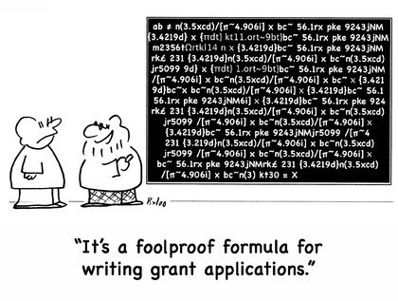
Ground work laid…
Now for the application!

Slide 39

In-depth donor knowledge also informs the style of writing and communication channels that are most appropriate and relevant to the donor.

Slide 40
Develop a Key Messages Statement if you don’t already have one
Notes:
Whose organisation has a key messages statement?

Slide 41
The Seven “C’s” of Key Messages
Clear
Compelling
Concise
Consistent
Correct
Certified
Current!

Slide 42
Key messages
Make sure your key messages
clearly define what your organisation is all about and your POINT OF DIFFERENCE.
Funders have hundreds of applications to read - survive the “tick and flick” and remember word restrictions!

Slide 43

The application – the ask
Talk the funder’s language

Slide 44
READ the questions carefully and ANSWER them!
Tell them HOW your project addresses their criteria within the responses
Have you got the most up-to-date project information from the project managers?
Include any research and results to date.
Use demonstrable evidence!
Ensure you have someone who writes well to put the application together
Illustrate the need WELL! Grants are highly competitive.

Slide 45
Remember Fundraising 101 –
People give to people!
Balancing Emotion vs Evidence:
“The organisations that are successful in receiving philanthropic funds are the ones able to outline a business case based on outcomes, rather than relying on emotional appeal”
Andrew Thomas, Perpetual.

Slide 46

Grant Writing checklist
When writing an application, ensure that the project match is spot on.
Ensure that applications contain the most relevant and up-to-date information about the organisation and clients / cause that it represents.
Ensure that the ask is at the front of the application (where possible) and that it focuses on the people being helped.
Clearly define the AIM of the project.
Demonstrate the project need and qualify with data.
Define the strategies the project is using to address the needs.
Substantiate all outcomes figures.
How is the project being evaluated? WHO is going to evaluate?
Budget: adhere to guidelines; factor in other income; include in-kind support
Spelling and grammar check
Ensure formatting adheres to any funder guideline specifications
Proofread
Get a third party to check the application

Slide 47

For example….
St Joseph’s Family Shelter:
Briefly describe your organisation:
For over 60 years, St Joseph’s has developed its position in Australia as a trusted organisation that offers a holistic approach to meeting the human need wherever it is required. Our mission is to preach the gospel of Jesus Christ and meet human needs in His name without discrimination. We believe in the power of community and to be community builders, not just service providers. We work with people over the long-term, helping them to find long-term solutions. We help over 10,000 people in Australia each year.
Notes:
What is wrong with this description?
It talks about the PEOPLE that the org supports last. This should be up the front. It does not succinctly say, in detail, what it precisely does? What services, where, etc. This sort of response is a common mistake.

Slide 48

OR….
St Joseph’s Family Shelter provides practical and emotional support to over ten thousand men, women and children each year through its diverse range of services at five sites across Greater Brisbane. Established in 1962, St Joseph’s still works in accordance with its original mission: to respond to and support those in times of need, without discrimination. St Joseph’s network of services is backed by a committed team of staff and volunteers and includes housing and homelessness services, family services, financial counselling and emergency relief.
Notes:
Hopefully, in this response, you can see that it is a lot more precise in providing a strong answer to the question. It talks about the people being supported up front, geographic reach, its track record, and breadth of support services.

Slide 49
Briefly describe your project and explain the need
Three years ago St Joseph’s identified a need to build a refuge which combines an addiction recovery facility and transitional accommodation in South Brisbane. This facility will provide services for men and women adversely affected by alcohol, drugs and gambling and offer temporary housing for those whose lives have been affected by addiction and do not have access to permanent housing.
Notes:
What is wrong with this response? It DOES NOT ANSWER THE QUESTION. It doesn’t explain the need. The project description is also very general.

Slide 50
OR….
Brisbane City Council’s 2006 Census found a total of 7 996 people are homeless in Brisbane. More than 2 000 of these were identified within Inner City Brisbane. Despite these numbers, there is currently NO facility in South Brisbane which offers both onsite addiction recovery support services and temporary accommodation. Reports show that people with mental health or substance abuse issues have particular difficulty in maintaining housing (www.lmct.org.au/homelessness-facts).
To this end, St Joseph’s will join forces with Brisbane Health Services to establish a new addiction recovery centre, where homeless men and women can both receive help to recover from substance addiction and a temporary roof over their heads. Counselling staff will also work together with residents to assist with employment and accommodation options.
Notes:
The need is clearly articulated in this response. As is a detailed project description, which also managed to weave in the collaboration with another provider, which funders of course love.

Slide 51
Back to relationship management..
THANKING and ENGAGING

Slide 52





Who is confident that 100% of their donors are being thanked in THE MOST APPROPRIATE way?

Slide 53
Pick up the phone and say thank you!
In addition to sending a receipt and thank you letter and/or, signed funding agreement

Slide 54
Acquittal and Reporting
When successful:
Process for signing off on Funding Agreements.
How are reporting and acquittal dates recorded?
What are the internal systems to ensure project leader report information is obtained in time to meet funder’s expectations?
What are the donor’s expectations?
Ensure they are met!

Slide 55
With funding comes responsibility...
Throughout:
Keep funder informed of any deviation from terms of funding agreement.
Let the funder know of any exciting achievements.
Completion:
Report on outcomes according to terms of funding agreement.
Offer explanations for any deviations.
Describe the impact of the project and also any issues and challenges and what you learnt.
Develop ongoing relationship.
HINT: Funders’ expectations vary. Ensure there is clarity about time lines, outputs and accountability of terms of funding agreement.
Notes:
The administering body – the entity to which the grant was made, is ultimately responsible for reporting and acquittal. Therefore you can expect to be contacted by them at regular intervals for reminders on when reports are due to funders etc.

Slide 56
Final Message
Grant applications are often the first impression a funder has of your organisation.
Quality counts!
Make sure that you apply best practice to demonstrate to prospective funders that you are a professional organisation, no matter your size.

Slide 57
Questions and Discussion
THANK YOU ☺

