Slide 1
Introduction to Fundraising
Jacqueline Cameron, Research Manager and Consultant
25 May 2015

Slide 2
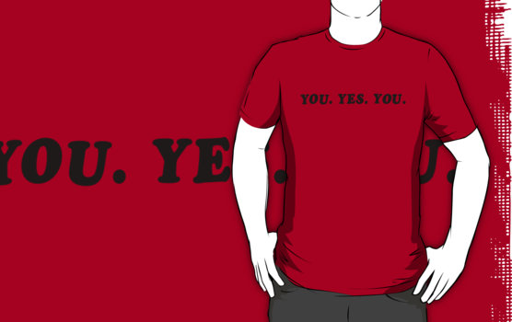
Introductions & Objectives
Your name
Your experience in fundraising
Your objectives for today

Slide 3
Agenda
Introductions
Fundraising Fundamentals
Fundraising Activities
Case for Support
Prospects
Q&A/Discussion

Slide 4
FUNDRAISING FUNDAMENTALS

Slide 5
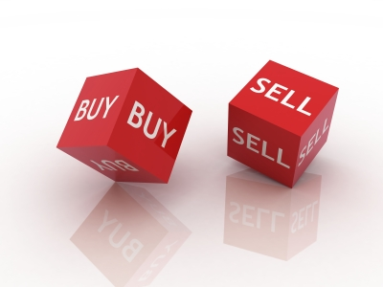
Philanthropy is based on
a meeting of values

Slide 6
Fundraising Principles
People give to you because you meet needs, not because you have needs.
A gift to your organisation is a gift through the organisation into the community – you are not the end user of the gift (it is not about you)
Fundraising is not about money, it is about relationships based in shared values
~Kay Sprinkel Grace~

Slide 7
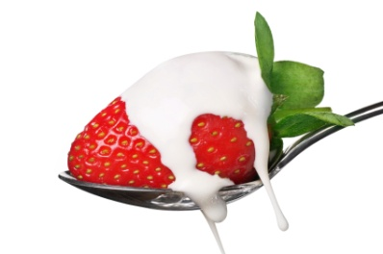

Donor Centered Relationships
“Personally I am very fond of strawberries and cream; but I find that for some strange reason fish prefer worms.
So when I go fishing, I don't think about what I want. I think about what they want.”
Dale Carnegie

Slide 8
The Donor’s Perspective
Do not assume you know the donor’s interest. People’s life experiences affect their interests.
Learn the donor’s interests and passions – their reasons for supporting your cause.
The most valuable time that you can spend is focused on connecting the donor to their passions.
Help donors see how their contributions are making an impact.
Advancement Resources, 2012

Slide 9
The Donor’s Perspective
Life changing experiences may be positive or they may be negative.
People are motivated to contribute for their own reasons – those reasons are not always obvious.
Advancement Resources, 2012

Slide 10

Fundraising is a process

Slide 11
1
Identify, Research & Qualify
2
Inform & Involve
3
Test Interest
4
Ask & Confirm
5
Thank, Do, Report

Slide 12
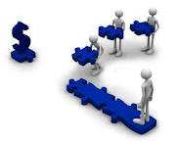
Everyone is Responsible

Slide 13
FUNDRAISING ACTIVITIES

Slide 14
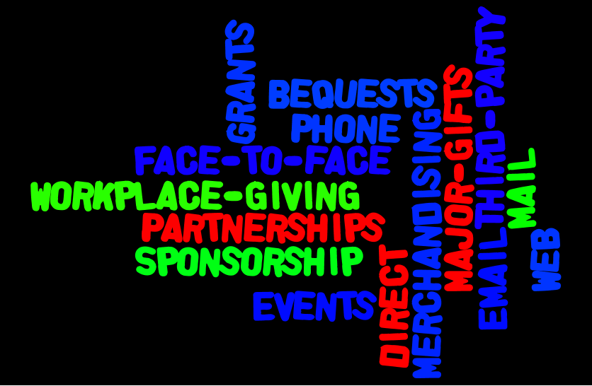

Slide 15
Results
Resources
Skills
Time

Slide 16
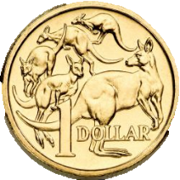
Return on a $1 investment for different types of fundraising activities
Bequests
$56.83
55
50
45
Major Gifts
$33.33
40
35
30
25
General donations
$19.11
Reported by over 20 Australian non‐profits in audited financial statements (2004‐2013)
20
Regular Giving
$8.41
15
10
Community Fundraising
$11.15
Direct Mail
$3.66
5
1
Events
$3.43
Lotteries/Art Unions
$1.51

Slide 17
Events
Consider get-to-know-events
Direct Mail
Projects to support?
Timing of mailing?
Grants
Resources to assist research/identification
Database/ list of names?
Sponsorship
What is your value proposition to sponsors?
Major Gifts
Who is in your network of prospects?

Slide 18
CASE FOR SUPPORT

Slide 19
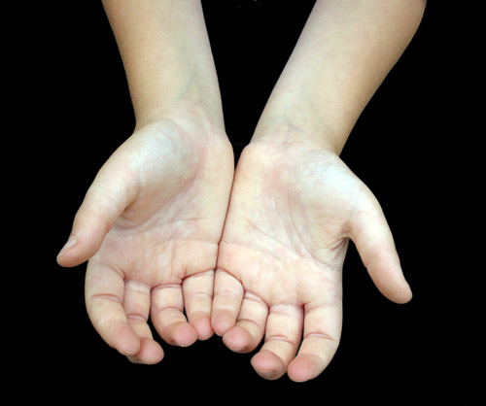
COMPELLING
URGENT
Making the Case

Slide 20
Developing the Case
The Case for Support is your story. It’s who you are, why money is needed and how you will meet that need with the money you raise.
The Case for Support is written from the donor’s perspective – not the organisation’s.

Slide 21
Developing the Case
The case describes how the important work you do makes a difference to those who help.
It tells a potential donor about the impact that their support can have.

Slide 22
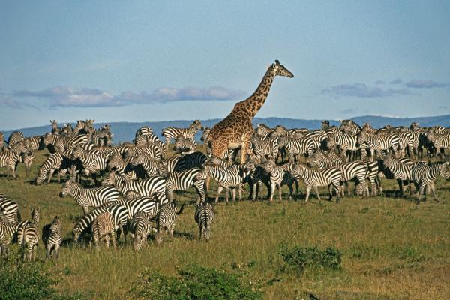
What’s makes your story unique?

Slide 23
CASE FOR SUPPORT FORMAT
Need
Plan to meet need
What will it cost, and
What you are asking for.

Slide 24
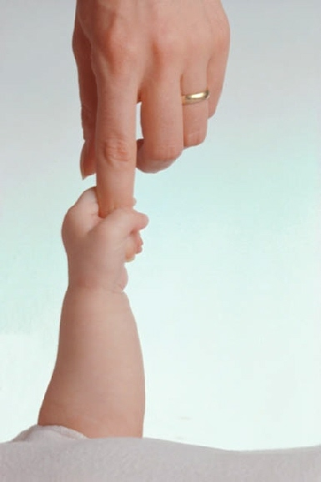
“Next to the human face, hands are our most
expressive feature. We talk with them. We
work with them. We play with them. We
comfort and love with them. An injury to the
hand affects people professionally and
personally. At Vector Health Programs, we
give people back the use of their hands.”
Notes:
Betsy Chapin Taylor, Healthcare Philanthropy – worth looking at for case for support writing

Slide 25


Slide 26
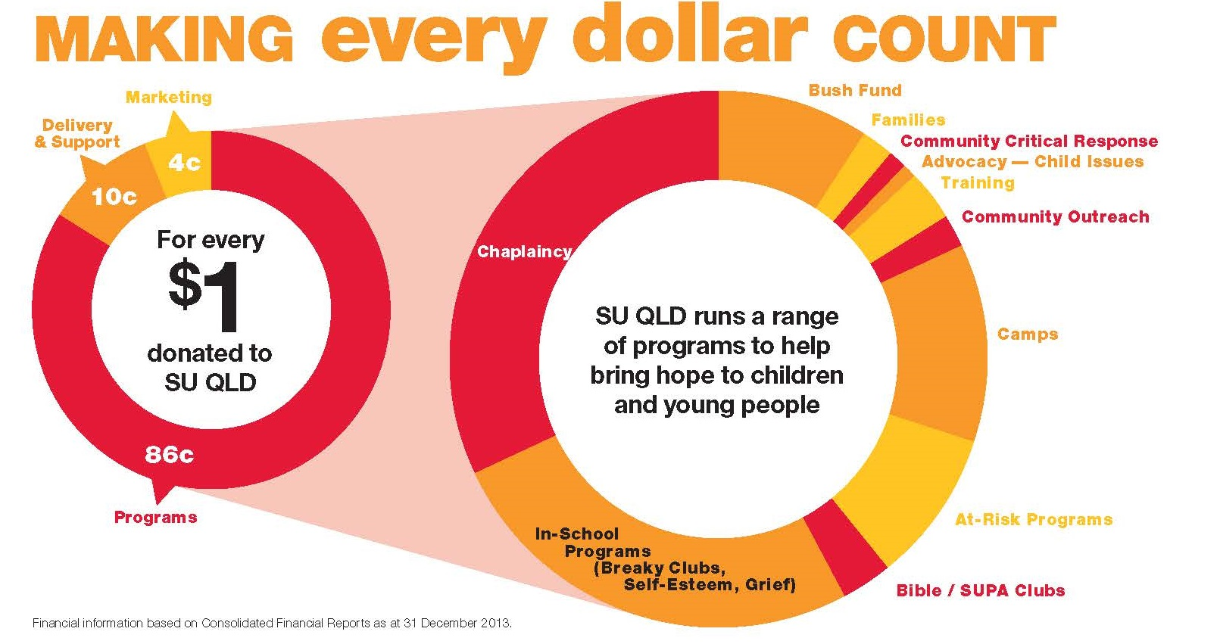

Slide 27
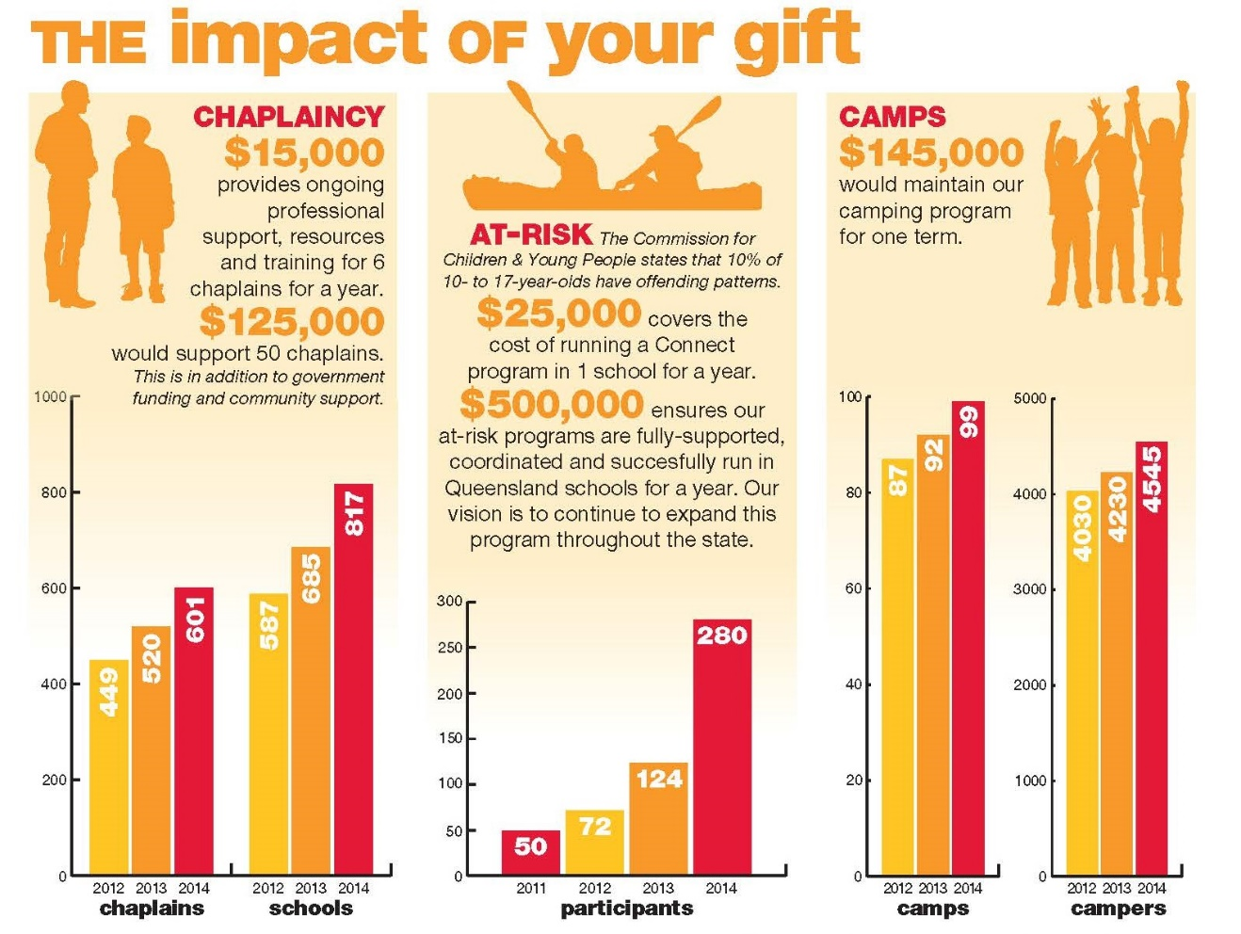

Slide 28
PROSPECTS

Slide 29
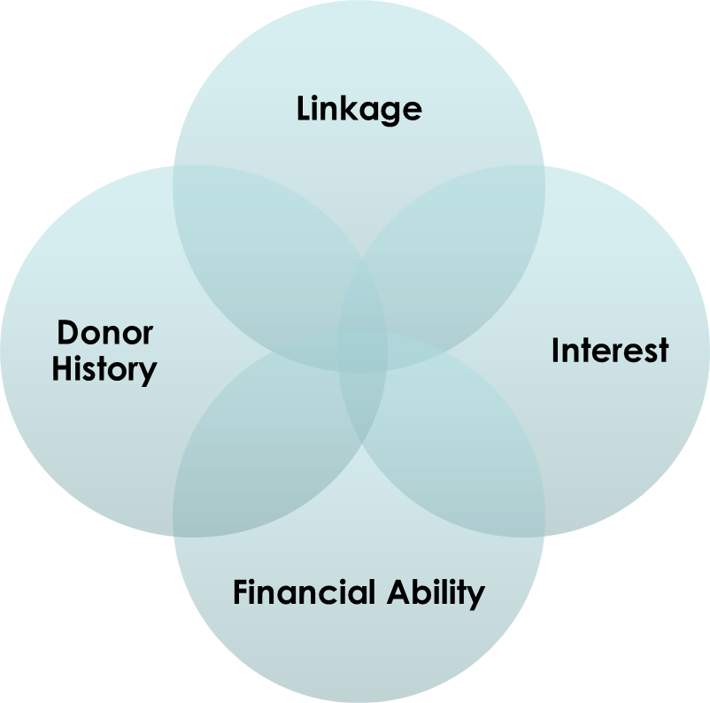
The Ideal Prospect
✓

Slide 30
Prospects
Ability – financial capacity
Linkage to your organisation, cause, or similar organisation or cause
Interest in your specific project, experience as a donor

Slide 31
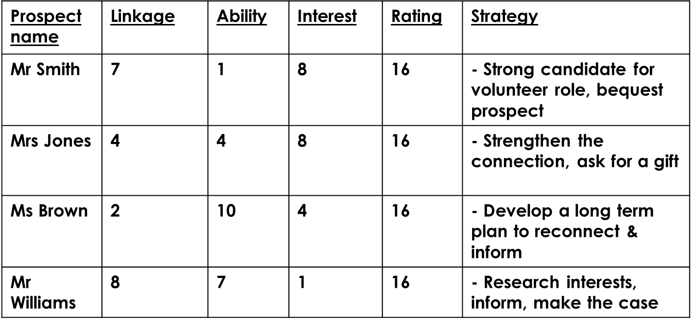
USE RATING SCORES TO DEVELOP STRATEGY (SCORE OUT OF 10)

Slide 32
ACTIVITY

Slide 33
What do we want to raise $ for? | Source of donations/sponsorship? | Type of FR activity could be? | Next steps

Slide 34
QUESTIONS

