Slide 1
Legacy Lawyering
Sharing your knowledge with next generation lawyers
Catherine Kenny, The College of Law Queensland
Helen McGowan , NACLC PLT Project

Slide 2
Overview
The system explained
What’s in it for you ?
3. Tips on Supervision

Slide 3
1: The system explained

Slide 4
What is practical legal training (PLT)?
The most common pathway to admission
That’s right there are no Articles of Clerkship!
Coursework
Workplace
Experience/ Work Experience
Admission
CPE ? COL requirement for Continuing Professional Education

Slide 5
National competency standards for entry level lawyers : 1 January 2015
Notes:
This diagram comes from Kris Greaves, a teacher at the Victorian College of Law. Kris is doing his PhD on teaching PLT. The link to this diagram is here http://thekglawyerblog.com/ptblog/wp-content/uploads/NCS-2015-PNG.png

Slide 6
Course work + workplace experience.
Coursework teaches these competencies through face to face and online teaching.
A minimum of 15 days workplace experience, focusing on the delivery of legal services, under the supervision of experienced lawyer.

Slide 7
What is workplace experience?
Insight into the legal profession
Experience the delivery of legal services in a real world context
Apply knowledge and skills to real-life problems
Experience a legal office environment
Understand the importance of clear communication, identification of clients’ problems and effective and efficient advice
Understand how legal practice professionals operate
Professional legal attitudes
Ongoing process of professionalism
Consolidate PLT learning

Slide 8
National competency standards: Skills
Lawyer’s skills
Communicating effectively
Cross cultural awareness
Interviewing clients
Writing letters
Drafting other documents
Negotiating settlements and agreements
Facilitating early resolution of disputes
Representing a client in a legal forum
Work management and business skills
Managing personal time
Managing risk
Managing files
Keeping client informed
Working co-operatively
Self management

Slide 9
2: What’s in it for you?

Slide 10
Sharing resources: yours and theirs
Supporting career development and training
Training a new crop of potential volunteers
Encourage young lawyers into the community sector
To assist your workload

Slide 11
Duration
Duration will affect what the PLT student can do e.g. is it a project or is it more immersion –both are acceptable
In COLQ’s experience most CLCs are looking for 15 week placements

Slide 12
What can they do?
Initially not very much… or maybe a lot ….depending on their experience
Familiarity with your organisation
Orientation - manual first up and questions
Maybe this webinar as CLC 101 for PLT orientation

Slide 13
Examples
Observe client meetings, write up file notes
Take initial /basic client details
Read files, case summaries, make initial assessments
Legal research and legal factual analysis
Policy that is not government funded but within your purview
Undertake advocacy training and attend tribunals as necessary
Attend team meetings
Draft legal advices and documents
Risk management processes - conflict checks, critical dates, timetabling, scheduling
Attend mediations
Interacting with legal and non legal staff

Slide 14
Project work
Collect a list of the ‘important but not urgent’ work that can be delegated.
Explain the context for the work they are doing;
What are we aiming to achieve?
How does it fit within the service system?
What work has already been done, and what more needs to be done before completion?
Notes:
‘Important but not urgent work’ has been identified as the area most deserving of our time (second quadrant) (Ref Steven Covey: the 7 habits of highly effective people)

Slide 15
3: Supervision

Slide 16
Supervisors –technical aspects
Substantial current or recent experience in practising law; or
Comparable relevant qualifications or experience;
and
Comply with any relevant legislative or regulatory requirements
e.g. Full practising certificate or restricted held for 3 years or admitted and entitled to hold a practising certificate

Slide 17
Shared responsibility
Consider developing a standard position description and a work plan to describe the role and key people.
Ask the student to pro-actively manage their compliance paperwork, timetable and ‘wish list’ for skill development.
Meet regularly to reflect and debrief.
Hold each other to account.

Slide 18
Encouraging mutual growth
Critical to success for supervisor and student
Aid the student’s learning by providing opportunities for learning
Feedback and Guidance
Provide support
Opportunities to discuss problems
Put it back on them

Slide 19
Critical and timely feedback.
Role in organisation and extent of authority
Clear instructions
Sufficient direction – facts and perhaps law
Realistic timeframes
Allow an atmosphere of questions
Encourage potential solutions – reality test
Work at an increasingly harder level
Substantive and procedural work - a balance is great
Workload?
Regular guidance and feedback on performance
Recognise improvements

Slide 20
Adapt + improvise + overcome
Hume Riverina Community Legal Service
lunch room whiteboard.
Notes:
Adapt, improvise and overcome (unless this requires you to do something illegal) and even then we will try to find a loophole.
Reflective practice, co-operative learning.
New (2015) standard Resilience and wellbeing

Slide 21
Problems
Ensure that aspects that require improvement are thoroughly discussed
Encourage self reflection and self development

Slide 22
Outcomes: Consolidate skills
Oral and written communication
Advocacy and negotiation
Persuasion and strategy
Identify and solve problems – what are the options
Limits of authority
Writing and drafting
Research and analysis
Acting professionally and ethically
People Skills
Work management
Managing Files

Slide 23
Sequence: PLT hosting
Include PLT hosting in your strategic plan.
Dedicate resources (a person as the point of contact, procedures, time in the annual plan)
Specify the ‘ideal candidate’ (duration, skills, time of year)
List your placement (eg NACLC, RRR PLT, COL)
Triage applicants to find the best ‘fit’
Provide orientation, supervision, debriefing.
Notes:
Adapt, improvise and overcome (unless this requires you to do something illegal) and even then we will try to find a loophole.
Reflective practice, co-operative learning.
New (2015) standard Resilience and wellbeing

Slide 24
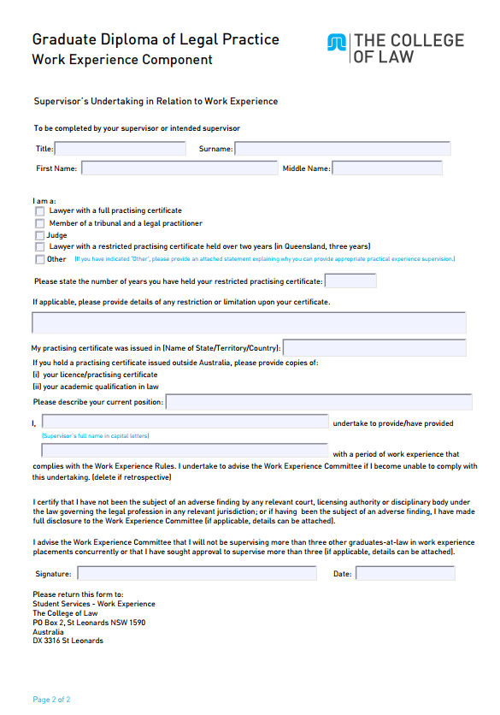
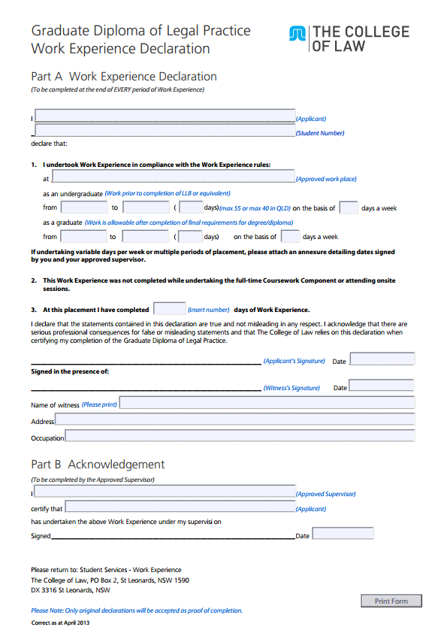
Exit
Yes, there is form filling!

Slide 25
4: Conclusion

Slide 26
Legacy lawyering: the next generation
Notes:
Pilbara CLS: Kelly Cassidy and Leah Billeam

Slide 27
Toolkit
We want to make it easy

Slide 28
Resources
National competency standards for entry level lawyers 2015
Clinical placement program: Hume Riverina CLS
The South Australian Law Foundation $1k
The Australian National University Legal Workshop $1k
Giddings: Promoting justice through clinical legal education
Best Practices: Australian clinical legal education
Rural and regional legal education network
ANU: A puppy lawyer is not just for Christmas
McGowan: NACLC Annual conference 2013
NACLC RRR PLT project: an introduction agency
The College of Law : www.collaw.edu.au
Notes:
These general resources include guidance for lawyers and legal services offering ‘clinical legal education’. Clinical legal education refers to the undergraduate experience where law students undertake a placement in a legal service and are supervised by lawyers. There is a strong parallel between this experience and the PLT in that both provide an immersion experience into a real world legal practice, under the supervision and guidance of qualified lawyers and within the practice management systems.

Slide 29
Contact
The College of Law | NACLC RRR PLT
QLD: Catherine Kenny E: ckenny@collaw.edu.au P: 07 3234 4555 NSW/General: Greg Dwyer E: gdwyer@collaw.edu.au P:02 9965 7000 | Helen McGowan, Mary Flowers and Matt Grogan E: RRR_PLT@clc.net.au M 0458 794 891 (Matt) P 02 6621 1073 (Mary)

