Slide 1
The Crime and Corruption Act 2001: a new framework
Presented at:
QAILS Working with Queensland regulators, investigators and enforcement agencies
Monday 25 May 2015
Presented by:
Kylee Rumble
Acting Director Integrity Services
Crime and Corruption Commission

Slide 2
The role of the CCC
To combat and reduce the incidence of major crime; and
To reduce the incidence of corruption in the public sector
(s4 CC Act)

Slide 3
The CCC’s Corruption function
To ensure a complaint about, or information or matter involving, corruption is dealt with in an appropriate way, having regard to the principles set out in section 34.
(s33 CC Act)

Slide 4
The principles
Cooperation
Devolution
Public Interest

Slide 5
The jurisdiction of the CCC – Units of Public Administration

Slide 6
Units of public administration
The CCC has jurisdiction with respect to:
State Departments
Statutory authorities (including GOCs)
Public sector agencies
Local Governments
Boards, tribunals
Universities
Queensland Police Service

Slide 7
The jurisdiction of the CCC – the definition of “corrupt conduct”

Slide 8
Corrupt Conduct (s.15)
Combination of pre-amendment - sections 14 and 15
Not fundamentally different
4 key elements to the definition (subsection (1))
Cumulative
3 main changes
Examples of what may be corrupt conduct (subsection (2))
Inclusive
Not exhaustive

Slide 9
Corrupt Conduct (s.15)
Conduct of a person, regardless of whether the person holds or held an appointment, that—
(a) adversely affects, or could adversely affect, directly or indirectly, the performance of functions or the exercise of powers of—
(i) a unit of public administration; or
(ii) a person holding an appointment; and
results, or could result, directly or indirectly, in the performance of functions or the exercise of powers mentioned in paragraph (a) in a way that—
(i) is not honest or is not impartial; or
(ii) involves a breach of the trust placed in a person holding an appointment, either knowingly or recklessly; or
(iii) involves a misuse of information or material acquired in or in connection with the performance of functions or the exercise of powers of a person holding an appointment; and
(c) is engaged in for the purpose of providing a benefit to the person or another person or causing a detriment to another person; and
(d) would, if proved, be—
(i) a criminal offence; or
(ii) a disciplinary breach providing reasonable grounds for terminating the person’s services, if the person is or were the holder of an appointment

Slide 10
Knowingly or Recklessly Subsection (1)(b)(ii)
Conduct that adversely affects powers or functions that “involves a breach of the trust placed in a person holding an appointment, either knowingly or recklessly”
Not defined in CC Act
Knowingly
Recklessly
An awareness by the person engaging in the conduct that there was a real and apparent risk ... and
The person nevertheless, without justification, went through with the conduct.

Slide 11
Benefit or detriment Subsection (1) (c)
Conduct that “is engaged in for the purpose of providing a benefit to the person or another person or causing a detriment to another person”
benefit includes property, advantage, service, entertainment, the use of or access to property or facilities, and anything of benefit to a person whether or not it has any inherent or tangible value, purpose or attribute.
detriment, caused to a person, includes detriment caused to a person’s property.

Slide 12
“…would, if proved…” Subsection (1)(d)
Conduct that “would, if proved, be—
(i) a criminal offence; or
(ii) a disciplinary breach providing reasonable grounds for terminating the person’s services, if the person is or were the holder of an appointment”
Meaning
The intent behind the change
Objective criteria
Criminal offence
Disciplinary breach providing reasonable grounds for termination

Slide 13
Examples of Offences Subsection (2)
Without limiting subsection (1), conduct that involves any of the following could be corrupt conduct under subsection (1)—
(a) abuse of public office;
(b) bribery, including bribery relating to an election;
(c) extortion;
(d) obtaining or offering a secret commission;
(e) fraud;
(f) stealing;
(g) forgery;
(h) perverting the course of justice;
(i) an offence relating to an electoral donation;
(j) loss of revenue of the State;
(k) sedition;
(l) homicide, serious assault or assault occasioning bodily harm or grievous bodily harm;
(m) obtaining a financial benefit from procuring prostitution or from unlawful prostitution engaged in by another person;
(n) illegal drug trafficking;
(o) illegal gambling.

Slide 14
The jurisdiction of the CCC – the definition of “police misconduct”

Slide 15
Police Misconduct
Conduct, other than corrupt conduct, of a police officer that—
(a) is disgraceful, improper or unbecoming a police officer; or
(b) shows unfitness to be or continue as a police officer; or
(c) does not meet the standard of conduct the community reasonably expects of a police officer. (Schedule 2 CC Act)

Slide 16
The requirement for Statutory Declarations

Slide 17
Via section 36(3)
Which provides that a complaint about corruption must be made by way of a statutory declaration;
UNLESS — The Commission decides because of exceptional circumstances, that it need not be made by statutory declaration.
Notes:
The Act does not define what it means by ‘exceptional circumstances’ and has instead been drafted to include 5 non exhaustive examples of what may be considered to be exceptional circumstances.

Slide 18
Exceptional circumstances (examples referenced in the CC Act)
The person making the complaint:
Fears retaliation for making the complaint
Is illiterate, or not literate in English
Has a disability or impairment that affects their ability to make the complaint
Has a personal or physical disadvantage that makes it difficult or impossible to make complaint by way of statutory declaration
Is a child

Slide 19
Relevant Exemptions s36(6) CC Act
Information or matter involving corruption given to the Commission under s36(5) CC Act.
A complaint about corruption that is made as a disclosure to the CCC under the Public Interest Disclosure Act 2010

Slide 20
Other material which may be received
A Notification is a communication given to the Commission by or on behalf of a public official;
Information is a communication received by the Commission which is not a complaint, notification or matter OR is information from other sources.

Slide 21
Other material which may be received (cont.)
Matter is an adverse finding made by Parliament, a Court, tribunal or other entity with legal authority that a person has or is engaged in corruption.

Slide 22
Therefore for the CCC ...
In assessing complaints, and exceptions to the statutory declaration requirement, there is no certainty and little guidance provided by the examples;
Case by case consideration of factual circumstances will be required, in combination with CCC policy on the issue;
Note — Section 14D of the Acts Interpretation Act states that in circumstances where there is conflict between a provision in an Act and an example provided in an Act, the provision of the Act prevails. It is worth bearing this in mind.

Slide 23
Forms of Statutory Declaration
CCC has uploaded a PDF link to a pro-forma document on its website – pro-forma is also accessible on the Queensland Courts website;
It is an offence under the Criminal Code (ss.193/194) to provide a statutory declaration which is knowingly false in a material particular and potential complainants will also be made aware of this.

Slide 24
The CCC’s monitoring role
The CCC may only exercise its monitoring role in relation to matters for the purpose of ensuring a complaint about corruption is dealt with in an appropriate way.
The CCC monitors suspected corrupt conduct in the following ways:
Conducting audits
Reviewing individual complaints or matters referred to agencies to deal with.

Slide 25
The CCC’s monitoring role
In 2013–14, the (then) CMC received 3881 complaints, which involved 8688 separate allegations.
Of the complaints received 34% came from members of the public
In 2013–14, the (then) CMC retained 51 of the most serious matters for investigation, including joint investigations with other agencies.
The majority of complaints assessed (79%) were referred to the originating agency or the QPS to deal with.
Around 20 per cent of complaints required no further action.
CCC Annual Report 2013-14

Slide 26
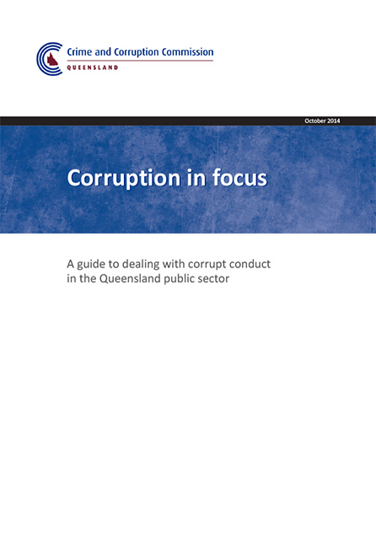
Guidance
For your assistance
www.ccc.qld.gov.au

