Slide 1
MEDIATION on MORNINGTON ISLAND

Slide 2
Definition of “mediation” used by Junkuri Laka
Mediation: any facilitated and consensual communication process that seeks to achieve an agreed outcome, including:
Restorative Justice (victim-offender)
Peace-making and peace-keeping
Conflict management
Interest-based negotiation (Fisher/Ury model)
Complaints about Police
Intra- and inter-family conflict

Slide 3
Is mediation relevant for CLC’s?
Part of mainstream legal practice, i.e. it is “hard to avoid” even when proclaiming that adjudication is always the better answer
General civil matters, the “push for ADR”
Family law
Criminal law (Restorative Justice)
Youth Justice
Part of the “activist agenda” of CLC’s
See “community lawyers and the new civil justice” by the Victorian Federation of CLC’s
Argument: CLC’s do not derive from pro-bono legal work, but from an activist tradition that pursues “substantive” rather than “procedural” justice

Slide 4
Junkuri Laka CLC: from mediation to legal services
Involved in mediation long before becoming a CLC
Need for legal assistance has grown out of the conflict resolution practice
Mediation work is funded, the CLC is not (at this time)
Mediation (MIRJ) started in 2008 as a Federal AG initiative targeting high conflict communities with deep involvement in criminal justice system
75 % of adult population appears in court regularly
7 – 10% of adult population appears in court every month
Incarceration rate of 4 – 5 %
Widespread community conflicts, threats of riots against police
Violence culturally embedded, aggravated by alcohol and social circumstances, failed AMP policies

Slide 5
MIRJ project stages:
Develop conflict resolution model with community input (2008 – 2009), focusing on large community disturbances
Train local mediators and facilitate with government workers (2010) to establish credibility in community and with relevant stakeholders (police, courts)
Transfer to local organisation (2011), link RJ with CJG work
Develop and extend the practice (2011 – 2014)
Organization development, business management
New funding structure
Increase types of conflict that can be referred
Use increased community peace and safety to focus conflict resolution on underlying issues, thus revealing legal challenges
Innovative practice development (e.g. integrate ADR in formal police work, school conflicts, community court)

Slide 6
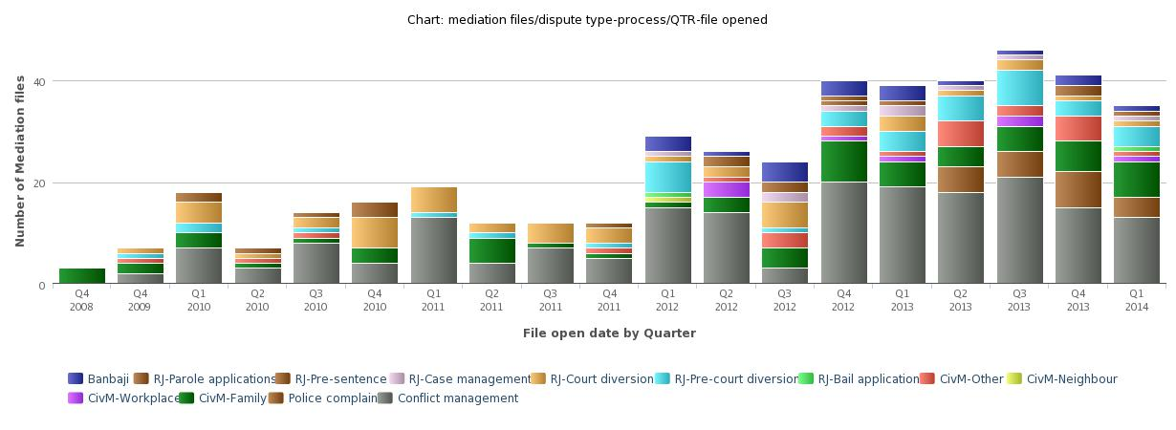
Statistics: files opened/QTR

Slide 7
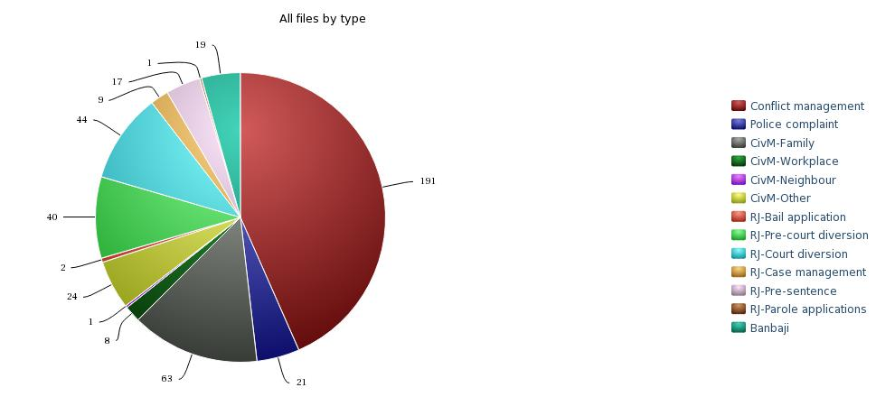
Statistics: conflict / process ID

Slide 8
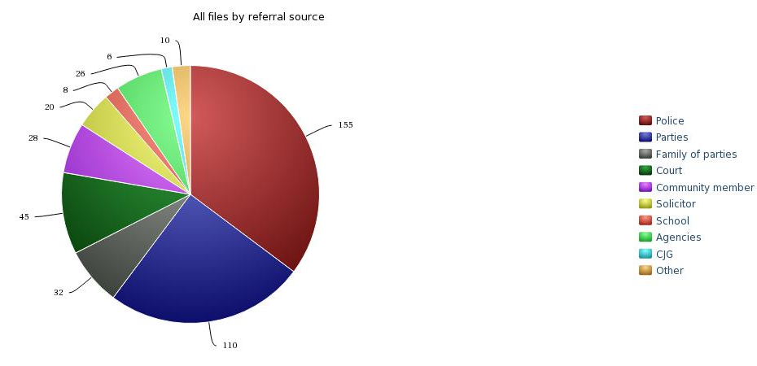
Statistics: referral source

Slide 9
Statistics: outcomes
Dispute ID / Outcome | Blank | No engage ment | Resolved at intake | No show | Walk out | Incon clusive | Settle ment | Recon ciliation | Total
Conflict management | 2 | 21 | 25 | 3 |  | 9 | 75 | 56 | 191
Police complaint | 2 | 1 | 8 |  | 1 | 1 | 7 | 1 | 21
CivM-Family | 1 | 6 | 4 | 1 | 1 | 3 | 25 | 22 | 63
CivM-Workplace |  | 1 | 3 |  |  |  | 4 |  | 8
CivM-Neighbour |  | 1 |  |  |  |  |  |  | 1
CivM-Other | 4 |  | 2 |  |  |  | 13 | 5 | 24
RJ-Bail application |  |  |  |  |  |  | 2 |  | 2
RJ-Pre-court diversion | 1 | 3 | 4 |  |  | 1 | 13 | 18 | 40
RJ-Court diversion | 2 | 1 |  |  |  | 1 | 19 | 21 | 44
RJ-Case management | 1 |  | 2 |  |  |  | 2 | 4 | 9
RJ-Pre-sentence |  | 9 | 2 |  |  |  | 1 | 5 | 17
RJ-Parole applications |  |  |  |  |  |  |  | 1 | 1
Banbaji | 2 | 4 | 2 |  |  | 1 | 2 | 8 | 19
Total | 15 | 47 | 52 | 4 | 2 | 16 | 163 | 141 | 440

Slide 10
Observations
Large scale community conflicts/fights have been eliminated
Scale of mediation has reduced (from 60+ to max 15-20)
Focus on issues rather than on emotions
Increased interest in legal positions and evidence
Family and relationship circumstances trump potential legal action in almost all cases for intra-community conflict
Improved understanding of external influences increases request for assistance in such matters (e.g. estates, insurance, consumer issues, regulation)
Challenges / tensions between substantive and procedural justice (e.g. conflict of interest)

Slide 11
Conclusions
Mediation / ADR provided a pathway to formal justice for the marginalised community of MI
Collaboration with justice stakeholders is essential (police, courts, DJAG, CJG, DCS)
This type of intervention is extremely economical compared to social service approaches (budget < 10%)
Dealing with issues as perceived by the community itself leads to community “buy in” and autonomous demand
It takes years to successfully travel this path, ongoing support is needed to continue the transformation
We now receive requests from other communities: Doomadgee (via DJAG), Aurukun (via community)

