Slide 1
Engaging with the United Nations 53rd Session Convention Against Torture Review Committee
Michelle O’Flynn & David Manwaring
Queensland Advocacy Incorporated

Slide 2
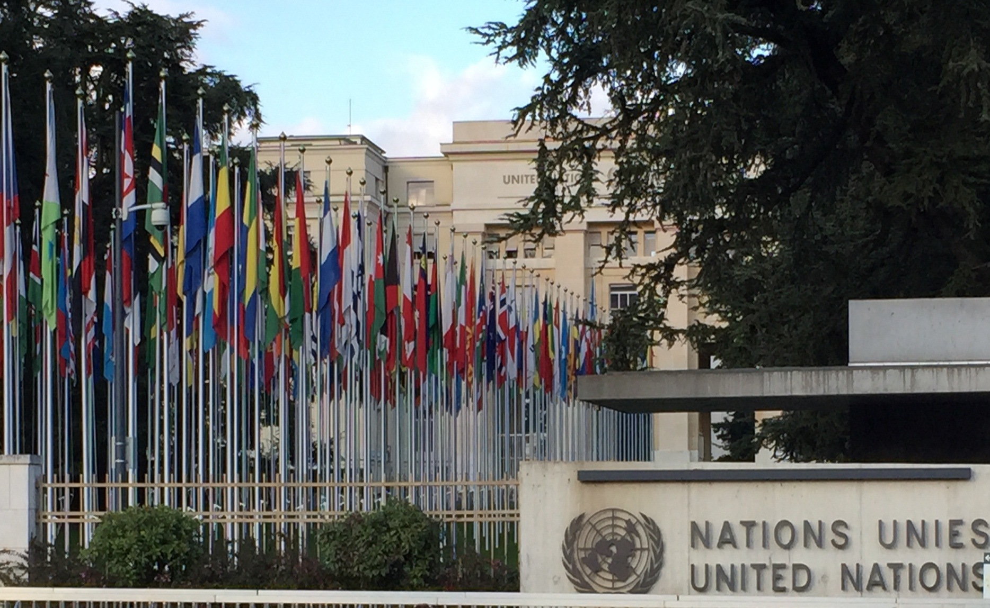

Slide 3
Who is the United Nations
Intergovernmental organisation Est 25.10.1945 to promote international cooperation.
51 member states when established, now 193.
Financed by contributions from member states.
The UN & its agencies enjoy extraterritoriality.
English, Arabic, Chinese, French, Russian and Spanish.

Slide 4
Objectives
maintaining international peace and security;
promoting human rights;
fostering social and economic development;
protecting the environment; and
providing humanitarian aid in the occurrence of famine, natural disasters or armed conflict.

Slide 5
Article 1 Charter of the UN purposes:
To maintain international peace and security, and to that end: to take effective collective measures for the prevention and removal of threats to the peace, and for the suppression of acts of aggression or other breaches of the peace, and to bring about by peaceful means, and in conformity with the principles of justice and international law, adjustment or settlement of international disputes or situations which might lead to a breach of the peace.
To develop friendly relations among nations based on respect for the principle of equal rights and self- determination of peoples, and to take other appropriate measures to strengthen universal peace.

Slide 6
Article 1 continued:
To achieve international co-operation in solving international problems of an economic, social, cultural, or humanitarian character, and in promoting and encouraging respect for human rights and for fundamental freedoms for all without distinction as to race, sex, language, or religion; and
To be a centre for harmonising the actions of nations in the attainment of these common ends.

Slide 7
What is the Review Committee?
Each State party has an obligation to take steps to ensure everyone in the State can enjoy the rights set out in the treaty.
A review committee (aka Treaty Body) is a body of independent experts who monitor implementation of core international human rights treaties.

Slide 8
There are ten treaty bodies (one for each treaty or convention) who are nominated and elected for fixed renewable terms of four years by State parties.
The Committee against Torture was established in 1988 pursuant to Art 17 CAT. The Committee monitors the implementation of the CAT and has brought powers of examination and investigation.

Slide 9
Functions of the Review Committee
Consideration of periodic reports by the States
Individual complaints
Conduct country inquiries
Organise thematic discussions related to the treaty.

Slide 10
Publish interpretations of treaty provisions (general comments or recommendations)
E.g. compre­hensive interpretation of substantive provisions, such as the right to life, to general guidance on the information that should be submitted in State reports
General comments also deal with wider, cross-cutting issues, such as the rights of persons with disabilities, violence against women.

Slide 11
How a Review is Undertaken
States parties are obliged to submit regular reports to the Committee on how the rights are being implemented.
States must report initially one year after acceding to the Convention and then every four years.
The Committee examines each report and addresses its concerns and recommendations to the State party in the form of "concluding observations".

Slide 12
In addition to the reporting procedure, the CAT establishes three other mechanisms through which the Committee performs its monitoring functions:
Consider individual complaints or communications from individuals claiming that their rights under the Convention have been violated (Art 22 CAT)
Undertake inquiries (Art 20 CAT) if they receive reliable information containing well-founded indications of serious, grave or systematic violations of the conventions in a State party
Consider inter-state complaints (Art 21 CAT). If a member State claims that another member state is not meeting obligations under the CAT.

Slide 13
How does the Review Committee know which issues to focus on?
In response to State Parties’ reports about their progress in implementing CAT the Committee can make general comments.
Before the session at which it formally considers a response, the Committee draws up a list of issues, which is submitted to the State party.
This list provides the Committee an opportunity to request additional information considered necessary to assess the state of implementation of CAT in the country concerned.

Slide 14
In addition to State reports, the Committee may receive information on a country’s human rights situation from other sources, including UN agencies, NGO’s, professional groups and academic institutions.
The Committee allocates specific plenary time to hearing submissions from UN agencies and NGOs.
Depending on when the information is submitted, issues raised by these organisations may be incorporated in the list of issues or inform the questions that members ask the State delegation. In the light of all the information available, the committee examines the States report.
QAI attended the 53rd Session as part of an NGO Delegation under this provision.

Slide 15
QAI goes to Geneva (Systemic Advocacy in Action)
QAI was successful in its application for funding from the Australian Human Rights Commission to attend the 53rd session of the UN Convention Against Torture in Geneva Switzerland.
As QAI had not made a submission to the CAT, we were fortunate to appear under the umbrella of PWD Australia (PWDA) as the submission tendered by that organisation (endorsed by QAI) was largely based on the shadow report to the CRPD “Disability Rights Now” which was written in conjunction with QAI.

Slide 16
Australian Delegation of Not-For-Profit Organisations
People with Disability Australia
First Peoples Disability Network
Women with Disabilities Australia
Human Rights Law Centre
Queensland Advocacy Incorporated
Amnesty International Australia
Care Leavers Australia Network
Survivors Network of Abuse by Priests
Association for the Prevention of Torture
Remedy Australia

Slide 17
Informal Briefing Session
Prior to the formal briefing session the NGO Delegation met with the Australian Government representatives informally.
The delegation was asked to briefly outline our issues and general discussion followed with the main concerns. This dialogue informed the Australian government responses to the Committee to some degree.

Slide 18
Issues Presented and Running Sheet for the Delegation
 | Opening statement | Ngila (PWDA) | 2 mins | 2 mins
Legal protection of rights Refugees and asylum seekers (onshore) | Constitutional recognition of Indigenous peoples OPCAT Implementation of treaty body views Mandatory detention Complementary protection ASIO detainees | Sophie (Amnesty) | 4 mins | 6 mins
Refugees and asylum seekers (offshore) Extra-territorial obligations Law enforcement and Counter-terrorism measures | Offshore detention ‘Enhanced screening’ Boat turnbacks Assisting foreign security forces Definition of ‘Terrorist Act’ ASIO powers Police powers Police use of force | Daniel (HRLC) | 4 mins | 10 mins
Indigenous persons | Unwarranted detention in prisons Access to justice Deaths in custody Indigenous persons with disabilities | Damien and Scott (FPDN) | 4 mins | 14 mins

Slide 19
Prisons | Overcrowding Healthcare Women in prisons Young people Transgender prisoners People with disabilities in prisons Crimes mental impairment issues | Ngila (PWD) | 3 mins | 18 mins
Treatment of persons with disability | Restrictive practises Involuntary treatment | David (QAI) | 3 mins | 21 mins
Violence against women | National plan to reduce VAW and their children Systemic review of family violence deaths Violence against women with disabilities Sterilisation | Cashelle (WWDA) | 3 mins | 24 mins
Rape and sexual violence against children |  | Nicky (SNAP) | 2 mins | 26 mins
Torture and deaths in care | Torture in care Deaths in care Government involvement and culpability | Leonie/Natalie (CLAN) | 4 mins | 30 mins

Slide 20
Day of Formal Briefing with UN Committee

Slide 21
THE PROCESS
The NGO delegation had 30 minutes in total to address the Committee which equated to approximately 2 to 3 minutes each organisation on their particular topic.
Each organisation was asked questions specific to their submission by the Committee Chairperson or individual members of the Committee.
Each organisation was to have only one speaker and David Manwaring was our spokesperson in the formal briefing.

Slide 22
Formal Briefing Session

Slide 23
Restrictive Practices and Involuntary Treatment
In spite of previous recommendations and findings of this Committee, and or the Special Rapporteur, many people with disability continue to be routinely subject to both regulated and unregulated restrictive practices and or behaviour modification.

Slide 24
Restrictive practices include seclusion, containment, mechanical, chemical and physical restraint as well as detention and time out. The alleged aim of these practices is to manage behaviour that is deemed ‘challenging’ or which may cause harm to the person or others. However, Restrictive practices are used as a means of coercion, discipline, punishment.

Slide 25
RATIONALE
Discrimination plays large part in the application of Restrictive Practices and therefore can constitute torture. At the very least restrictive practices constitutes cruel, inhuman or degrading treatment or punishment.
The Special Rapporteur on Torture Juan Mendez previously concluded that seclusion (solitary confinement) on a person with disability is cruel, inhuman or degrading treatment and if used for prolonged periods it is torture.

Slide 26
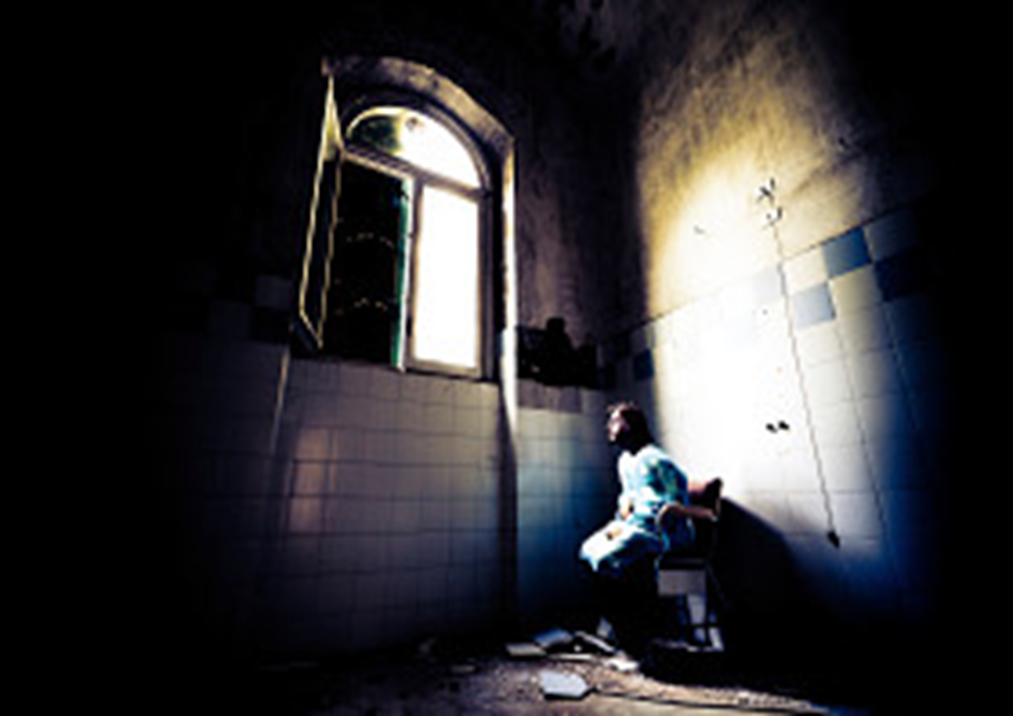

Slide 27
The Queensland and Victoria government have legislated to regulate the use of restrictive practice, other states rely on policy – nonetheless restrictive practices are sanctioned by all governments in Australia. A permissive rather than a preventive attitude exists.

Slide 28
An example of this is Australia’s National Framework for Reducing and Eliminating the Use of RP in the disability sector appears to focus more on when and how to use RP’s rather than preventing them. Whilst there are references to the CRPD it is arguable that obligations arising under the CRPD are not being met in this framework. Additionally the framework fails to extend to all settings where the use of RP’s occur. The framework would work better if consideration was given to Australia’s obligations under CAT – including ratification.

Slide 29
Mental health laws also fail to adequately protect people with disability from arbitrary detention or involuntary treatment. They can be confined to residential facilities, forensic disability services and even mental health facilities where they are subject to seclusion and timeout….Human rights violations (CRPD Art 14 disability used to detain/deprive of liberty). Australia’s interpretative declaration on (CRPD Art 17 protecting integrity of person) affects how the government sees current mental health legislation, policy and frameworks surrounding involuntary treatment. The Government interpretation allows for involuntary treatment when it is necessary, as a last resort with appropriate safeguards. It is arguable that these safeguards are sufficient.

Slide 31
RECOMMENDATIONS for Australian Implementation
1. Ratify OPCAT
2. Human Rights Act
3. Develop nationally consistent legislative framework protection of people from Restrictive Practices
4. Remove interpretative declaration re: CRPD Art 17
5. Develop effective mechanisms to identify and eliminate Restrictive Practices
6. Develop national plan outlining positive behavioural support strategies.

Slide 32
NGO Side Event
Following the formal session the NGO delegation hosted a side event with some Committee members.
This informal event was an open conversation and allowed the Australian delegation of community organisations an opportunity to elaborate on the issues raised and to offer some context by way of case examples and personal stories.

Slide 33
Members Of NGO Delegation

Slide 34
Australian Government Response
The Australian Government delegation, led by Mr. John Quinn, presented their 45 minute response to the questions from the UN CAT regarding the List of issues prior to the submission of the fifth periodic report of Australia (CAT/C/AUS/5)* Specific information on the implementation of articles 1 to 16 of the Convention, including with regard to the Committee’s previous recommendations.
The present list of issues was adopted by the Committee at its forty-fifth session, according to the new optional procedure established by the Committee at its thirty-eighth session, which consists in the preparation and adoption of lists of issues to be transmitted to States parties prior to the submission of their respective periodic report. The replies of the State party to this list of issues will constitute its report under article 19 of the Convention

Slide 35
Committee Questions in Regard to NGO issues
Committee members commended the Australian government on ensuring there was no impunity or immunity for acts of torture.
Committee members impressed all the NGO delegates with their incisive questions which were largely focussed on the issues of refugees/asylum seekers:- offshore processing; mandatory detention; the detention of children; transparency of processes; child sex abuse in detention; and attempts to changes standards of proof of claims. It was stated that (as per Article 3 CAT) asylum seekers should be more likely to be believed than not.

Slide 36
Summary of Committee Conversation and Questions AUS. Govt. Day 1
Mandatory detention – reactionary, concerns about terrorism measures
Violence against Women – indignation of the concept that this was a ‘private matter”. Questions about funding and implementation of Action Plan
Manus Island and Nauru – conditions, health care and abuse by staff
Prisoners’ health overcrowding, incarceration of indigenous Australians
Half of young people in detention are indigenous and with disabilities
Committee requested data for solitary confinement of women, juveniles and transgender people
Committee expressed deep concerns regarding people with intellectual/cognitive impairment declared unfit for trial held in indefinite detention
Indigenous deaths in custody, pre-trial detention of indigenous women
Excessive use of force by police
Sterilisation of people with impaired capacity in particular women and girls

Slide 37
Summary of Questions and Conversations AUS Govt. Day 2
Responders for specific questions came from different representatives from Dept. Immigration and Border Protection; Immigration Status Resolution Group, Department of Immigration and Border Protection; and Australian Attorney General’s Department.

Slide 38
Summary of Responses
A date will be set for a referendum on Constitutional recognition of Indigenous Australians as per recommendations of the review panel in January 2012.
There is a zero tolerance to domestic violence against women and children although there is a view that this does not fall within CAT articles 2 and 16. There is recognition that acquiescence by government could be in breach of the CAT. $200 m is allocated to the National Plan of 2010 – 2022, and that the second phase is 2012 – 2016.
Contentious discussion regarding offshore and mandatory detention - outsourced contractors are trained in ‘human rights’ but it was explained that it was at the responsibility of the government of each country and ‘unapproved boat arrivals” subject to the immigration laws of that country (PNG or Nauru).
Discussion of overcrowding in prisons and deaths in custody
Royal Commission into child sex abuse and incorporating forced or coerced sterilisation of women and girls “best interest test applied”

Slide 40
Further Questions from Committee
The Committee sought further reporting on statistics about :-
actions and punishments for violence against women
deaths in custody, suicide rates, mental health detention facilities
training of police in the use of Tasers
Is ratification of OPCAT still a priority for Australia? (signed in 2009, committed to ratification in 2011
When will Australia’s Human Rights legislation be complete (Human Rights Bill 2012)? Australia needs a Bill of Rights to enforce rights of victims

Slide 41
Reflections of taking casework into broader advocacy
Common theme/thread with each representative group
Experience of meeting other delegates
Why it is important – issues remain unknown – to make any real and permanent change issues need to be taken into a broader arena
Allows for a collective and focused approach rather than individual - concerns of all gives unification to the issues
Forces some form of government response - difficult to ignore a collective
However some issues are given more priority – perhaps to the disadvantage of others
Created energy and a drive to advance the human rights agenda.

Slide 42
Subsequent Actions and Outcomes
Australia has come under close scrutiny by the UN CAT Committee which was prompted by some of the government responses.
QAI was asked to report on our engagement to the Public Advocate.
Media interview in regard to police force
Follow up event in Sydney with NGO delegates and academics and allies to progress the agenda of cessation of ‘ill treatment i.e. torture, cruel, inhumane and or degrading treatment
Research project underway
Engagement with “Rights for Queenslanders Alliance.”

