Slide 1


Community Legal Services Plan – Priority Regional Need

Slide 2
Why are we doing this and how will this information be used?
LPITAF identified geographical priority areas (for generalist services)
  National Legal Need and Strategic Planning Project
  Government population projections to 2031
The LAW Survey – Queensland
Small group discussion
Shortlist

Slide 3
National Legal Need and Strategic Planning Project
Indicators of legal need
Calculated legal need
Probability of legal need
National CLC need ratio
SEIFA ranking
Notes:
Calculated legal need: THE NUMBER OF PEOPLE refers to results of a probability model that combines and weights key indicators of legal need in order to calculate the total numbewr of adults in an LGA likely to experience a legal problem of any type over a three year period
Probability of legal need: PROPORTION of adult population in an LGA likely to experience a legal problem of any type over a three year period
National CLC need ratio: formula using CLSIS data (advices and informations) measured against the calculated legal need to indicate relative levels of CLC servicing

Slide 5
Discussion here about a civil law project for communities working with ATSILS, ATSIWLSNQ, QIFVLS,

Slide 7
Notes:
2020 people in Qld surveyed about their experiences of legal need
People with a disability had high prevalence of legal problems overall, substantial legal
problems, multiple legal problems and problems from 10 problem groups.
• People who had been unemployed had high prevalence of legal problems overall, substantial
legal problems, multiple legal problems and problems from six problem groups.
• Single parents had high prevalence of legal problems overall, substantial legal problems,
multiple legal problems and problems from three problem groups.
• People who had lived in disadvantaged housing had high prevalence of legal problems overall,
substantial legal problems and problems from four problem groups.

Slide 8
The LAW Survey - Queensland
2020 people surveyed
10% of respondents accounted for 68% of the problems reported
People with a disability
People who had been unemployed
Single parents
People who had lived in disadvantaged housing
Age
Notes:
2020 people in Qld surveyed about their experiences of legal need
People with a disability had high prevalence of legal problems overall, substantial legal
problems, multiple legal problems and problems from 10 problem groups.
• People who had been unemployed had high prevalence of legal problems overall, substantial
legal problems, multiple legal problems and problems from six problem groups.
• Single parents had high prevalence of legal problems overall, substantial legal problems,
multiple legal problems and problems from three problem groups.
• People who had lived in disadvantaged housing had high prevalence of legal problems overall,
substantial legal problems and problems from four problem groups.

Slide 9
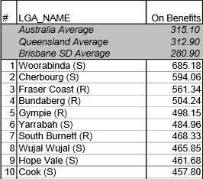
Top 10 LGAs Rate On Benefits Recipients per 1,000 Adults,

Slide 10

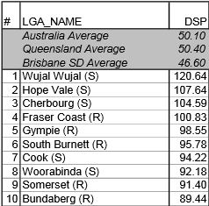
Top 10 LGAs DSP Recipients per 1,000 Adults

Slide 11
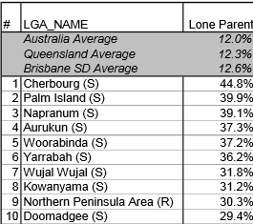
Top 10 LGAs Rates of Lone Parents

Slide 12
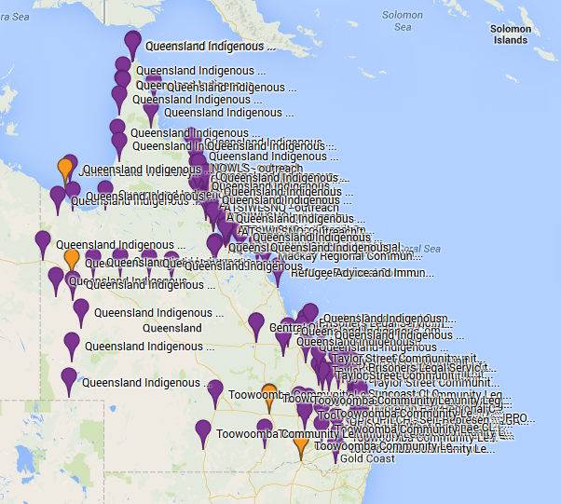

Slide 13
