Slide 1


QAILS update
James Farrell
director@qails.org.au

Slide 2
Outline
2014-15 activities and achievements
Sector funding
Law reform priorities
Accreditation

Slide 3
2014-15 Actions and achievements

Slide 4
2014-17 Strategic plan
Support and develop the organisational capacity of community legal centres
Support and develop community legal centre staff, including volunteers
Provide targeted information to members of the public so legal needs are responded to in a timely way
Mature QAILS’s role as a peak body for Queensland’s community legal centres
Be a respected and leading voice for community legal centres and social justice
Deliver clear and transparent governance
and operational management

Slide 5
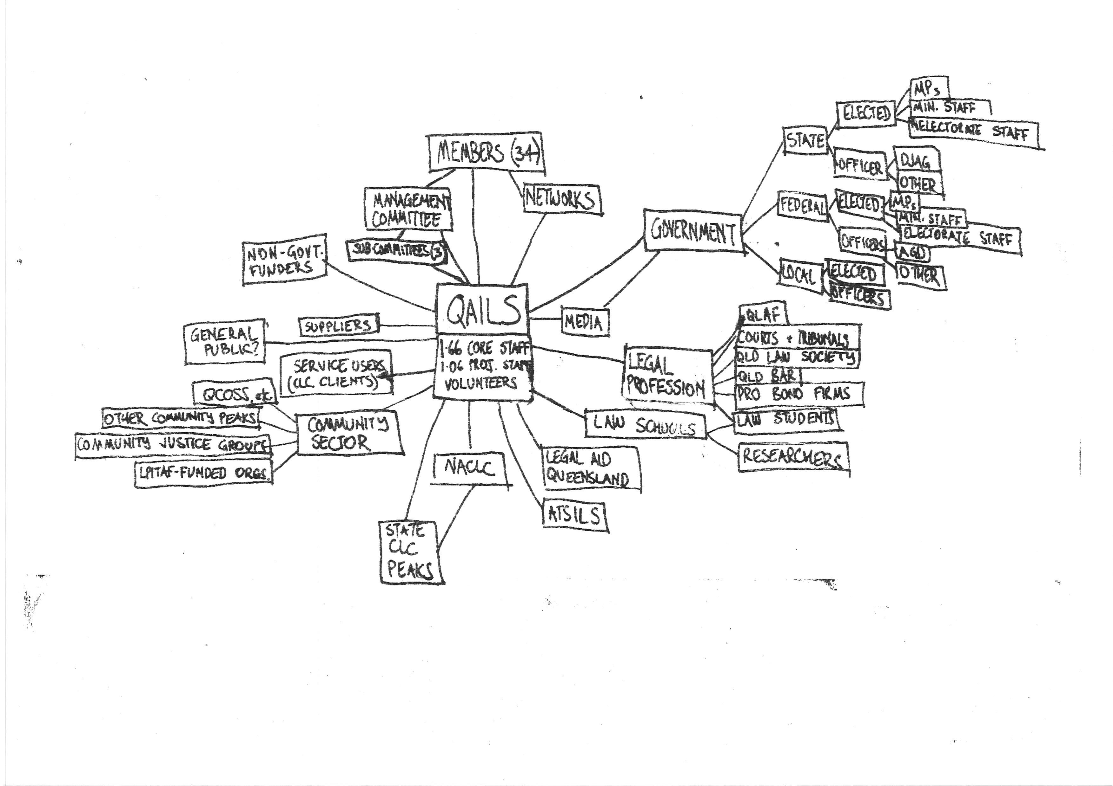

Slide 6
Sector funding issues
Domestic violence services
  Commonwealth: Keeping Women Safe
  State: DV Duty Lawyers
Additional NPA funding (Cth)
STARS
EDOs
No state funding increases

Slide 7
Current law reform activities
Human Rights Act
Anti-Discrimination Act Review
Child Protection Act Review
Domestic and Family Violence Prevention Strategy

Slide 8
QAILS rebrand

Slide 9
Accreditation changes
Outcome of accreditation is just “Accredited” or “Not accredited”
Requirements to be made either primary or secondary
Standards will be redrafted
  Aboriginal and Torres Strait Islander Cultural Safety requirements
  CALD requirements
No change to Evidence indicators for each
requirement

Slide 10
Accreditation changes
Client interviews will not ordinarily be conducted.
Client file reviews will not ordinarily be undertaken.
New requirement to successfully complete annual PII crosscheck
Adopt timetable adopted

Slide 11
Accreditation changes
Complaints:
  about the state RAC → QAILS Director
  about the NAS Coordinator → NACLC CEO
  About certification decision: TBC
Information will continue to be shared with funders (where they fund the NAS)
  Red-flag information will be shared immediately
    Fraud, misappropriation, trading while insolvent,
    other serious criminal offences

