Slide 1
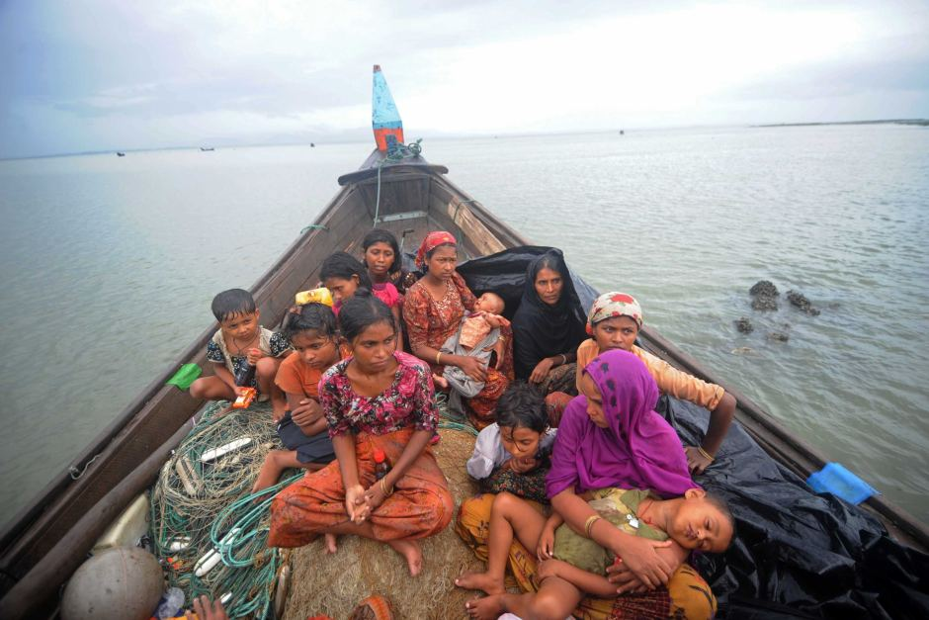
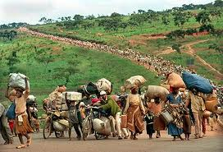

QPASTT & RAILS
Queensland Program of Assistance to Survivors of Torture and Trauma and
Refugee and Immigration Legal Service
Introduction to the Refugee Experience: the Impact of Trauma

Slide 2
Session Outline
Overview
Definitions and Important Terms
Understanding The Refugee Experience
Australia’s Humanitarian Program
Impact Of Torture And Trauma
The Settlement Process: Impact On Survivors Of Torture And Trauma
Effects Of Trauma
The Incidental Counsellor
© FASSTT

Slide 3
QPASTT
QPASTT was established in 1995 to provide a community-based response to the needs of refugees in Queensland
The service was developed in consultation with key communities and is part of a National Forum of Services for Survivors of Torture and Trauma (eight services nationally)
It is a state-wide specialised service which aims to provide a range of flexible and culturally sensitive services to people who have been tortured, or who have suffered refugee related trauma, prior to migrating to Australia
QPASTT main office is in Brisbane. We also service Toowoomba, Gatton, Logan, Gold Coast, Inala, Goodna, Ipswich, Townsville, Rockhampton and Cairns.
More information about QPASTT and it’s various services see www.qpastt.org.au
© FASSTT
Notes:
The Queensland Program of Assistance to Survivors of Torture and Trauma was established to address the unique needs of people who have survived the physical and psychological violence of war. While fear does not end nor does trauma necessarily disappear with arrival in a safe country, the provision of sensitive services can enable individuals to recover and rebuild their lives. QPASTT is non-denominational, politically neutral and non-aligned. Our services are free and confidential.

Slide 4
RAILS
1980 South Brisbane Legal Service
1990 South Brisbane Immigration and Community Legal Service
2005 Refugee and Immigration Legal Service
What RAILS Does
Specialises in refugee and immigration law
Advises and assists highest need clients before DIBP, Migration Review Tribunal, Refugee Review Tribunal and Federal courts.
© FASSTT

Slide 5
A Refugee Is…
‘Owing to a well-founded fear of being persecuted for reasons of race, religion, nationality, membership of a particular social group or political opinion, is outside the country of his nationality and is unable or, owing in such fear, is unwilling to avail himself of the protection of that country.’
(UNHCR, 1951)
‘…includes individuals recognized under the 1951 Convention relating to the Status of Refugees and its 1967 Protocol, persons recognized under the 1969 Organization of African Unity (OAU) Convention Governing the Specific Aspects of Refugee Problems in Africa, those recognized in accordance with the UNHCR Statute, individuals granted complementary form of protection, and those enjoying temporary protection. The refugee category also includes persons in a refugee-like situation.’
(UNCR, 2014)
© FASSTT
Notes:
People who flee their country for fear of being persecuted for reasons
of race, religion, nationality, political opinion or social group are deemed
refugees by United Nations High Commission for Refugees (UNHCR).
The international protection of refugees was a mandate given to UNHCR by the General Assembly of the United Nations.
The most important parts of the above refugee definition are:
Refugees have to be outside their country of origin
The reason for their flight has to be a fear of persecution
The fear of persecution has to be well-founded
The persecution has to result from one or more of the 5 grounds listed in the definition, that is race, religion, nationality, membership of a particular social group, or political opinion
They have to be unwilling or unable to seek the protection of their country
“Refugees flee the violence of war or direct persecution. Such persecution can take many forms including torture, imprisonment and the denial of the right to express one’s religious and cultural identity. Persecution and violence occurs by or with the complicity of authorities. Many of Australian’s refugee and humanitarian entrants also spend considerable periods in the harsh conditions of refugee camps in countries of asylum before being accepted for permanent residence in Australia.” (from The Darkness to the Light)
Australia is signatory to the convention since 1973

Slide 6
An Asylum Seeker Is…
‘…are individuals who have sought international protection and whose claims for refugee status have not yet been determined.
(UNCR, 2014)
‘…a person who has fled from his or her country and seeks legal and physical protection (asylum) as a refugee in another country’.
(Racism No Way, 2015)
© FASSTT
Notes:
It is a human right to seek asylum.
Every person who got the refugee status was and asylum seeker before but not all asylum seekers will become refugees because their claims might not be consider appropriate.
If you want to can talk about different types of asylum seekers such us:
In Immigration detention Centres
Living in the community
On a bridging visa.
In Australia, people might come by plane or by boat to seek asylum.
Those who come by plane may come with a tourist, student or business visa and seek asylum once they are here.

Slide 7
Migrants, Refugees And Asylum Seekers –
What’s The Difference?
Migrants | Refugees | Asylum Seekers
Choose their new country and find out all they can about it before they leave Plan their move carefully in advance Take time to get their passport and visa ready Pack all their belongings up and organize for everything to be sent to their new home Say goodbye to friends and family Leave a forwarding address Can go home if things don’t work out in their new country | Take the quickest way out of their country, often not knowing where they will finish up Leave hastily, often to escape from midnight raids and soldiers with guns Leave secretly, often not daring to advertise their intention of leaving by arranging travel documents Leave with whatever they can carry, often no more than the clothes on their back Often cannot tell anyone that they are leaving for fear that family or friends will be tortured to reveal the information Often dare not to get in touch with anyone in case they are suspected of having the same beliefs and tortured Will probably be very difficult to go back home once they settle | Many take the quickest way out of their country often not knowing where they will finish up. Others have a bit more time to plan and arrive on holiday or student visas and then seek asylum. Many leave quickly escaping persecution and/or war zones. Some have more time and can plan their departure. Many leave with whatever they can carry, often no more than their clothes and often without documents. Often cannot tell anyone that they are leaving for fear that family or friends will be tortured to get them to reveal information. Often dare not get in touch with anyone back home in case their families are suspected of having the same beliefs and tortured. Will probably never be able to go back home.
© FASSTT

Slide 8
Worldwide Statistics
Mid-2014 figures of persons of concern worldwide for UNHCR was 46.3 million, compared to 42.9 million at the end of 2013.
Who | 2013 Figures | Change | 2014 Figures
Refugees | 11.1 mil. | ↑ 2.1 mil | 13 mil.
Applications for Asylum | 456,000 | ↑ 102,600 | 558,600
People who were repatriated during the first half of the year | 33,700 | ↑ 4,300 | 37,000
Internally Displaced Persons (IDPs) | 20.8 mil. | ↑ 5.2 mil | 26 mil.
IDPs who returned to their place of origin during the first half of the year | 189,300 | ↓ 82,300 | 107,000
Stateless persons | 3.5 mil | → | 3.5 mil.
Other Concerns | 1.4 mil
(UNCR, 2013 & 2014)
Notes:
This is the first time that UNHCR (United Nation High Commision for Refugees) prepare a report for mid of the year.
The combination of refugees and IDPs constitude some 83 per cent of the total population of concern recorded at mid-2013 If people are interested in reading more about it I added the link at the end as bibliography the report is called: UNHCR Mdi-Year Trends 2013- This is also a very good article to read if you would like to have a better understanding of what it is happening around the world in relation to this issue.
To be stateless is to be without nationality or citizenship. There is no legal bond of nationality between the state and the individual. A well know example is Palestinian people. To read more about it you can go here: http://www.unhcr.org/pages/49c3646c158.html

Slide 9
Australia’s Humanitarian Program
Australia's Humanitarian Program has two components:
  Offshore resettlement for people in humanitarian need overseas; and
  Onshore protection for those people already in Australia who engage Australia’s protection requirements under the United Nations 1951 Refugee Convention.
Each year the government sets the number of visas that may be
granted under the programme.
The 2014-15 programme has 13 750 places comprising:
  a minimum of 11 000 places offshore (including up to 1000 places for women at risk), and
  the balance of places for permanent Protection visas granted onshore, for people who have arrived in Australia legally.
In 2013–14, 13 768 visas were granted under Australia’s Humanitarian Program. Of these, 47.2% were Refugee visas and 32.8% were visas granted under the Special Humanitarian Program (SHP). The remaining 20% were Protection visas and other visas granted onshore.
The composition of the humanitarian program is constantly changing
(Australian Government, Department of Immigration and Border Protection, 2015)
Notes:
The offshore component of the Refugee and Humanitarian Program has two categories.The Refugee category for people subject to persecution in their home country.The Special Humanitarian Program (SHP) category for people who, while not being refugees, are subject to substantial discrimination amounting to a gross violation of their human rights in their home country.◦People who wish to be considered for an SHP visa must be living outside their home country and be proposed for entry by an Australian citizen, permanent resident, eligible New Zealand citizen, or an organisation operating in Australia.These categories go beyond our international obligations and have been introduced to enhance our assistance to those in need.
Onshore seeking asylum once in Australia: To be granted a Protection visa (subclass 866) you will need to be found to engage Australia protection obligations because you either: are a refugee as defined by the Refugees Convention meet the Complementary Protection criteria in the Australian Migration Act 1958.You might also be eligible for a Protection visa if you are the family member of a person found to engage Australia's protection obligations.You and any eligible family members included in the application must be in Australia when you apply for this visa.The Protection visa (subclass 866) is a permanent visa.

Slide 10
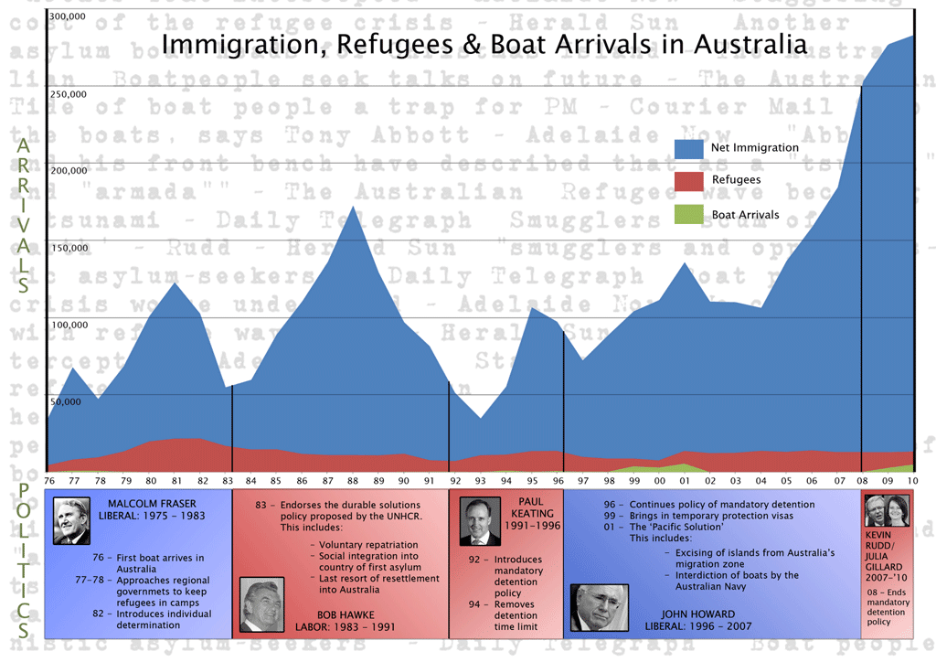
Australia’s Arrival Numbers
Notes:
This is an old slide- came out in 2010 but it is an useful slide to look into the numbers of migrants regularly coming to Australia in comparison with the number of people from refugee backgrounds and asylum seekers.

Slide 11
Numbers of people seeking Asylum in Australia
 | Total | Queensland
Held Detention (IMA) | 1648 | 77
Community Detention (IMA) | 2091 | 424
In Community on a Bridging Visa | 25,569 | 3070
On shore claims (13/14) (non IMA) | 9646 annual claims | -
© FASSTT

Slide 12
Two new visas being introduced by the current government
TPVs (Temporary protection visa holders)
SHEVs (Safe Haven Enterprise Visa holders)
For both Visas:
can’t bring family members or apply for citizenship
Can’t go to home country and can only travel to other countries if Minister agrees
Can’t get settlement services unless relevant minister allows
Can work, study and get Medicare
Can get social security – special benefits, rent assistance, family and maternity allowance
School age children get education
Must tell immigration if change address
© FASSTT

Slide 13
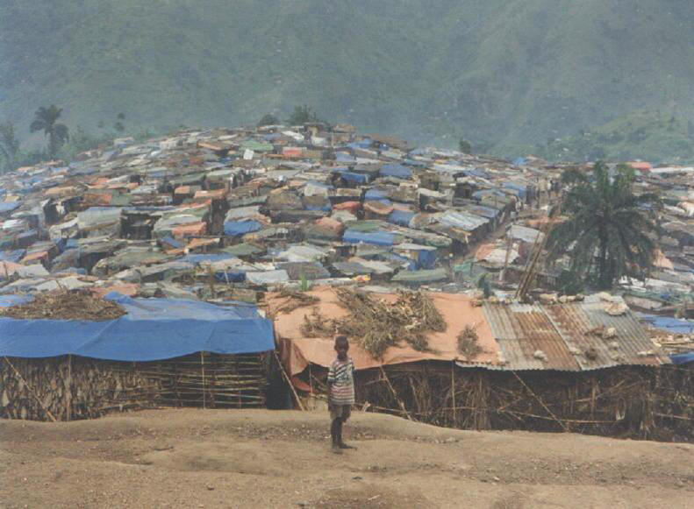
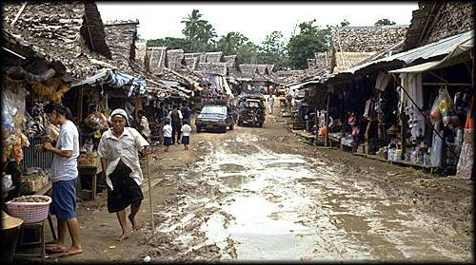
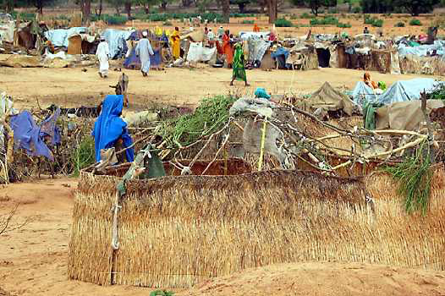
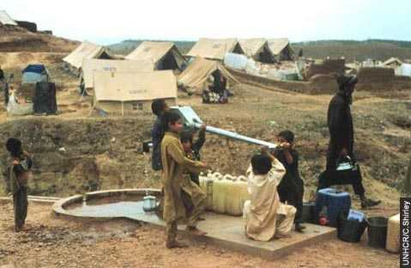
DVD
Welcome to Kakuma
Notes:
Kakuma is a refugee camp in Kenya. This DVD was done in 2002 however this refugee camp continues to exist. Centre for Refugee Research- Dr Eileen Pittaway.
A lot of people from refugee backgrounds live in urban areas not everyone live in camps – Egypt example
Please be sure that you have an understanding of what Rohingya people has been through just in you are asked.

Slide 14
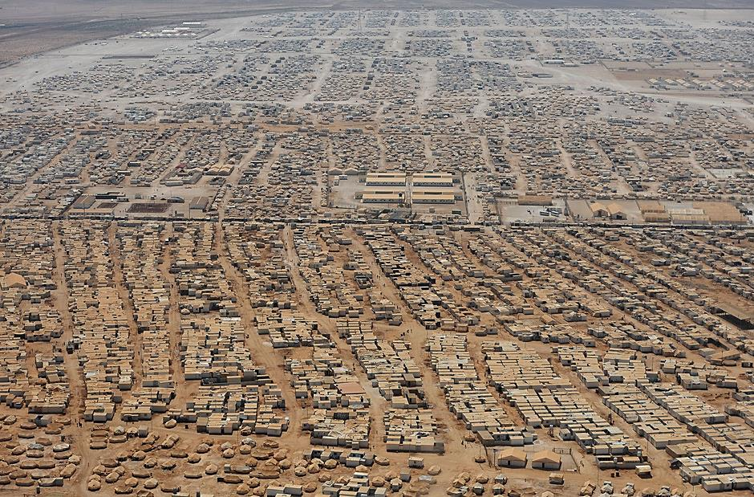
Ariel View Of Zaatari Refugee Camp In Jordan
(National Post Paper- 19.7.2013)
Notes:
Zaatari refugee camp is in Jordan. Hosting more than 115.000 people
The flow of people seeking asylum at times is about 4000 arriving a day
This photo and the information are taken from an article from National Post from 19.7.2013

Slide 15
Torture - The Legal Definition
Torture is defined by Article 1 of the United Nations Convention Against Torture and Cruel or Degrading Treatment as:
“… any act by which severe pain or suffering, whether physical or mental, is intentionally inflicted on a person for such purposes as obtaining from him or a third person information or a confession, punishing him for an act he or a third person committed or is suspected of having committed, or intimidating or coercing him or a third person, or for any reason based on discrimination of any kind, when such pain or suffering is inflicted by or at the instigation of or with the consent or acquiescence of a public official or other person acting in an official capacity.”

Slide 16
Torture
Torture can range from an act that is humiliating to the most extreme brutality.
The intention is to maim the victim psychologically and physically and instill terror in the victim, their family and wider community.
Need not be inflicted directly on victim – can include threats and being forced to witness.
It can be both random and impersonal and/or targeted and personal.
Used politically as a weapon of social control.
The psychological damage comes from being utterly helpless in the total control of someone whose intention is to cause you the greatest possible harm.
© FASSTT
Notes:
Clients have been severely controlled – we can help by allowing clients to make their own choices.

Slide 17
Trauma
‘Trauma’ is derived from the Greek word meaning ‘wound’.
“Traumatic event is used to refer to an event that has actually resulted in psychic injury and trauma will be used to refer to the psychic injury itself” (Australian Centre for Posttraumatic Mental Health)
The person was exposed to: death, threatened death, actual or threatened serious injury, or actual or threatened sexual violence, as follows (DSM-V):
    Direct exposure
    Witnessing, in person
    Indirectly, by learning that a close relative or close friend was exposed to trauma. If the event involved actual or threatened death, it must have been violent or accidental.
    Repeated or extreme indirect exposure to aversive details of the event(s), usually in the course of professional duties (e.g., first responders, collecting body parts; professionals repeatedly exposed to details of child abuse). This does not include indirect non-professional exposure through electronic media, television, movies or pictures.
“…an event is traumatic if it is extremely upsetting and at least temporarily overwhelms the individual’s internal resources” (Briere & Scott, 2006)
© FASSTT
Notes:
The above definitions of trauma highlight some of the key features commonly associated with this concept:
there is an experience of physical and/or psychological harm (wound or injury);
this harm provokes an intense response (such as fear, helplessness or horror); and
this experience is overwhelming to a person’s coping abilities.

Slide 18
Traumatic Events Characteristic Of The Refugee Experience
Witnessing death squads
Witnessing mass murder
Torture
Disappearances
Forced marches
Extreme deprivation – poverty, unsanitary conditions, lack of access to health care
Persistent and long-term political repression, deprivation of human rights and harassment
Removal of shelter, forced displacement from home
Perilous flight or escape
Separation from family members
Refugee camp experiences – prolonged squalor, malnutrition, lack of protection
Deprivation of education and for children, deprivation of the opportunity to play
© FASSTT
Notes:
Torture is the intentional infliction of severe mental or physical pain or suffering by or with the consent of the state authorities for a specific purpose. The aim of torture is to break down the victim's personality and is often used to punish, obtain information or a confession, take revenge on a person or create terror and fear within a population.
Torture is distinguished from other forms of ill-treatment by the severe degree of suffering involved. It encompasses many forms of suffering, both physical and psychological, which are remarkably similar worldwide. Most techniques seek to prolong the victims' pain and fear for as long as possible without leaving visible evidence.
Some of the most common methods of physical torture include beating, electric shocks, stretching, submersion, suffocation, burns, rape and sexual assault.
It is important not to forget about psychological forms of ill-treatment which very often have the most long-lasting consequences for victims. Common methods of psychological torture include: isolation, threats, humiliation, mock executions, mock amputations, and witnessing the torture of others.

Slide 19
Trauma
Trauma is the result of an uncontrollable, inescapable, unpredictable, overwhelming life threatening event.
Trauma can result from direct experience of an event to witnessing or hearing about an event.
In the general population abut 10% go on to develop severe pervasive symptoms from exposure to trauma. This percentage is much higher in the refugee population.
Refugee trauma results in profound discontinuity and loss in all spheres of life
(complex trauma – prolonged events rather than single event)
© FASSTT
Notes:
Looking at the difference between one off traumatic events and prolonged trauma over life / at key developmental stages.
Worse when perpetrated by other human beings.
Most people recover from single incident trauma – it’s the repeated nature of trauma that is significant. People become hyper-vigilant, internalise anxiety, on alert for threat, feel unsafe and don’t trust easily

Slide 20
Complex Trauma
“In many cases… sustained and/or repeated traumatic events are of human design, intended to leave the victim fearing, and feeling helpless to prevent recurrence.”
    E.g. Childhood physical or sexual abuse, domestic violence, incarceration as a prisoner of war, torture and the refugee experience.
Where adults (and young people) have developed PTSD and associated features following exposure to prolonged and/or severe traumatic events, we need to provide more time to establish a trusting therapeutic alliance (relationship), more attention to teaching emotional regulation skills, and a gradual approach to exposure therapy may be required.
(Australian Centre for Post-Traumatic Mental Health)
Notes:
The experience of refugee-related trauma is often considered “complex trauma” (Herman). The two key features of complex trauma is that it is:
sustained and repeated (prolonging the sense of helplessness and fear as well as potentially reducing the capacity of the individual to recovery from individual events);
and of human design (which potentially disrupts a person’s view of human nature and trust in others). (Australian Centre for Post-Traumatic Mental Health)
Based on this understanding of complex trauma, it is recommended that in working towards recovery a gradual, gentle approach is used with a focus on building a trusting therapeutic relationship and the development of skills to manage the emotional impacts of the experience of trauma (The Australian Centre for Post-Traumatic Mental Health).
The fact that the trauma is sustained/repeated means that the person/community has less capacity to rebound from the events and particularly in the case of children to form a positive and integrated sense of self – or to build or utilise coping strategies
It is important to understand that most people from refugee backgrounds are extremely resilient and stoic when it comes to hardships which we may consider traumatic. Many people from refugee backgrounds have endured a lifetime of what we might see as extreme hardship and suffering; therefore it is very important to help them to reconnect with those strengths that might be forgotten or they might believe that are not applicable in the new environment.
Conversely, situations which would not concern us in our culture may actually be traumatic for those from another culture and socio-political history. For example, a letter sent from a school to a Congolese family stating that their son has been identified as needing counselling following the floods may actually result in feeling of high anxiety and trauma for the parents. Or phone calls from people that they don’t actually understand who they are and they might get worried that there could be something wrong.
The fact that the trauma is of human design potentially impacts of the individual’s capacity to maintain a positive view of human nature and thus this colours relatedness to others.

Slide 21
Signs To Look For
These Can Be Observed Or Disclosed
Sleeping problems
Headaches
Stomach aches or other bodily pains
Reluctance to talk about past experiences
Becoming very demanding
Stealing or hoarding of food, books or clothing
Eating too little or too much/fussy eating
Increased or decreased weight
Aggressive behaviour
Excessive shyness or avoiding other people
Overly protective of children
Irritability or outbursts of anger
© FASSTT

Slide 22
Signs To Look For Cont
These Can Be Observed Or Disclosed
Accident-prone
Evidence of self-harm, such as scarring
Expressing hopelessness or guilt
Excessive tiredness
Appearing very sad
Poor memory or poor concentration (or “vaguing out”)
Becoming easily upset
Nightmares
Appearing fearful
Appearing very tense
Shortness of breath, or rapid breathing or heart rate when not exercising
© FASSTT

Slide 23
Additional possible presentations for Children
These Can Be Observed/Disclosed By The Child Or Their Parent / Carer
Clumsiness
Irritability
In play, acting out bad experiences (including drawing them)
Acting younger or older than
their age
Not attending school
‘Bedwetting
‘Clinginess’ to parents or teachers
Very distressed when separated from parents
Overly protective of parents
Tantrums
Daydreaming
© FASSTT
Notes:
23

Slide 24
Key Issues Encountered With This Client Group
Normal reactions to abnormal circumstances
The majority of clients seen at QPASTT have experienced:
    Some form of state sanctioned violence (torture) and/or trauma
    Long periods of displacement in harsh conditions with limited access to basic services
    Cultural adjustment on arrival, which can be equally traumatic
    Challenges of settlement
    New & confusing systems
    Complex Trauma
    Post Traumatic Stress Disorder (PTSD)
    Grief and Loss
  Asylum seekers/refugees can experience strong fear reactions that may compromise ability to communicate. This condition can continue for years.
  Refugees often fear authority and may not trust officials or lawyers.
© FASSTT

Slide 25
Additional Challenges faced during settlement
Differences between the culture of the refugee and the host culture
Loss of possessions, loss of employment (status), loss of family, loss of culture, loss of country, without a sense of belonging
Lack of family or other social support & changes in family dynamics
Difficult living conditions (e.g. housing, poverty, feeling unsafe, difficulty communicating in new language)
Continued worries concerning family members left behind
Discrimination by the host community against refugees
Ongoing feeling of being different
NSW Service for the Treatment and Rehabilitation of Torture and Trauma Survivors (STARTTS)
Notes:
People cope the best way they know how. Ask yourself: how is this symptom or behaviour serving this client to protect him/herself? Eg People may shut down (dissociation), avoid triggers, hyper-arousal because of chronic internalised anxiety – always on alert. May be expressed as agitation or irritability.

Slide 26
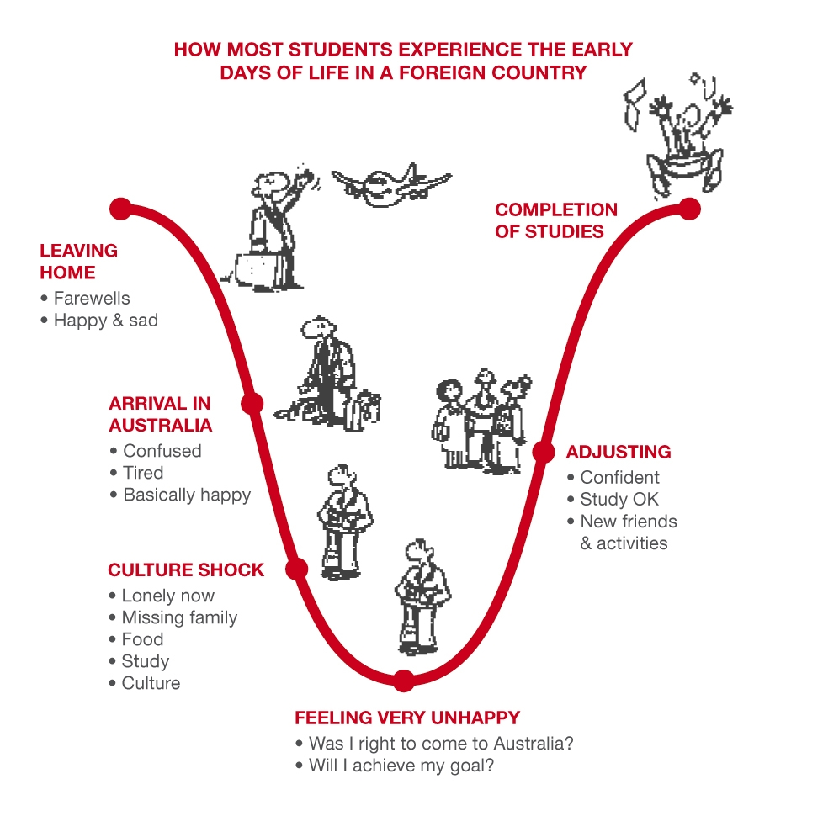
U-Curve Of Adjustment
Confident and Happy
Nervous
Excited
Happy
Sad
Relief
Confused
Tired
Still happy
Adventurous
Work/ Study, friends, activities, things going better
Lonely
New Food, language,
Culture, environment
Trying to make friends
Looking for home
Feeling miserable
Was I right to come to Australia?
Does anybody like me?
Do I belong?
© FASSTT

Slide 27
Impacts To Consider
Life
Migration and
Settlement
Trauma
© FASSTT
Notes:
When working with an individual, family or community from a refugee background it is important to consider the interplay of all the aspects of their experiences. This includes a consideration of those issues that are common to the human condition which may consist of births, deaths, partnership/marriage, education, work, leisure, caring for children/elderly parents, school, illness, friendships and developmental milestones.
For those from a refugee background there are additional and extremely significant components which also impact on their identity, capacities, values, world view and relationships to others. This involves a consideration of the impacts of specific experiences of refugee related torture and/or trauma and the process of settlement in Australia. It is within this rich and complex context that the additional experience of a natural disaster occurs and that the specific meaning of such an event for an individual will formulate. These interlocking components will potentially have varying importance and priority at different times of a person’s life trajectory. For instance, it is common that during the time of early arrival in Australia, the issues of resettlement are most figural while the person’s ability to focus on the resolving impacts of past trauma may be prioritised. When the stressors of settlement subside somewhat when there is increased comfort with the new culture and its processes and institutions, this may allow the sense of safety essential for the consideration of the impacts of past trauma. Additionally, the different components of life experience interact. The birth of a child while celebrated may also act as a reminder of separation from extended family due to past trauma and/or the process of resettlement away from a person’s country of origin. These overlapping components remind us of the importance of recognising the complexity of human existence as well as the necessity of allowing the person, family and/or community to identify their priorities and needs.

Slide 28
Violence and persecution
Social & Psychological Effects
Core Components of the Trauma Reaction
Life threat
Killings, assaults
Threats of harm to family, friends
Poor nutrition
Chronic fear and alarm
Anxiety
Feelings of
helplessness
Loss of control
Loss
Death
Separation
Isolation, dislocation
Disruption of connections to family, friends, community, and cultural beliefs
Relationships changed
Grief
Depression
Exposure to boundless human brutality on mass scale
Destruction of central values of human existence
Shattering of previously held assumptions:
Loss of trust
Meaning, identity & future
Value transgression
Invasion of personal boundaries
Impossible choices
Humiliation
and
Degradation
Guilt
Shame
© FASSTT
Notes:
The framework presented here represents the way in which the violence and persecution common to the refugee experience (in the left hand column) leads to particular social and psychological effects. It is these social and psychological effects that have the potential to have serious impacts on a person’s sense of self, connections to others and on their world view.
The experience of refugee-related trauma is often considered “complex trauma” (Herman). The two key features of complex trauma is that it is:
sustained and repeated (prolonging the sense of helplessness and fear as well as potentially reducing the capacity of the individual to recovery from individual events);
and of human design (which potentially disrupts a person’s view of human nature and trust in others). (Australian Centre for Post-Traumatic Mental Health)
Based on this understanding of complex trauma, it is recommended that in working towards recovery a gradual, gentle approach is used with a focus on building a trusting therapeutic relationship and the development of skills to manage the emotional impacts of the experience of trauma (The Australian Centre for Post-Traumatic Mental Health).
The four Core Components of the Trauma Reaction model was developed by Dr Ida Kaplin of the Victorian Foundation for Survivors of Torture and Trauma. It serves as a useful tool for working with refugee survivors of torture and trauma.
Anxiety, feelings of helplessness and loss of control. This component often manifests in symptoms such as those defined in a diagnosis of Post Traumatic Stress Disorder. As such it may include sleep difficulties, nightmares, flashbacks, panic attacks, hypervigilence (scanning the environment for threat), heightened startle response, avoidance of situations which are reminders of traumatic events, irritability, reduced concentration, memory lapses. The chronic feelings of fear and anxiety may also manifest in physical symptoms such as undiagnosed pains and reduced immune responsiveness.
Relationships changed, grief and depression. This highlights the overwhelming loss of connections: to family friends, culture etc, as well as the potential loss of a positive view of human nature. It is this loss of connection which can lead to a loss of enjoyment in life and hopefulness about the future.
Shattering of previously held assumptions, loss of trust, meaning, identity and future. This component reflects the overwhelming disruption to the individual’s beliefs and values about the world, justice and meaning in the world, e.g. the survivor may no longer believe the world to be a benevolent and safe place.
Guilt and Shame: It is common for survivors of trauma to feel guilt, shame and humiliation. This relates to the survivor’s belief that they may in someway be to blame for their experiences which is potentially an internalisation of the meaning conveyed by the actions of the perpetrator/s. It may also be a response to the feelings of helplessness and a wish that the survivor may somehow have been able to respond or act differently or prevent the situation. (adapted from The Need for Understanding)

Slide 29
The Four Recovery Goals
CORE COMPONENTS OF THE TRAUMA REACTION
THE RECOVERY GOALS
Anxiety
Feelings of helplessness
Perceived loss of control
To restore safety, enhance control
and reduce the disabling effects of fear and anxiety
Relationships changed
Capacity for intimacy altered
Grief
Depression
To restore attachment and
connections to other human
beings who can offer emotional
support and care
Shattering of previously held assumptions:
loss of trust
meaning & identity destroyed
view of the future altered
To restore meaning and
purpose to life
Guilt
Shame
To restore dignity and value which
includes reducing excessive
shame and guilt
© FASSTT

Slide 30

Strategies for Working with People From Refugee Backgrounds
Helplessness and isolation are the core experiences of psychological trauma
Empowerment and reconnection are the core experiences of recovery
© FASSTT

Slide 31
Strategies for Working with People From Refugee Backgrounds
Important principles: reliability, predictability, honesty, empathy
Be open and curious, adopt a learning perspective to new cultures, embrace difference acknowledging the positive impact this has on our society
Assess each situation and person – explore
Listen attentively
Encourage the use of interpreters
Be respectful of cultural practices
Be as consistent as possible, say things you know you can commit to
Dress appropriately
Recognize client strengths and encourage them to build on these
© FASSTT

Slide 32
Strategies for Working with Survivors of Torture and Trauma
Be open, adopt a learning perspective to new cultures, embrace difference acknowledging the positive impact this has on our society
Assess each situation and person – explore
Research to build your knowledge of country of origin
Give examples to assist to normalise situations
Attentively listen
Use interpreters to listen to client’s needs
Have a welcoming and warm environment
Be as consistent as possible, say things you know you can commit to
Dress appropriately
Recognise client strengths and encourage them
Discourage violence and inappropriate behaviour
Help identify symptoms and help others to understand
© FASSTT
Notes:
Principles of giving accurate information, setting realistic goals, creating a safe environment – this is the same in the context of a supportive relationship (counselling or case/support work).

Slide 33
More Strategies …
Ensure confidentiality
Negotiate times and stick to them
Provide options and choice wherever possible to promote self determination
When organising activities be sensitive to environment, food, clothing and interactions
Be sensitive to competing needs and people’s own priorities and need for their own time
Create spaces where clients can help each other and encourage this
Refer appropriately in a supportive and containing way
Encourage people to defend their rights and speak out for themselves
© FASSTT
Notes:
“A little over a long time” – consistency, spelling name correctly, respecting time, calling when you say you will, apologising where there has been a wait.

Slide 34
Incidental Counselling Skills
Maintain respect
Remain calm
Acknowledge his or her feelings
Allow the individual to talk
Show you are willing to help
Speak slowly and clearly
Do not take comments personally
Offer refreshments
Use open ended questions
Try to be honest - don’t make promises you can’t keep or give false hope
© FASSTT

Slide 35
Tips for Active Listening
Face the person and stand or sit still, don’t fidget or look distracted
Focus your attention on them (awareness of your own thoughts)
Keep an open mind, don’t pass judgement
Ask questions to clarify and make sure you understand
Pay attention to their non-verbal cues such as body language and tone of voice
Learn to be comfortable with silence and pauses – allow the person time to gather their thoughts
Don’t try to change the subject or talk about yourself
Don’t speak over the top of the person
Think before giving advice
Adapted from Australian Institute of Professional Counsellors (2010). Principles of Active Listening. www.aipc.net.au
Notes:
Be aware of what happens for you when you listen – can’t stop your mind, there is no right or wrong, the importance is awareness – of generalisations / stereotypes – not just your ears, your mind is always at play.

Slide 36
Managing Challenging Behaviours
Accept that everyone has the right to feel angry, if you become defensive you may escalate the person’s anger.
Acknowledge and accept the full verbal expression of the aggressive feelings. Move on to finding out why the person is feeling this way. Just because the person is directing their anger at you does not mean you are the cause of their anger.
Talk to the person about what leads to aggressive feelings. If the person is yelling, it is better to speak in a normal volume or even softly. The person may stop yelling in order to hear what you are saying. Take control -don’t yell back.
© FASSTT
Notes:
Trust your gut – if you feel unsafe, remove yourself from the situation.
Aggressive behaviour allows a survivor to feel powerful for a little bit, rather than continually helpless.
Impact of sleep deprivation – many of our clients are sleep deprived. When awake, exhausted and constantly checking their environment for threat – like a duck on the lake where it looks clam on top but paddling furiously underneath. Getting through each day is an effort.
Understanding this client group – what triggers can we avoid? Waiting times, unknown people, noisy waiting rooms, no interpreter, etc.

Slide 37
Managing Challenging Behaviours cont.
Let the client talk – avoid interrupting.
Don't defend the situation that the person is angry about. This can be especially difficult if the person is attacking you.
Avoid confrontation - it may be worth just leaving it alone until the person cools down.
Avoid backing the person into a corner, either physically or emotionally. Often people will abandon aggression if there is a way out.
Stick with one message, eg., “phone the police”, or “please stop yelling”.
© FASSTT
Notes:
Just because the behaviour may have a cultural origin (eg., yelling, threatening to get needs met) that doesn’t mean it’s right or OK.

Slide 38
The Incidental Trauma Counsellor:
Respectful Responses to Disclosures of Trauma
© FASSTT
Remind client that they only need to share if they feel safe to do so, i.e. if they do not feel emotionally overwhelmed and/or there are not other more pressing matters.
Honour story by listening intently and remaining authentic
Normalise common reactions to trauma, e.g. powerlessness, helplessness, guilt and shame
Acknowledge pain, loss, and horror
Talk about trauma in the past tense
Watch for signs of dissociation (glazed eyes, pale, distant, trailing speech) or panic (shaking, sweating, pressured speech) – slow down and return to the present
Bring client back to present (grounding activities) and remind of survival
Sit with silence and tears (except if dissociating - ground)
Curb own curiosity – allow for gaps in story and for client to stop telling story
Notes:
Move to word document
It is possible that the re-trigger of past trauma by the experience of a natural disaster will lead some clients to disclose past trauma to you even if this is not the usual line of work.
Reference: Babette Rothschild

Slide 39
Respectful Responses to Disclosures of Trauma
Thank them for their trust
Plan for after session, discuss the provocative nature of sharing story and encourage self-care
Check in post disclosure re: wellbeing
Use disclosure as opportunity to explore potential for further support, e.g. counselling
Practice self-care, debrief
Recognise your limitations and set boundaries
Importance of centering self (eg., notice breath, drop shoulders)
Consider timing of disclosure and the client’s safety - do you, the worker, have the emotional space or time? Is the client overwhelmed emotionally? Do they have safety in their environment? If not, stop them from proceeding further, share any concerns and make other arrangements.
© FASSTT

Slide 40
Grounding Principles
Grounding techniques used when:
  Sudden panic
  Flashbacks
  Intrusive thoughts or memories
  Highly distressed
  Focus the client’s attention on the here and now, which feels more safe and predictable.
Can be useful in crisis situations.
Be careful not to stigmatize the client by over- dramatizing the situation – remain calm.
© FASSTT

Slide 41
Basic Grounding
1. Focus the client’s attention onto yourself as opposed to internal processes.
Shift closer to the client
Speak clearly
Be careful with touch – verbal interventions are recommended.
2. Ask the client to describe/label his or her internal experience (not in detail). Keep focus on the present, not the past.
3. Orient the client to the immediate external environment. Use their name: “…….. you are here, safe in this room”
4. Focus on breathing practice, if indicated.
5. Repeat steps 2 and 3 and assess the client’s ability and willingness to continue.
John Briere PhD & Catherine Scott MD. Principles of Trauma Therapy: A Guide to Symptoms, Evaluation and Treatment. Sage Publications Inc 2006, London.
© FASSTT

Slide 42
Burnout and Vicarious Trauma
Being involved in emotionally demanding situations over a long period may cause physical, emotional and mental exhaustion known as burnout
Being exposed to another persons trauma history may cause vicarious trauma. Vicarious trauma mirrors traumatic stress. It happens suddenly and typically results in depression, despair, alienation from self/others, inability to work or inability to experience enjoyment
The extent of vicarious trauma experienced differs from person to person. This can depend on personality type, protective factors, life experience including own trauma or similar, and the appropriateness of work/life balance.
It is also possible to experience vicarious resilience – a sense of greater personal strength or courage through working with another who, against all odds, has triumphed over their circumstances.
© FASSTT
Notes:
Social support, physically well, behavioural balance (enjoyable activities), cognitive (being aware of unhelpful thoughts, intrusive memories)

Slide 43
Risk Factors for Burnout and Vicarious Trauma
Clients with traumatic histories
Experiences of personal trauma
Unrealistic expectations of self
Inability to attend to self care
Too high demands from others and/or the situation
Lack of resources and time
Lack of control over work
Lack of support and acknowledgement from higher management
© FASSTT

Slide 44
Points to Remember:
You are not an expert on every topic – you don’t need to have an answer and you don’t need to do everything.
It is best not to give advice – consider referral.
If the client presents an issue you do not wish to discuss, it’s OK to respectfully suggest a referral, e.g.., “I understand this is very important to you and I want you to have the best help available”.
Recognise your limitations and set boundaries. Don’t feel you have to step outside these because the client wants you to.
Don’t under-estimate how much you are helping the client simply by listening attentively.
Prioritise your own health and wellbeing.
© FASSTT

Slide 45
RELAXED BREATHING PRACTICE
Find somewhere comfortable and quiet to sit or lie down.
Whenever your thoughts wander, gently bring them back to your breath.
Practice this exercise for 5 to 10 minutes each day.
Breathe in and out through your nose 6 times, paying attention to how long each in-breath and
out-breath lasts.
Count the breaths as you go.
Place one hand gently on your abdomen and the other on your chest. For the next 6 breaths, breathe much more deeply. Imagine your breath flowing into, and filling, your belly first
and then rising to fill your chest. When breathing out notice the breath leaving the chest first and then the abdomen.
Next, slow the breath down again. Slowly count to 3 with each in-breath and each out-breath: in for 3, out for 3.
Do this for 6 breaths.
Adapted from Briere & Scott, 2013

Slide 46

The following symptoms, where persistent, suggest the need for a referral:
Uncontrolled or frequent crying or other extreme reactions to mildly stressful events
Sleep problems – too much or too little
Depressed mood
Fearfulness
Significantly impaired memory & concentration
Stress-related physical illness: headaches, stomach pain
Flashbacks
Nightmares
Excessive rumination or preoccupation with one idea
Excessive physiological startle response
Avoidance of triggers
PLUS these symptoms are believed to be associated with client’s experiences of torture and/or trauma
* Remember children and young people will express their distress differently
© FASSTT

Slide 47
The following symptoms, where persistent, STRONGLY suggest the need for a referral:
Fear/threats of harm to self or others
Extreme withdrawal, no emotional response
Self destructive despair
Marked agitation, irritability, aggression
Frequent re-telling or re-living of a traumatic event
Inability to take care of personal hygiene
PLUS these symptoms are believed to be associated with client’s experiences of torture and/or trauma
* Remember children and young people will express their distress differently
Referral form available on our website: www.qpastt.org.au
© FASSTT

Slide 48
Referring to QPASTT
QPASTT only works with people from refugee backgrounds who have had trauma/torture as part of their refugee experience
QPASTT works with children, young people, individual, adults and families
QPASTT does not have the capacity to work with acute mental health issues or crisis situations
Referral form available on our website: www.qpastt.org.au
© FASSTT

Slide 49
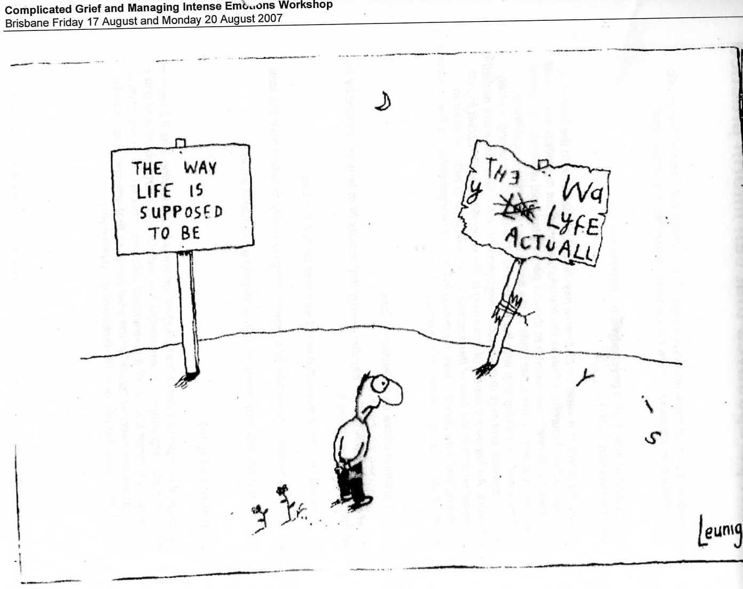
Leunig Slide
Notes:
What do people see? How might this relate to trauma as you know it?
Trauma exposes the LACK OF CONTROL and SAFETY that lies at the heart of being human. Humans ARE inherently vulnerable (although not like to think about it). Healing involves confronting lifes inherent truths and uncertainties.

Slide 50
QPASTT Contact Details
Address: 28 Dibley Street, Woolloongabba, 4102
Phone: 3391 6677
Email: admin@qpastt.org.au
Web: www.qpastt.org.au

Slide 51


Further Information
Recommended Readings:
What is the what? A novel by Dave Eggers
The Kite Runner. A novel by Khaled Hosseini
Useful websites:
Refugee Council http://www.refugeecouncil.org.au/
Department of Immigration http://www.immi.gov.au/Pages/Welcome.aspx
United Nations http://unhcr.org.au/unhcr/
FASTT Network http://www.fasstt.org.au/home/index.php
Foundation House http://www.foundationhouse.org.au/home/index.htm
STARTTS http://www.startts.org.au/
Association for Torture and Trauma Survivors http://www.asetts.org.au/
Companion House https://www.companionhouse.org.au/
Melaleuca http://www.melaleuca.org.au/
Migrant Resource Centre http://www.mrchobart.org.au/index.htm
Supporting Survivors of Torture and Trauma http://www.sttars.org.au/

Slide 52
Bibliography
American Psychiatric Association. (2013). Posttraumatic Stress Disorder. In Diagnostic and statistical manual of mental disorders (5th ed.). doi:10.1176/appi.books .9780890425596.744053
Australian Centre for Posttraumatic Mental Health (2015). Retrieved from: http://www.acpmh.unimelb.edu.au/
Australian Government, Department of Immigration and Border Protection (2015). Illegal maritime arrivals. Retrieved from: http://www.immi.gov.au/About/Pages/ima/info.aspx
Australian Government, Department of Immigration and Border Protection (2014). Australia’s Offshore Humanitarian Programme: 2013–14. Retrieved from: http://www.immi.gov.au/pub-res/Documents/statistics/australia-offshore-humanitarian-program-2013-14.pdf
Australian Government, Department of Immigration and Citizenship. (2012). Migration Legislation Amendment (Regional Processing and Other Measures) Act 2012. Retrieved from: http://www.immi.gov.au/legislation/amendments/2012/120818/lc18082012-01.htm - See more at: http://www.mindframe-media.info/for-media/reporting-mental-illness/priority-population-groups/culturally-and-linguistically-diverse-populations#sthash.b0KHKDNB.dpuf
Briere, J. & Scott, C. (2006). Principles of Trauma Therapy, A Guide To Symptoms, Evaluation and Treatment. Sage Pulbications Inc.
Foundation House (1998). Rebuilding Shattered lives. Retrieved from: http://www.foundationhouse.org.au/resources/publications_and_resources.htm
Herman, J. (1997). Trauma and Recovery. The aftermath of violence- from domestic abuse to political terror. Basic Books.
NSW Service for the Treatment and Rehabilitation of Torture and Trauma Survivors (2015). Retrieved from: http://www.startts.org.au/
Racismnoway (2015). Teaching Resources. Retrieved from: http://www.racismnoway.com.au/index.html
United Nations (1984). Convention against Torture and Other Cruel, Inhuman or Degrading Treatment or Punishment. Retrieved from: http://www.un.org/documents/ga/res/39/a39r046.htm
UNHCR (2014). Irregular Maritime Movements in South-East Asia. Retrieved from: http://www.unhcr.org/53f1c5fc9.html
UNHCR (1951). Convention and protocol relating to the status of refugees. Retrieved from: http://www.unhcr.org/3b66c2aa10.html
UNCR (2014). UNCR Mid-Year Trends 2014. Retrieved from: http://www.unhcr.org/54aa91d89.html

