Slide 2
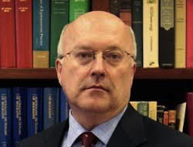
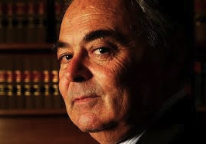
Background

Slide 3
The stories spectrum
case studies
direct testimony
community-led storytelling

Slide 4
Report in a table
Benefits | Risks | Principles | Techniques
Effective advocacy | Harm to the individual | Consent | Submissions and reports
Individual empowerment | Privileging voices | Participation | Recorded stories
Community development | Appropriating power | Collaboration | Direct testimony
Strengthening democracy | Legal risks | Campaign | Media engagement

Slide 5
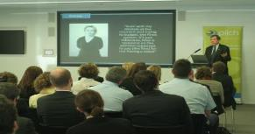
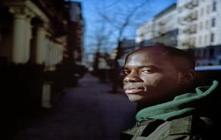
Examples
Drone Wars
House of Lords
Why is the NYPD after me?
Kan Yama Kan
In the Public Eye

