Slide 1
Working with People Who Use Drugs

Slide 2
QuIHN’s Mission
Our mission is to provide innovative health services addressing a range of drug related issues to illicit drug users and the wider community throughout Queensland.

Slide 3
QLD Injectors Health Network
Brisbane I Southport I Burleigh Heads I Townsville I Cairns I Maroochydore
Needle Syringe Program (NSP’s) – safer injecting I drug health education I vein care I safe disposal I prevention of BBV’s I HCV program
Treatment – AOD counselling I therapeutic groups I outreach I parenting & family I Significant Other Support (SOS) I Pharmacotherapy
Medical - GP’s and Nurses – fully bulk billing clinic I Acupuncture
advocacy I education I workforce development I peer support I resources I health magazine for injecting drug users
www.quihn.org

Slide 4
Harm Reduction
An approach that aims to reduce the adverse health, social and economic consequences of alcohol and other drugs by minimising or limiting the harms and hazards of drug use for both the community and the individual without necessarily eliminating use
Australian National Policy since 1985
Fundamental principle of the Queensland Illicit Drug Action Plan
In line with National Drug Strategy 2010 - 2015

Slide 5
Harm Reduction
As simple as ‘Do no harm’
Focuses on harms caused by drug use rather than the drug itself
Maximising the option for intervention
Choose appropriate, practical and achievable goals
Respect the rights of person
Accepting people’s human rights & choices

Slide 6
Harm Minimisation
Harm Reduction
Needle and Syringe Programs (NSPs)
Provision of information
Education
Maintenance programs
Demand Reduction
Individual counselling
Motivational interviewing
Relapse prevention
Drug education in schools
Supply Reduction
Interception by Customs
Seizures by Police

Slide 7
Drugs
Three main groups:
Stimulants
Depressants
Hallucinogens
Illicit: Drug prohibited by law
Includes pharmaceuticals obtained through someone else’s prescription or a dealer.
You can never know for sure what is in any certain drug.

Slide 8
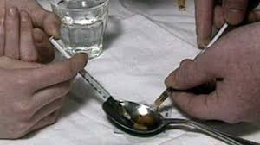
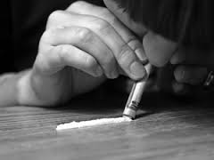
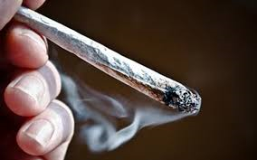
Routes of Administration
Intravenous
Intramuscular
Oral or swallowing
Inhalation
Snorting/sniffing
Shafting
Shelving

Slide 9
Stimulants
Amphetamines / Cocaine / Ecstasy / Caffeine / Nicotine
Increased heart rate
Feelings of exhilaration
Increased sexual desire
Increased energy
Reduced appetite
Rapid or irregular heartbeat
Possible dependence
Large pupils

Slide 10
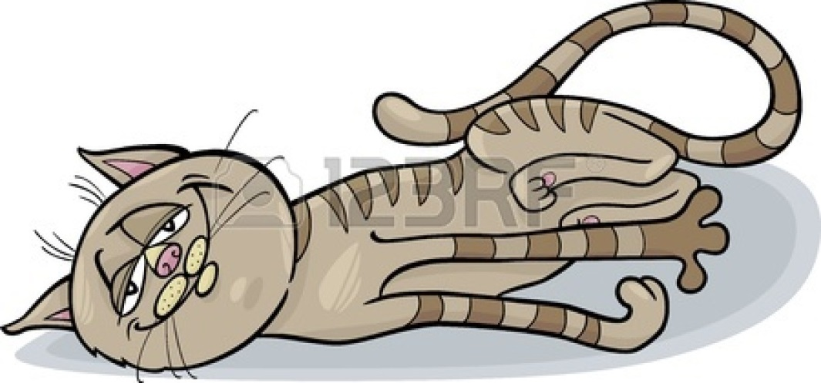
Depressants
Heroin / Cannabis / Alcohol / Morphine / Opioids / Benzodiazepines / Fentanyl / Methadone
Euphoria & wellbeing
Warm flushed skin ‘sweating’
Slowed breathing
Nausea
Relief from pain
Constricted pupils
Possible dependence
Small ‘pinned’ pupils

Slide 11
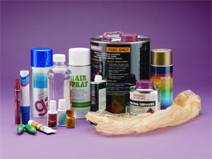
Volatile substances – Inhalants
Solvents: Petrol / spray paint / glue / cleaning products
Aerosols: Deodorant / hairspray
Gases: Butane (lighter fluid) nitrous oxide
Dazed, Dizzy, Disoriented
Feelings of exhilaration
Nervous irritated
Red glassy eyes
Excitement
Mood changes
Disconnectedness
Nausea and diarrhea
Hallucinations

Slide 12
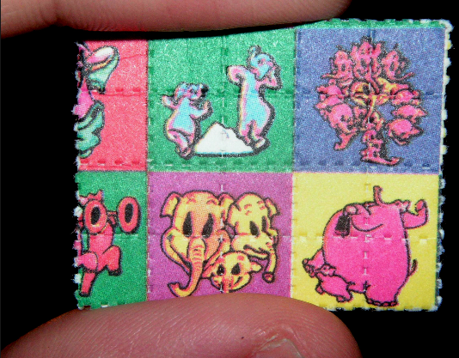
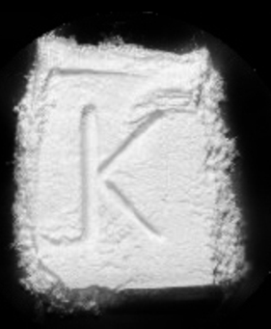
Hallucinogens
LSD (acid) / Magic mushrooms / Datura
Ketamine / PCP / Khat
LSD: Acid, Trips, Tabs, T’s, Micro dots
Ketamine: Special k, K, ket
PCP: Angel dust, dust blunt
Increased activity
Feelings of euphoria
Sweating
Distorted senses and hallucinations / Panic & paranoia
Delusions
Nausea / Rapid heart beat
Altered perception Intense thoughts Dizziness
Numbness
Feeling of bliss

Slide 13
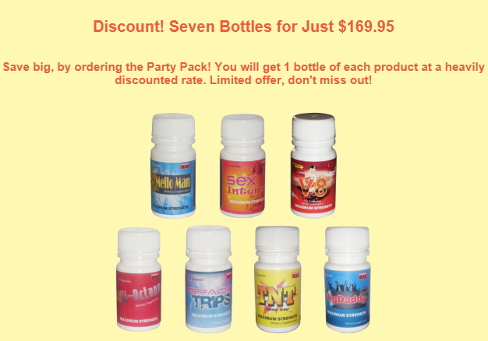
Novel Psychoactive Substances
The 3 most common types of NPS are known as:
Herbal highs or party pills
Synthetic cannabis
Research chemicals and drug analogues
-- Recently made illegal
-- Usually purchased online
-- Mimic effects of illicit drugs
(cannabis, LSD cocaine etc)
101 new NPS’s reported in 2014 alone

Slide 14
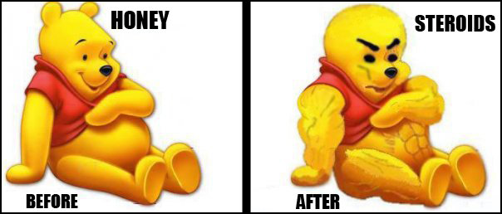
Performance & Image Enhancing Drugs
Performance and image enhancing drugs (PIEDs) are substances taken by people with the intention of improving their physical appearance and to enhance their sporting performance.
Steroids – synthetic hormones esp. testosterone
Imitate male sex hormones
Peptides - stimulate human growth hormone
Muscle & bone growth & repair

Slide 15
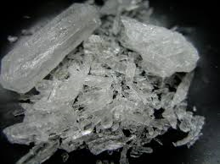
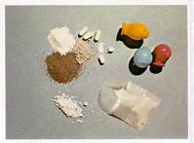
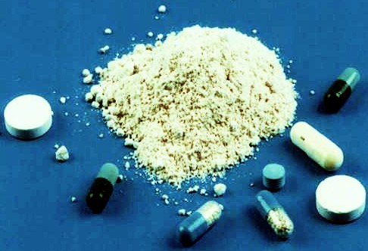
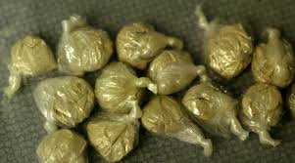
Purchasing drugs 101
Ice/crystal $100 point
Speed $50 point
(Wiz, Up town, Fast, Skates,
Meth, Tina)
Heroin $100 per quarter gram
Morphine tabs $50 to $100 100mg
(H, Gear, Downtown, Harry, Slow)

Slide 16
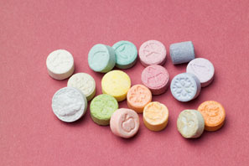
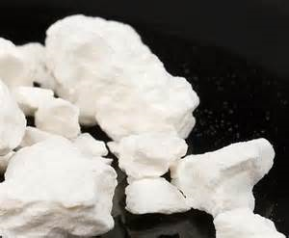
Purchasing drugs 101
Ecstasy / MDMA
$25-40 tab/point
(Eckies, e, molly, bikkies)
Cocaine
$100 quarter gram
(Coke, Fast, Charlie, Crack, Blow)

Slide 17
Opiate Treatments
QLD Opiate Treatment Program
State and National Guidelines
Effective and safe
Available for opiate dependence
No medication assisted treatment for other illicit substances in QLD
Schedule 8 controlled medications

Slide 18
Medications
Methadone / Biodone
Buprenorphine (Subutex)
Buprenorphine / Naloxone (Suboxone)
Physeptone
Naltrexone

Slide 19
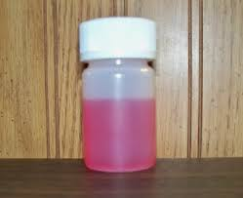
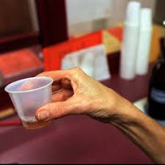
Methadone
Used as opiate treatment since 1970’s
Either Methadone Syrup or Biodone Forte
Liquid form
Taken orally
Every 24 hours
Some tablet form available- Pyseptone
Full opiate
Done, juice, petrol

Slide 20
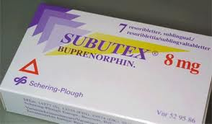
Buprenorphine
Subutex - Buprenorphine - since 2001
Suboxone – Buprenorphine & Naloxone -since 2006
Partial opiate
Can be taken every 2nd or 3rd day
Double and triple dosing
Tablet or strip form
Taken sublingually
Bupe, Subby

Slide 21
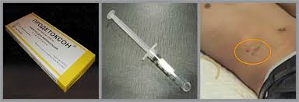
Naltrexone
Not fully approved by the FDA for opiate treatment
Implant
Very costly
Risks associated with reduced tolerance, overdose, and other drug use
Not overly common
Has resulted in deaths and coroners inquiries
Successful for alcohol dependence (tablets)

Slide 22
Benefits of OST
Reduction in deaths (all-cause mortality but especially drug overdose)
Reduction in morbidity (HIV, hepatitis B, hepatitis C, bacterial infections abscesses,, endocarditis, reduction in non-fatal overdoses
Improvement in mental health
Improved relationships and parenting
Reduction in crime
Increased employment
Improved residential status (i.e. less homelessness)
Increased education and training
Reduction in drug use (all sorts)
Reduced heroin use (including abstinence)
Earning income legally, or social security
Less debt
Benefits outweigh costs to individuals and society
Less cost to community- reduce crime, reduced health concerns

Slide 23
Barriers to Engaging PWUD
Us and them’ attitude
We know what's best for the client
Staff as helper, fixer, expert
Drug user as bad, criminal
Fear
Organisations can feel threatened by PWUD
Fearful of violence / aggression
Challenging group to work with
Worker being afraid to ask

Slide 24
Barriers
Beliefs and Attitudes
PWUD believe they have nothing to contribute / low self confidence
PWUD fear they will not be listened to
Nothing will change anyway
Negative past experiences with system
Workers moralising drug use
Shame
Non trusting of any ‘authority’

Slide 25
Barriers
Organisational Culture
Ability and readiness to work with PWUD - Policy and protocol developed and reviewed
Supported by management, appropriately resourced to work effectively with PWUD
Feedback Forms - consultation in service planning & delivery
Regular training and skill development
Funding limitations – appt keeping / follow up/ reminders
Confidentiality
Fears about breaching confidentiality

Slide 26
Barriers
Capacity
PWUD may not always be able to attend appts – seen as unreliable
Range of other commitments (drug use / treatment / children / work / study)
Mindful of meetings in Government buildings – low key settings
9am / early starts
Pay day appointments
Low Literacy
Intoxication / drug affected
Cost of travel
Stigma
PWUD often don’t identify their needs
Desire anonymity
Isolation – not feeling worthy
Negative past experiences with the system / authority
Illegality and criminalization of drug use

Slide 27
Barriers
Language
Jargon and acronyms may intimidate and exclude
Language should be easily understood
Clear explanations available
Other barriers
Supporting clients to be active in process
Intoxication
Other pressing life priorities e.g. Drug use

Slide 28
Working with & engaging People who Use Drugs
Consistent staffing
One regular worker
Holistic approach (not just AOD specific)
Collaborative plans
Information & service brochures
Time to explore options
Pro-active engagement
Environment / physical setting / comfort / community – low key!
Flexibility!

Slide 29
Working with PWUD
Complicated access / referral pathways / systems
Stigma & discrimination - from community & services
Access – longer hours, flexible delivery
Attitude & ideology
Staff - professional, trained & non-judgemental
Fees – flexible and fair
Open dialogue - appts, expectations
Someone they can be honest to without fear of punishment (harm reduction approach / non punitive )

Slide 30
In a nutshell…
Consistency- Settings / Workers
Rapport
Better communication
Improved access
Choice
Respect
Support
Improved systems
Inclusion

Slide 31
Contact
QLD Injectors Health Network (QuIHN)
07 3620 8111
nparry@quihn.org
www.quihn.org

