Slide 1
Building the right environment for stronger relationships, national pride and shared prosperity for all Australians

Slide 2
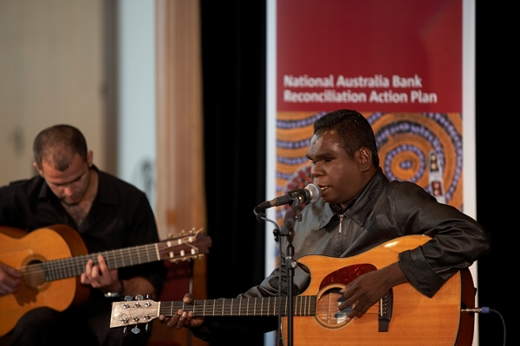
Who is Reconciliation Australia?
Reconciliation Australia is the national organisation promoting reconciliation between the broader Australian community and Aboriginal and Torres Strait Islander peoples.
Independent, not for profit
Funded by Federal Government and corporate sponsors
HQ in Canberra; Recognise campaign office in Sydney; other offices in Brisbane and Melbourne
Manage relationships with more than 800 stakeholders
Notes:
Without the right ‘environment’, progress on closing the gap targets will continue to be slow
Reconciliation Australia’s vision is an Australia that provides equal life chances for all, recognising and respecting the special place, culture and contribution of Aboriginal and Torres Strait Islander peoples as the First Australians.
The social context (environment) for change and progress is not positive:
Trust between Indigenous and other Australians is low (9%)
Perceived prejudice towards Aboriginal and Torres Strait Islander people is unacceptably high (97% Indigenous; 71% Non-indigenous)
Nearly half of all Australians believe it is harder to achieve success if you are Aboriginal or a Torres Strait Islander
Reconciliation is about changing this context & laying the foundations for positive change

Slide 3
Who is Reconciliation Australia?
Vision
Everyone wakes to a reconciled, just and equitable Australia
Our Purpose
RA is dedicated to building relationships, respect and trust between Aboriginal and Torres Strait Islander people and other Australians.
Outcomes
Stronger two way relationships between Aboriginal and Torres Strait Islander and non-Indigenous Australians.
Aboriginal and Torres Strait Islander history, culture and rights are a proud part of our everyday life.
Our national wellbeing is enhanced by Aboriginal and Torres Strait Islander strength and prosperity.
The collective rights of Aboriginal and Torres Strait Islander peoples are recognised and respected.
Notes:
Without the right ‘environment’, progress on closing the gap targets will continue to be slow
Reconciliation Australia’s vision is an Australia that provides equal life chances for all, recognising and respecting the special place, culture and contribution of Aboriginal and Torres Strait Islander peoples as the First Australians.
The social context (environment) for change and progress is not positive:
Trust between Indigenous and other Australians is low (9%)
Perceived prejudice towards Aboriginal and Torres Strait Islander people is unacceptably high (97% Indigenous; 71% Non-indigenous)
Nearly half of all Australians believe it is harder to achieve success if you are Aboriginal or a Torres Strait Islander
Reconciliation is about changing this context & laying the foundations for positive change

Slide 4
Why is Reconciliation important?
The social context and environment for change and progress is not positive.
Trust between Aboriginal and Torres Strait Islander peoples and other Australians is extremely low;
Perceived prejudice towards Aboriginal and Torres Strait Islander people is unacceptably high;
Nearly half of all Australians believe it is harder to achieve success if you are Aboriginal or a Torres Strait Islander
WITHOUT THE RIGHT ‘ENVIRONMENT’, PROGRESS ON
CLOSING THE GAP TARGETS WILL CONTINUE TO BE SLOW
Reconciliation is about changing this context;
laying the foundations
Notes:
- Without the right ‘environment’, progress on closing the gap targets will continue to be slow
- Reconciliation Australia’s vision is an Australia that provides equal life chances for all, recognising and respecting the special place, culture and contribution of Aboriginal and Torres Strait Islander peoples as the First Australians.
- The social context (environment) for change and progress is not positive:
- Trust between Indigenous and other Australians is low (9%)
- Perceived prejudice towards Aboriginal and Torres Strait Islander people is unacceptably high (97% Indigenous; 71% Non-indigenous)
- Nearly half of all Australians believe it is harder to achieve success if you are Aboriginal or a Torres Strait Islander
- Reconciliation is about changing this context & laying the foundations for positive change

Slide 5
Our Reconciliation Framework
Respect
Pride in the cultures that have existed in this country for tens of thousands of years and the contribution of Aboriginal and Torres Strait Islander people to Australia’s development.
Opportunity
Creating opportunities that will achieve equality in life expectancy, education, employment and all the important, measurable areas of disadvantage.
Relationships
Good relationships are based on trust, understanding, communication and mutual respect.
Notes:
RA Framework - creating an environment for stronger relationships, shared national pride and shared prosperity

Slide 6
Reconciliation Action Plan (RAP) Program
Turning good intentions into action
Build meaningful relationships
Create sustainable opportunities
Aligned to organisational objectives
Engage within sphere of influence
Set timelines and targets
Notes:
What is a RAP?
RAPS are tools organisations can use to turn good intentions into actions
RAPs are about building meaningful relationships
RAPs are about creating sustainable opportunities
For a successful RAP – needs to be aligned with organisations core business and objectives
RAP needs to be mutually beneficial
RAP is a “vehicle” for organisations to achieve change and work towards reconciliation

Slide 7
Four types of RAPs
Type 1: Reflect RAP
Laying the Foundations for building respectful relationships
Organisations commit to a pre-determined set of generic actions to achieve over the year.
Type 2: Innovate RAP
Trying new approaches
Organisations focus is on innovation and testing/piloting programs and strategies.
Type 4: Elevate RAP
Focussed attention towards reconciliation
Work with Reconciliation Australia to include actions that will advance reconciliation on a national level.
RAP Program
Type 3: Stretch RAP
Setting measurable targets
Organisations start to set stretch targets for their activities.
Notes:
What is a RAP?
RAPS are tools organisations can use to turn good intentions into actions
RAPs are about building meaningful relationships
RAPs are about creating sustainable opportunities
For a successful RAP – needs to be aligned with organisations core business and objectives
RAP needs to be mutually beneficial
RAP is a “vehicle” for organisations to achieve change and work towards reconciliation

Slide 8
RAP partners commit to minimum actions
Relationships Minimum Elements
RAP Working Group
Celebrate National Reconciliation Week
Respect Minimum Elements
Cultural awareness/ cultural competency training
Aboriginal and Torres Strait Islander protocols respected & celebrated
Celebrating and recognise NAIDOC Week
Opportunity Minimum Elements
Community-wide Aboriginal and Torres Strait Islander Employment Strategy.
Use of/support for Aboriginal and Torres Strait Islander businesses
Tracking progress Minimum Elements
Complete the RAP Impact Measurement Questionnaire annually.

Slide 9
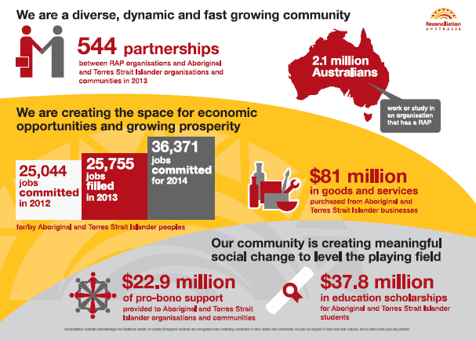
Opportunities: Outcomes in RAP organisations 2013

Slide 10
RAPS are having a significant impact on attitudes and behaviour
Relationships
Respect
Opportunities
RAP Impact Measurement Report 2012
People in RAP organisations…
Contact
…have more frequent contact with Indigenous people
(66 per cent vs. 41 per cent general population)
Pride
…feel prouder of Indigenous cultures
(77 per cent vs. 51 per cent general population)
Prejudice
…are less prejudiced
(9 per cent vs.70 per cent general population)
Trust
…have higher levels of trust
(71 per cent vs. 13 per cent general population)

Slide 11
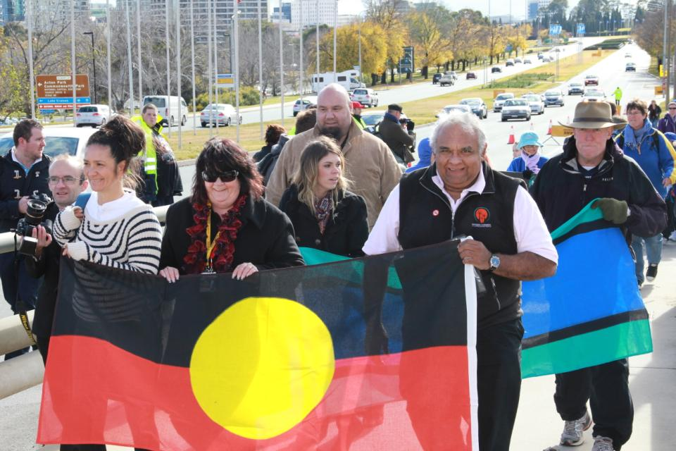
Contact details
Reconciliation Australia
P: 02 6272 2600
E: raps@reconciliation.org.au
W: www.reconciliation.org.au
H: www.reconciliation.org.au/raphub
Anna Jovanovic
National RAP Manager
anna.jovanovic@reconciliation.org.au
Amber Roberts Philip Jerrard
RAP Manager NSW & QLD RAP Officer QLD
amber.roberts@reconciliation.org.au philip.jerrard@reconciliation.org.au
Notes:
Business plans that use an holistic approach to building meaningful relationships and creating sustainable opportunities.
Turns good intentions into real actions.
Identify mutually beneficial actions that are aligned to organisational objectives.
Engage within their sphere of influence to ensure sustainable commitments.
Set timelines and targets that can be measured.

