Slide 1
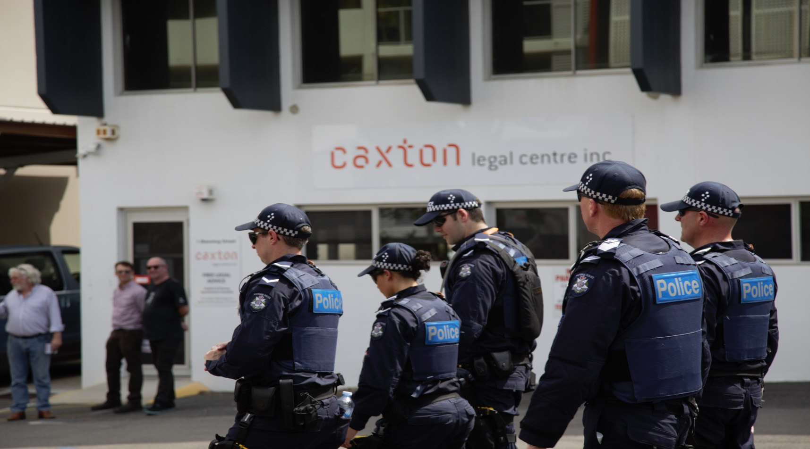
G20 Legal Observers Project
G20 Legal Observer Project

Slide 2
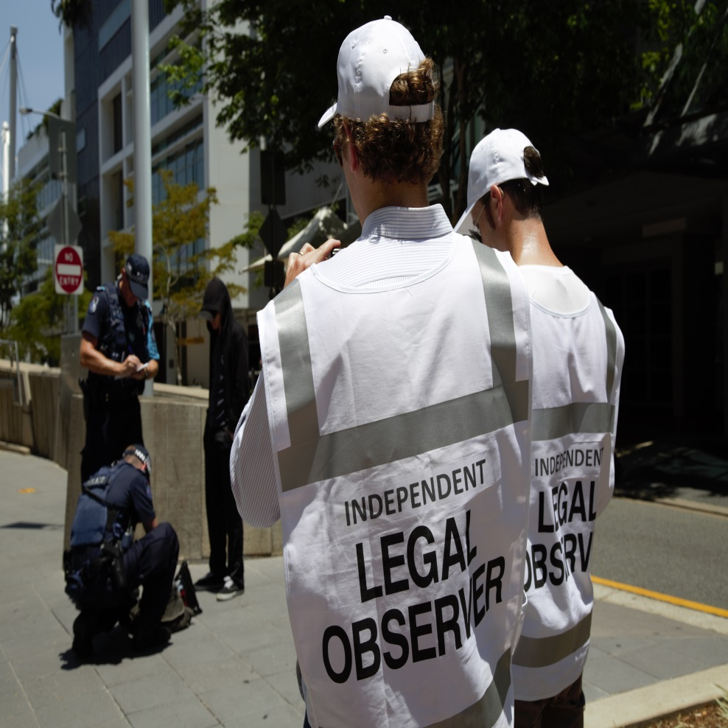
Overview
Why we did it
What we did
How we did it
Was it worth it?

Slide 3
G20 Summit – A Snapshot
Logistics of Australia’s largest ever security task
History of poor G20 policing – London and Toronto
G20 Safety and Security Act 2013
The Climate of Fear
A successful operation?
Notes:
43 International Protected Persons
4000 delegates
$450M security operation
3000 media
6000+ police
12 sole use hotels
5 venues
8000 flights booked
50,000 bus movements
120,000 meals
200,000 bottles of water
London 2009 – death of innocent bystander Ian Tomlinson.
Toronto 2010 – 1100 arrests – only 44 convictions. In both cases the tactics of police were heavily criticised.
The Act’s objectives included:
- Protecting people and property from acts of civil disobedience
-
The objectives did not include protecting or facilitating human rights such as freedom of assembly, expression, freedom against arbitrary detention etc
The Act also contained a bunch of nasties such as:
Reversal of onus of proof for bail;
Power to detain people without charge for extended periods;
Expansive stop and search powers
Offences for disrupting a G20 meeting, possessing prohibited items
Climate of Fear created by media, legislation, Newman Government regime, ISIS decapitation video releases
Success? If securing world leaders and having an ‘incident free’ G20 is only goal then it was a stunning success and score 9.5/10.
If criteria was “Brisbane is open for business” I’d suggest the fact that police and protesters grossly outnumbered sightseers and shoppers by a ratio of 5:1 - means a score of 3/10.
Finally as an exercise in democracy I would rate the G20 as 4/10.

Slide 4
Objects of the Act
to promote the safety and security of persons attending any part of the G20 meeting, and
to ensure the safety of members of the public from acts of civil disobedience in relation to any part of the G20 meeting; and
to protect property from damage from civil disobedience in relation to any part of the G20 meeting; and
to prevent acts of terrorism directly or indirectly related to any part of the G20 meeting; and
to regulate traffic and pedestrian movement to ensure the passage of motorcades related to any part of the G20 meeting is not impeded.

Slide 5
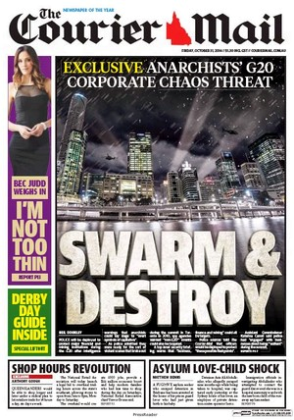
Media Build Up

Slide 6
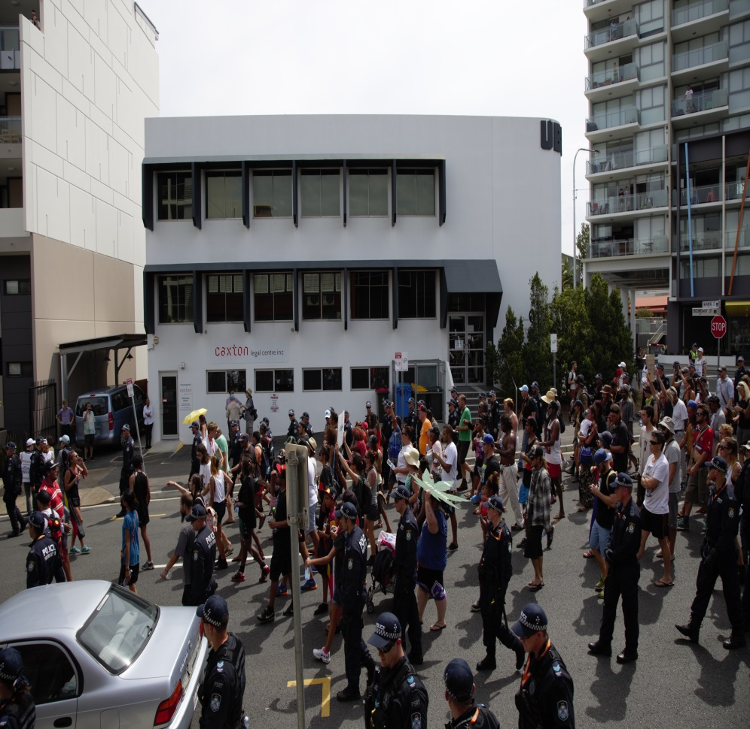
Why we did it
Responding to
community need
Upholding the rule of law
Meeting the obligations
of Officers of the Court
Protecting fragile ‘rights’
and freedoms

Slide 7
What we did
CLE and Banco Court Forums
50 ILOs performed 19 shifts monitoring approximately 54 protests conducted by about 27 “issue motivated groups”
31 interactions recorded over 5 days
Notes:
The G20 laws came in to effect on Saturday 8 November 2014, and terminated on Monday 17 November. According to QPS records, during this period:
· 4 people were prohibited from attending the G20 Summit;
· 27 people were issued exclusion notices; and
· 14 people were charged with offences under the G20 laws.
During this period Caxton’s volunteer legal observers (ILOs) performed nineteen shifts of 4 hours duration at numerous sites across the Brisbane CBD. Thirty-one interactions between police and members of the public were recorded by ILOs.
Pers comm with QPS, 25 November 2014.

Slide 8
How we did it
Fundraising
Training
Meetings with QPS
ILO Reference Group (QLS,BAQ)

Slide 9
Was it worth it?
Relationship with QPS
Promotion of the use of negotiation tactics
High levels of satisfaction ratings from volunteer ILOs
Strong feedback from community about calming effect of ILO presence
Support for the recognition of human rights in the objectives of future legislation

Slide 10
If you’re interested…
View Caxton ILO Video http://youtu.be/cfWfCQgvFg
Caxton report to the QCCC
Briscan submission to QCCC http://briscan.net.au/2015/04/25/activists-lodge-submission-ccc-review-g20-act/

