Slide 1
Social Media 101

Slide 2
Questions
social media’s value for CLCs
social media planning and management
social media pitfalls
social media content
social media tips and tricks
Wordpress
Mailchimp
Questions
Links and Resources
Tools
Extras

Slide 3
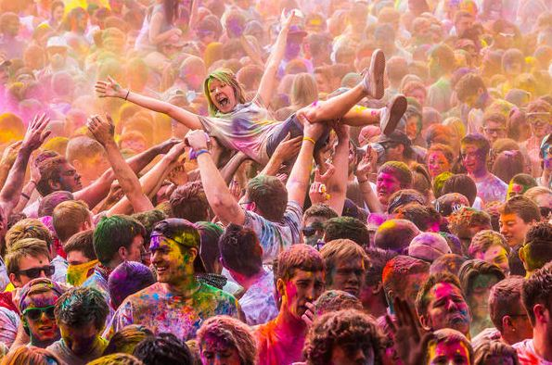
1. Social media’s value for CLCs
Is social media worthwhile?
What are the benefits for CLCs?
How can social media help build our CLC’s profile in the community?
What are the common social media objectives of CLCs?

Slide 4
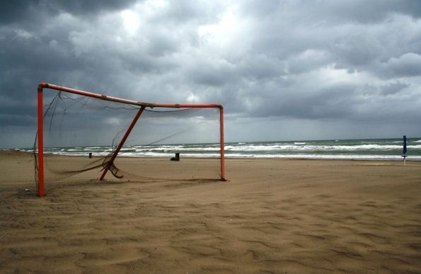
2. Social media planning and management
What are the minimum requirements for each tool to be effective?
Are there ways CLCs can use Facebook and other tools with minimal staff resources/time? Can you replicate content across social media channels to reduce your workload? How does this work?
How do CLCs build a social media strategy/plan?
What is the best social media tool for CLCs?
How do we keep up with social media?

Slide 5
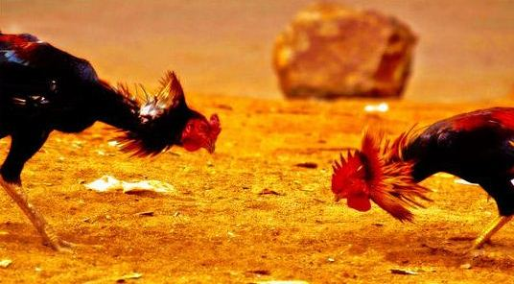
3. Social media pitfalls
What are the pitfalls (eg inappropriate comments)?
What are the pros and cons of allowing comments and moderating feedback (beware the trolls!)?
What are the traps for young players?

Slide 6
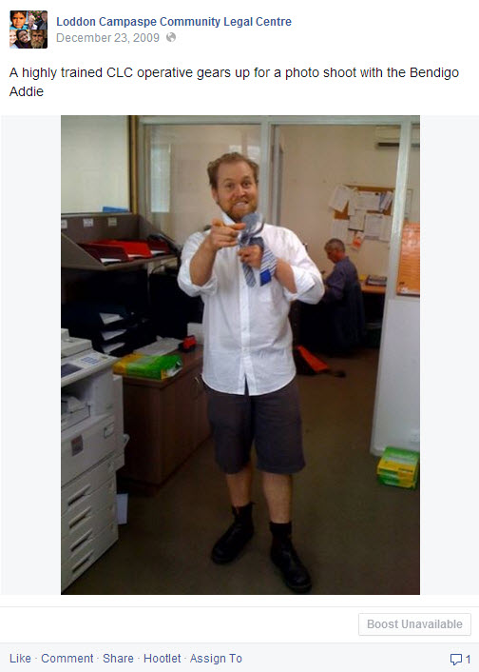
4. social media content
Practical examples of the best content for each tool (eg articles)
How do different social media channels work with each other to promote visits to your website?

Slide 7
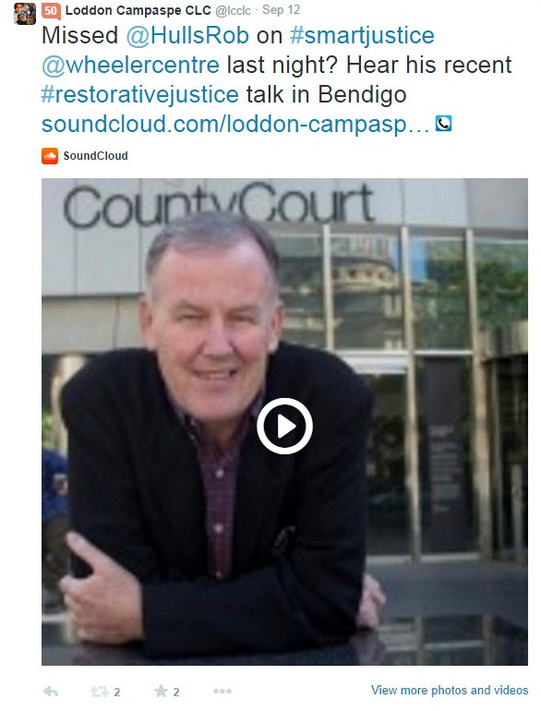
5. social media tips and tricks
How do CLCs drive social media engagement?
What are the best ways to maximise web access and promote online information for clients?
What are the most efficient and effective methods of using these tools?

Slide 8
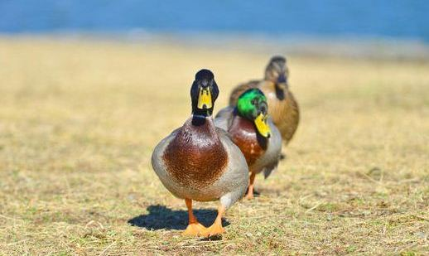
6. Wordpress
What is Wordpress (a CMS)?
What are the benefits of a CMS like Wordpress?
Get your ducks in a row (or your website house in order)

Slide 9
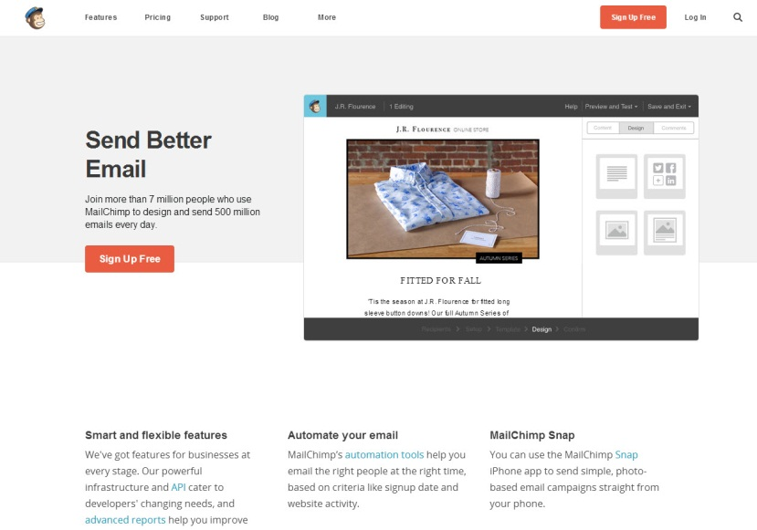
7. Mailchimp
What is the best e-news format (Mailchimp, PDF sent as attachment to in-house email list, other)?
How does your e-news link with your web content?
How do you gather email subscribers?
What if you only want your e-news to go to paid members?

Slide 10
8. qUESTIONS

Slide 11
9. Resources
CLC Communications Folk: https://www.facebook.com/groups/113872832091148/
VLF online legal resources: http://www.victorialawfoundation.org.au/online-information-resources
10 qualities of a social media manager: http://www.nptechforgood.com/2011/09/13/11-qualities-of-an-effective-social-media-manager/
SMILE (Social Media in Legal Education): http://socialmediainlegaleducation.com
YouTube Nonprofit Program: http://sproutsocial.com/insights/how-you-can-benefit-from-the-youtube-nonprofit-program/
NACLC CLEWS Network Social Media Resource: http://www.naclc.org.au/cb_pages/clews_resources.php
Connnecting Up: http://www.connectingup.org/
Hootville: http://www.hootville.com/
Community Legal Centres [Twitter list]: https://twitter.com/NACLCBruce/lists/community-legal-centres

