Slide 1
Queensland Tenancy Law
The Basics for CLC Workers

Slide 2
What does home mean to you?

Slide 3
How we used to be …..

Slide 6
Tenant Advice & Advocacy Services (TAASQ)
Empowers tenants with:
tenancy law advice & advocacy
QCAT applications and hearings
emergency housing referrals
tenancy education for groups

Slide 8
Session topics
1
COVERAGE
2
COMMON TENANCY ISSUES
3
DISPUTE RESOLUTION PROCESS
4
REFERRAL PATHWAYS

Slide 9
Residential Tenancies & Rooming Accommodation Act 2008
Commenced on 1 July 2009
Combined the Residential Tenancies Act 1994 and the Residential Services (Accommodation) Act 2002

Slide 10
Coverage

Slide 11
Coverage
s12 residential tenancy agreement
(1) an agreement under which a person gives to someone else a right to occupy residential premises as a residence

Slide 12
Coverage
(3) applies whether the agreement is
(a) wholly in writing, wholly oral or wholly implied; or
(b) partly in a form mentioned in paragraph (a) and partly in 1 or both of the other forms

Slide 13
Who is not covered?
s32 boarders & lodgers (refer s433)
s31 genuine holiday lettings
s31 educational institutions student accommodation within the university

Slide 14
Who is not covered?
s34 hospitals and nursing homes, Retirement Villages Act
s35 rental purchase plans
s36 emergency & refuge accommodation

Slide 15
Coverage – other tenancies

Slide 16
Rooming Accommodation
Coverage – other tenancies
s14 resident means a person
(a) who occupies one or more rooms as the person’s only or main residence & (b) is not the provider or a relative of the provider

Slide 17
Rooming Accommodation
s15
rooming accommodation available for occupation by residents in return for rent if each of the residents
has a right to occupy 1 or more rooms; and
does not have the right to occupy the whole of the premises in which the rooms are situated; and

Slide 18
Rooming Accommodation
(c) does not occupy a self-contained unit; and
(d) shares other rooms or facilities outside of the resident’s room, with 1 or more of the other residents
(2) … it is immaterial whether or not –
(a) the rooms are in the same premises

Slide 19
Rooming Accommodation
s44 some exemptions
If provider lives on premises & not more than three rooms occupied or available for residents
SAAP
Aboriginal Hostels Ltd
uni accommodation (on grounds)
holiday accommodation

Slide 20
Rooming Accommodation
s18 if rooming accommodation & both parties agree can opt in to be a residential tenancy
s418 person may apply to QCAT for a determination about coverage
General point – tenancy might not be covered but bond is protected

Slide 21
public & community housing
Covered but some sections of the Act are exempt
eg) rent increases

Slide 22
Common tenancy issues
I feel better when I know my
tenancy rights

Slide 23
The big four
Common tenancy issues
_{Bond}
_{disputes}
1
Repairs
How much of an issue for tenants?
2
Databases
3
Ending tenancy
_{Ending}
_{Tenancy}
4
Bond disputes
_{Databases}
Common issues for tenants
_{Repairs}

Slide 24
Residential Tenancies Authority (RTA)

Slide 25
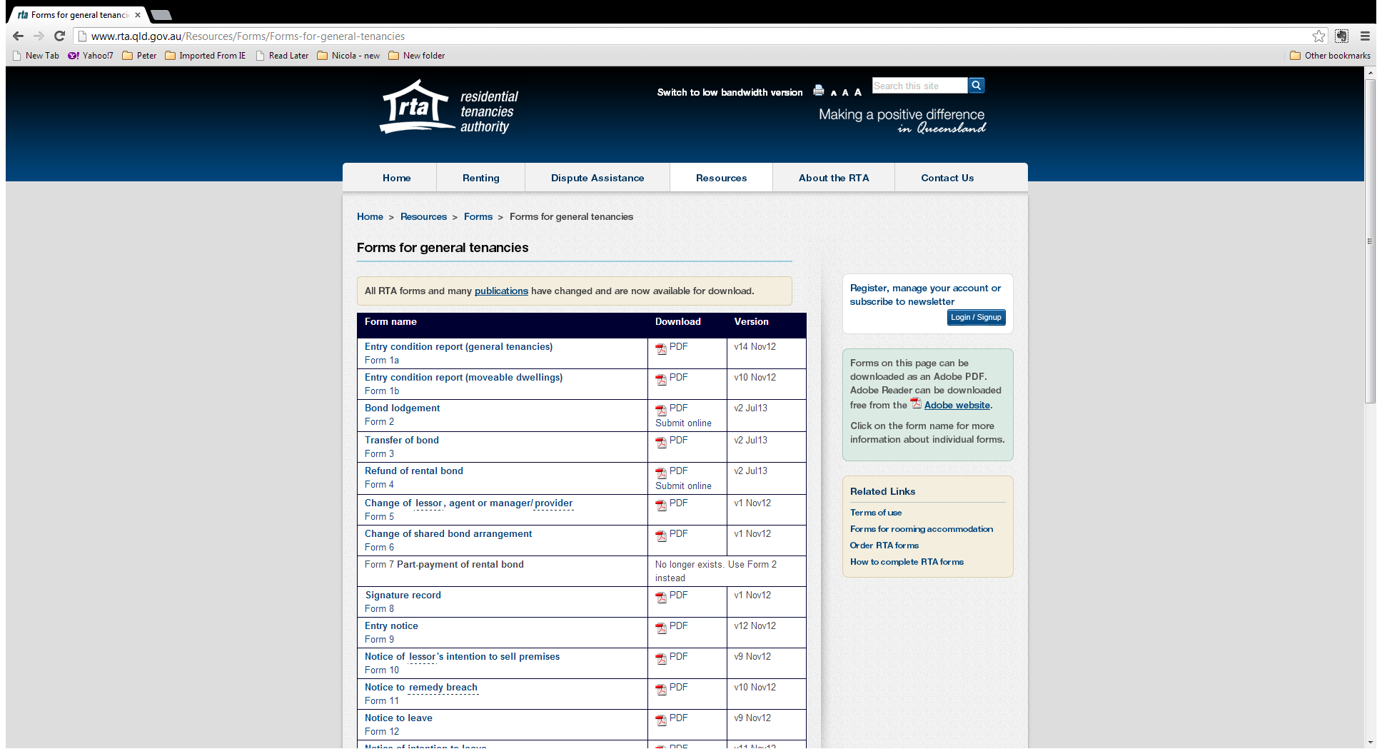
All about the forms

Slide 26
Dispute Resolution
Notice to remedy breach
Dispute resolution request
Notice of unresolved disputes
Form 11
Form 16
NURD
QCAT
Non-urgent application
Parties represent themselves
Agents automatic right to represent

Slide 27
Conciliation – s406
Conciliation is voluntary
Conciliators are impartial in regard to the matter and the parties
Conciliators are partisan in favor of the Act
Notes:
Neither party is compelled to participate in conciliation
It is voluntary and any party can withdraw at any stage.
If a party withdraws or does not participate they are not penalised

Slide 28
Conciliation – cont.
s411
Conciliators are bound to secrecy and can only disclose information in certain circumstances
s413
Evidence of anything said or admissions made is inadmissible at a hearing relating to the matter in the tribunal or any other court

Slide 29
Conciliation – cont.
The process may include:
telephone conferencing
joint meetings with both parties
private meetings
other means described in the Regulations

Slide 30
Functions of Conciliators – s401
Conciliation – cont.
to help, encourage and facilitate the parties to negotiate a settlement
to promote open exchange of relevant information between parties
to provide information about the Act and its operation regarding the dispute
to help in any other way appropriate

Slide 31
Conciliation Agreements s408
Conciliation – cont.
Agreements must be signed by both parties
Parties are bound by the agreement which becomes an addendum to the tenancy agreement and parties are in breach if they fail to abide by the agreement

Slide 32
Conciliation – cont.
If a conciliation agreement is breached the aggrieved can make a direct non-urgent application to the tribunal
If conciliation fails the RTA must issue a Notice of Unresolved Dispute (NURD)

Slide 33
Time limits – s418
Time limits are important where there has been a breach of an agreement
Either the tenant or lessor must apply to the tribunal (make a dispute resolution request) within 6 months of becoming aware of the breach.
Notes:
There are various time limitations attached to the right to put in an application to the SCT.

Slide 34
Dispute Resolution
Urgent applications allow both parties to apply directly to QCAT
No requirement to go through RTA
Generally matters relating to ending tenancies, emergency repairs & databases

Slide 35
Referral pathways

Slide 36
For further advice for tenants
TUQ State-wide phone advice
Ph: 1300 744 263
Ph: 3257 1108
9am-4pm Mon to Fri
7pm Tues & Wed
Or local TAASQ

Slide 37
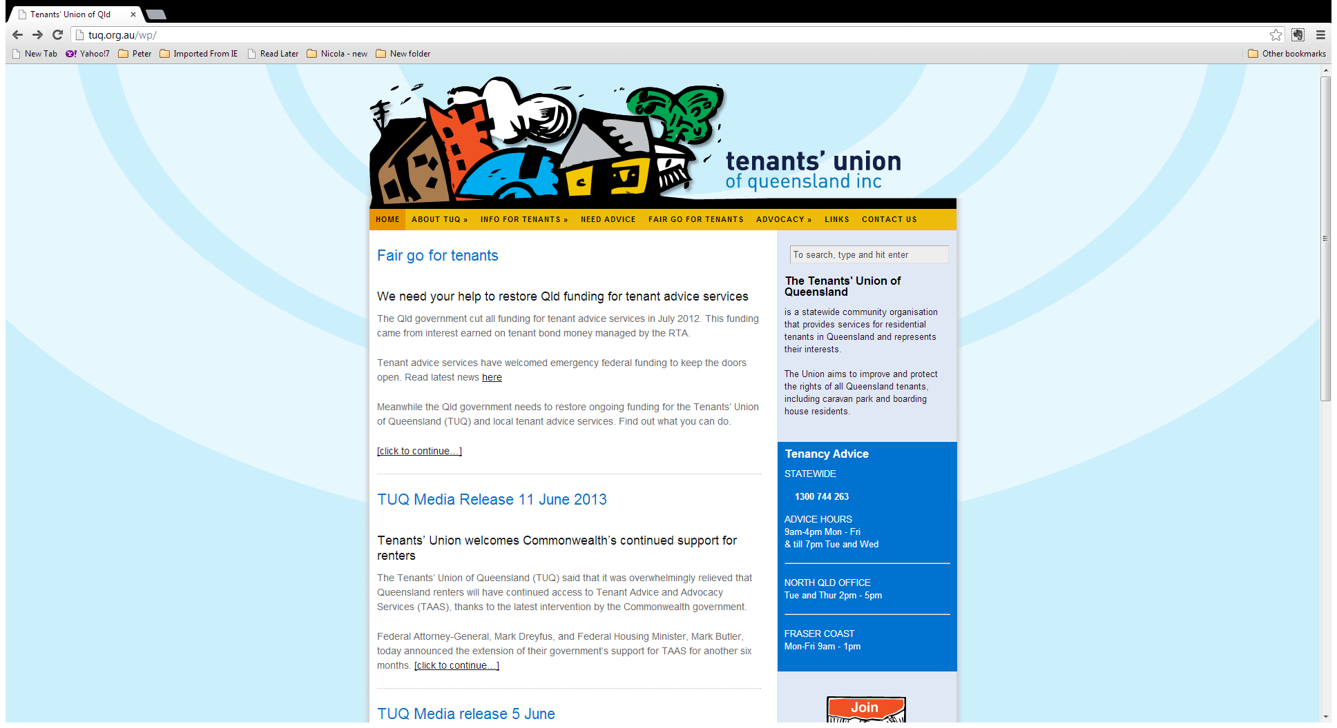

Slide 38
For back-up advice
Tenants’ Union Queensland
Help Desk for workers
Ph: 3257 1047

Slide 39
For further information
Peter Mott
Training and Advice Worker
training@tuq.org.au
Ph: 3257 1411

