Slide 1
International Human Rights Mechanisms: An NGO Perspective
Ben Schokman
June 2013
www.hrlc.org.au

Slide 2
UN Human Rights System
Security Council
Secretary–General and UN Secretariat
Office of the High Commissioner for Human Rights (OHCHR)
General Assembly
Economic and Social Council (ECOSOC)
Human Rights Council
Special Procedures
Universal Periodic Review
UN Specialised Agencies
Such as UNICEF, UNDP, UNHCR, WHO, ILO and many others
Treaty Bodies

Slide 3
Outline
Why use International Human Rights Mechanisms?
Treaty Bodies
Special Procedures
Universal Periodic Review

Slide 4
About the Human Rights Law Centre
Advocate for the protection and promotion of human rights by using the law
Strategic combination of research, advocacy, litigation and education
Use both domestic and international mechanisms
Work in partnership with community organisations

Slide 5
Why use the international human rights system?
To secure the domestic implementation of international human rights standards
To use the outcomes of these mechanisms in litigation, policy development and advocacy at the domestic level
To critique Australia’s human rights record
To create a dialogue with government
To develop knowledge of human rights in Australia

Slide 6
UN Human Rights Treaties
Universal Declaration of Human Rights 1948
International Convention on the Elimination of All Forms of Racial Discrimination 1965
International Covenant on Economic, Social and Cultural Rights 1966
International Covenant on Civil and Political Rights 1966
Convention on the Elimination of Discrimination Against Women 1979
Convention Against Torture 1984
Convention on the Rights of the Child 1989
[International Convention on the Protection of the Rights of All Migrant Workers 1990]
[Convention for the Protection of All Persons from Enforced Disappearance 2006]
Convention on the Rights of Persons with Disabilities 2006

Slide 7
Procedures of Treaty Bodies
Consideration of Periodic Reports → Concluding Observations
Individual Complaints – Requires exhaustion of domestic remedies
Early Warning and Urgent Action Procedures
General Comments

Slide 8
Case Study 1:
Australia’s Review under the ICCPR

Slide 9
ICCPR Review
Government’s Report
NGO Report
Committee’s dialogue with the Government delegation
Concluding Observations issued
Implementation of recommendations (?)

Slide 10
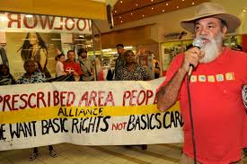
Case Study 2:
Northern Territory Intervention – CERD Request for Urgent Action

Slide 11
Timeline
Request for Urgent Action filed on 28 January 2009
CERD sent a letter to the Australian Government on 13 March 2009:
expressing its serious concern about the NTER measures
requesting that the Australian Government submit further information on its progress on lifting the suspension of the RDA and redesigning the NTER measures
Update to the communication was filed in August 2009

Slide 12
Value of the communication?
Committee’s response to the Request for Urgent Action indicated its concern about “serious, massive and persistent racial discrimination”
Used in domestic advocacy and lobbying
Subsequently used in conjunction with other UN human rights mechanisms, including ICCPR, ICESCR and CERD, Special Rapporteur visits and reports, Universal Periodic Review

Slide 13
Treaty Bodies:
Advantages and disadvantages?
General considerations:
Committee’s recommendations are “optional” and “unenforceable”
Attitude of the Australian Government, state government?
Domestic considerations:
Limited constitutional and legal framework in Australia
Can influence executive decision-making and policy development

Slide 14
Special Procedures
Country mandates (13) and thematic (36) mandates
Working Group on Arbitrary Detention
SR on Adequate Housing
SR on the Right to Health
SR on the Right to Education
SR on the Rights of Indigenous People
SR on Extreme Poverty
SR on Violence Against Women
SR on Torture and other Cruel, Inhuman or Degrading Treatment
SR on Countering Terrorism

Slide 15
Functions of Special Procedures
Communications: urgent appeals and “allegation letters”
Country visits
Annual Reports to UN Human Rights Council
Awareness raising (thematic reports, press releases, conferences, contact with NGOs)

Slide 16
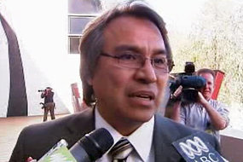
Case Study 3:
Country Visit by UN Special Rapporteur on Indigenous Rights, James Anaya

Slide 17
Timeline
Official Country Visit to Australia in August 2009
Advance report specifically on NTER released in February 2010
Report released in March 2010
37 specific conclusions and recommendations
Special Rapporteur’s report tabled at the UN Human Rights Council in September 2010

Slide 18
Value of the country visit?
Preparedness of Aust Government to receive SR’s visit
Significant domestic media attention during and after visit
Scrutiny by the international community
Opportunity to visit affected communities and individuals
Specific, targeted, expert conclusions and recommendations made to the Australian Government
Used in conjunction with other UN human rights mechanisms, including CERD Concluding Observations, other SR visits and reports, Universal Periodic Review

Slide 19
Special Procedures Advantages and Disadvantages:
Timely and expeditious
No need to exhaust domestic remedies
SRs, as independent experts, are generally highly regarded
There may not be a relevant mandate holder
Communications are confidential between SR and Govt
Author may not be informed of outcome
Govt may simply ignore urgent appeal or refuse request for country visit
Generally make observations, not “legal” recommendations

Slide 20
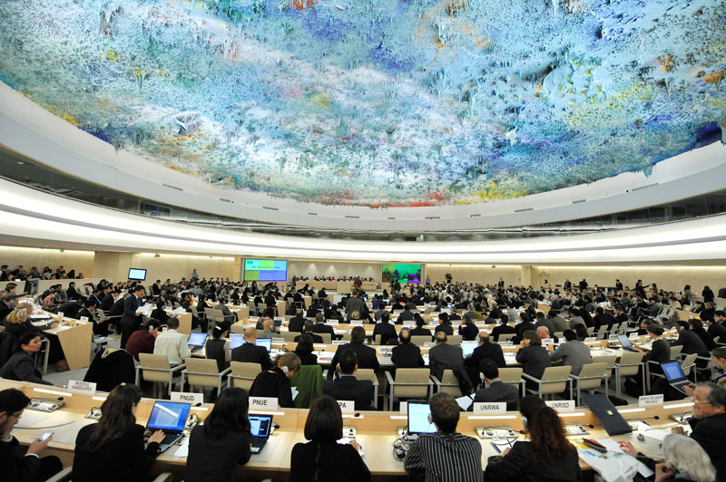
Case Study 4: Universal Periodic Review of Australia

Slide 21
Universal Periodic Review
New mechanism of the UN Human Rights Council
All 192 UN member states reviewed every 4 years
Every country is reviewed
Every country is a reviewer
Nature – political / diplomatic

Slide 22
Sources of Information
Information prepared by the State – 20 pages
Compilation prepared by OHCHR – 20 pages
Treaty Bodies, Special Procedures, other UN documents
Other “credible and reliable” information – 10 pages
NHRIs, NGOs

Slide 23
Australia’s Review
Australia’s Opening Statement
Interactive dialogue: Statements, questions and recommendations made by 53 countries
Responses, explanations provided by the Australian Govt
145 specific recommendations made and included in the Draft Report of the Working Group
Australia’s formal response provided in June 2011
Mid-term report provided in June 2013
Next review – 2015

Slide 24
Recap – Why use the international human rights system?
To secure the domestic implementation of international human rights standards
To use the outcomes of these mechanisms in litigation, policy development and advocacy at the domestic level
To critique Australia’s human rights record
To create a dialogue with government
To develop knowledge of human rights in Australia

Slide 25
In summary… Things to consider
Could the international human rights system be useful?
What mechanism is most appropriate? Consider the political and legal nature of the mechanisms?
Domestic context – consider the Australian legal, political and social landscape
There is a need, opportunity and obligation to make use of international human rights law in litigation, policy development and advocacy

Slide 26
Further Information
HRLC website (www.hrlc.org.au)
Human Rights Law Manual – Ch 6
Copies of reports, complaints, documents, case notes
Monthly Bulletin, Rights Agenda
OHCHR (www.ohchr.org)
Ben Schokman ben.schokman@hrlc.org.au

