Slide 1
A new framework for legal assistance, and how to get there
Dr Warren Mundy
Presiding Commissioner Access to Justice Arrangements Inquiry
Productivity Commission
Queensland Association of Independent Legal Services
25 May 2015

Slide 2
What were we asked to do?
A wide terms of reference that poses four key questions
How accessible is the civil justice system?
What inhibits access?
What are the impacts of a lack of accessibility?
How might access be improved?

Slide 3
Context is important
The notion of a civil justice ‘system’ is problematic
Disputes can be resolved in many ways:
Informally: Private and Alternative Dispute Resolution; Ombudsmen
More formal mechanisms: Tribunals; Courts
Commission examined each of these in turn

Slide 4
Issues I won’t talk about today
Measurement of unmet need
Legal profession and consumer protection
Alternative dispute resolution Ombudsmen, tribunals and courts
Private funding of litigation
Indigenous specific services

Slide 5
Legal assistance for disadvantaged Australians
Civil law matters are the poor cousin in the legal assistance family
Unresolved civil disputes can spiral into more complex matters leading to costs in other areas of government spending
The quantum of funding is inadequate, not linked to need and its distribution does not always align with areas of highest need

Slide 6
Benefits generally outweigh costs but sometimes the ‘goose is overcooked’
Preferred approach
Current pitfalls
what would happen to an individual if legal assistance were not provided?
how much does receiving assistance affect the legal outcome of a case?
does obtaining a favourable legal outcome avoid adverse outcomes in the client’s life ‘outside the court room’?
what are the costs of these adverse outcomes that are avoided?
analysis assumes that an individual who doesn’t receive assistance won’t act on their problem and that it will escalate
improvements in legal outcomes for clients are not well understood. Some assume ‘best possible’ outcome achieved and that outcomes are enduring
Hard to estimate the (avoided) costs of adverse outcomes such as loss of employment, financial distress, homelessness, relationship breakdown and family violence

Slide 7
Cuts only reinforced inadequacy of funding
Little or no public assessment of impacts
Evidence given to us suggested frontline services were affected
Government’s decision effectively adopts our recommendation to reverse the cuts
But turning funding ‘off and on’ can still lead to costly uncertainty and difficulties in planning ahead
Examples of cuts provided to the inquiry:
Queensland CLCs: losses of some specialist family lawyers, duty lawyer services (including child protection)
Western Australia CLCs: loss of solicitor to support Domestic Violence Court Outreach; reduction in services for family law matters (including Indigenous-specific services)
Consumer Action Law Centre: loss of telephone advice service
Women’s Legal Centre (ACT): loss of 0.6 FTE solicitor (out of 2.8 FTE)
Women’s Legal Service Tasmania: loss of 1 solicitor (out of 6), no longer rolling out an app to assist young women with legal issues
(Source: Final Report, Table 21.1, page 737)

Slide 8
Cuts only reinforced inadequacy of funding
There is a sound public policy case for government funding of advocacy
Identifying and acting on systemic issues can lead to lower costs and clarifying law, which are of benefit to all
There are often few private incentives for these advocacy activities, yet they can be worthwhile from a community-wide perspective
Legal assistance providers on the ‘frontline’ are uniquely placed to identify systemic issues particularly those affecting disadvantaged Australians

Slide 9
Recommended near-term changes
An increase of around $200m per year is required now, until longer-term funding can be determined:
This would allow the LACs to:
provide additional grants of aid in other civil matters (this represents the bulk of the funding increase)
relax their means tests, allowing eligibility for around 10 per cent of households
A relatively small share would allow LACs, CLCs and ATSILS to maintain valuable frontline services
(Adopted, apart from EDO funding cuts.)

Slide 10
But longer term changes are also required – a sector wide perspective
Quantum of funds does not generally relate to government priorities or an assessment of legal need
Means tests used by LACs are too mean
Matters are not being funded even when means test is met
The same matters don’t always attract the same level of assistance – assistance varies from state to state and from service provider to service provider depending on resources
The merry-go-round of funding frustrates medium and long-term planning

Slide 11
But longer term changes are also required – a CLC perspective
Legal need can change and move. Resources need to adjust in accordance with changing needs and in line with an understanding about what works and doesn’t work. The legacy funding model frustrates this process
Some centres, recognising the advantage of scale and specialisation, are amalgamating or working more closely with other centres. This process needs to be more widespread and systematic
Data and reporting by CLCs is inconsistent at best and non-existent at worse. Funding should be allocated to those centres that are best at what they do: collecting data on incidence of need, cost of service and outcomes from assistance is vital

Slide 12
A longer-term funding model…
Recommendations (21.5, 21.6, 21.7):
Over the medium and longer term, governments need to agree on priorities for legal assistance services and fund them adequately
Funding should be stable enough to facilitate long-term planning
Commonwealth funding for the providers of legal assistance services should be allocated:
according to models that reflect the relative costs of service provision and indicators of need
to encourage funding participation by States and Territory Governments

Slide 13
A longer-term funding model…
Legal Assistance Forums in each state and territory should be used to reach an agreement between the four main legal assistance providers as to their respective roles in addressing the service priorities articulated by government
Allocation decisions should be informed by assessments of legal need and the efficiency and effectiveness of service providers
Eligibility principles should be applied more consistently for more transparent and equitable outcomes

Slide 14
…and the role of CLCs in that model
The allocation of Community Legal Services Program funds within jurisdictions should be determined by representatives from the Australian Government and the relevant State or Territory Government, the relevant legal aid commission and a representative from the relevant community legal centre association.
A collaborative approach designed to match the legal need with the services that CLCs are best-placed to provide

Slide 15
Better understanding the system
The absence of data hampers policy evaluation
Common definitions and protocols would increase the value of data currently collected
Where possible, data should be outcomes based, ‘linked’ across providers and be made public

Slide 16
Thank you

Slide 17
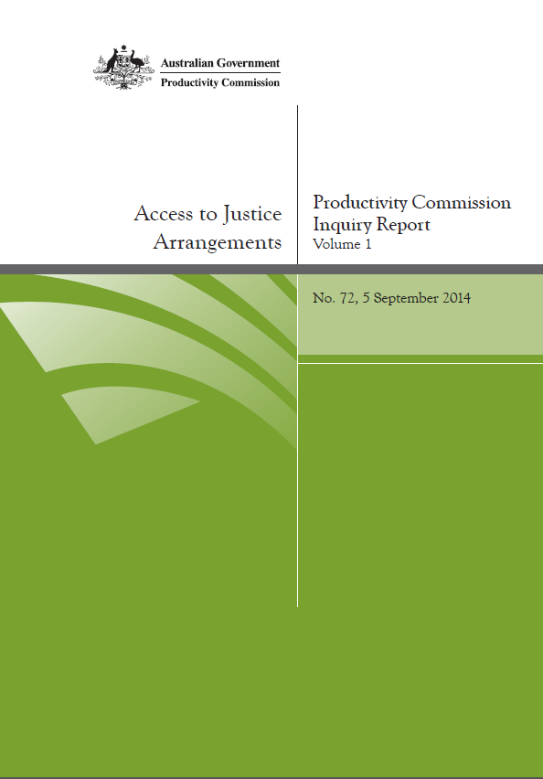
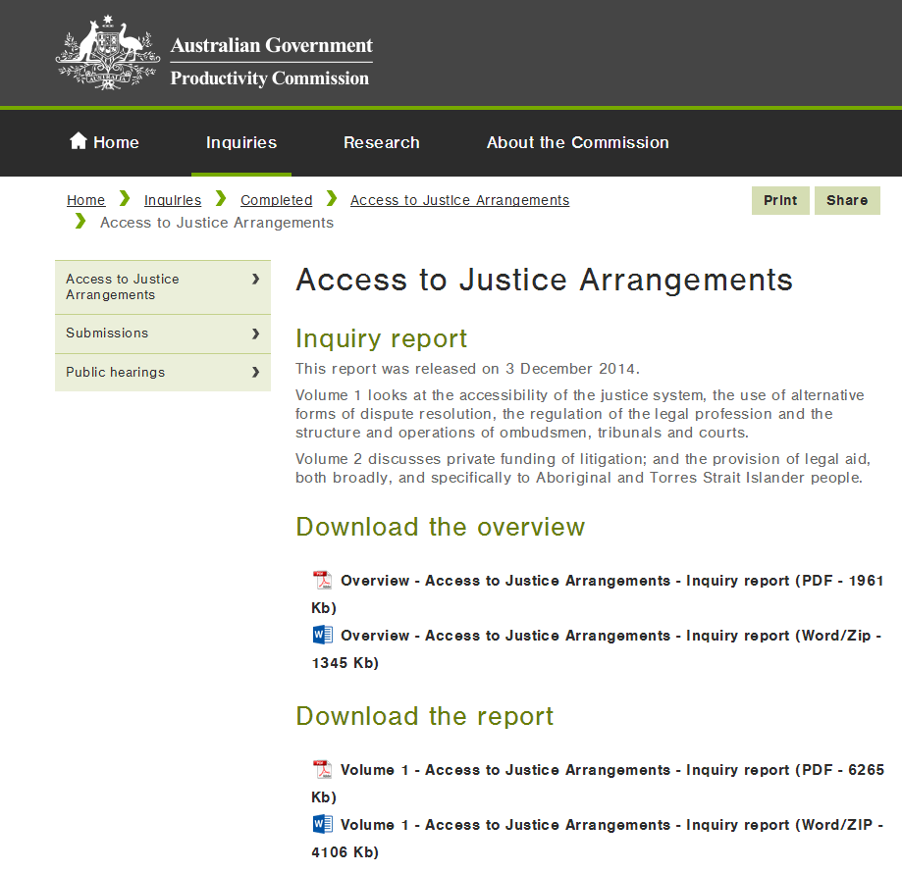
The Inquiry report is available online
http://www.pc.gov.au/inquiries/completed/access-justice

