Slide 1
Representing clients before the Mental Health Review Tribunal
Queensland Advocacy Incorporated
Rebekah Leong
QAILS Webinar 26/02/14

Slide 2
Outline
Background to representation
Scope of powers of MHRT
Initial contact with client and MHRT
Who can attend MHRT hearings?
Capacity
Documents, evidence and experts
At the hearing
Appeal process
Forensic matters
Referral sources

Slide 3
Representation statistics (2011-12)

Slide 4
Importance of representation
Quality and efficiency
Increase patient attendance
Clearly defines roles
Improves perception and understanding of process
Increase understanding and communication with treating team

Slide 5
Powers of MHRT
Review of ITOs – in first 6 weeks then every 6 months
Review of FOs – every 6 months,
Fitness for Trial – every 3 months in first year and then every 6 months
Applications to move out of Qld
Applications for ECT
Confidentiality orders
Exclusion of visitor appeals

Slide 6
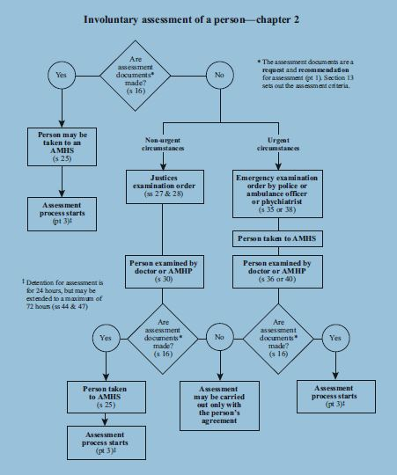
EEOs, JEOs and R&Rs

Slide 7
Initial contact with client and MHRT
Is it something the MHRT can help with?
When is the next hearing, is there value in applying for an early hearing?
Get written authority from client.
Send written authority to MHRT hc@mhrt.qld.gov.au advising that you now act for the client and request all documents relevant to the matter

Slide 8
Who can attend the MHRT hearing?
Patient Ch 12 Pt 4
Legal representative
Agent
Allied person s 455
Guardian – s 44 and 76 GAA Act
Support people
Treating team, Attorney-General representative, security guards

Slide 9
Capacity
Presumption of capacity
Capacity is time-specific, domain specific and decision specific
Capacity can be increased with appropriate support
Test for capacity:
Understanding the nature and effect of decisions about the involuntary order
Freely and voluntarily making decisions about the involuntary order
Communicating decisions in some way.
Formally appointed guardians or separate representative

Slide 10
Documents from the MHRT
ITOs | FOs
Notice of hearing | Notice of hearing
Clinical report | Forensic dossier
Notice of decision | Clinical report
 | LCT review committee recommendation
 | CFOS report
 | Notice of decision

Slide 11
Clinical reports
>6 days before hearing – 38%
3-6 days before hearing – 26%
1-2 days before hearing - 11.2%
Same day as hearing – 17%
Nil report – 4.7%
After hearing – 0.2%

Slide 12
Tips for representation
Proceedings are not adversarial – remember that in most cases, the client will have to maintain a relationship with the treating team after the hearing.
It is not all about winning. Positive outcomes for the client include: progress with their treatment, opening up a line of communication with the treating team, ensuring better participation and understanding of their diagnosis and treatment.
Encourage the client to participate in the hearing and speak for themselves. The lawyer’s role is to ensure the client has said everything they wanted to say and apply the law to the facts.
Avoid the situation where the client or their support/allied person unhelpfully hijacks a hearing. Prior to the hearing, explain to the client and any other people attending the hearing their role at the hearing. Try not to interrupt. Everyone will have their opportunity to speak and respond.

Slide 13
Tips for representation (cont)
Be ready to assist the client if they are having difficulties in expressing themselves properly.
Do not judge the client. Like everyone, they have a right to make their own decisions, even poor decisions.
Maintain boundaries. Ensure the client understands the role of their lawyer.
If your client intends to give false evidence at a hearing, inform them that it is an offence to provide false or misleading information to the Tribunal and that we cannot continue to represent them if they intend to lie. Also inform them that if they lie at the Tribunal hearing, we are under an ethical obligation to the Tribunal to inform them that we do not rely on that evidence.
Act on instructions

Slide 14
Appeal process
Written reasons within 7 days - 21 days
Appeal within 60 days
Form on court’s website www.courts.qld.gov.au
Representation through LAQ.

Slide 15
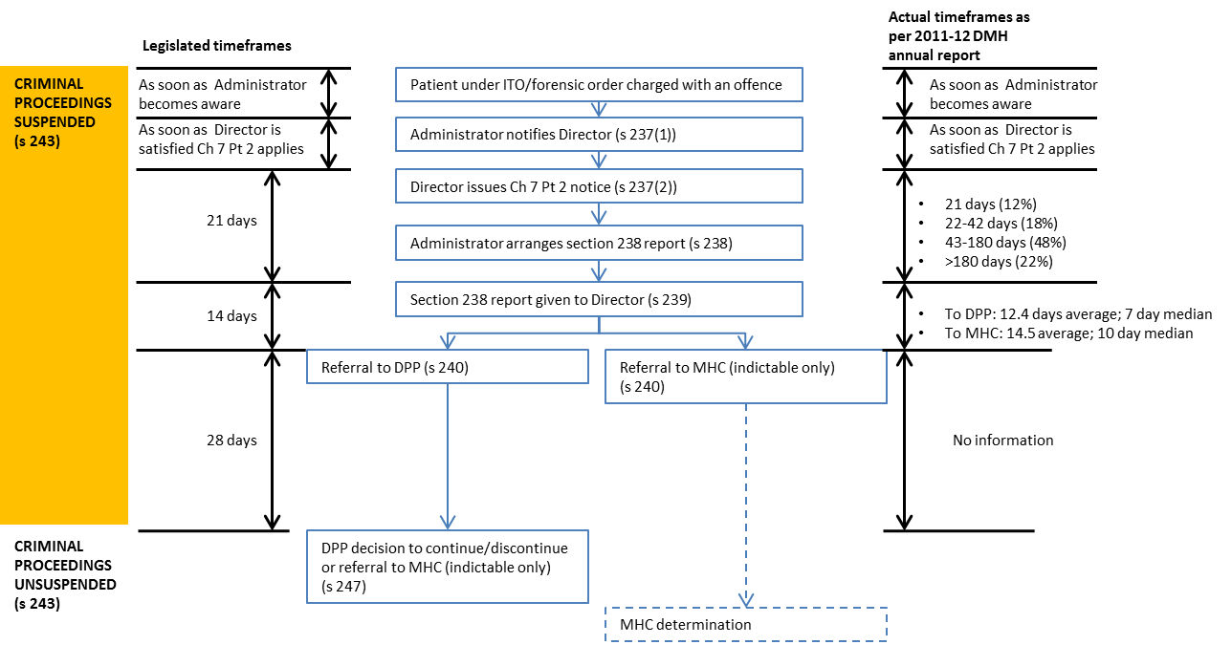
Forensic process

Slide 16
Organisations that do MHRT work
QAI – 3844 4200; rebekah.leong@qai.org.au
LAQ – advice and MHC matters
Legal – QAI, QPILCH, QADA, TASC
Advocacy organisations – Amparo, Independent Advocacy Townsville, Gold Coast Advocacy, Rights in Action (Cairns), Sunshine Coast Citizen Advocacy, Speaking Up for You, Mackay Advocacy, Queensland Parents for People with Disability, Capricorn Citizen Advocacy

