Slide 1
Is it ok not to pay? Building a community campaign around fines and SPER
Community Legal Centres Qld Conference
31 May 2016
Marissa Dooris
Homeless Persons’ Legal Clinic, QPILCH

Slide 2
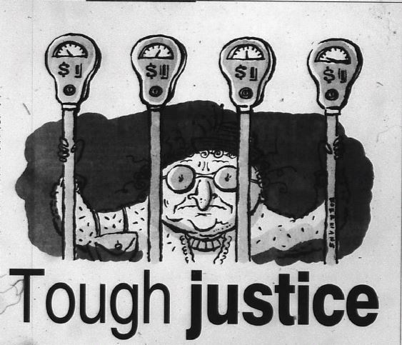
Today’s presentation
Key definitions and ideas
Before SPER
SPER today
Opportunities for systemic advocacy

Slide 3
Key definitions
To turn (a person) into a criminal, especially by making his or her activities illegal.
To turn (an activity) into a criminal offence by making it illegal.
Maintenance of what is just or right by the exercise of authority or power; assignment of deserved reward or punishment; giving due deserts.
That which is owed or due; anything (as money, goods, or service) which one person is under an obligation to render to another.
fig. Used in Biblical language as the type of an offence requiring expiation, a sin.
The condition of having little or no wealth or few material possessions; indigence, destitution.

Slide 4
Key ideas
Overcoming poverty is not a task of charity, it is an act of justice. […] poverty is not natural. It is man-made and it can be overcome and eradicated by the actions of human beings. (Nelson Mandela, Trafalgar Square, 2005)
Justice is not achieved through criminalisation or debt.
Marginalised people are more likely to be criminalised and fined but do not or cannot get legal assistance for these issues.
Ignoring or not paying a SPER debt can have negative consequence….but current options for are very limited.
Marginalised people are more vulnerable to negative consequences from fines. Legal issues tend to cluster, leaving people with fewer options.
To change the current system, we need to work together to tell our clients’ stories and present new options.

Slide 5
SPER debts and marginalisation
SPER debt sample from HPLC casework in 2014-15

Slide 6
What is SPER?
The State Penalties Enforcement Registry (SPER) collects and enforces unpaid fines, court-ordered penalties or monetary orders and some other debts for the state of Queensland.
SPER is is a division of the Office of State Revenue, which is part of Queensland Treasury.
SPER’s functions and powers are set out in the State Penalties Enforcement Act 1999 (Qld).
Notes:
SPER enforces
Un

Slide 7
Before SPER
“Statistics released last week revealed that of 1800 people jailed in Australia last year for defaulting on fines, 1600 were in Queensland. It is not news that people who don’t pay fines in this state go to jail, but the national comparative proportion is staggering.”
(Tony Koch, ‘Tough justice’, The Courier Mail, 22 July 2000)

Slide 8
Brief overview of SPER
Unpaid infringement notices
Infringement notice issued by non-court agency (eg, Department of Transport, Queensland Police Service)
28 days to pay in full, contest the fine or set up a Voluntary Instalment Plan.
Court-ordered penalties or monetary orders
If the person is found guilty or pleads guilty to an offence, a court may impose a monetary penalty or order payment of money (eg. restitution or compensation). The offender levy is also automatically imposed.
Victims of crime assistance
Victims of crime assistance is a financial assistance scheme administered by Victim Assist Queensland. Victims of crime can apply to Victim Assist Queensland for financial assistance.
If financial assistance is granted, the scheme manager can register the debt with SPER for collection. These debts do not attract SPER registration fees.
If no action is taken, fine is registered with SPER and a registration fee is added. Voluntary Instalment Plans are also transferred to SPER.
Once the penalty is entered in the Courts system, the monetary penalty and offender levy is registered with SPER. These penalties do not attract SPER registration fees.

Slide 9
Enforcement action
Driver’s licence suspension
Fine collection notice
Enforcement warrant
Immobilisation warrant
Warrant for arrest and imprisonment
Notes:
Fine collection notice – civil enforcement: Funds deducted from a debtor’s bank account or wages.
Enforcement warrant (two stages): impose a charge on real estate or personal property (house, vehicle, boat etc) and issue warrant to seize and sell real estate or personal property.
Immobilisation warrant: issue warrant to immobilise a vehicle with a wheel clamp
Warrant for arrest and imprisonment: last resort used by SPER once all other types of enforcement actions have been attempted. Section 119(3) of State Penalties Enforcement Act 1999:
The registrar may issue a warrant (arrest and imprisonment warrant), directed to all police officers, for the arrest and imprisonment of the enforcement debtor for the period stated in the warrant.
Complicated formula for calculating the period of imprisonment to be specified in the warrant is set out in section 52A.
Escalator image from the SPER website

Slide 10
Individual Consideration Team
Marginalised people are generally eligible for personalised services provided by SPER’s Individual Consideration Team (ICT) (formerly the Community Engagement Team).
The Individual Consideration Team can be contacted on 1300 131 510.

Slide 11
Who is a ‘disdadvantaged debtor’?
Clients who may be eligible for assistance through the ICT include:
People experiencing or at risk of homelessness
Asylum seekers and refugees
People with a disability
People with impaired decision-making capacity
People in rehabilitation
People with no capacity to pay (due to unemployment or reliance on social security benefits)
People in custody or recently released from custody
Aboriginal and Torres Strait Islander peoples

Slide 12
Limited options
The following options may be available for marginalised people:
Fine Option Orders (unpaid community service)
Manageable instalment plans
Deferrals of enforcement action
Good Behaviour Orders
Fine Option Orders and Good Behaviour Orders are not available for:
Compensation or restitution orders
Offender debt recovery orders (victims of crime assistance)
Offender levy

Slide 13
Issues with the current system
Automated and inaccessible for marginalised people; no outreach
Lack of public guidelines about exercise of power
Limited write-offs; no ability to negotiate waivers or reductions (eg, for the offender levy or SPER’s administrative charges) for people who cannot pay
No system of internal review

Slide 14
Opportunities for systemic advocacy
Anti-Poverty Week initiatives
Specialist courts
Role for the Queensland Sentencing Advisory Council
Judicial review options?
Work and Development Order pilots
Data collection and storytelling
Research links with other government debts
How are the people you work with criminalised?
How can we work together to address the issue of unmanageable debt to SPER for marginalised people in our communities?

Slide 15
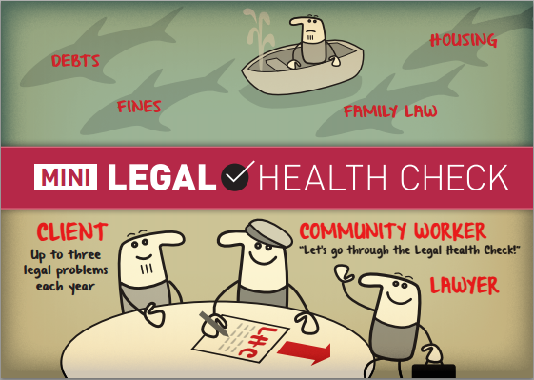
Contact us
QPILCH Outreach Legal Clinics www.qpilch.org.au
Ph: (07) 3846 6317 Fax: (07) 3846 6311
PO Box 3631, South Brisbane BC QLD 4101
Coordinator: Cameron Lavery
Email: hplc@qpilch.org.au
Lawyer: Marissa Dooris
Email: hplcresearch@qpilch.org.au
Lawyer: Faye Austen-Brown
Email: hplclawyer@qpilch.org.au
Lawyer: Fiona Thatcher
Email: hplcproject@qpilch.org.au
Administrator: Victoria Allen
Email: hplcadmin@qpilch.org.au
Project Officer: Michaela Transton
Email: legalpod@qpilch.org.au

