Slide 1
120
100
80
60
40
20
0

Slide 2
Now the buck stops with you
120
100
80
60
40
20
0
Risk Management

Slide 3
The Scheme
Wholly owned subsidiary of the Queensland Law Society
Captive insurer for profession in Queensland
Compulsory professional indemnity insurance
Lexon comprises 3 distinct but related arms
Risk Management
Claims
Underwriting

Slide 4
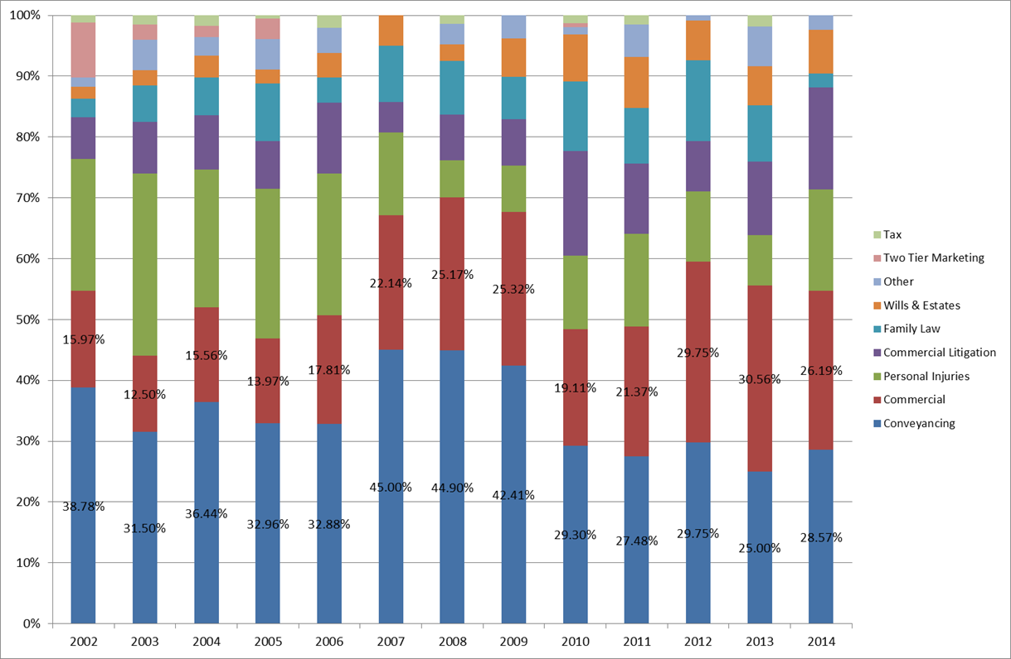
Where are claims coming from so far?

Slide 5
What will a claim cost me?
Level of cover - $2 million per claim

Slide 6
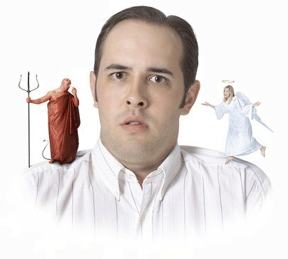
Practice Areas
What areas of law will you practice in?
How will you keep up to date with changes to those areas?
Will you always stick to that? No exceptions? Even for a valued long-term client?
What about doing it for family and friends?

Slide 7
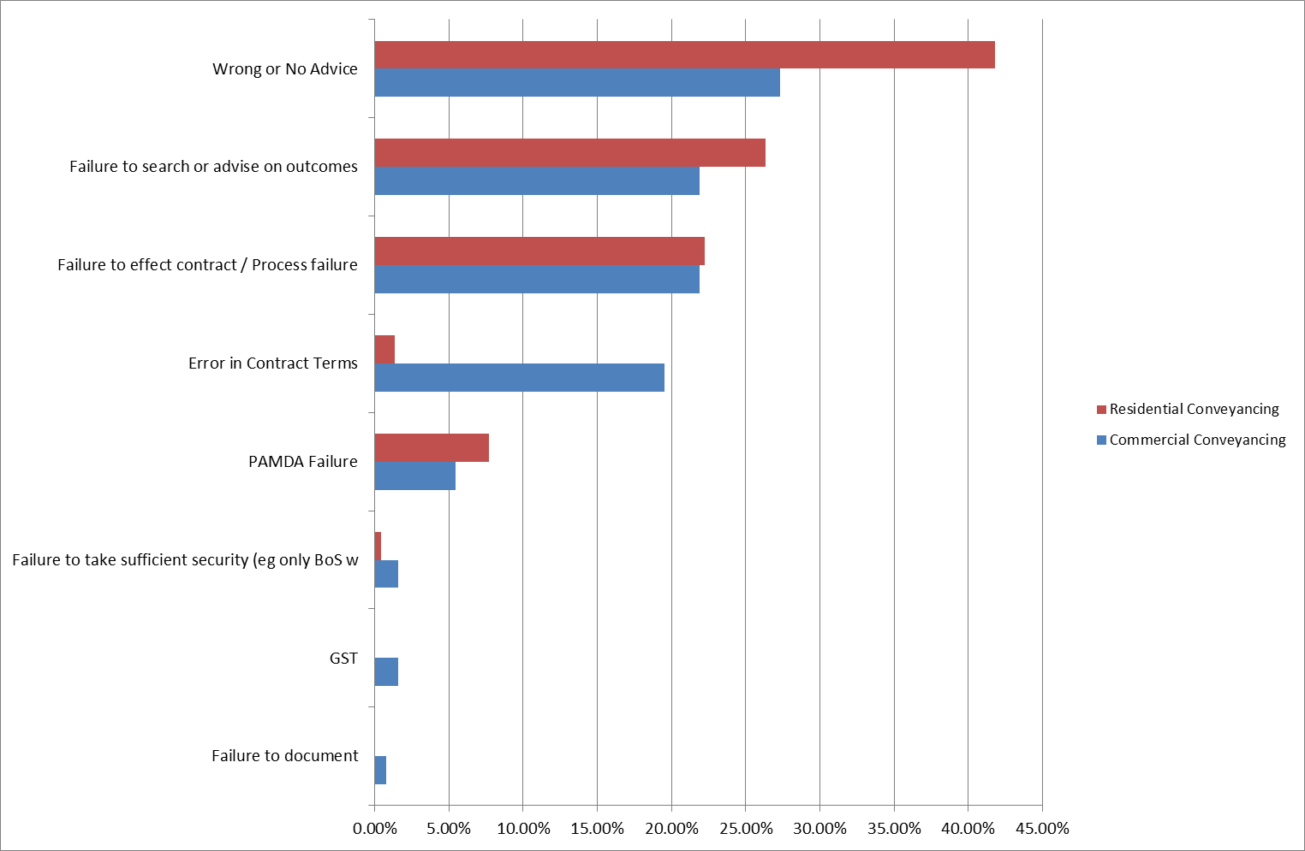
Conveyancing Claim Allegations

Slide 8
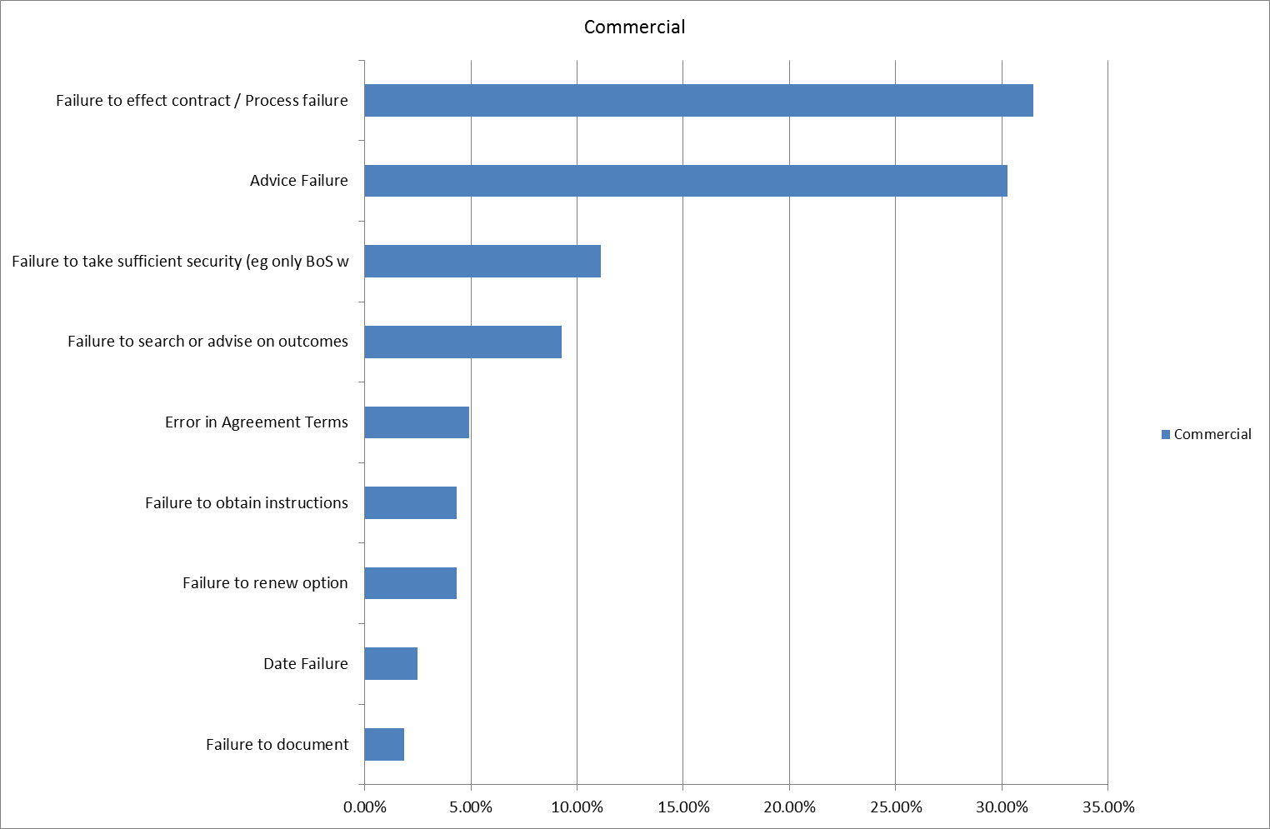
Commercial – Claim Allegations

Slide 9
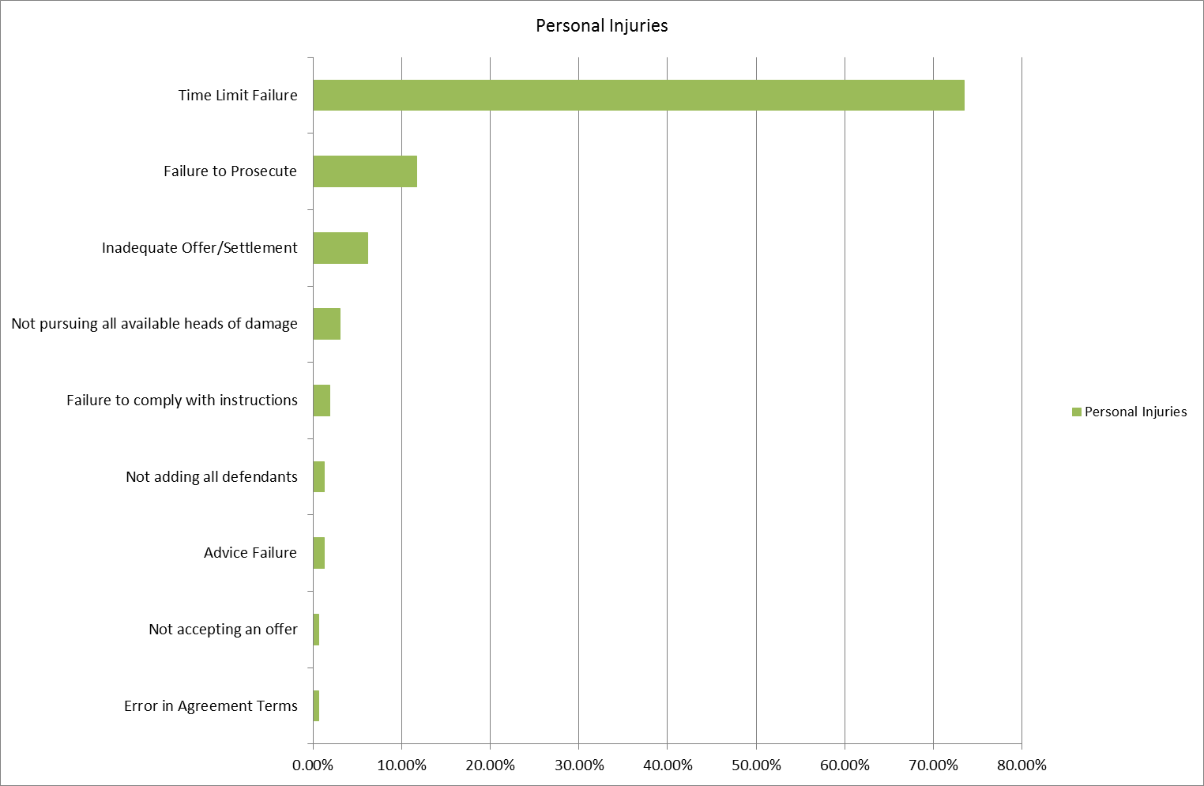
Personal Injuries – Claim Allegations

Slide 10
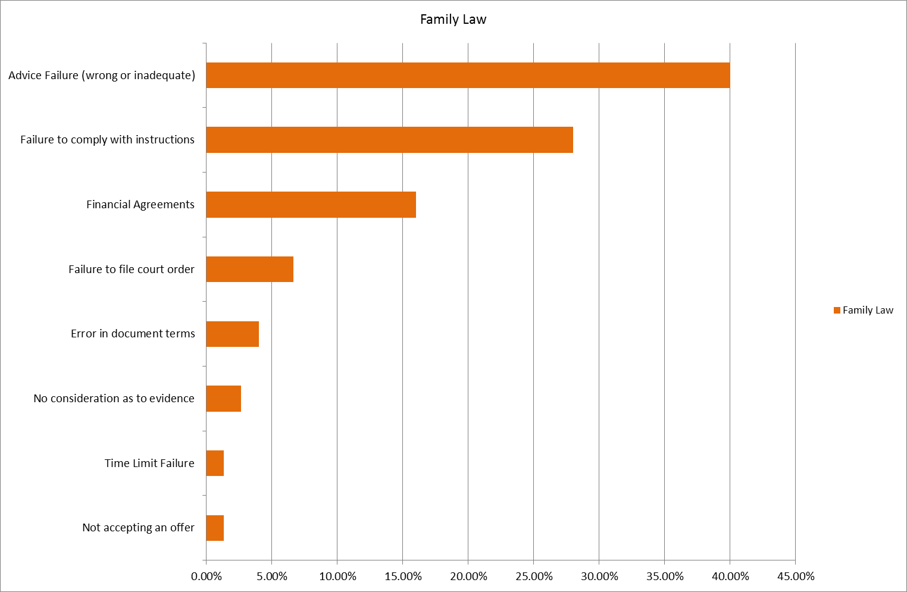
Family Law – Claim Allegations

Slide 11
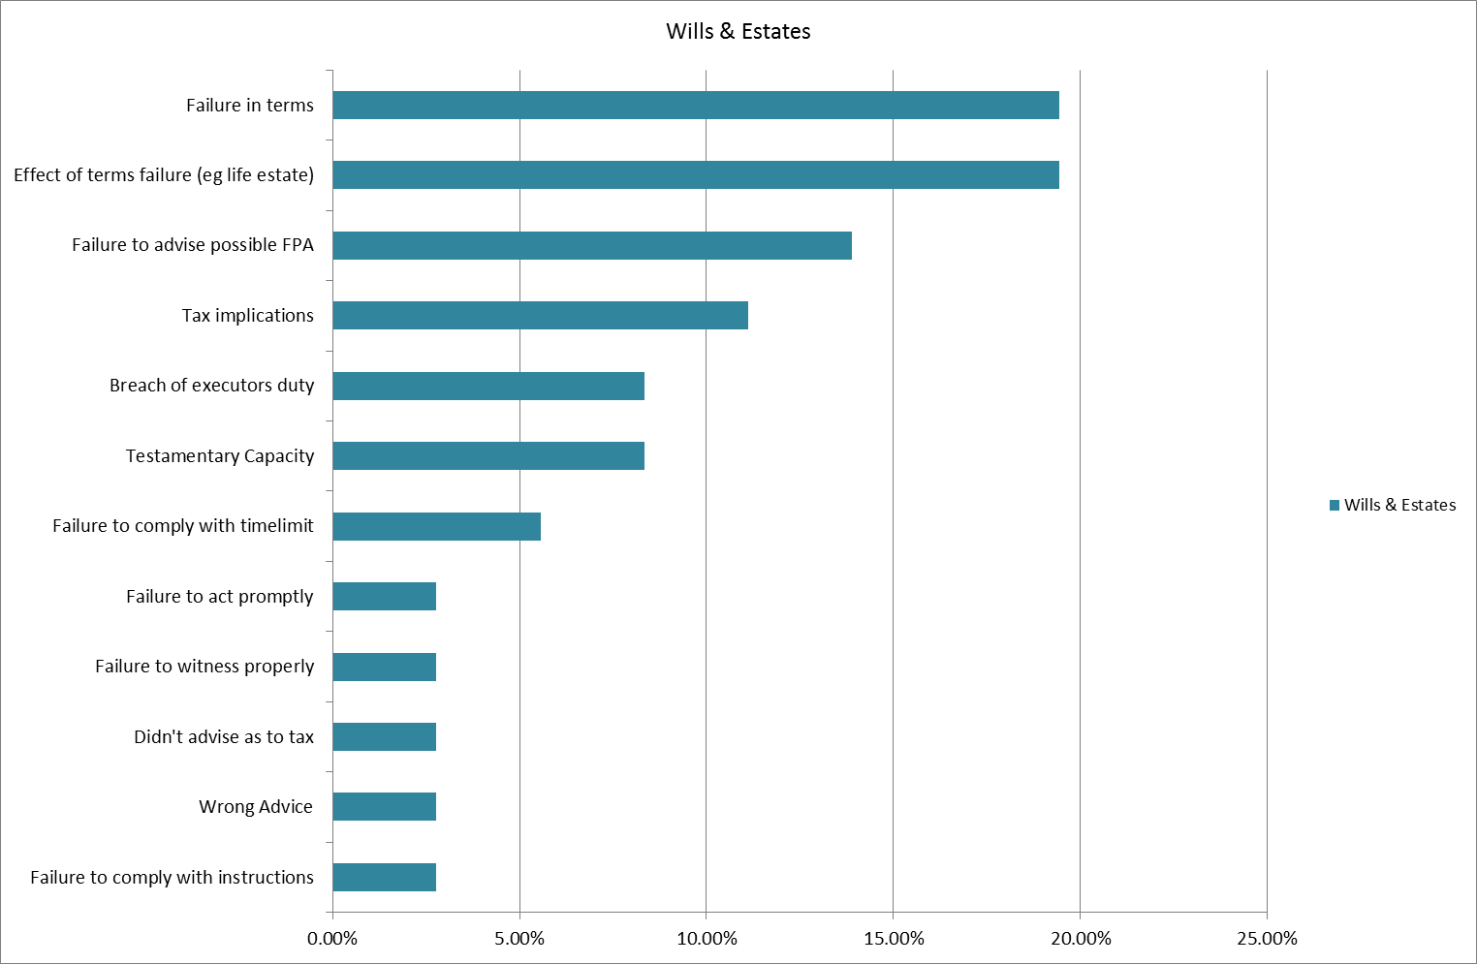
Wills and Estates – Claim Allegations

Slide 12
Why am I taking on this client?
Ask yourself more than simply:
“is it my area of law and do they have the money to pay me?”
Ask:
WHO are they?
WHAT do they expect from me?
WHEN do they want it?
HOW will I deliver on that?

Slide 13
The shopper
“I’ve had this file with other lawyers. They were idiots but I know you’ll do the right thing by me.”
“I would just like a second opinion.”
Ask:
- how many others?
- who were they?
- who left whom?
- what is wrong with first opinion?

Slide 14
The phantom client
“But I thought you were acting for me”
“We don’t even do Personal Injuries. The only claim we have ever had was when an employee chatted to someone at a party about their car accident. They gave some helpful ‘information’ without talking about limitation dates. I got sued”

Slide 15
The Angry client
Angry at someone/something
They can transfer hostility to you
Hard to please

Slide 16
The Crusader client
“I want justice”
“It’s not the money, it’s the principle” *
*(until I get your final bill…then it will be about the money)”

Slide 17
The Scrooge
Negotiate on your fees
“Firm X only charge $450 for a conveyance”
Ask you to cut corners
“just give me a one-pager”
Reluctant to sign costs agreement
Slow to pay

Slide 18
Will you see them coming?
How are you going to identify these clients?
How will you manage this risk?
Not act (worth acting? heightened risk?)
Tighten controls (thorough paper trail)

Slide 19
Client’s expectations
Know your client
Know their objectives
Know their ‘risk profile’
Know what result they hope to achieve
Ask yourself: Are those expectations reasonable and achievable?
Ask yourself: What would I want to know if this was my matter?
Reflect back and document

Slide 20
Scope
Be clear, in writing, about:
The work you will be doing
The work you won’t be doing e.g. tax, commercial viability advice, separate but related issues
Update retainer as needed as matter evolves including stopping scope creep:
What’s in
What’s out
Advise risks re “What’s out” – check understanding

Slide 21
Communication
Clients don’t know what they don’t know
Clients don’t know what is important for you to know
May not ask the right (or any) questions
May not listen attentively
May not read all your correspondence
May not fully comprehend what they hear & read
May therefore genuinely believe “you never told me”

Slide 22
Communication
Protect yourself
Avoid misunderstandings and the he said/she said battles
What advice would you want if it was your matter?
Risks, Options and Potential Outcomes
Confirm, in writing, instructions received; advices given
Stay in touch – progress updates; prompt return phone calls/replies

Slide 23
How is this Happening?

Slide 24
Process Errors
Simple oversights (e.g. failure to check document, missed a date)
Incorrect knowledge or application of law
Incomplete grasp of facts (didn’t investigate, check or analyse sufficiently – often linked to poor communication with client)
Flawed legal analysis (missed an issue)
Flawed resolution strategy (matter drifted along because ‘too hard’ or ‘too busy’)

Slide 25
Process Errors
How will you manage:
All the steps in a process without overlooking one?
All the issues in a matter without missing one?

Slide 26
How do we manage this?
Ineffective solution: Relying on memory and expertise to avoid oversights and a failure to manage the legal processes
Effective solution: Augment expertise by implementing tools and prompts to identify issues and cross-check matters

Slide 27
Claim example – Personal Injuries
I acted on a ‘no win, no fee’ basis in a slip & fall matter. When more was known about the circumstances, the injury and the economic loss, I thought prospects of success were poor.
Discussed this with client. They said they would go away and think about what to do next.
Closed my file, never heard from client again until….
What could go wrong…

Slide 28
Claim example - continued
… We received letter from her new lawyers, claiming negligence in missing limitation date.
In retrospect I should have confirmed the end of the retainer in writing, also reminding her of the limitation date and to take steps to protect her interests if she wished to pursue the claim.
My firm has non-engagement letters as a standard precedent. I use them regularly, but cannot explain the oversight on this occasion…perhaps subconsciously I thought this was not making me money. The irony is it ended up costing me money.

Slide 29
What’s really going on?
Checklists and systems used to augment expertise, reduce risk
Why is it some firm systems still fail?
What else might be done in addition to checklist use?

Slide 30
Example Responses
We didn’t have file reviews – I did ask about legal issues but rarely – they were supposed to be very competent and I trusted them. SUPERVISION
We did have a lot of big deals on at the time and I think the employed solicitor might have been overwhelmed particularly as they had been out of this area of practice for a while. It was like jumping in the deep end and it didn’t help I was on leave. TOO BUSY
They had massive mood swings so much so that when I was away other people in the firm refused to deal with them. There were lots of days absent without any notice. HUMAN FACTOR
We didn’t have a checklist for that part of these transactions at the time. We do now. LEGAL ISSUE
I just had way too much on – I was carrying the load of 2 other solicitors as well as my own work. It’s no wonder I missed this simplistic issues (which I am well aware of). TOO BUSY/ LEGAL ISSUE

Slide 31
Example Responses
We had just moved offices at the time and I was having a lot of difficulty with my wife who was trying to help. I just lost focus. HUMAN FACTOR
I have diagnosed depression am on medication and had difficulty managing the client. HUMAN FACTORS
No one ever came in and looked at my files. SUPERVISION
I drafted the material but left it unclear if it was the client or the firm who was to check for the correct version. SCOPE
We never checked the conveyancing clerk’s work. Significant client interactions not file noted – never checked by file review. SUPERVISION / EVIDENCE
The clerk had too much going on at the time and didn’t pick up on the fine issues. TOO BUSY
There was no file note control in the firm at the time and the information just got lost. INTERNAL COMMUNICATION

Slide 32
Effect of Human Factor

Slide 33
Effect of Problem Clients

Slide 34
Effect of being Too Busy

Slide 35
Why were these issues not identified earlier?
CLIENT MANAGEMENT
SUPERVISION
HUMAN FACTOR
TOO BUSY
LEGAL ISSUE
TOO BUSY/ LEGAL ISSUE
TOO BUSY
HUMAN FACTOR
CLIENT MANAGEMENT
SUPERVISION
SCOPE
SUPERVISION / EVIDENCE
TOO BUSY
INTERNAL COMMUNICATION
Why are firms surprised when claims arise in these circumstances?

Slide 36
Real Life Example – Human factor
Sole Practitioner having trouble finding work
Obtains clients by dropping fees and taking on work outside his field of expertise
Too afraid to say no to work
Several matters escalate quickly and the Sole Practitioner is swamped
Matters are neglected as larger matters must be dealt with first, and due to the costing structure there are financial pressures mounting
Unable to up rates for matters to market rates as the matters are not being attended to

Slide 37
Human Factor Part 2
Sole Practitioner does not ask for help from support staff or colleagues and takes everything on himself
Suffers from depression and stress and does not ask for help
Due Dates on less valuable matters are missed resulting in multiple claims
Too Busy, Scope, Client Management
Human Factor

Slide 38
Lack of objectivity = unpleasant surprise
We weren't comfortable reviewing other partners’ files
I would walk into the practitioner's room to ask how things were going, and the practitioner always would start typing quickly and comment that he was "very busy"
I didn't realise how bad things had become until I talked about it with someone else
I thought it was burnout and I could work through it

Slide 39
Objectivity
How do we objectively know what is occurring in our practice?
How are you going with your files?
Is everything OK?
Do you have everything in the diary?
Any problems I need to know about?
How can we pick up on issues early when the system fails?
How do we pick up on underlying causes of claims while they are treatable?

Slide 40
A real life example – file review
Firm implements file review process
Two years later gets very busy
Stops file review program. Important billable work is a higher priority
New employee, 5 years admitted, said to be very experienced – employed to help with the workload
No file reviews

Slide 41
A real life example – file review
New employee had exaggerated experience
Created a series of problem files – potential claims
Principal ultimately discovers problems
Calls employee in to terminate employment
As leaving the firm, employee deletes all dates in diary system and takes 20 files
Wouldn’t it have been better if the firm could have seen this coming and intervened earlier to prevent problems?
Not just employees

