Slide 1
Legal Health Check Pathways
MODULE ONE: Introductory Concepts for Legal Assistance Services

Slide 2
Introductory Concepts
1. Legal Health Check Basics
2. What are LHCs good for at a Legal Assistance service?
3. What can you change?
4. Is it worth it?

Slide 3
1. Legal Health Check Basics
DJAG LHC Project 2014-16
www.legalhealthcheck.org.au
Stories
Definitions

Slide 4
DJAG LHC Project 2014-16
Background: Since 2009, BYS/L&JF etc-Roma House-sharing thinking-LAQ videos-NACLC videos-QCOSS launch-ongoing feedback
Phases: QPILCH evaluation – Pilot sites evaluation
Pilots:
Maroochydore : Suncoast Legal, LAQ, Sunnykids (DV)
Toowoomba: TASC, Red Cross Homestay (Mental health and disability)
Cairns: ATSILS, Wuchopperen (Indigenous)
Products: Best practice guidelines and training for Legal Assistance Services/ Update resources / Evaluation report
Notes:
2 minutes

Slide 6
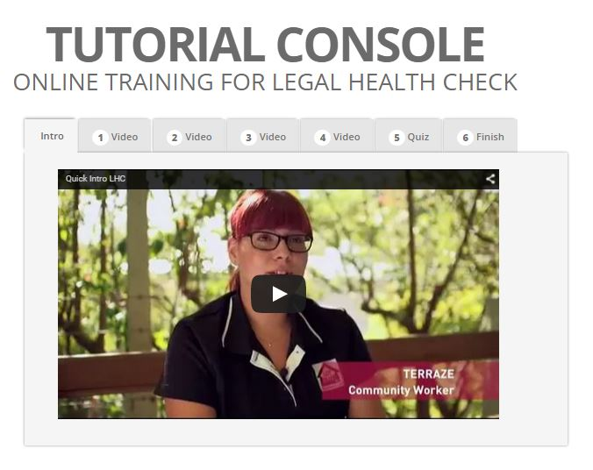
www.legalhealthcheck.org.au
Resources/four tutorial videos for community workers
NACLC/QPILCH site
40+ CLCs around Australia

Slide 7
Quiz time and prizes!!

Slide 8
Stories
QPILCH
Pilot sites
NT
others

Slide 9
Definitions
Legal Need= requires any access to justice response, such as resources, advocacy, advice or representation.
Actual Legal Need= the recognised AND unrecognised clustered legal needs of vulnerable clients
Some sections of the community are more vulnerable to legal problems than others
9% of Australians account for approximately 65% of legal problems
Legal problems more prevalent among socially disadvantaged groups, and these individuals tend to have lower capability to resolve legal problems
Legal problems are clustered with other legal problems and with non-legal problems
Not likely to recognize the issue as a legal problem or seek help from a lawyer. May seek help from non-lawyer, such as health and community worker.
Coumarelos C, et al, ‘Legal Australia-Wide Survey: legal need in Australia’ (2012) Law and Justice Foundation of NSW, Sydney

Slide 10
Collaborative Service Planning
“...to most efficiently and effectively assist those with the disproportionate amount of legal need, services should be increasingly client-focused, that is:
Targeted to reach those with the highest need and lowest capability
Joined up with other services to address complex life problems
Timely to minimise the impact of problems and maximise the utility of services
Appropriate to the needs and capabilities of users. “
Collaborative Planning Resource-Service Planning 2015 Law and Justice Foundation

Slide 11
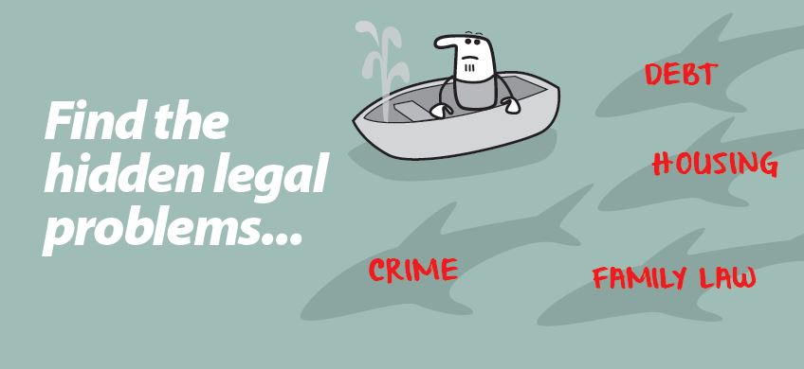

Slide 12
2. What are LHCs good for? (at a LAS)
2.1 Who are your potential clients and what are their actual legal needs?
2.2 What are the actual legal needs of your existing clients?
2.3 Do you want community agencies to connect their clients to you?
2.4 Do you want community agencies to diagnose their clients’ actual legal need?

Slide 13
2.1.Who are your potential clients and what are their needs? Fig.1
THE PATH TO YOUR DOOR
What the client knows
and can do
Legal
Assistance
Service
Centre-based
Outreach
Embedded
LHC offers:
-clarify range of legal issues
-grouping of issues
-Endemic add-on issues (“DV +”)
Notes:
TARGETED
2.1 Do you want to assist vulnerable populations (in your area of law/geography) to both understand and address their actual legal needs?
LHC =Awareness raising or needs assessment tool
Can use Legal Needs toolkits but effective results from LHC approach in a range of centres
Its not about whether your service is centre based on embedded, but about what processes/conversations/knowledge is shared, planned and prioritised
…at any point along your service delivery model
…its about how holistic you want to be from a legal perspective

Slide 14
2.2. What are the actual legal needs of existing clients? Fig.2
THE PATH TO YOUR DOOR
What the client knows
and can do
LEGAL
ASSISTANCE
SERVICE
Centre-based
Outreach
Embedded
+“Just-in-time” CLE
LHC offers CLE:
-process focussed
-for workers
-Client awareness of “DV+”
Notes:
TIMELY
Do you want to assist with the actual legal needs of your existing vulnerable clients?
OR do you rely on
The legal needs your service is actually addressing?
The legal needs your client is aware of and can access your service for?
(even with your excellent, targeted, just-in-time CLE program)

Slide 15
2.3. Do you want community agencies to connect their clients? Fig.3
THE PATH TO YOUR DOOR
What the client knows
and can do
LEGAL
ASSISTANCE
SERVICE
Centre-based
Outreach
Embedded
+“Just-in-time” CLE
+Community worker
engagement
LHC offers:
-Relationships & Communication
-Referral frameworks
-Training
-Resources
Notes:
JOINED UP
Observe path getting easier and bigger
2.3 Do you want the community agencies who work with your vulnerable clients (existing and potential) to connect their clients to your service?
Efficient and effective….
Relationships
Referral frameworks
Training
LHC is clear and concrete, but also flexible…tell a story

Slide 16
2.4. Do you want community agencies to diagnose their clients? Fig.4
THE PATH TO YOUR DOOR
What the client knows
and can do
LEGAL
ASSISTANCE
SERVICE
Centre-based
Outreach
Embedded
+“Just-in-time” CLE
+Community worker
engagement
+LHC is assessment tool
at community agency
CLC #2
Notes:
APPROPRIATE
Observe path getting more flexible and wholistic
2.4 Do you want the community agencies working with vulnerable populations to strategically identify the legal needs of their clients and connect them effectively to your service?
Referral frameworks
Training
Resources
Communication tools
VI-SPDAT ( Vulnerability Index – Social Prioritisation Decision Assistance Tool)
Outcomes Star
Recovery frameworks
QHIP (Qld Housing Info Platform)
…all recognise the complexity and capability issues around vulnerabilty, but either ignore legal needs or ask poor questions

Slide 18
3. What can you change?
Better to provide: “a more systematic diagnosis of a client's full range of legal and non-legal needs at entry, followed by a case plan for addressing all of those needs through coordinated response across all services”
Vulnerable clients require an assertive/persistent/wholistic/coordinated response (c.f. self-help, one-off or advice)
More Effective Social Services: Report of NZ Productivity Commission August 2015
Notes:
Realistically?

Slide 19
3. What can you change?
Task One: LAS Service Spectrum
What do you currently offer to your most vulnerable clients?

Slide 20
Legal assistance service spectrum
Advice: I can advise you about how the law applies in your situation
Referral to other legal services: I’ll connect you to more appropriate lawyers and advocates
Small task assistance: I can help with this specific task
Duty lawyer: I speak for you at this hearing today only
Casework: I advise, write letters and negotiate on your behalf
Representation: I speak for you before a court, tribunal, or during a mediation… I may be a barrister “instructed” by a solicitor “instructed” by you
Information, Community Legal Education and Community Development: Information about the law
Eligibility criteria and intake processes?
-legal issue
-client vulnerability
Law reform: Let’s try to change this for everyone impacted
Notes:
Are you mostly a crisis focussed emergency department or

Slide 21
3. What can you change?
Task Two: Which LHC is relevant?
What legal issues do your existing clients have?
Use your experience/casework statistics/assumptions/networks.
Also consider other legal needs diagnosis tool, e.g NACLC Legal Needs Strategic Planning Toolkit or emerging L&J tools

Slide 22
3. What can you change?
Task Three: What is one change you can make?
Strategic, assertive targeting of issues? (DV+)
Warmer referrals?
Collaboration protocol with other LAS ( LegalPod and LAQ Child Protection)
Form filling or discrete task assistance
Protocol with “problem agency” e.g. SPER
58% of HPLC clients had a SPER issue identified using an LHC, whereas only 8% of clients asked about SPER

Slide 23
3. What can you change?
Task Four: How might this make a difference for your client?
Story
Canadian research

Slide 25
4. Is it worth it?
Findings from evaluation
Lit review summary
Updates from around Australia
In short: A LHC can guide the non-legal practitioner, when they are with the client, as to what to say and what to do, about their client’s legal needs
What do you want to do in response to that ?
(Guidelines are next module)

Slide 26
LHC Evaluation (phase one) 2015
Does the LHC help in QPILCH settings?
Good concept, good document and good questions
Works best if actually complete form (3.5 vs. 1.5 legal issues per client)
Appears to influence community workers to engage with legal service and prioritise support for client which influences favourable outcomes for clients
BUT – busy lawyers and busy community workers rarely use form (could be result of entrenched LHC “approach”)

