Slide 1
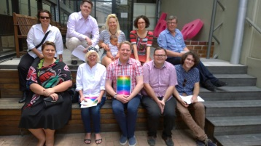
Project showcase
Expunging historical sex offences
Emile McPhee
Executive Director
30 May 2016

Slide 2
Background
Homosexuality was illegal in Queensland until 29 November 1990.
Offences ranged from ‘unnatural offences’ and ‘indecent practices between males’ to prostitution, sexual assault and public order offences.
We know people were charged with a range of offences, but don’t know exact number or exact offences.
In Queensland, we have a ‘spent convictions’ regime which allows non-disclosure for expired convictions, but that has exceptions (particularly around working with children and legal jobs).
To fully address the issues these convictions created, need to ‘expunge’ the conviction i.e. as if it never happened.
Similar reform occurring in Vic, NSW, SA and was underway in Tas.

Slide 3
Alan’s story
Alan was on the Cairns foreshore late at night in 1988.
Approached by a young man who stared suggestively at Alan, before walking into the adjacent gardens hidden from view. Alan followed at struck up a conversation about a nearby group, to which the man replied he wasn’t interested in other people. Alan took this as an encouragement and brushed against the man’s genitals.
The man then announced he was a police officer and arrested Alan. He was formally interviewed and asked whether he had shown control over his “sexual urges”. He was told he would be charged with aggravated sexual assault.
At Court 2 weeks later, Alan was allocated a caseworker. As Alan had indeed touched the man, he thought he should plead guilty and did so, receiving a suspended sentence.
Following this conviction, Alan was forced to abandon his dreams of being a teacher, which he had studied for but was told not to apply for registration because of the conviction.

Slide 4
What we did
Initial discussions between a number of organisations (including HRLC, Pride, QAILS, Caxton) identifying the need and the momentum being gained in other states
Tried desperately to find examples of people affected
Worked closely in conjunction with Allens, who developed our discussion paper:
Historical criminal treatment of consensual sexual activity between men in Queensland
Continued to lobby the Government and work with news and community organisations to keep traction
Provided discussion paper to Queensland Law Reform Commission and Attorney-General in September 2015
AG announced referral to QLRC in January 2016, response due 31 August 2016

Slide 5
Our recommendation
Create a new expungement scheme (i.e. don’t use spent convictions or pardons scheme).
Have a wide range of ‘eligible offences’ and ‘conviction’ to which the scheme applied.
Allow anyone the subject of a conviction, or their representative, to make an application.
Individuals apply to a panel (which would include a member of the LGBTI community) for expungement by giving basic details. Information is then collated from the relevant Departments and the applicant can be asked to give further information if necessary.
Expungement granted if, on balance of probabilities, the person would not have been convicted but for the fact that they engaged, or were suspected of engaging in, same sex or gender diverse activities, and that behaviour would not result in a conviction today. Consent and age must be considered if relevant.
A decision to expunge means the offence is treated as if it never occurred. Primary records should be annotated and secondary records destroyed or fully de-identified.

Slide 6
Who was involved
Undeniably a team effort
Organisations included:
Allens
Human Rights Law Centre (Victoria)
Caxton Legal Centre
QAILS
Pride Festival
Queensland AIDS Council
Townsville Community Legal Service Inc
Individuals including Alan Raabe

Slide 7
Where are we now
QLRC to provide report by end August 2016
Scope of engagement limited to how to implement reforms
Still a long way from getting actual tangible reform

Slide 8
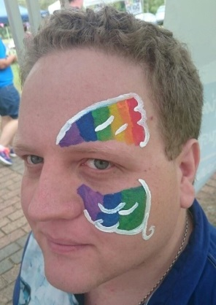
Contact
Emile McPhee
Executive Director
T 0438 766 176
E info@lgbtilegalservice.org
Disclaimer: This presentation covers legal and technical issues in a general way. It is not designed to express opinions on specific cases. This presentation is intended for information purposes only and should not be regarded as legal advice. Further advice should be obtained before taking action on any issue dealt with in this presentation.

