Slide 1
Using Theatre for Community Legal Education
Toni Wills
Project Officer
Suncoast Community Legal Service Inc

Slide 2
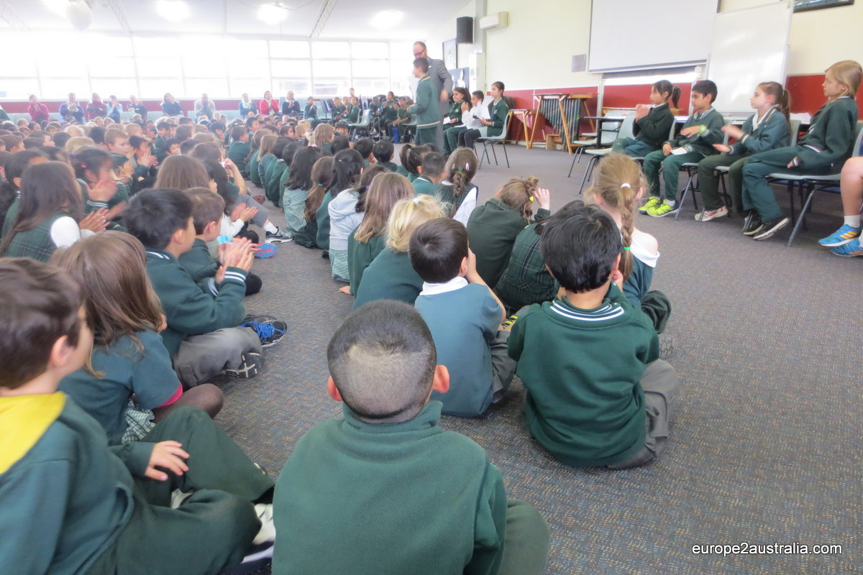

Slide 3
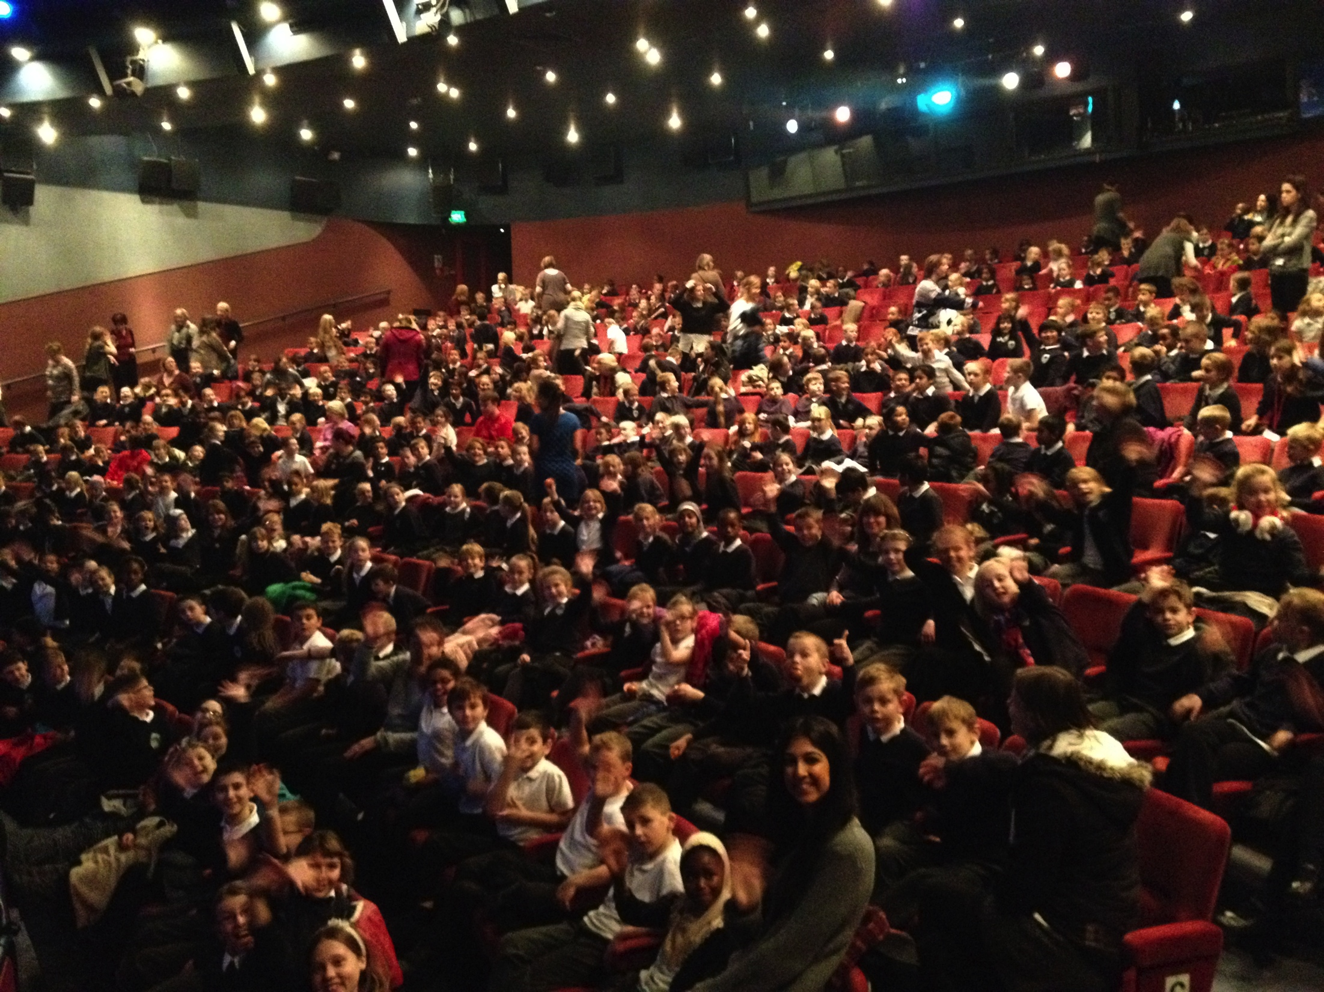

Slide 4
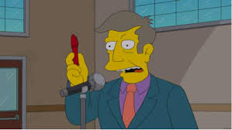

Slide 5
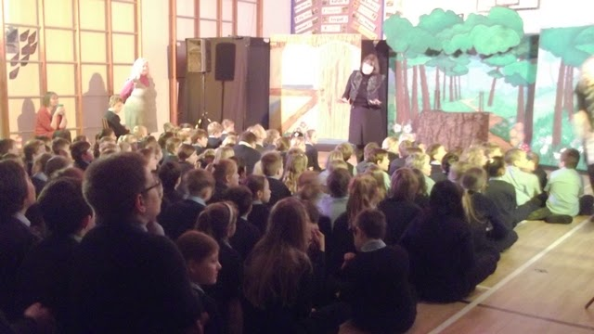
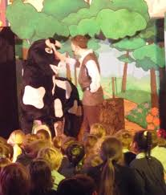

Slide 6
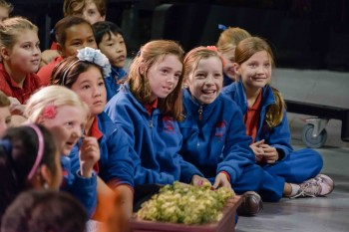

Slide 7
What?
Why?
How?
Where?
When?

Slide 8
What?

Slide 9
Why?
Why Theatre?
Extend our reach/attract different audiences
Talk about different/sensitive topics
Media
Why these legal topics?
Demographics of the Sunshine Coast
Extension of past project
Popular topic
Promotion of services available for people

Slide 10
How?
University research degree/partnership
Public Reading
Feedback
Funding to work with Theatre Director/Dramaturg
Radio Play Recording
Scheduling of Performances
NEXT
Promotion
Rehearsal
Shows

Slide 11
Where? When?
In Community Theatres
Buderim (War Veterans Memorial Hall)
Noosa (Noosa Arts Theatre)
Nambour (Black Box Theatre)
Matinee and Evening Performances
19th to 24th September 2016

Slide 12
Thank you

