Slide 1
DV Duty Lawyering
Julie Sarkozi
Outreach Lawyer
Women’s Legal Service
Outreach Lawyer with WLS since October 2012
FRC advice lawyer, LAM, Telephone and face to face advice, DV Duty Lawyer at Holland Park Magistrates Court. My background – NSW duty lawyer – local court, ATSIL’s duty lawyer QLD.

Slide 2
What WLS does:
Provide duty lawyer service at the Holland Park Magistrates Court – self funded – since 2012
Provide duty lawyer service at Caboolture Magistrates Court – LAQ pilot project – since 2015
Provide duty lawyer service at Ipswich Magistrates Court –LAQ pilot project – since 2015.
Other CLC’s are also providing the DV duty Lawyer service through the recent fund and LAQ program.

Slide 3
‘Best Practice’ in DV duty lawyering.
Ethical implications:
“The majority of people who experience domestic and family violence in Queensland are women. This is not to say that women cannot be the perpetrators of fear and violence upon male victims. Men can be and are victims of violence and coercive control, and are victims of domestic and family violence homicides. Any domestic and family violence, regardless of who the victim and perpetrator are, is unacceptable. The statistics (detailed at some length in this Report) tells us, however, that the most common pattern of domestic and family violence is that it is committed by men against women.
Understanding the gendered nature of domestic and family violence is vital in designing the response model and identifying reforms to provide better support to victims and measures to change the culture.”
Not Now, Not Ever – Report by Quentin Bryce 2015.
WLS is one of the few women only dv duty lawyer services, however, I would support and encourage all duty lawyers working in this area to be aware of the gendered nature of domestic and that this inform your work practice.

Slide 4
Not Now, Not Ever
Possible best practice initiatives:
Private waiting rooms
Domestic and family violence lists
Court support/liaison workers
Dedicated prosecutors
Outreach workers
video-conferencing facilities
Justice stakeholder group meetings
Pro-bono legal advice and representation by local firms
Dedicated domestic and family violence magistrates
Provision of interpreters.
CLC Model for a domestic violence duty lawyer service see pg 11 – Domestic Violence duty Lawyer Services for QLD Courts December 2014.
Notes:
Page 279 of the Not Now Not ever Report.

Slide 5
History of the provision of the duty lawyer service provided by WLS.
2012 – minimal staff.
Lawyers who wanted to maintain their advocacy skills.
Proximity to Local Court – Holland Park.
This court had no formal duty lawyer services.
Recognition of the lack of legal and other service support for women applying for domestic violence orders.
Identification of need – compatible with organisational and staff prioritises.
Recognition of the impact that domestic and family violence has within separation and family law jurisdiction.

Slide 6
In the beginning …
Contact with other organisations to work together with WLS to provide a co-ordinated ‘wrap around’ service for women seeking domestic violence applications.
Meetings – MOU – DVASS – made up of DV Connect, Registrar, Magistrate, Court Support Volunteers, Police Prosecutions, WLS Solicitors and Social Worker, solicitor from local private practice, LAQ, QIFVLS.
Regular meetings – once every six weeks.
Resourcing – access to photocopying; access to rooms for solicitors and support staff, later to section off part of the foyer as women’s only space, access to documents held at registry of court (applications, orders, etc),

Slide 7
Expect the unexpected.
Already had dv support services – in fact, quiet well resourced. WLS social workers stopped going.
For various reasons, the private law firm who provided duty lawyer service to respondents stopped attending.
Lack of duty lawyer service for respondents – slows down opportunities for resolution and meaningful negotiations.
Photocopier not working.
Lack of referral from support services holding on to clients.
Notes:
Because the support service are already there, and can give procedural advice to clients about what to expect, you have to look at what value does a lawyer add. The key things are: appearing in court, quickly putting together better evidence.

Slide 8
In practice:
Staff at Holland Park – 2 lawyers, 2 volunteer paralegals
Court provides DV list day before for the Holland Park Court this depends on registry staff ad when the dv court happens – conflict check done prior to attendance at court.
DV Court was moved from afternoon to the morning to take into account women who needed to pick up children from school.
WLS Triage clients based upon vulnerability – CALD, disability, ATSI, and some level of self-referral. Private aggrieved, Police respondent.
Any new additions to court list – paralegals call back to office for conflict check.
Security provided by the Court during DV Court – some incidents have occurred.
Notes:
Conflict checks prior to court attendance depends upon the size of the list – Holland park 20 – 30 matters, whereas Ipswich court can be 70 – 90 matters.

Slide 9
In practice (cont)
Flexible needs driven service – will draft where resources available, represent, advise, etc.
Back at the office – precedent open and closing letter.
Having to draft Stat. Dec. to support client’s material on the spot.
Police prosecutors with varying degrees of interest/ motivation.
Magistrates – unpredictable.

Slide 10
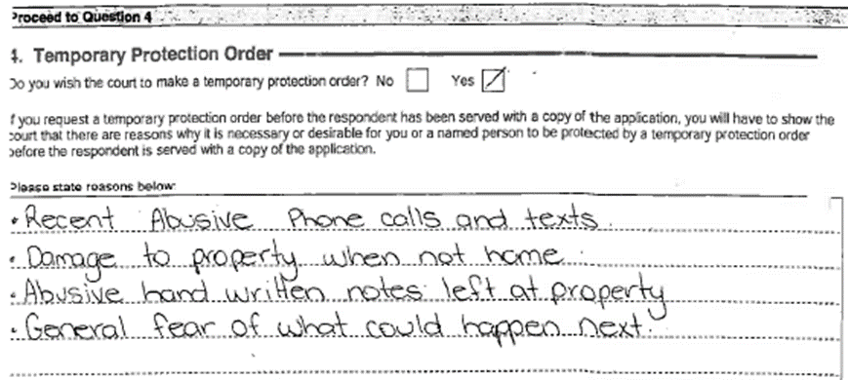
Example 1

Slide 11
Example 1

Slide 12
Example 2

Slide 13
Example 2

Slide 14
Importance of relationships
Building trust with existing dv support service – showing what lawyers can do – adding value:
Appear;
Draft documents;
Advise on merit of application;
Give family law advice;
Also important with Police, Registry, Volunteers, other lawyers.
This is why regular stake holder meetings so important.

Slide 15
Skilling up workers who are new to this type of service.
Know the Domestic Violence Family Protection Act
Do some training – QUAILS, LAQ, FLPA.
Talk to other services – WLS, happy to help.
DO IT!
Client doesn’t know what is happening with their matter, providing procedural information is very important, but also make sure you have correct forms – vary/ withdraw/ stat. dec’s.

Slide 16
Wishful thinking…
LAQ – Application Assistance Program – where clients actually get assistance to fill out the domestic violence forms.
Child care.
Support workers – link women into emergency relief, crisis accommodation, transport. Safety planning
Lawyers – have carriage of matter from application to hearing.
Video conferencing and other protections for client so that they don’t have to be in court at the same time with respondent.
Adequate Police response to breaches and also seeking reasonable conditions on the orders.
Magistrates who have interest and training in domestic and family violence.

Slide 17
Why do this work?
Exciting, rewarding, and fun.
Can have a SIGNIFICANT impact on another persons life, and the outcome of their application.
Client is often very frightened and overwhelmed.
Maintain advocacy skills.
Domestic violence applications – unlikely to make a lot of money for private practice.
Fits into ‘ access to justice’ mandate.

Slide 18
Questions

