Slide 1
JURISDICTIONAL ISSUES TO CONSIDER IN UNPAID ENTITLEMENT MATTERS
Michael Murray, Townsville Community Legal Service Inc.
Contact:
Address: Unit 2/181 Sturt Street, Townsville 4810
Ph: (07) 4721 5511
Fax: (07) 4721 5499
Email: solicitor@tcls.org.au

Slide 2
Overview
Jurisdictional issues to consider when advising employees on unpaid entitlement claims including:
State system employees
National system employees
Considering different venues

Slide 3
Overview
Basic considerations first →
Employee, independent contractor or volunteer? How does that impact on entitlements?
Full-time, part-time or casual? How does that impact on entitlements?
Where to find an employee’s entitlements?

Slide 4
Overview
Jurisdictional issues:
State System Employee or National System Employee
Mechanisms for recovery under the Fair Work Act 2009 (Cth) (the “FWA”)
How the FWA has impacted QCAT’s jurisdiction, a brief consideration of Ervin and Ford
Other relevant factors to consider
Questions
Paper forthcoming

Slide 5
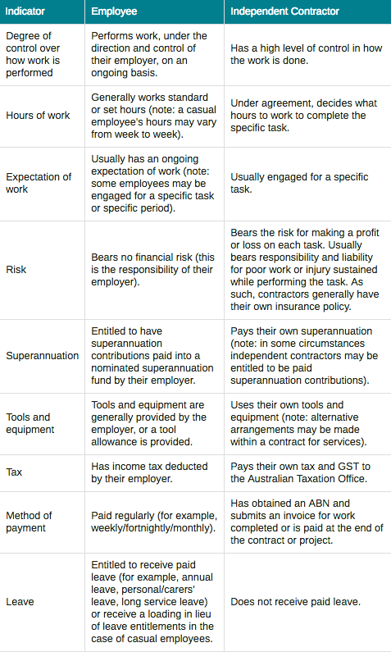
Basic considerations
Who is an employee?
Why is this important?
Some considerations:
For more information, see:
https://www.fairwork.gov.au/how-we-will-help/templates-and-guides/fact-sheets/rights-and-obligations/contractors-and-employees-whats-the-difference

Slide 6
Basic considerations
What type of employee?
Full-time
Part-time
Casual
The type of employee changes entitlements

Slide 7
Basic considerations
Where do I find my entitlements?
Minimum entitlements – National Employment Standards (“NES”)
Queensland Employment Standards
Contract
Award
Enterprise Bargaining Agreement (“EBA”)
Still unsure, contact Fair Work Australia 1300 799 675

Slide 8
I’m a full-time employee, covered by an Award, and am owed entitlements, what do I do next?

Slide 9
State System Employee or National System Employee?
Generally the first jurisdictional question posed
What is a State System Employee?
State System Employee → Queensland Industrial Relations Commission (QIRC)
Section 278 of the Queensland Industrial Relations Act provides for civil remedies for unpaid entitlement matters
Applications can be made for unpaid wages, unpaid tool allowance, remuneration lost by apprentice or trainee due to contravention of section 391(2), contributions to the approved superannuation fund that are unpaid

Slide 10
QIRC
Monetary cap - $50,000.00
Proceedings to be commenced within 6 years
Representation? Generally not permitted for matters under section 278
Conferences
Costs
Appeals

Slide 11
QIRC
1. File the approved form
2. Directed to serve application by QIRC and set matter down for conference
3. Conference to help settle applications without recourse to a formal hearing
4. If application not resolved, matter is set down for a call over, prior to a formal hearing
5. Call over conducted to determine preliminary matters
6. Formal hearing conducted
7. Written decision handed down

Slide 12
National System Employees
All private sector employees are covered by the National Industrial Relations System (Fair Work)
This was established in 2009 under the FWA, which also established the FWC and the Fair Work Ombudsman (the “FWO”)
What is a National System Employee?

Slide 13
Mechanisms under the FWA for recovery of unpaid entitlements for National System Employees
Part 4 of the FWA sets out civil remedies available for unpaid entitlements
Section 541 – FWO Inspector may also apply for orders in relation to safety net contractual entitlements
Section 542(1) – Entitlements under contracts – For the purposes of this Part, a safety net contractual entitlement of a national system employer or a national system employee, as in force from time to time, also has effect as an entitlement of the employer or employee under this Act.
Section 12 of the FWA defines safety net entitlements to mean an entitlement under a contract between an employer and employee that relates to any of the subject matters described in the national employment standards, or may be subject to a modern award (minimum wages, overtime, penalty rates etc.)
Broad definition of entitlements

Slide 14
Mechanisms under the FWA for recovery of unpaid entitlements for National System Employees
Section 543 provides for means of enforcement of entitlements: a national system employer or employee may apply to the Federal Court or the Federal Circuit Court to enforce an entitlement.
Six year limitation period (section 544)
Section 545 sets out the Orders that can be made by particular courts
Federal Court or Federal Circuit court may make an order that unpaid entitlements be paid.
An eligible State or Territory Court can also order an employer to pay an amount to an employee if the employer was required to pay the amount under the FWA or a Fair Work Instrument
In addition, section 26 of the FWA provides it is intended to apply to the exclusion of State and Territory industrial laws. However, section 27 sets out that some State and Territory laws are not excluded by section 26, including claims for enforcement of contracts of employment.

Slide 15
QCAT’s jurisdiction for unpaid entitlement claims from national system employees
Where does that leave QCAT?
Is QCAT an eligible State or Territory Court?
Is QCAT capable of dealing with claims for enforcement of contracts of employment within the meaning of section 26 and 27 of the FWA?

Slide 16
QCAT’s jurisdiction for unpaid entitlement claims from national system employees
Ervin v Smipat Pty Ltd [2013] QCATA 153
Ford v Thexton trading as Family Legal and Thexton Lawyers [2014] QCATA 180

Slide 17
Ervin
An eligible State or Territory Court is defined in the FWA as:
A District, County or Local Court;
A Magistrates Court;
The Industrial Relations Court of South Australia;
Any other Court prescribed by the Fair Work Regulations

Slide 18
Ervin
QCAT is not defined as an eligible State or Territory Court in the FWA, therefore QCAT may not order an employer to pay unpaid entitlements owing to an employee under section 545(3) of the FWA
The FWA should be interpreted in a way that best achieves its purpose, the Courts referred to in the FWA as eligible State and Territory Courts form an exhaustive list of appropriate forums.

Slide 19
Ford
Agreed with Ervin in part.
For entitlements prescribed by the FWA, the Fair Work provides exclusive mechanisms for recovery. QCAT is not prescribed as an eligible State or Territory Court in the FWA for recovery of these entitlements. Therefore, for these entitlements, QCAT would not have jurisdiction.
However, for entitlements not covered by the FWA, so entitlements arising under a contract of employment that may exceed statutory entitlements, or are not provided for under the FWA, may be enforced in QCAT’s minor civil dispute jurisdiction, provided of course that it is a debt or a liquidated demand.

Slide 20
Where does this leave QCAT?
The FWA has certainly impacted on QCAT’s jurisdiction
There is no ‘one size fits all’ rule
The introduction of the FWA brought with it new mechanisms for National System Employees to recover unpaid statutory entitlements.
This includes, commencing proceedings in the Federal Court or the Federal Circuit Court to enforce FWA entitlements.

Slide 21
Where does this leave QCAT?
However, this is in addition to the right to pursue breaches of contract of employment in an eligible State or Territory Court as defined in the FWA.
This does not include QCAT, but would include the Queensland Magistrates Court.
QCAT may have jurisdiction to enforce unpaid entitlements where those entitlements are not FWA entitlements, and the claim is for a debt or liquidated demand.
However, considering the broad definition of entitlements under the FWA, there may be limited matters that would fall under QCAT’s jurisdiction.

Slide 22
If not QCAT…then where?
Under the FWA:
Federal Court and Federal Circuit Court can make any order the court considers appropriate if it is satisfied a person has contravened a civil remedy provision (section 545(1) of the FWA)
An eligible State or Territory court (Magistrates Court of Queensland) may make an order to pay an amount to, or on behalf of an employer, if it is satisfied the employer was required to pay an amount under the FWA or has contravened a civil remedy provision (section 545(3) of the FWA)

Slide 23
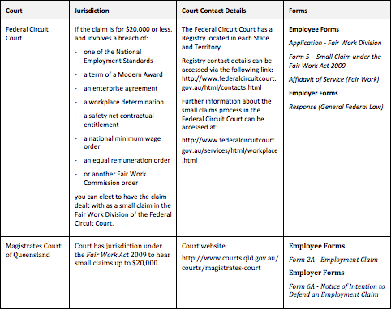
Small claims less than $20,000.00

Slide 24
Claims greater than $20,000.00
- General court action in a court of competent jurisdiction under the FWA

Slide 25
Some considerations…
Venue
Monetary Jurisdiction
Complexity of process
Filing and service
Legal representation
Legal costs

Slide 26
Venue
Is there a Federal Circuit Court (Civil Registry) that will accept a Small Claims (Fair Work Division) application?
Is it practical for your client to file matters in a different town or city?
Where will it be heard, including any interlocutory steps?

Slide 27
Monetary jurisdiction
Does your client meet the small claims monetary cap for small claims process

Slide 28
Complexity
If your client is self-representing, do they have capacity or skills to take and maintain action in certain venues?
Federal Circuit Court (Fair Work Division) Small Claim has simplified procedure:
Simple claim form
Judge not bound by any rules of evidence
Judge may correct any mistake in the application
Judge can act in an informal manner and without regard to legal formalities
Neither party can be represented by a lawyer, unless permitted by the Judge

Slide 29
Complexity
Employment claims in the Magistrates Court also has a different procedure from standard civil claims:
Simplified claim form
UCPR rules in relation to pleadings, disclosure, summary judgement, discontinuance, trials and hearings do not apply to some extent
Compulsory conciliation process prior to hearing, where there is limited right to representation
Limitation on awarding costs

Slide 30
Costs of filing and service
What are the filing fees for employment matters in QCAT, QLD Magistrates Court or the Federal Circuit Court?
Can your client afford the costs associated with litigation?
What other costs might there be?
What about service of documents?

Slide 31
Legal representation
Does your client require legal representation? Is it beneficial for your client to be self represented? Is it strategic to deny the other side legal representation?
QCAT → Generally not permitted, unless given leave (children, person with impaired capacity or complex questions of fact/law) – section 43 of Queensland Civil and Administrative Tribunal 2009 (Qld)
QLD Magistrates Court → Permitted in hearings (section 18 of Magistrates Court Act 1921 (Qld)) , but limited right for representation in conciliation process – section 42J of Magistrates Court Act 1921 (Qld)
Federal Circuit Court → Not permitted in Small Claims Division (Fair Work) without leave of the Court – section 548 of the FWA
Generally permitted outside small claims process in all jurisdictions

Slide 32
Costs orders
Would your client be at risk of a costs order? Does your client need a costs order?
QCAT – each party usually bears own costs – section 100 of Queensland Civil and Administrative Tribunal Act 2009 (Cth)
Costs can be made where in the ‘interests of justice’ (unfair conduct, complexity of dispute, strength of claims, financial circumstances of parties to the proceeding)
Federal Circuit Court (Fair Work Division) Small Claims – limited power to award costs – section 570 of FWA
Magistrates Court of Queensland Employment Claim – limited power to award costs – section 42ZC of the Magistrates Courts Act 1921 (Qld)

Slide 33
Useful contacts/referrals
Queensland Public Interest Law Clearing House (“QPILCH”) Self Representation Service in the Federal Circuit Court or Federal Court.
Caxton Legal Centre Inc. Employment Law Service
Working Women Queensland
Other generalist services – Community Legal Centres Queensland

Slide 34
Questions?

