Slide 1
Community Legal Centres Queensland 7 September 2016

Slide 2
Queensland Training Ombudsman

Slide 3
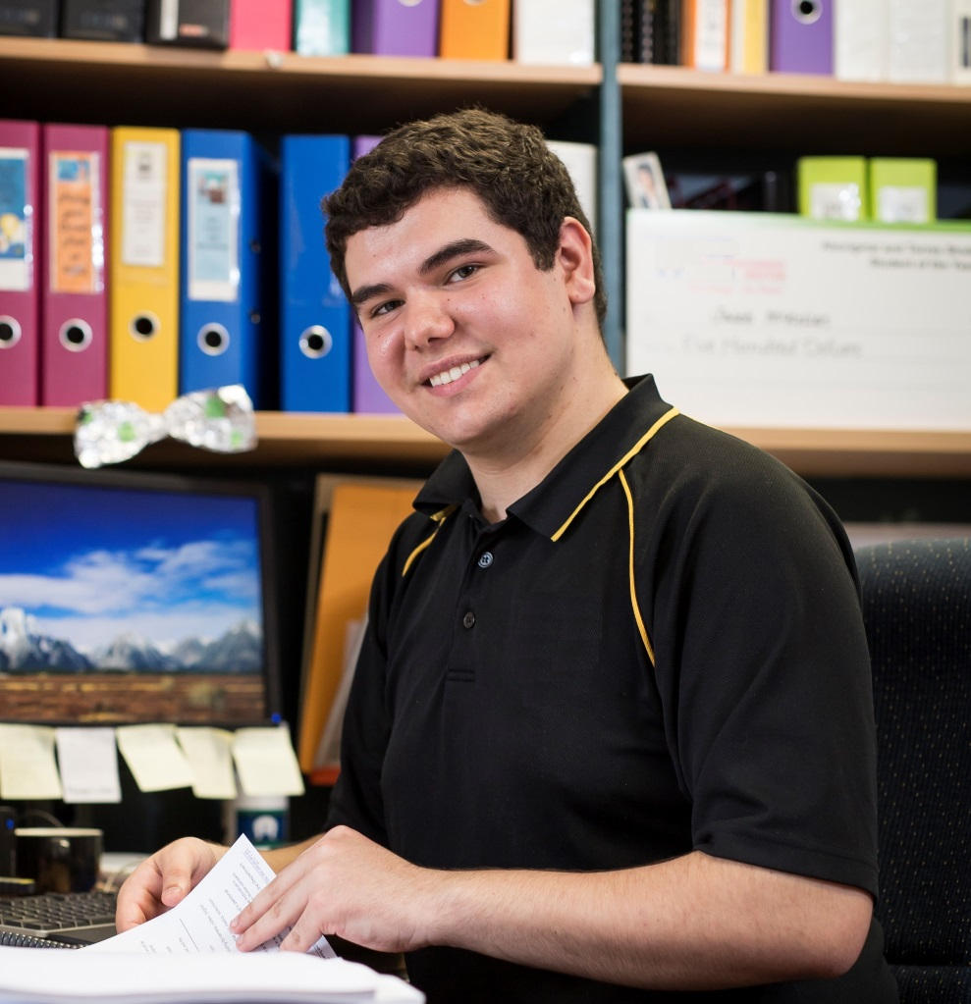
A high quality system is the only way for VET to effectively match individual aspiration with the opportunities created by employers, industry and communities

Slide 4
What is quality?
Meeting or exceeding customer expectations…
(Joseph Juran – Engineer, Western Electrical)
…the degree of excellence of a thing…
(Oxford Dictionary)
Reconsider your definitions. We are prone to judge success by the index of our salaries or the size of our automobiles rather than by the quality of our service and relationship to mankind.“
(Martin Luther King Jr)

Slide 5
Who is responsible for a quality VET sector in Queensland?
All stakeholders are responsible for quality
ASQA is not solely responsible for quality in Queensland’s VET sector
It is in everyone’s interest that poor quality, and perceptions of poor quality, are adequately addressed
The shared responsibility for quality makes it a confusing and complex environment for students and employers

Slide 6
Queensland Training Ombudsman will:
Receive, and where appropriate investigate, complaints about VET
Establish effective partnerships with all agencies with a role relating to VET in Queensland
Make recommendations to the Director-General in relation to complaints
Identify systemic issues arising out of complaints and make recommendations to the Minister for Training and Skills to strengthen DET policies and procedures

Slide 7
Queensland Training Ombudsman will:
Develop strategies and report to the Minister for Training and Skills on ways to improve the quality of VET provision in Queensland
Undertake or promote reviews or research
Perform other functions assigned by the Minister
Promote the quality of VET delivery in Queensland

Slide 8
Update on establishment of the Training Ombudsman
14 September 2015 – Interim Training Ombudsman appointed operating under Ministerial Charter
25 February 2016 – legislation to create the role of Training Ombudsman was considered
22 April 2016 – proclamation of legislation

Slide 9
Training Ombudsman so far…
Issue | Number of Complaints
Apprenticeships/Traineeships | 42
RTO Matter (incl FFS) | 64
RTO/PQS | 66
VET FEE HELP | 78
Other | 17

Slide 10
Training Ombudsman so far ….
Industry Sector | Number of Complaints
Arts and Entertainment | 22
Automotive | 4
Business | 34
Communications | 8
Community Services | 66
Construction | 19
Engineering | 10
Food Processing | 2
Furnishing | 2
General Education & Training | 3
Government | 1
Health | 15
Hospitality | 7
Mining | 6
Multiple | 7
Not Specified | 20
Primary Industries | 6
Retail | 15
Sport and Recreation | 5
Transport & Distribution | 9
Utilities | 6

Slide 11
Training Ombudsman so far ….
Location/Region | Number of Complaints
Central QLD | 21
DDSW | 12
Far North QLD | 16
Interstate | 19
Metro | 69
North Coast | 53
North Queensland | 16
Not Specified | 17
South East | 44

Slide 12
Training Ombudsman so far ….
Month received | Number of Complaints/Enquiries
September (commenced 14/9/15) | 4
October | 9
November | 20
December | 18
January | 14
February | 33
March | 31
April | 39
May | 49
June | 38
Total for 2015/16 | 255
July | 38
August | 33
Total for 2016/17 | 71
Total since commencement | 326

Slide 13
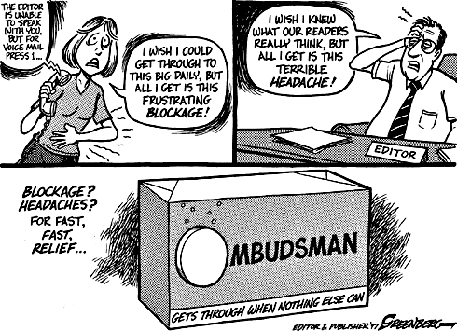

Slide 14
Contact Details
Office of the Training Ombudsman
Level 17, 53 Albert Street, Brisbane, 4000
PO Box 15090, City East 4002
Ph: 1800 773 048
E: info@trainingombudsman.qld.gov.au
W: www.trainingombudsman.qld.gov.au

