Slide 1
Best practice in collaborative service delivery – mental health law
CLCQ Webinar
Thursday 6th October 2016
The Mental Health Collaboration Project
An Initiative of QPILCH – Funded by DJAG
Project Lawyer: Deborah Stafford
MHLP.Secondee@QPILCH.org.au
Notes:
Thursday 6th October 2016 – Purpose of webinar is to showcase MHCP and raise awareness about better assisting clients with MI through collaboration Target: CLC lawyers engaging with non-legal professionals and support workers
What does this look like?
- exploring how to deliver legal services in collaboration with client’s support workers

Slide 2
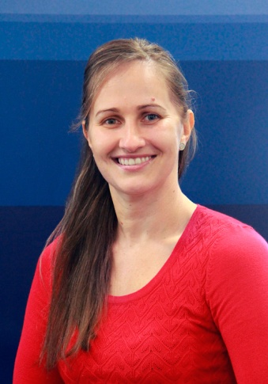
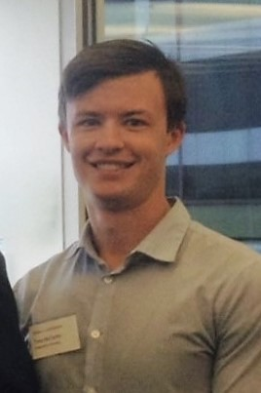
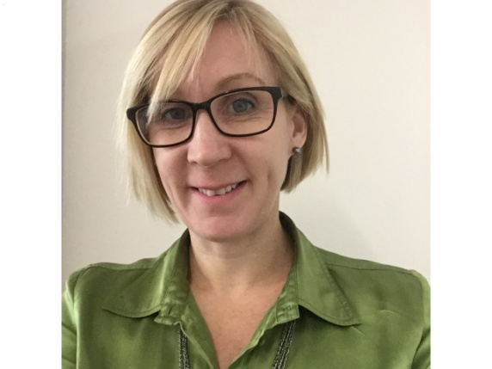
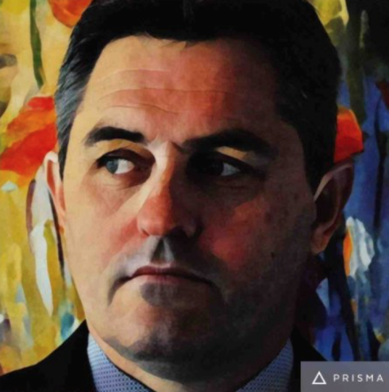
Panel Introductions
Deb – QPILCH Project Lawyer
Catherine – ADA Australia (Training)
Tony – Solicitor (Mental Health Legal Specialist)
Anthony – Barrister (background MH nursing)
Notes:
Panel Introductions
Deb Stafford – QPILCH Mental Health Law Practice (MHLP) – Project Lawyer for “Best practice in collaborative service delivery – mental health law” [Mental Health Collaboration Project]
Anthony Skelton – Barrister-at-Law, Queensland (background in Mental Health Nursing)
Tony McCarthy – Specialist Solicitor, Mental Health Legal Service (MHLS), Queensland Advocacy Incorporated (QAI)
Catherine Aitken – Senior Project Officer, ADA Australia (formerly QADA)

Slide 3
Project Focus
Client
[Lived experience or experiencing mental health concerns]
Other Professional/ Service [Health, Non-Legal Professionals & Support Persons / Advocates etc]
Generalist CLC Lawyer
Mental Health Collaboration Project
A collaborative client-centred approach using an integrated framework
Notes:
QPILCH Project Aim & Target Audience
To address the civil legal needs of clients experiencing mental health concerns (the client group) by developing resources for generalist lawyers working in partnership with non-legal caseworkers
Improving the delivery of legal services in collaboration with client’s support workers
Deliberate practice changes to be more effective at seeing mental illness; and addressing the client’s issues (currently ad-hoc).
Project challenges and limitations
Two specialist MH Legal Services n Queensland – QAI and QPILCH
Collaborated service delivery / integration of services – this approach is consistent with findings in the report
C Coumarelos et al., ‘Legal Australia-Wide Survey: Legal Need in Australia (LAW Survey Report, Law and Justice Foundation of New South Wales, 2012) Available
http://www.lawfoundation.net.au/ljf/app/&id=FC6F890AA7D0835ACA257A90008300DB
Access to Justice report – Productivity Commission
National Partnership Agreement – Legal Assistance Services: underpins principles and desired outcomes align with above.

Slide 4
Key Project Deliverables
Creating access | Developing and maintaining holistic legal services in generalist community legal settings and other relevant non-legal settings assisting the client group.
Mental health conditions | Understanding the spectrum and presentation of different mental health conditions.
Collaboration | Negotiating “another professional in the room” – including issues of confidentiality, privacy, taking instructions, delivering legal services & maintaining trust in collaborative settings.
Diagnostic tools | Use of legal needs diagnostic tools in mental health settings. Legal Health Check
Approach | A case-management approach – the alignment of legal services with recovery oriented health practices.
Client support | Family, carers and supporters – practical tips, ethical duties and augmented communication strategies.
Notes:
Project framework, resources will address key project deliverables – encourage, empower, effect change to enable more collaborative partnerships
RESOURCES = literature review, guidelines and training package, webpage with resources mentioned + videos + fact sheets + links to key resources
In this practical webinar we will examine elements of collaborative service-delivery which best meet the legal needs of clients with mental illness.
This webinar will provide you with best practice practical tips on collaborative practice when assisting this vulnerable client group . Webinar discussions will look at:
Communicating with clients
Collaborating with services to improve client outcomes Outreach clinics
Resources aimed to support lawyers within the CLC sector to help those centres to assist their clients, create access, improve outcomes (health, legal, social etc)

Slide 5
Definitions
Caseworker (used interchangeably Community / Support / Social Worker)
Includes any worker at any community, health or social service setting who is assisting vulnerable clients with non-legal need.
Actual Legal Need
The recognised and unrecognised clustered legal needs of vulnerable clients.

Slide 6
Creating Access
Collaborative Service Planning
“…to most efficiently and effectively assist those with the disproportionate amount of legal need, services should be increasingly client-focused, i.e.
Targeted | to reach those with the highest need and lowest capability
Joined up | with other services to address complex life problems
Timely | to minimise the impact of problems and maximise the utility of services
Appropriate | to the needs and capabilities of users.”
Collaborative Planning Resource – Service Planning 2015 Law and Justice Foundation http://www.lawfoundation.net.au/ljf/site/templates/reports/$file/CPR_Service_Planning_Nov2015.pdf
BEST PRACTICE:
Identify and address actual legal need
Outreach clinics
Training and Education – equip and empower staff

Slide 7
Creating Access
‘Legal Australia-Wide Survey: Legal Need in Australia (LAW Survey Report, Law and Justice Foundation of New South Wales, 2012) C Coumarelos et al
People with chronic illness/disability with legal problems require joined-up responses from legal and broader human services in order to address all of their needs.
A holistic approach to justice in Australia is required – Justice should be ‘made to measure’ according to the varying legal needs and capabilities of people and groups across the whole community.
Marking pathways to legal assistance via ‘problem noticers’ and other non-legal gateways at points that coincide with when a person may perceive a problem or become psychologically ready to act may also be a feature of the more holistic approach to access to justice (see Coumarelos et al. 2012; Genn 1999; Pleasence 2006).
Notes:
LAW Survey Available http://www.lawfoundation.net.au/ljf/app/&id=FC6F890AA7D0835ACA257A90008300DB
CLCs have pioneered many lawyer/social service collaborations “lawyers working with social services” - eg tenancy, DV, health, etc. Often, it is the non-legal services referring (or bringing) the client to the lawyer.
http://www.lawfoundation.net.au/ljf/site/templates/LAW_AUS/$file/AustraliaChapter1.pdf
‘legal capability’ → It has been argued that some people lack the capability to solve legal problems alone and may require broader non-legal support in addition to legal assistance in order to achieve legal resolution (Coumarelos et al. 2006; Forell et al. 2005; Genn & Paterson 2001; Mulherin & Coumarelos 2007; Pleasence 2006).
Knowledge – One must have knowledge to know rights have been violated.
beyond legal knowledge, people must have the necessary skills to pursue legal resolution effectively. At the most elementary level, they must have adequate literacy, language, communication and information-processing skills (Genn & Paterson 2001; Jones 2010; Kirby 2011; Nheu & McDonald 2010).
legal capability requires the psychological readiness to act and persevere until legal resolution is achieved. (for eg. confidence, determination, emotional fortitude)
Access to justice
To help increase representation before MHRT – QAI have developed guide to assist advocates Advocate’s Guide to Involuntary Treatment Orders
http://www.qai.org.au/images/stories/docs/2016/ITO_Review_Handbook_v5.pdf

Slide 8
Understanding Mental Health
BEST PRACTICE:
General understanding of mental health conditions / diagnoses
Trauma Informed Practice
Client connection & communication
Involve caseworker to better understand client &communication style
Client Interview considerations
How to effectively and sensitively communicate with the client
Taking instructions
Capacity considerations
Medications + identify any side – effects
Notes:
Expectations – general understanding of MH conditions
Communication: Build trust & rapport, then discuss MH diagnosis/diagnoses -- Does client agree? What does client think the issue is?
Trauma informed Practice http://www.blueknot.org.au/WHAT-WE-DO/For-Legal-and-Justice-Practitioners
Trauma related? If so, identify triggers to better assist … (ensure those triggers not in the CLC environment)
Training – see Blue Knot Foundation In-house training options (brochure)

Slide 9
Understanding Mental Health
Trauma-Informed Practice
Blue Knot Foundation – Background Paper Trauma and the Law: Applying trauma informed practice to legal and judicial contexts
establishes the need to apply trauma-informed practice within and across the legal and judiciary system.
Most if not all, situations of conflict and harm involve questions of justice and injustice, and situations of injustice frequently involve trauma. (Zehr, 2009)
Trauma and law...are interconnected. (Randall & Haskell, 2013:503)
Source http://www.blueknot.org.au/WHAT-WE-DO/For-Legal-and-Justice-Practitioners
Notes:
Source http://www.blueknot.org.au/WHAT-WE-DO/For-Legal-and-Justice-Practitioners

Slide 10
The Reality
“There are many factors that contribute to the poor physical health of people with severe mental illness (SMI), including lifestyle factors and medication side effects. However, there is increasing evidence that disparities in healthcare provision contribute to poor physical health outcomes. These inequalities have been attributed to a combination of factors including systemic issues, such as the separation of mental health services from other medical services, healthcare provider issues including the pervasive stigma associated with mental illness, and consequences of mental illness and side effects of its treatment.” David Lawrence & Stephen Kisely, “Inequalities in healthcare provision for people with severe mental illness” (2010) 24(11) Supplement 4 Journal of Psychopharmacology 61
Notes:
Discuss stigma , human rights, identifying/addressing all needs, and how this impacts the client – collaboration can aim to stamp out stigma
EG: Health and Legal Advisory Clinics (HALC) – A QPILCH initiative – Health Justice Partnership
Focus is on treating the client as an individual, identify & address all needs, increase their access to justice to improve outcomes for client (health, legal, social etc)
MH stats – 1 in 5 will be treated for MH issue at some point, some stats suggest as many as 1 in 2 will experience a MH concern in their lifetime.

Slide 11
Collaboration
Client Centred: Collaboratively providing health, social and legal assistance where possible to improve client outcomes
BEST PRACTICE: Working with fellow CLCs, legal assistance services, and non-legal services to develop warm referral relationships.
Negotiating another professional into the room
BEST PRACTICE: Identify client needs & link to relevant service/s
Importance of explaining why to client
Consent
Caseworker involvement to ensure client understanding
Nurture formal & informal collaborations
BEST PRACTICE: Know & understand role of services within your region
Regular contact to review, discuss, improve referral process , collaboration etc.
Notes:
Deb to discuss – importance of constantly engaging (CW/SW) and agency/partners to ensuring continuity and consistency of presence and approach to ensure client needs are met, outcomes etc
NOTE:
This webinar is specifically focussing on assisting clients with mental health concerns /issues under MH law -- Deb to provide examples of QPILCH – Health and Advisory Legal Clinics [1] St Vincent’s; & [2] Mater; Mental Health Civil Law Clinics - [1] Footprints; [2] Open Minds
Deb then to ask Q to panel members re: collaborating to better assist client group
Tony / Catherine – to briefly discuss collaboration between QADA/QAI to create handout (to be given to webinar participants) “SDM within MH” – and how this has helped those assisting this vulnerable client group / creates a valuable resource
Tony - anything else important you would like to add?
Anthony – anything else important you would like to add?

Slide 12
Clients often experience severe mental illness + (for eg)
Homelessness and Tenancy Issues | QPILCH Homeless Person Legal Clinic (HPLC) http://www.qpilch.org.au/cms/page.asp?ID=60736 Queensland Statewide Tenants’ Advice and Referral Service (QSTARS) 1300 744 263 Provides all QLD renters with high quality, free, independent tenant advisory services that assist tenants to manage & sustain their tenancy.
Mental Health Law Issues &/or Debt Issues | Specialist Mental Health Legal Services – QAI – Mental Health Legal Service www.qai.org.au QPILCH – Mental Health Law Practice www.qpilch.org.au
Domestic Violence | Legal Aid Queensland http://www.legalaid.qld.gov.au/Find-legal-information/Relationships-and-children/Domestic-and-family-violence Women’s Legal Service www.wlsq.org.au QLS Guidelines – http://www.qls.com.au/For_the_profession/Advocacy/Domestic_and_Family_Violence_Best_Practice_Guidelines
Health | Health Justice Partnerships (HJP) Brisbane: QPILCH Health and Advisory Legal Clinics (HALC) http://www.qpilch.org.au/cms/page.asp?ID=61014 Find your local HJP https://healthjustice.org.au/where-is-my-local-hjp/
Notes:
Focus on Partnerships and delivery of services to this vulnerable client group
To address all client needs (legal and non-legal) … consistently engage with
Caseworkers / Social workers (if client consented)
Agencies / partners involved with client care (if client consented)
Support/carers (if client consented)

Slide 13
Diagnostic tools
Client: Multiple and complex issues + severe Mental Illness
Importance of identifying actual legal need & all client needs
Legal Health Check (LHC)
The LHC identifies potential/actual legal need.
View the training module at www.legalhealthcheck.org.au
LHC Tools
[1] Mental Health [2] Basic [3] Youth [4] Newly arrived [5] Housing
LHC Postcard
BEST PRACTICE:
Use tool as guide & a conversation starter with client

Slide 14
Approach
Shift focus from a lawyer-centric model of service-delivery
Focus for lawyers to develop collaborative practice skills in order to increase access to justice for this vulnerable client group.
BEST PRACTICE:
Non-adversarial approach when collaborating
Client centred, holistic, recovery-oriented approach
Consider Walsh article – feminist legal approach
Empowerment, partnership, and acknowledgement
Notes:
T Walsh, ‘Lawyers and social workers working together: ethic of care and feminist legal practice in community law’ (2013) 21 Griffith Law Review 3:752
Available http://espace.library.uq.edu.au/view/UQ:320601/UQ320601_OA.pdf
This article demonstrates that that the organisations that reported close, supportive and successful working relationships between lawyers and social workers tended
to adopt a particular feminist approach9 to their delivery of services. 9. This includes not only an ‘ethic of care’ orientation, but also a commitment to feminist political values related to empowerment, partnership and acknowledgement of the structural influences on disadvantage.

Slide 15
Approach
Client-Centred
Recovery Oriented
Holistic
Collaborative
View the client as an individual – not as a mental illness
Notes:
NB: A national framework for recovery-oriented mental health services http://www.mhima.org.au/pdfs/Recovery%20Framework%202013_Policy_theory.pdf

Slide 16
Client Support
BEST PRACTICE
Standard practice – Lawyer to seek client consent
Communicate openly, honestly, and clearly to both parties
Explain lawyer role and obligation to act on instructions of client – even if support does not think it is in best interests of client
Communication Strategies
Caseworkers
Other partners / agencies where relevant and consent provided

Slide 17
Take home messages …
Lawyers: Self-reflect – practice, approach, communication style, skills
Acknowledge client group often severe mental illness with multiple/complex needs + disadvantaged & vulnerable
Encourage, empower, & effect change if possible (CLC & Client level)
Reprioritise to create access / increase access to justice
Understand mental illness & its impacts + consider trauma informed practice
Treat each client as an individual – what affects one may not affect another
Identify and address actual legal need/s and non-legal need/s
Utilise Legal Health Check
Focus on partnerships + Collaborative practice
Know the services / professionals to link with
Non-adversarial, client-centred approach
Link with services to address client needs
Client support often important part of recovery process

Slide 18
Watch this space!
Queensland Roadshow – Face-to-face training sessions
Cairns, Townsville, Sunshine Coast, Gold Coast
Webpage launch in November 2016
Access will be via QPILCH webpage www.qpilch.org.au
Guidelines and training package
Online learning videos
Fact sheets
Links to existing resources
Implementation of new mental health act legislation – March 2017
More information https://www.health.qld.gov.au/clinical-practice/guidelines-procedures/clinical-staff/mental-health/act/2016/default.asp
Notes:
Mental Health Act –
It is noted that a recent review of the current legislation, the Mental Health Act 2000 (Qld), was conducted by the Queensland Government – Department of Health and resulted in amendment of the current legislation.
The Mental Health Act 2016 (Qld) was passed on 18 February 2016 (assented to on 4 March 2016). At the time of publishing this resource, a commencement date had not been fixed by proclamation but was proposed for February/March 2017. More information https://www.health.qld.gov.au/clinical-practice/guidelines-procedures/clinical-staff/mental-health/act/act-2016/implementation/default.asp

Slide 19
Questions
Best practice in collaborative service delivery – mental health law

Slide 20
Some Useful Resources
Blue Knot Foundation (Trauma Informed Practice / In-house training) http://www.blueknot.org.au/WHAT-WE-DO/For-Legal-and-Justice-Practitioners
Caxton Legal Centre Inc “Queensland Law Handbook” www.queenslandlawhandbook.org.au
Health Justice Australia www.healthjustice.org.au
Legal Aid Queensland www.legalaid.qld.gov.au
Best Practice Guidelines/frameworks http://www.legalaid.qld.gov.au/About-us/Policies-and-procedures/Best-practice-guidelines
“Criminal Law Duty Lawyer Handbook” – Ch 14: MH& capacity http://www.legalaid.qld.gov.au/For-lawyers/Criminal-Law-Duty-Lawyer-Handbook
Legal Health Check www.legalhealthcheck.org.au
Mental Health Review Tribunal www.mhrt.qld.gov.au
Mental Illness Fellowship Queensland (MIFQ) www.mifq.org.au
Notes:
To better assist this client group – CLCs are encouraged to know / be familiar with useful resources and services to link with to assist clients with all issues/needs

Slide 21
Some Useful Resources
Queensland Advocacy Incorporated (QAI) www.qai.org.au
Queensland Handbook for Practitioners on Legal Capacity www.qai.org.au/images/stories/docs/2015/Queensland_Handbook_for_Practitioners_on_Legal_Capacity.pdf
Advocates Guide to Involuntary Treatment Order (ITO) http://www.qai.org.au/images/stories/docs/2016/ITO_Review_Handbook_v5.pdf
Queensland Law Society (QLS) www.qls.com.au
Access to Justice http://www.qls.com.au/Knowledge_centre/Access_to_justice
DV http://www.qls.com.au/For_the_profession/Advocacy/Domestic_and_Family_Violence_Best_Practice_Guidelines
Ethics http://www.qls.com.au/Knowledge_centre/Ethics
QPILCH www.qpilch.org.au
Rights in Action (North Queensland) www.rightsinaction.org/
TASC National (South-West Queensland) www.tascnational.org.au/
Women’s Legal Service www.wlsq.org.au
Notes:
To better assist this client group – CLCs are encouraged to know / be familiar with useful resources and services to link with to assist clients with all issues/needs

Slide 22
Lawyer Well-Being
R Bradey, ‘The Resilient Lawyer – A Manual for Staying Well @ Work’ (version 7, 2014) http://www.lawcover.com.au/wp-content/uploads/2015/09/3324-The-Resilient-Lawyer_V7.pdf
Queensland Law Society, ‘love law, live life’ (webpage) http://www.qls.com.au/For_the_profession/Love_Law_Live_Life
Mental Health in the workplace – a practical guide https://www.humanrights.gov.au/publications/2010-workers-mental-illness-practical-guide-managers/1-mental-health-workplace

Slide 23
Special thanks to …
Specialist Mental Health Legal Services – QAI & QPILCH
QPILCH staff / services (Brisbane, Townsville, Cairns)
QPILCH Mental Health Civil Law Clinics – Volunteer firms
Barristers: Karen Williams, Dr Kim Forrester, Anthony Skelton
Professor Harry McConnell & St Vincent’s Private Hospital Brisbane
MH Specialist Nurses – Helen Webster, Todd Bagshaw
Queensland Health – Metro North AMHS
Community Legal Centres Queensland (formerly QAILS)
ADA Australia (formerly QADA)
Caxton Legal
knowmore
Legal Aid Queensland (LAQ)
Open Minds
TASC National
Women’s Legal Service (Brisbane)
Community LAS – Cairns , Gold Coast, Sunshine Coast, and Townsville
Inner Melbourne CLC – Dan Stubbs
Relevant resources: Caxton Legal, Health Justice Australia, LAQ, QAI, QLS, QPILCH

