Slide 1


Culturally safe and secure legal services
Presentation by Dean Bell, Aboriginal and Torres Strait Islander Engagement Team Leader and Warren Strange, Executive Officer

Slide 2
Acknowledgment of country
We acknowledge the Traditional Owners on whose lands we meet, and Elders past, present and future

Slide 3
Seminar Outline
Introductions
Context –the Royal Commission into Institutional Responses to Child Sexual Abuse and knowmore legal service
Key lessons from our work – delivering services and supporting staff
Reflections and questions

Slide 4
Context
The Royal Commission into Institutional Responses to Child Sexual Abuse
Terms of reference provide (among other things):
We direct you, for the purposes of your inquiry and recommendations, to have regard to the following matters:
the experience of people directly or indirectly affected by child sexual abuse and related matters in institutional contexts, and the provision of opportunities for them to share their experiences in appropriate ways while recognising that many of them will be severely traumatised or will have special support needs

Slide 5
knowmore legal advisory service
A program of NACLC, funded by the Australian Government through AGD
The Funding Agreement for the service requires provision of specific services:
  Free legal advice, information and referral – through a national phone line, website and face-to-face services
  Counselling services “to facilitate and support clients obtaining legal advice and information”
  Community outreach, information and education sessions

Slide 6
knowmore legal advisory service
Funding Agreement also requires those services to be provided:
“ … with a team including …
    appropriately qualified legal staff;
    specialist staff for Aboriginal and Torres Strait Islander clients; and
    specialist staff trained and experienced in dealing with victims of sexual assault and/or trauma

Slide 7
knowmore legal advisory service
Our strategic plan – one objective is to deliver “widely accessible, effective and culturally appropriate” services. The plan provides:
Our services are targeted and accessible to vulnerable and hard-to-reach clients, with particular emphasis on reaching those least likely to be reached by other organisations, including:
Aboriginal and Torres Strait Islander people
prisoners and those in juvenile justice and immigration detention
people with an intellectual disability
people with mental health issues
people from culturally and linguistically diverse backgrounds
young people

Slide 8
knowmore legal advisory service
knowmore has an integrated, multi-disciplinary approach to service delivery
Trauma-informed, client-centred and culturally safe framework is seen as key to supporting a vulnerable client group, with complex needs
We adopt the principles of trauma-informed practice, applying to both clients and staff: Safety, Trustworthiness, Choice, Collaboration and Empowerment

Slide 9
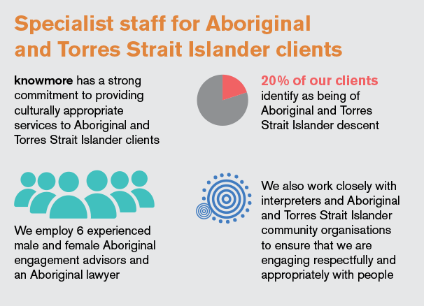
knowmore legal advisory service

Slide 10
Culturally safe and secure services
Intention of both terms in a service delivery context is that Aboriginal and Torres Strait Islander community members receive services from an organisation which demonstrates respect of culture and delivers services in ways which ensure the safety and respect of clients, from staff who are culturally competent.

Slide 11
Culturally safe and secure services
‘Cultural security’ – interpreted as the main culturally significant conditions that an organisation such as knowmore creates, especially as a service provider and an employer, and provides to Aboriginal and Torres Strait Islander clients and staff to ensure cultural safety

Slide 12
Culturally secure services – what did we do?
We are a ‘mainstream’ service
Recruitment was key – of the Engagement team, and of all other staff. Experience & gender balance to support cultural business.
Workplace ‘culture’
  Induction and on-going cultural competence training
  No ‘lead’ discipline. Fully integrated Engagement team
  Team Leader role, part of management team
  Apply a ‘cultural lens’ to all decisions, systems and work practices
  Supporting our staff – our ‘Cultural Care plan’

Slide 13
EXTERNAL DAY TO DAY CULTURAL INFLUENCES & RESPONSIBILITIES
Land Country
Commitment to Native Title
Kinship
Roles & responsibilities
Family
Mothers, Fathers
Aunts, Uncles
Grandparents
Kids, grandkids
Significant cultural events
Mabo day
Sorry day
NAIDOC week
Reconciliation day
Sorry business
Lore
Aboriginal & Torres Strait Islander Engagement Advisors’s
Engaging
Community
knowmore
Community responsibilities
Boards
Community
Mentoring
Ceremony leave
Men’s & women’s business
Recognition of cultural roles within our communities

Slide 14
knowmore’s cultural care plan
Cultural mentors
  8 hours per month
Quarterly face to face AEA meeting
  2 day meeting that may include community outreach or training or engagement with the RC
Monthly one hour teleconference for AEA’s
Continued financial assistance for client referrals
  To support services, art therapy, healing & men's and women's groups
Cultural care session at the knowmore all staff conference
  An hour at each meeting with Q&A
Support greater collaboration between knowmore’s engagement team and Aboriginal & Torres Strait Islander specialist workers in the RC & call centre

Slide 15
Culturally secure services – what did we do? (cont.)
  Outward signs - signalling knowmore as a welcoming organisation for Aboriginal and Torres Strait Islander clients; e.g. branding on website & resources; Indigenous artwork and flags displayed in all offices
  A focus in our submission and law reform work is giving a voice to Aboriginal and Torres Strait Islander clients and their experiences and needs

Slide 16
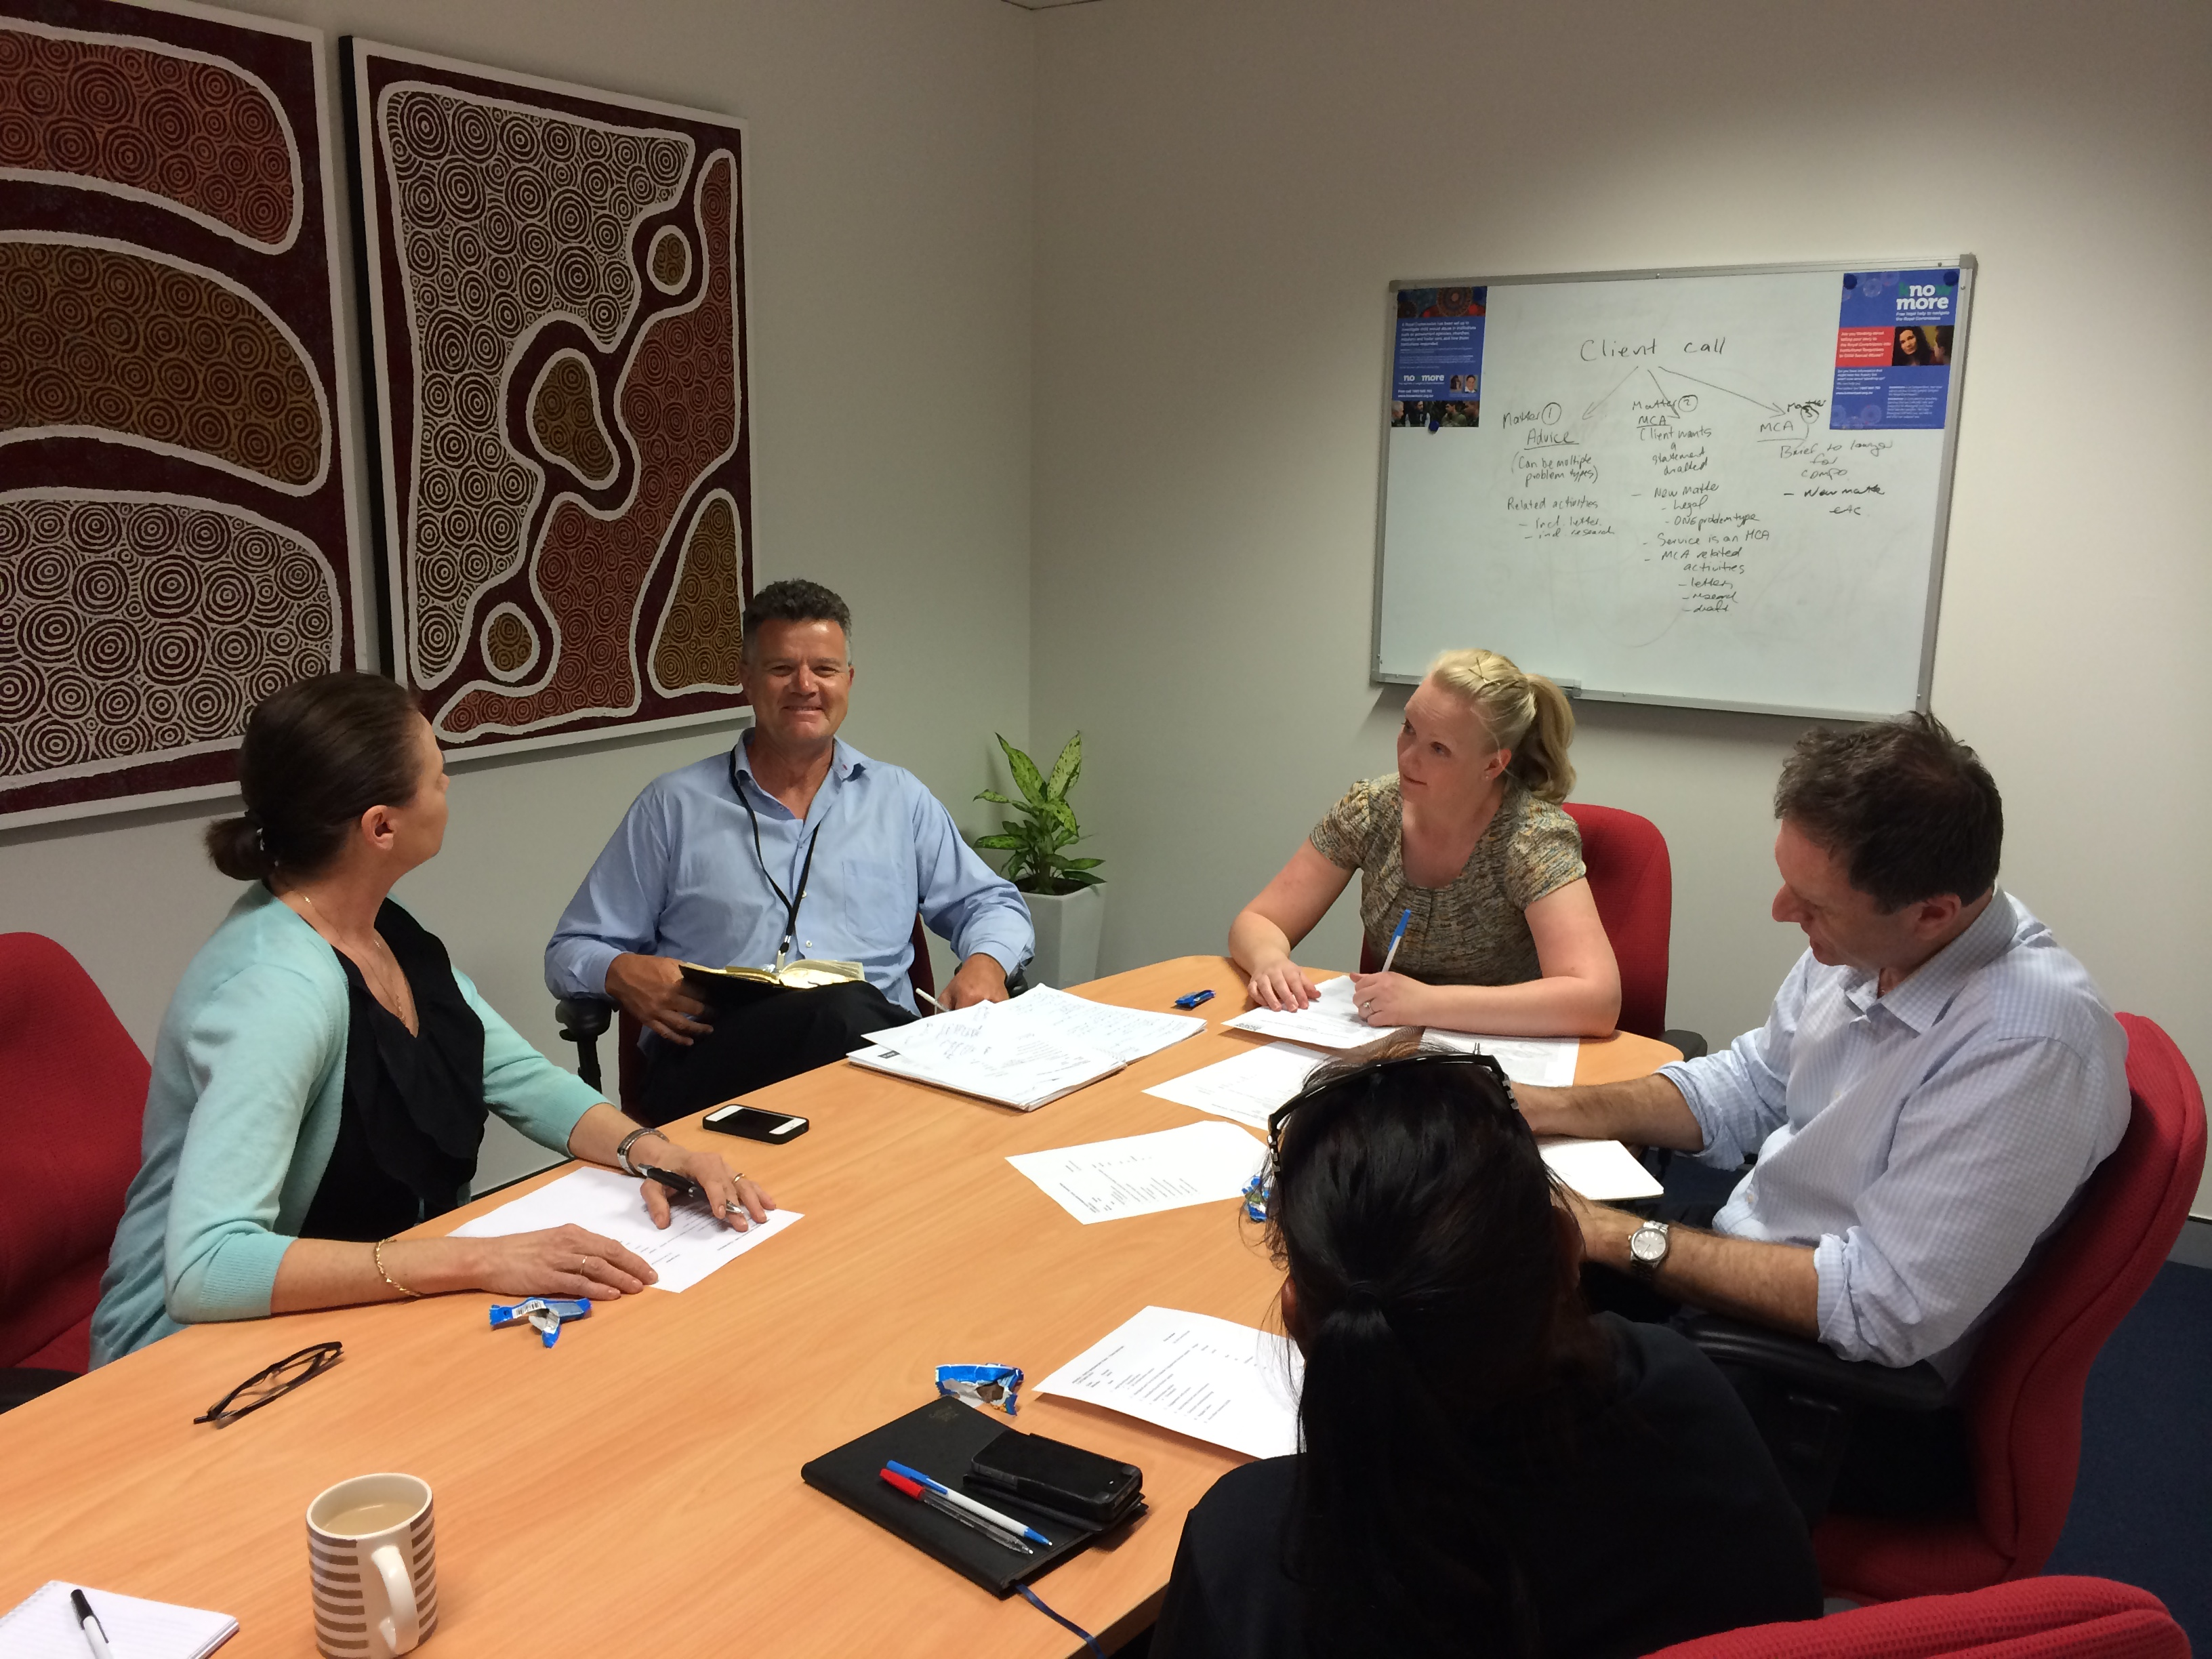

Slide 17
knowmore’s engagement team
All Aboriginal and Torres Strait Islander staff have many years of experience in supporting Aboriginal & Torres Strait Islander survivors of sexual abuse; family/domestic violence and institutional abuse.
As an Aboriginal & Torres Strait Islander team within a mainstream organisation, we have constant contact with each other, both as a team and individually to draw on each other’s experience & knowledge to assist in the diversity of people we talk to in a Culturally appropriate manner so they are able to engage with knowmore and, if they want, tell their stories to the Royal Commission, in a Culturally safe way.

Slide 18
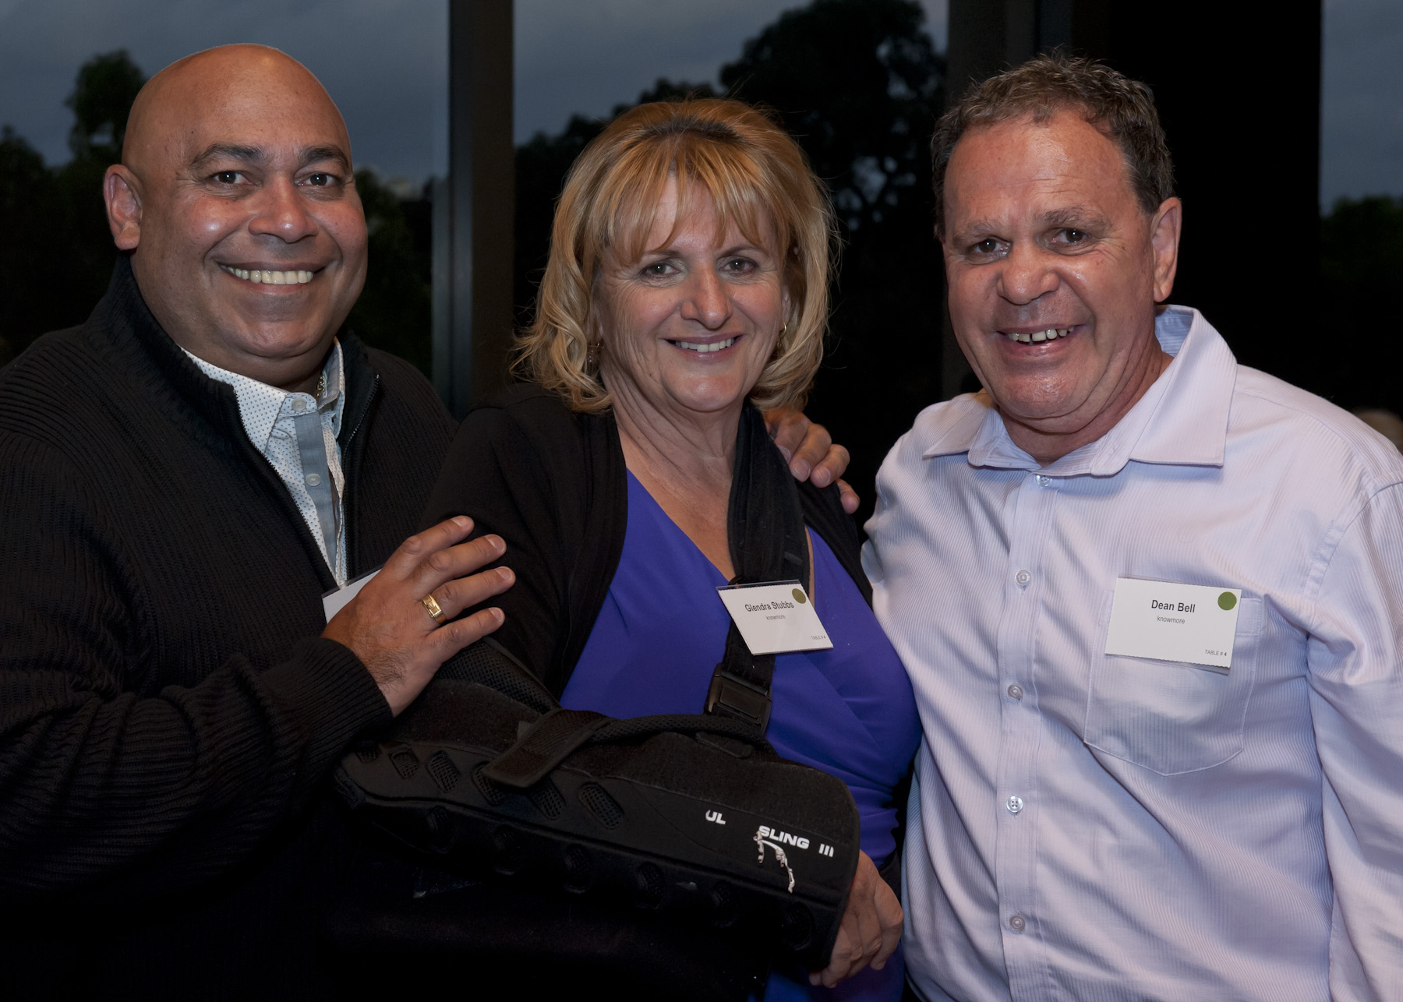
knowmore’s engagement team

Slide 19
knowmore’s engagement team
Co-operative service delivery arrangements – with Aboriginal & Torres Strait Islander Legal services and the FVPLS
Strong working relationships with the Royal Commission’s Community Engagement team
Outreach and community engagement work – provide a culturally secure environment for clients. Specific Indigenous engagement strategies for each State & Territory

Slide 20
Engagement principles
Acknowledge
the issue, local community, Aboriginal diversity, Service Providers
Feedback
Complete CLE Report, send acknowledgement to service providers and clients
Follow-up
Provide updates on the activity and meet the agreed dates
Respect
the clients, partners and local community
Review
the activity and our actions, and look for improvements

Slide 21
Outreach planning
Research
Identify
Consultation
the community in the proposed area of outreach
the relevant service providers in the proposed area of outreach
with lawyer, the Aboriginal engagement team and s/w to determine whether there are any clients in the proposed outreach location
Develop
a detailed travel proposal for approval from the management team based on service providers and clients; and
Approval
subject to approval, carry out the outreach activity

Slide 22


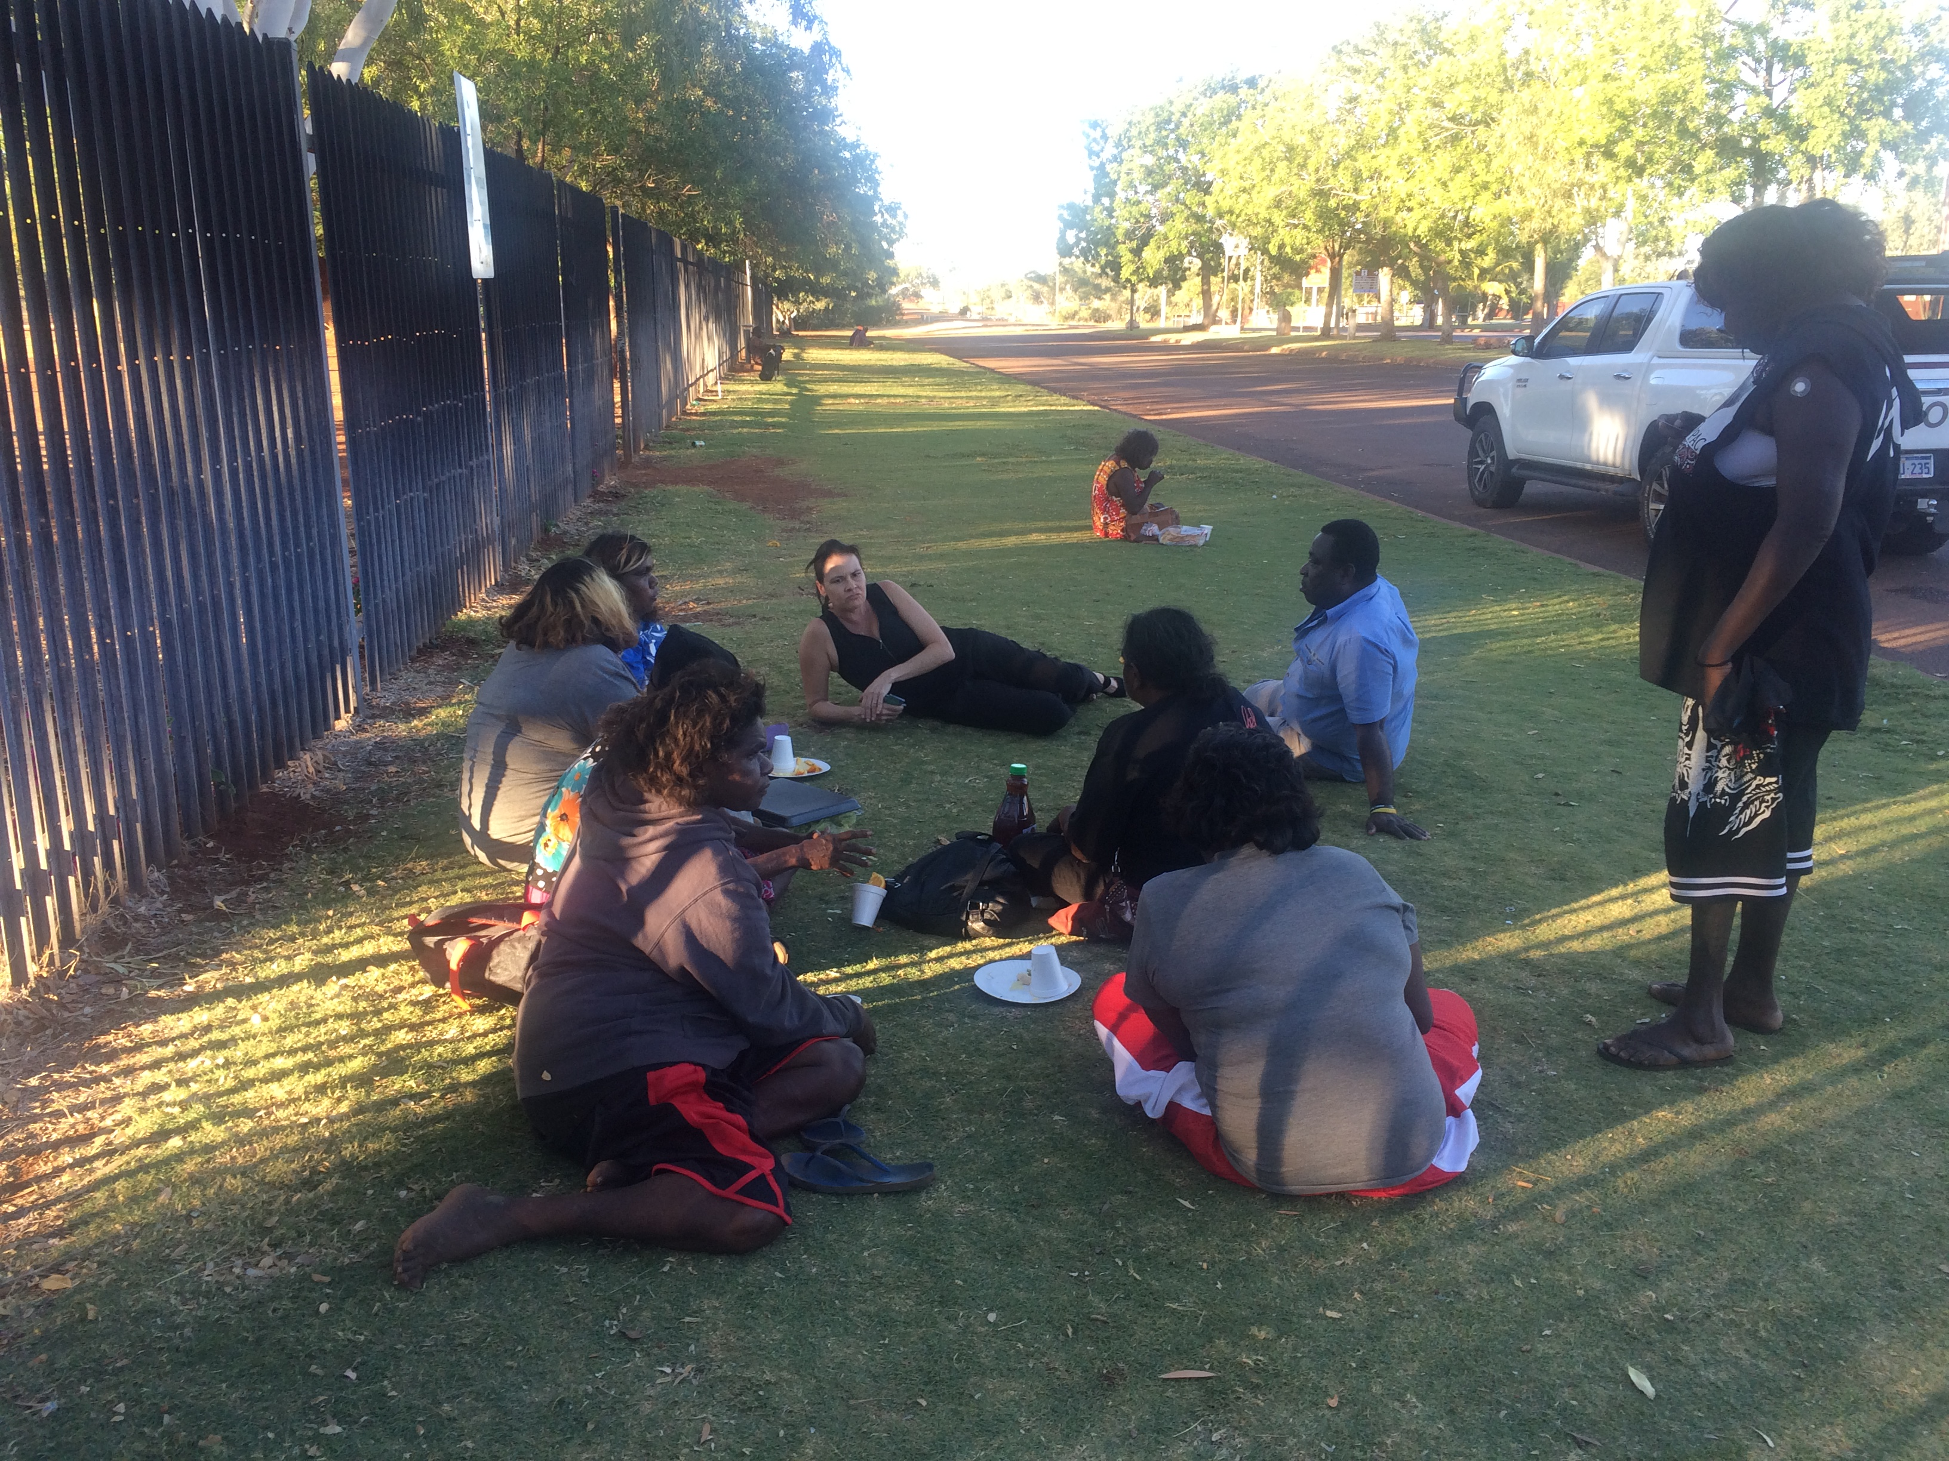
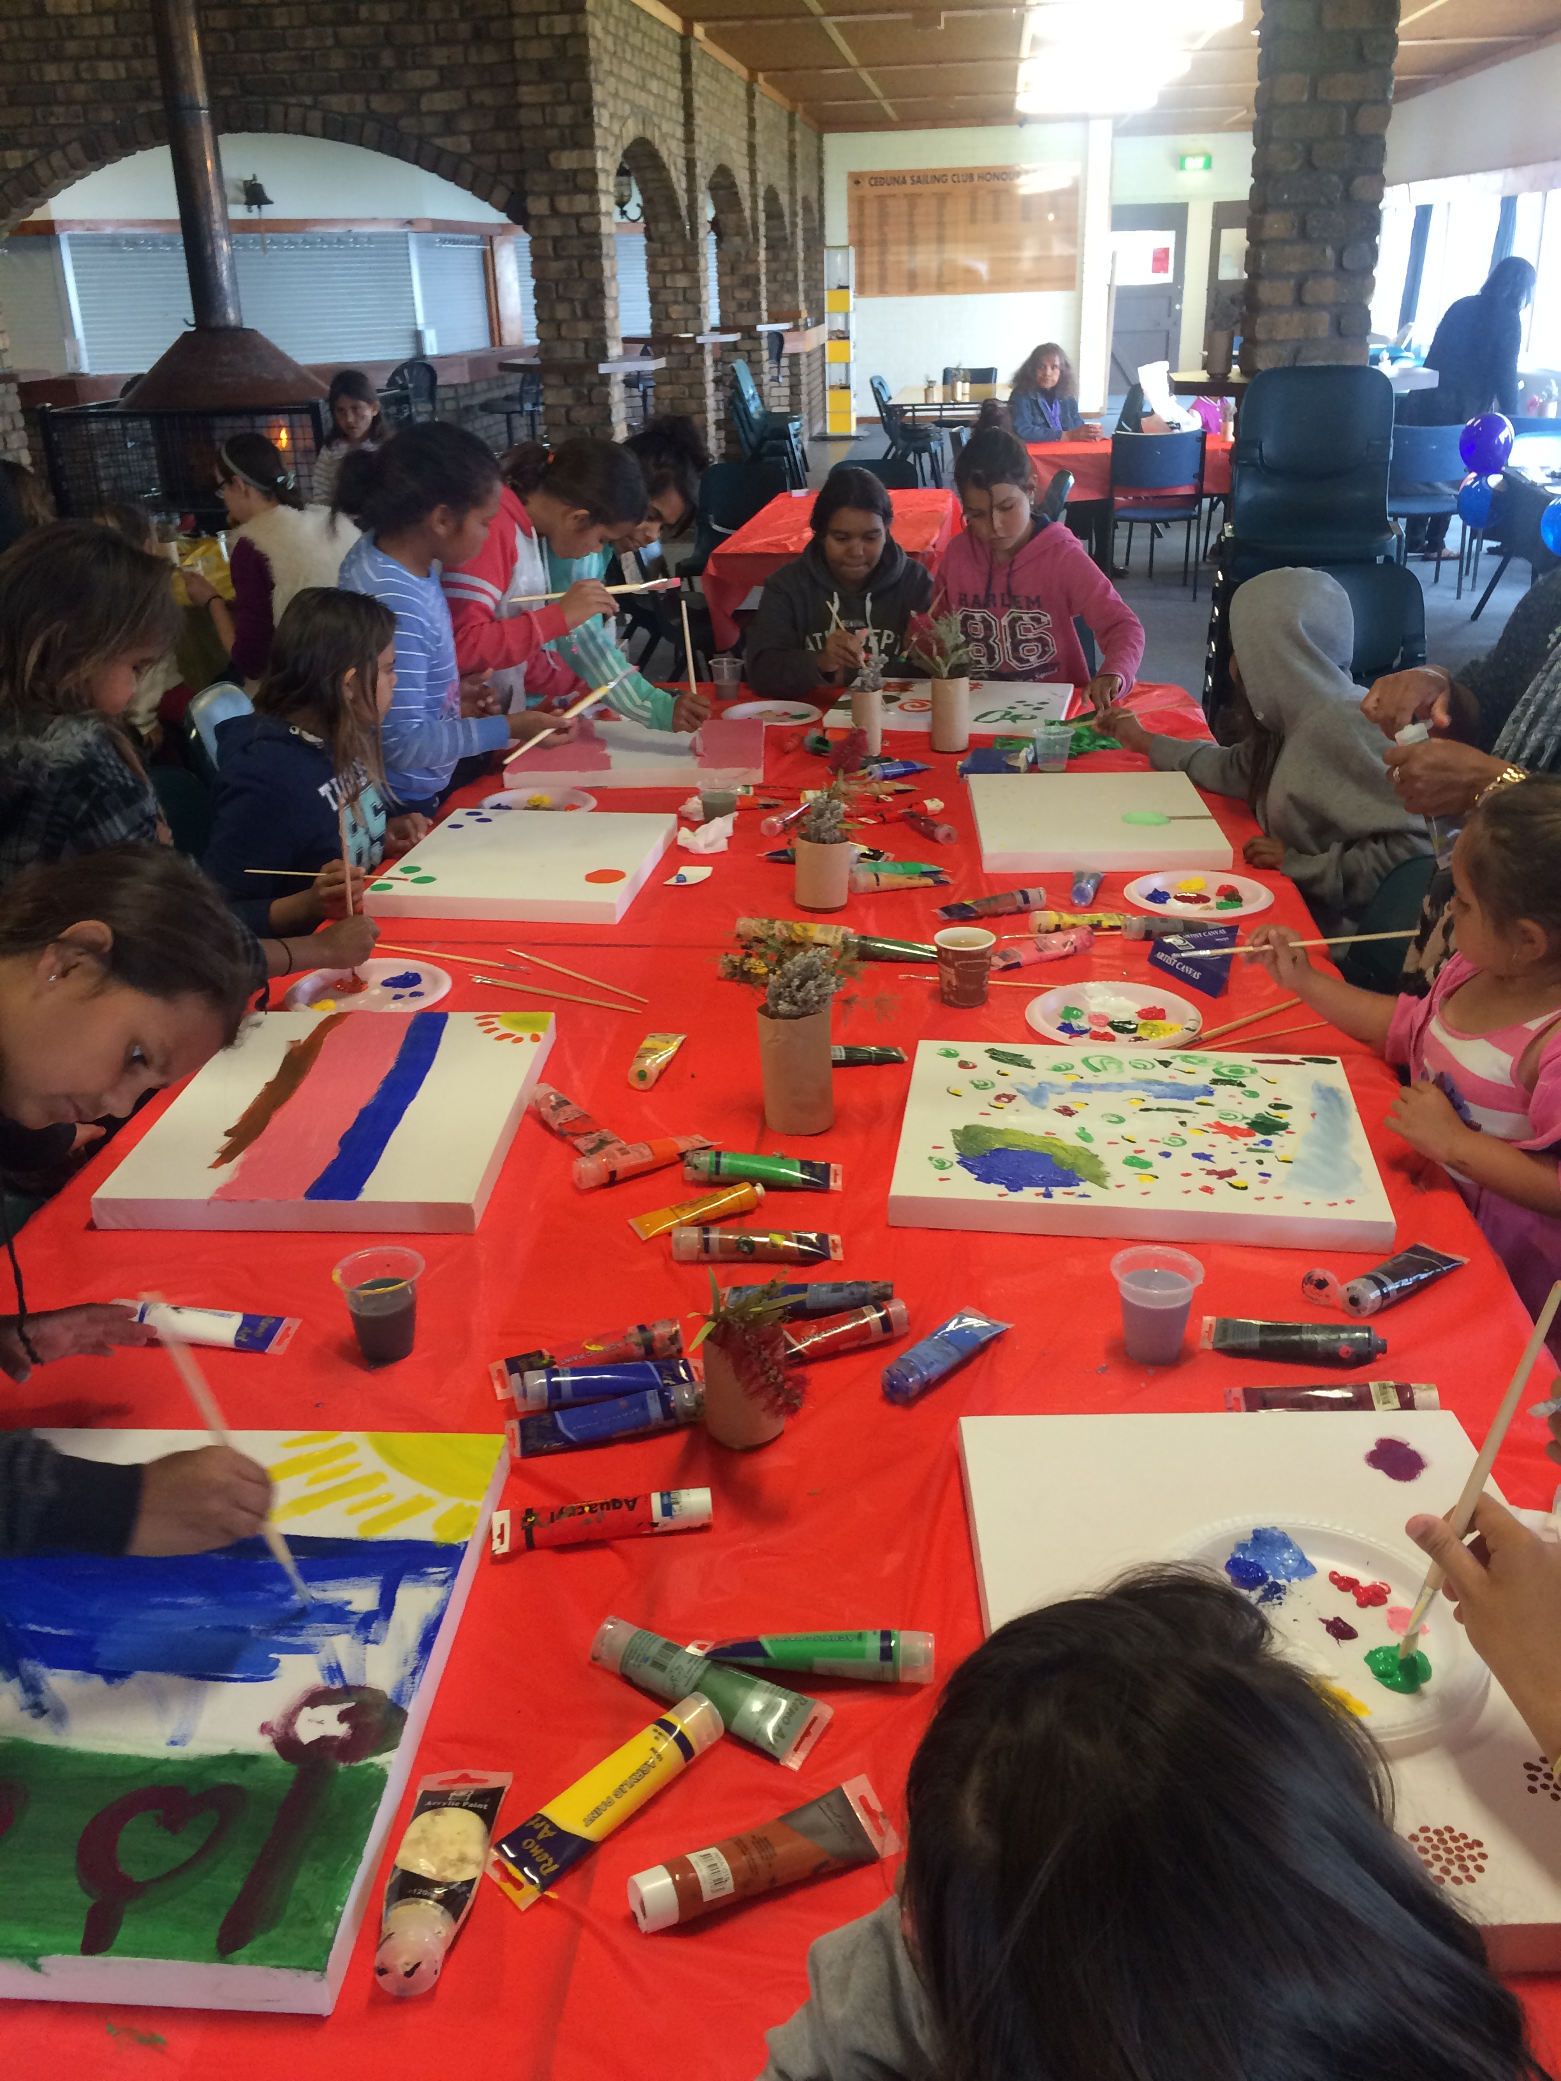
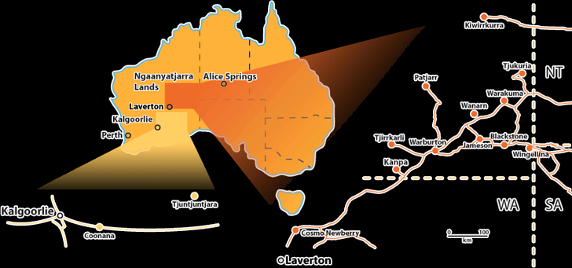
Community Engagement

Slide 23
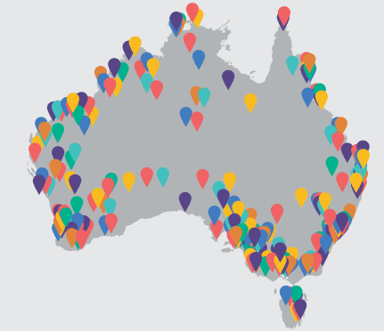
Outreach

Slide 24
More reading
Under the funding agreement, NACLC was required to have an independent evaluation undertaken of the knowmore service. Commencing in 2014, the evaluation examined how knowmore has responded to the challenge of providing a service to clients deeply aggrieved personally and legally, and carrying a legacy of trauma into their adult lives.
You can read the final evaluation report at:
http://knowmore.org.au/resources/

Slide 25
Where we are and how to contact us?
knowmore legal service offices are situated at
SYDNEY PERTH (to early December 2016)
Suite G02, Ground Floor Level 9
233 Castlereagh Street, Sydney NSW 2000 41 St Georges Terrace, Perth WA 6000
PO Box 20319 World Square NSW 2002 PO Box 8095 Cloisters Square WA 6850
(02) 8267 7400 (08) 9225 0200
MELBOURNE BRISBANE
Suite 3, Level 1 Suite 1, Level 16
180 Flinders Street, Melbourne VIC 3000 141 Queen Street, Brisbane QLD 4001
PO Box 84 Flinders Lane VIC 8009 PO Box 2151 Brisbane QLD 4001
(03) 8663 7490 (07) 3218 4500
You can phone knowmore toll-free 1800 605 762
www.knowmore.org.au

