Slide 1
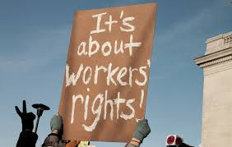
General Protections
Bridget Burton
22 November 2016

Slide 2
General Protections
What are the ‘General Protections?
The key General Protections for our clients
Helping a client make a choice about jurisdiction

Slide 3
General Protections:
A less complicated option for bringing discrimination actions and an alternative to victimisation proceedings
Better remedies than unfair dismissal actions
A partial reverse onus of proof
A more friendly costs rule than the human rights jurisdiciton

Slide 4
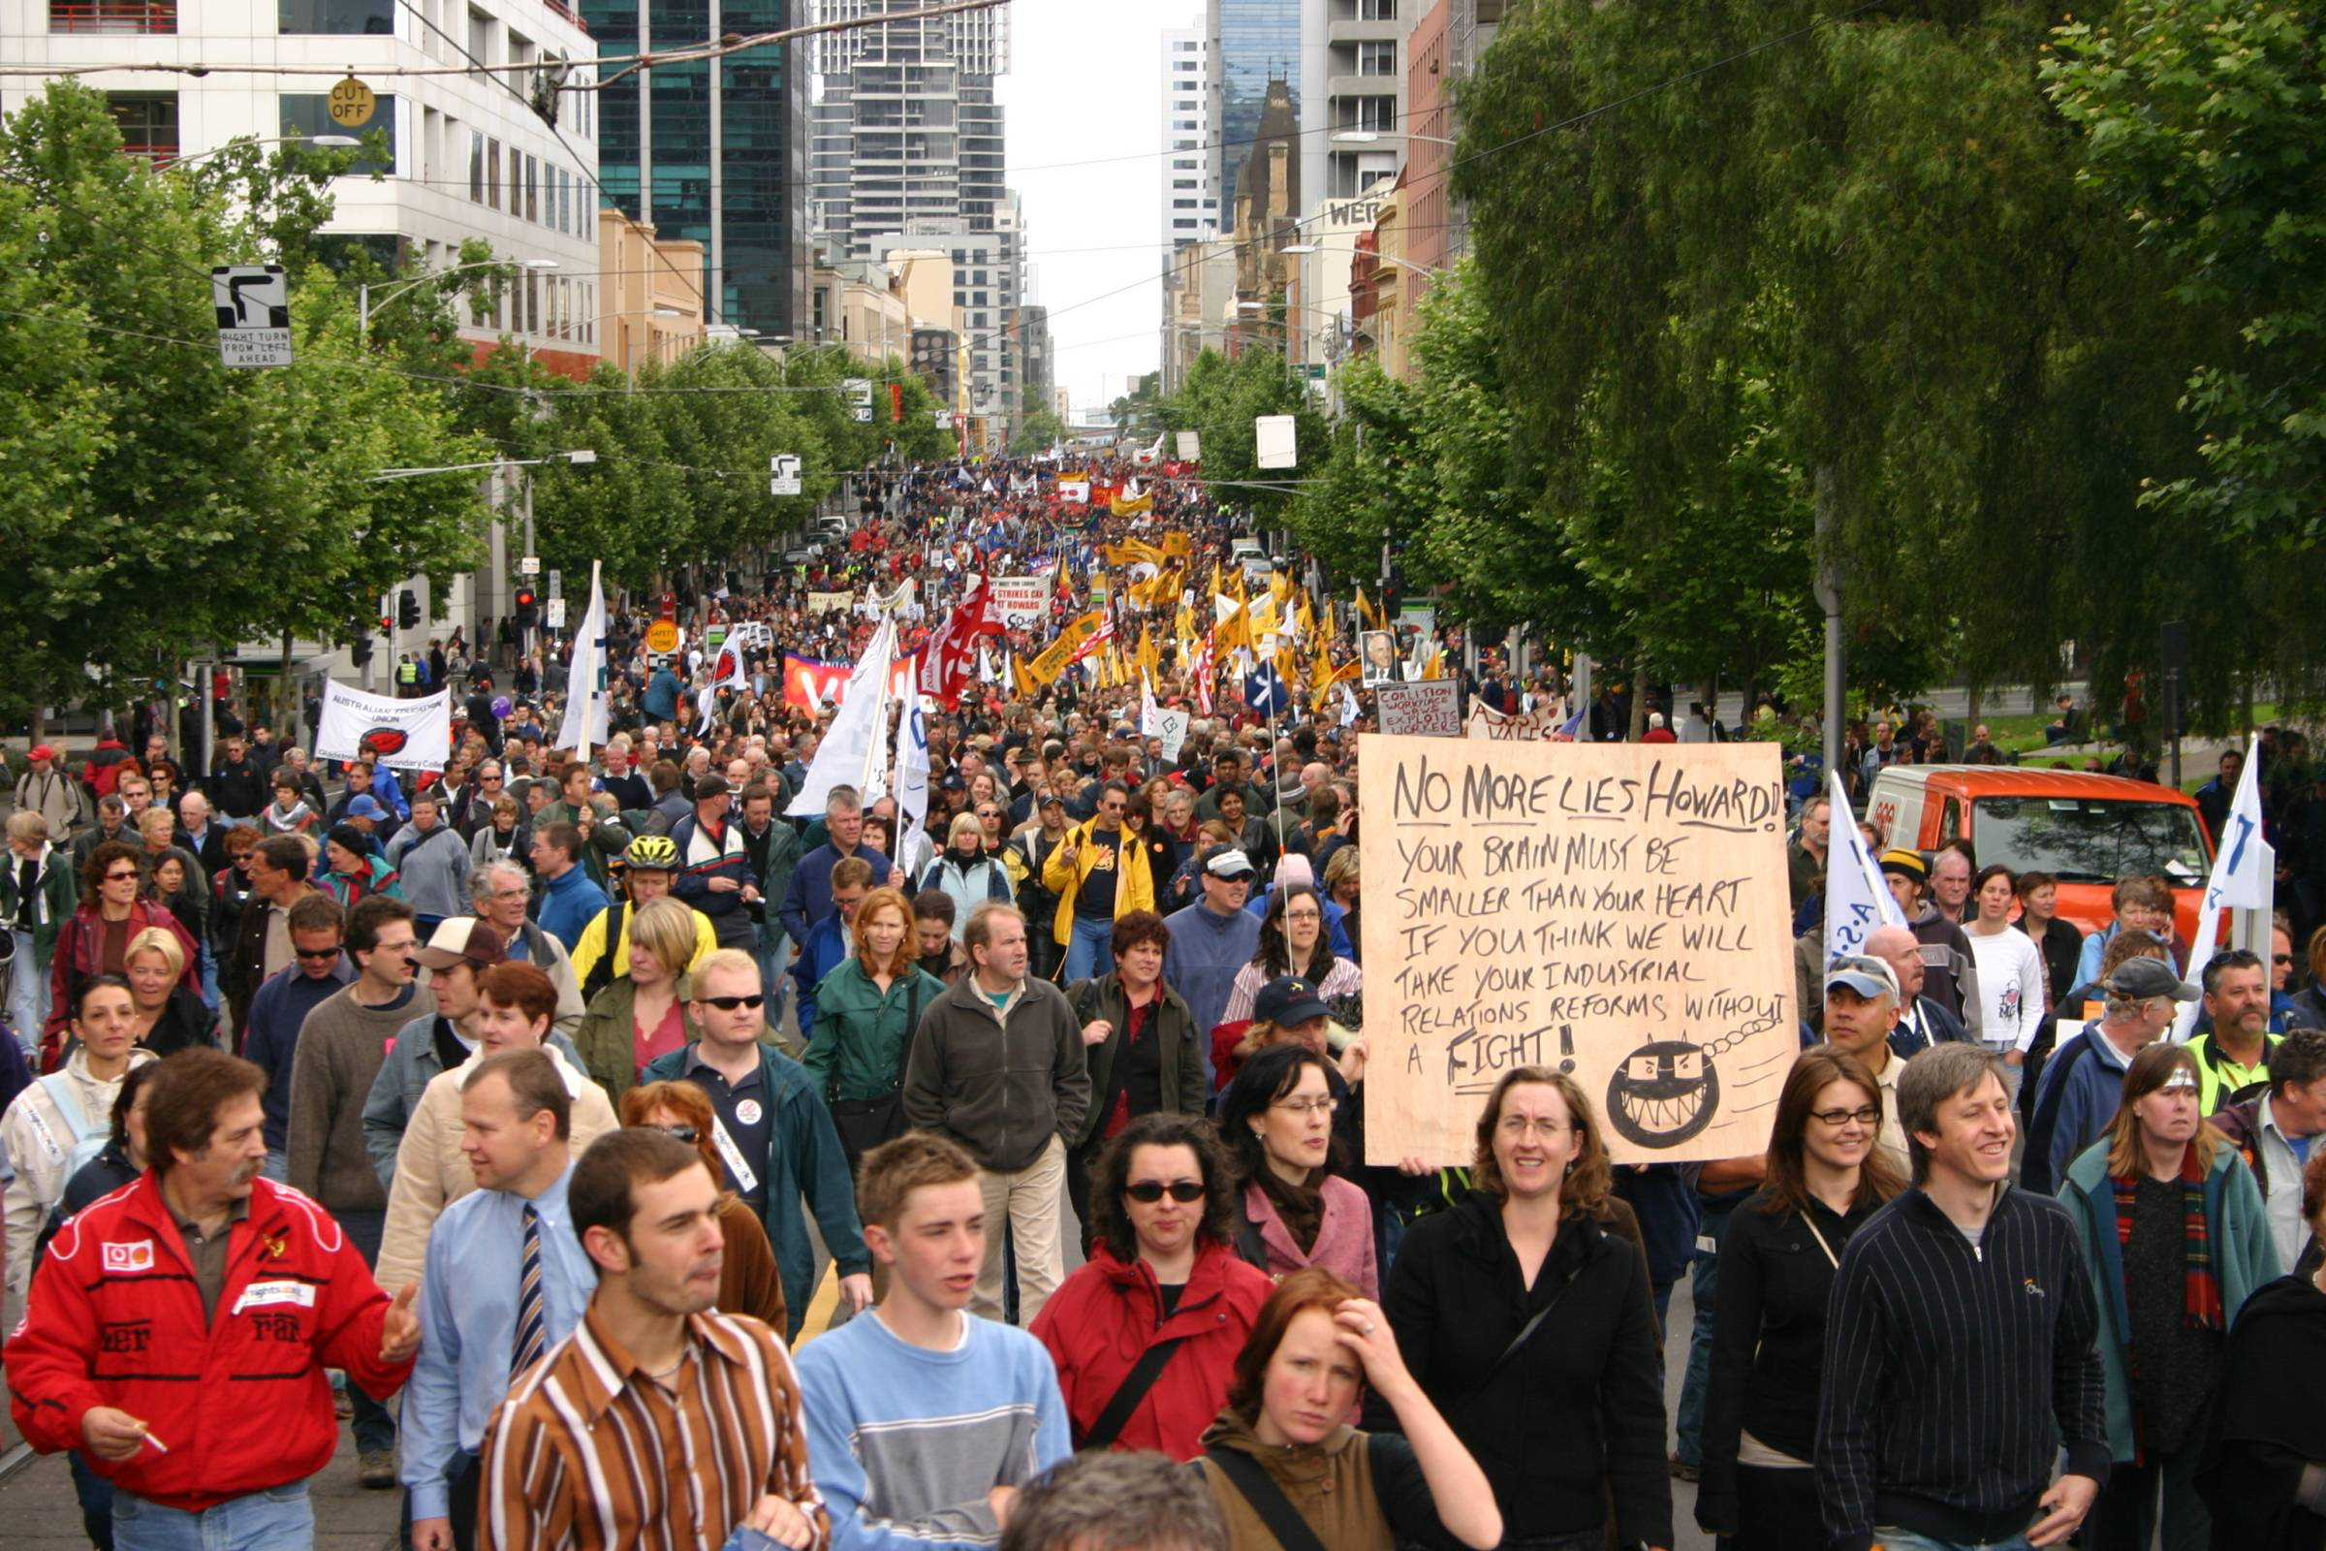
What are the General Protections?
Part 3.1 of the Fair Work Act 2009
Section 336 Objects
To protect workplace rights
To protect freedom of association
To protect against workplace discrimination
To offer relief for people adversely affected by breaches
Sham contracting
Misrepresentations
Dismissing for temporary
illness or injury

Slide 5
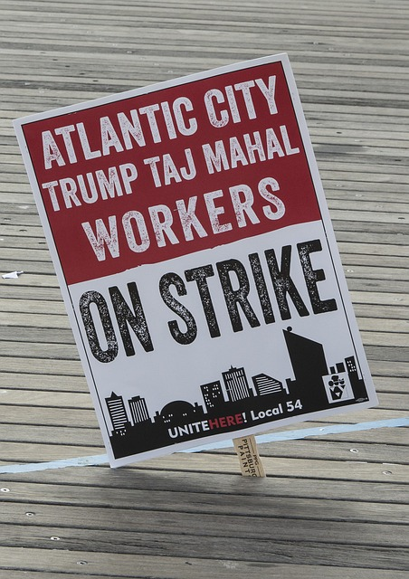
Workplace Rights
Section 340
Three critical elements:
Adverse action
Is taken ‘because of’
A prohibited reason (relating to a workplace right)

Slide 6
Adverse action…
Adverse action is set out in a
table in section 342
Employers take adverse action against employees when they:
Dismiss the employee
Injure the employee in their employment
Alter the employee’s position to their prejudice
Discriminate between the employee and other employees of the employer

Slide 7
…because of…
Board of Bendigo Regional Institute of Technical and Further Education v Barclay [2012] HCA 32
Substantive and operative reason
Reversed onus of proof
Producing the decision maker

Slide 8
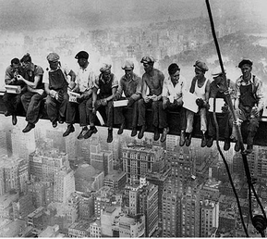
… a prohibited reason
Section 341 defines workplace right
A person has a protected workplace right if they:
Are entitled to the benefit of a workplace law or instrument
Are able to initiate or participate in a process or proceeding under a workplace law or instrument
Make a complaint or enquiry in relation to their workplace (to their employer or an appropriate external body)

Slide 9
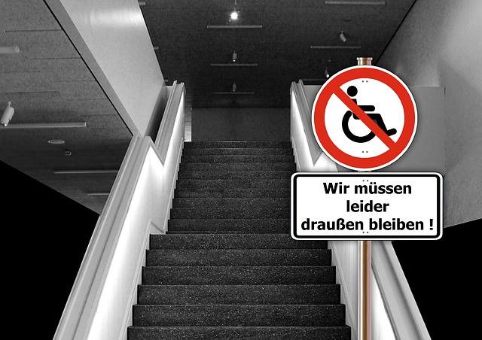
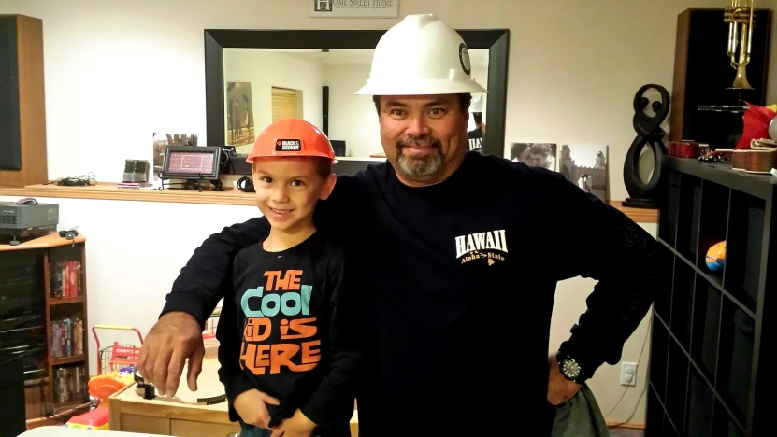
Examples of workplace rights
Making a work cover claim
Complaining about bullying, sexual harassment or other mistreatment at work
Enquiring about underpaid wages either directly or via the Fair Work Ombudsman
Taking maternity leave and exercising the return to work guarantee
Asking for flexible hours because of caring responsibilities, disability or age
Asking for workplace adjustments

Slide 10
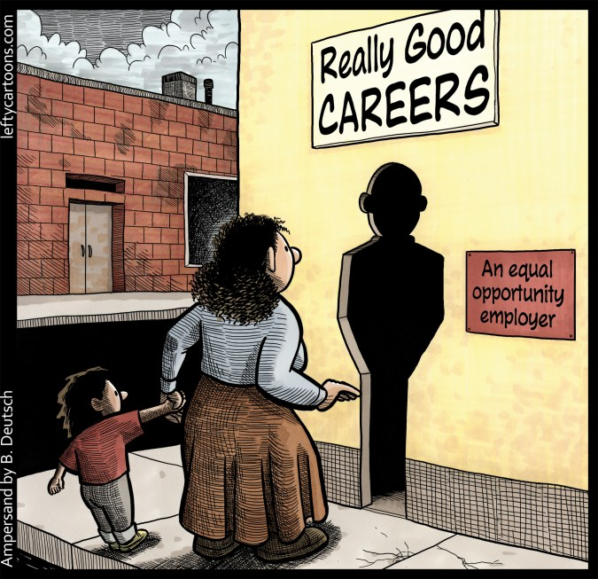
Discrimination
Section 351 prohibits discrimination at work
An employer must not take adverse action against an employee or a prospective employee because of the person’s race, colour, sex, sexual orientation, age, physical or mental disability, marital status, family or carer’s responsibilities, pregnancy, religion, political opinion, national extraction or social origin.

Slide 11
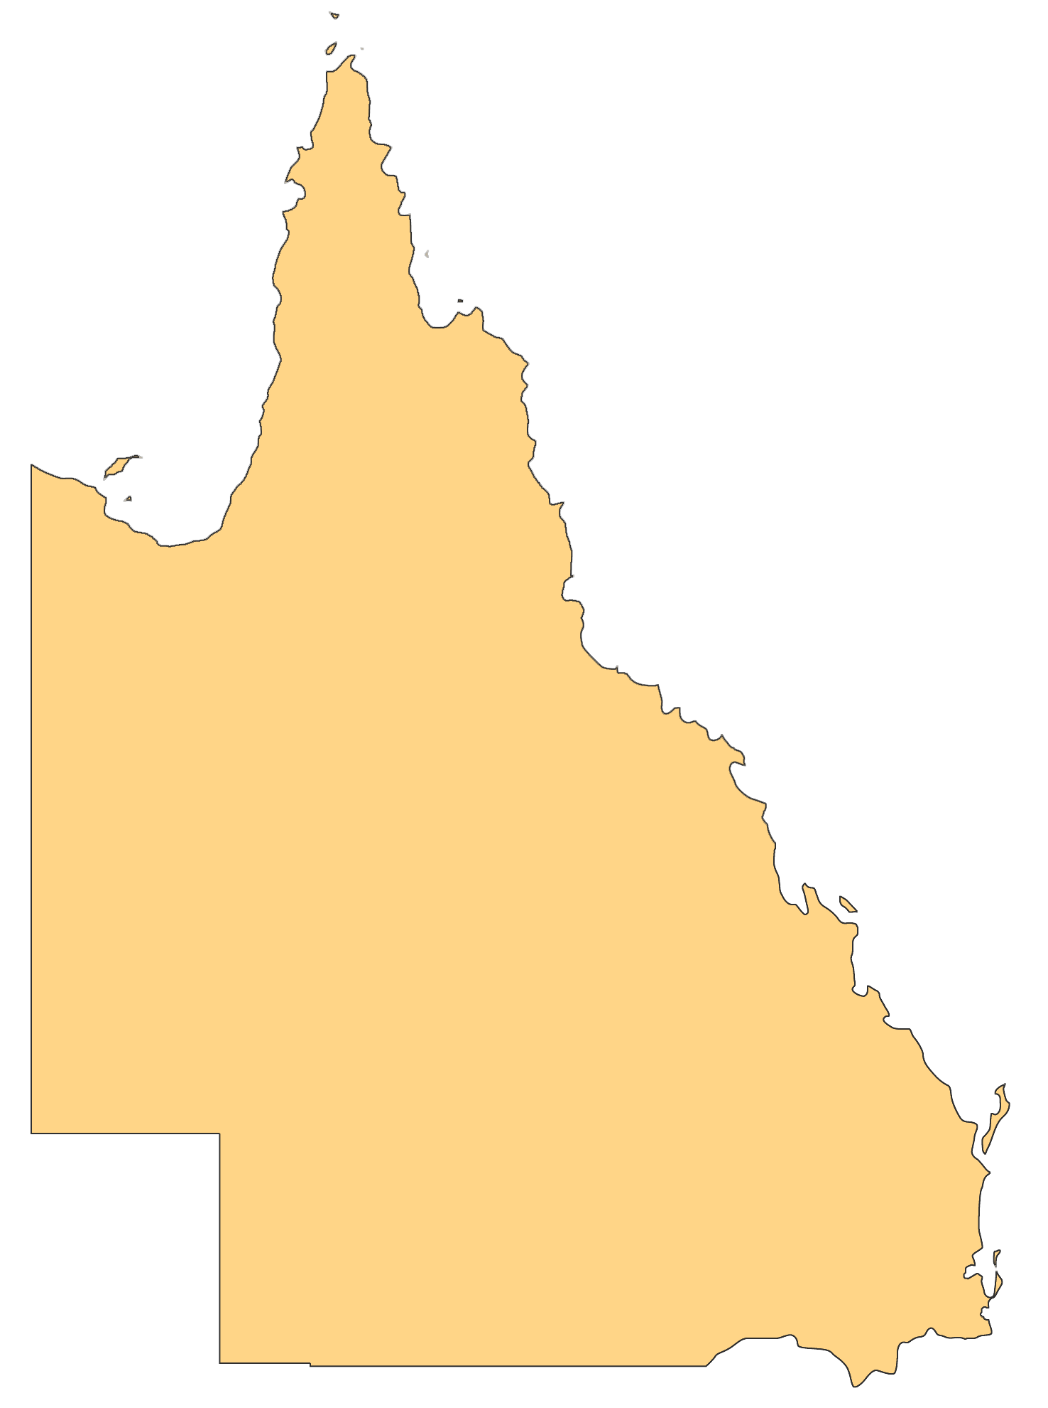
Discrimination v Discrimination (an example)
A woman is transferred (her position is altered to her prejudice) for leaving early to collect her child from school. She had also taken time off to tend to her child when he was ill.
(Wilkie v National Storage Operations Pty Ltd [2013] FCCA 1056)
Under the Queensland Anti-Discrimination Act you would likely need to prove that the woman was subjected to less favourable treatment because of her caring responsibilities compared with someone who had left early, or taken their sick leave entitlements for another purpose (such as their own illness).
The decision to dismiss this particular worker was made ‘because of’ her leaving early and taking carers leave. The leaving early was to collect her son. She was successful. Whether or not other workers with similar needs, or who are absent for other reasons, are or are not treated similarly unfavourably is irrelevant.

Slide 12
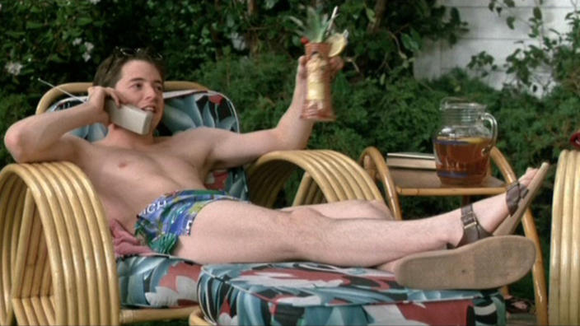
Dismissed for temporary absence for illness or injury
Section 352
An employee cannot be dismissed for temporary absence from work because of their own illness or injury
Conduct breaching section 352
may also breach:
Workers compensation legislation
Discrimination law
Other general protections
provisions such as section 340

Slide 13
Remedies
Orders that can be made by the Federal Circuit Court in relation to General Protections breaches are:
Reinstatement (more likely in cases involving a large organisation);
Compensation for financial losses;
Compensation for pain and suffering;
Payment of unpaid entitlements;
Interest (not in relation to a penalty); and
Pecuniary penalties (up to $51,000 per breach for companies and $10,200 for individuals)
Costs only in unreasonable and/or vexatious circumstances

Slide 14
Process
General Protections – Dismissal
Lodge in the Fair Work Commission within 21 days of date of dismissal
Conciliation conference
If not settled, 14 days to proceed to the Federal Circuit Court
General Protections – no dismissal
Lodge in the Fair Work Commission or the Federal Circuit Court
Conciliation or mediation
Proceed to hearing in Federal Circuit Court

Slide 15
Choice of Jurisdiction
Some of the factors that might influence a
client’s choice of jurisdiction are:
How well the client’s facts fit the various
laws
The available remedy range
The risk of an adverse costs award if unsuccessful (or if represented, the availability of costs if successful)
Would the reverse onus help at all?
How might the client fare in the conciliation conference process?
Time limits
Eligibility criteria
Whether all the client’s problems can be collected together in a single legal action

Slide 16
How it works in practice
Client example 1:
My client had autistic spectrum disorder. He was placed in a hospitality job by a specialist disability placement service. He worked hard believing he would get an apprenticeship after a year of work. In the end he was sacked for minor issues that arose out of his communication problems. His employer denied it knew about his disability, saying they thought he had an attitude problem.

Slide 17
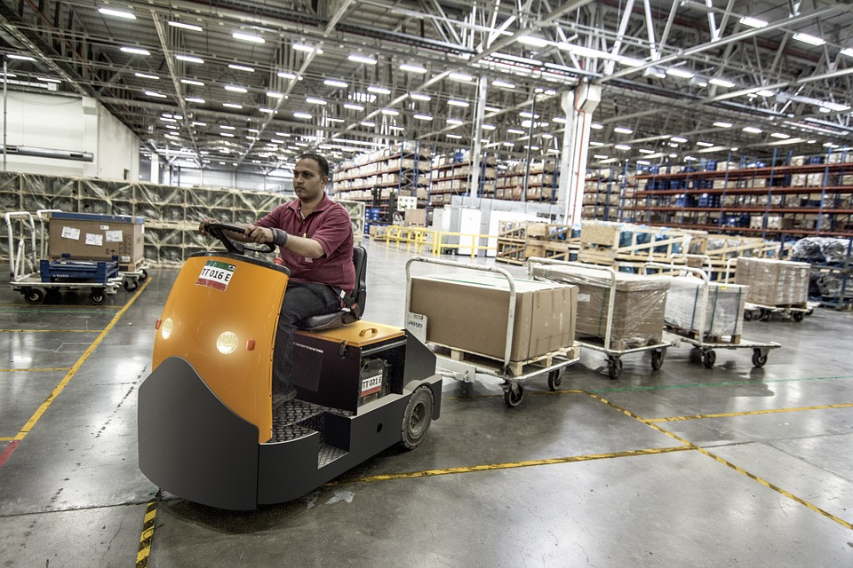
How it works in practice
Client example 2:
Our client had a serious mental illness, which, on at least two occasions, included psychotic symptoms. He worked in a large employer for four years without incident. Then he became ill again. He had some insight early on and went home sick but he became increasingly unwell and ultimately was sacked for misconduct.

Slide 18
How it works in practice
Client example 3:
Our client was a labour hire employee. He was subjected to a sustained campaign of racist bullying in his workplace. He complained to the host employer and was told that there was no longer any work for him at that workplace. His labour hire company then told him as he was no longer wanted at that employer, there would be no more work for him with their company.

Slide 19
Questions?

Slide 20
Caxton Legal Centre contacts
Monday to Friday 9.00am to 5.00pm
Address: 1 Manning Street, South Brisbane QLD 4101
Phone: 07 3214 6333 Fax: 07 3846 7483
Email: caxton@caxton.org.au
Website: www.caxton.org.au
www.queenslandlawhandbook.org.au
https://apprentices.queenslandlawhandbook.org.au

