Slide 1

In case of emergency apply your own oxygen mask first before helping others:
Trauma informed practice and resilient lawyering
QCLC - 2016
Amanda Whelan – Team Leader Support Services
Ann Gummow – Managing Lawyer, Brisbane Office

Slide 2
Acknowledgement of Country
We acknowledge the Traditional Owners on whose land we meet, and Elders past, present and future

Slide 3
Introductions
Ann and Amanda
Acknowledge our clients and their stories as being at the heart of what we do.
“knowmore was founded in close consultation with survivor groups; this is another example of the CLC’s learning from their clients” (James Farrell)
Here today however to talk more about approaches to the work and our own wellbeing, self care and resilience
LOTS of great material and work out there on these topics, these are some of knowmore’s favourites, we encourage you to explore your own!

Slide 4
Today’s Webinar
Part 1: knowmore Legal Service
Part 2: Trauma Informed Practice
Part 3: Impacts Of The Work
Part 4: Wellbeing and Resilience
Part 5: Reflections/question

Slide 5
Part 1
knowmore legal service

Slide 6
About knowmore
Context - the Royal Commission into Institutional Responses to Child Sexual Abuse and knowmore legal service
A program of NACLC, funded by the Australian Government through AGD
Multidisciplinary model of lawyers, Aboriginal and Torres Strait Islander Engagement Advisors, Social Work/counsellors (and administration team)
For more information about us www.knowmore.org.au

Slide 7
knowmore’s model
Trauma-informed, person-centred, culturally secure practice framework seen as key to supporting a very vulnerable client group (whose complex needs were acknowledged in establishing the service)
It is important to acknowledge that knowmore was resourced appropriately by the AG through the funding agreement to provide this model
knowmore’s model seeks to learn from other multidisciplinary service approaches that have supported this client group over time, and from the vast experience of the CLC sector in doing the same

Slide 8
Some data…
As of September 30th 2016:
  Knowmore provided 44,520 legal advices to 5,565 clients;
  61% were over the age of 45;
  59% were male and 41% were female;
  21% identified as Aboriginal and/or Torres Strait Islander
  62% of these clients received Support Services Team support and 49% were referred to other support services

Slide 9
Part 2
Trauma Informed Practice

Slide 10
What do we mean by Trauma-informed practice?
Recognises the enduring impact of complex trauma and sees people’s behaviours and impacts as responses to trauma instead of a pathology. It also recognises that recovery is possible, and that people may move in and out of wellness.
Doesn’t ask ‘what’s wrong?’ with a person but ‘what’s happened?’ to them.
‘Triggers’ can occur at any stage in the process, and may not always seem obvious; what triggers one person another will step through without issue.

Slide 11
What do we mean by Trauma-informed practice? (cont..)
Practice Guidelines for TIP ask us to think about how we create the following for the people we work with (and ourselves!) http://www.blueknot.org.au/
  Safety
  Trustworthiness
  Choice
  Collaboration
  Empowerment
Trauma informed practice needs to exist in ALL levels of the work; first and foremost with clients, but also across teams and in organisations/services if it is to be truly effective
Question: WHY?

Slide 12
What do we mean by Trauma-informed practice? (cont..)
Trauma informed practice needs to exist in ALL levels of the work; first and foremost with clients, but also across teams and in organisations/services if it is to be truly effective
Question: Why does it need to exist at all levels to be effective? How does that help clients?
Question: Why is TIP so important in CLC work?
http://www.blueknot.org.au/Portals/2/Reports%20and%20Docs/Legal%20and%20Justice%20Background%20Paper%20with%20Abstract%20FINAL.pdf

Slide 13
WHY trauma informed practice? knowmore’s example
TI approaches are recognised as leading best practice responses to victims and survivors of child abuse and complex trauma
They have been extensively implemented across the Royal Commission processes and DSS-funded support services, so consistency in approach was seen as crucial for knowmore when working with a common client group
knowmore consulted with survivors groups when being established, all of whom said this was important
Our core business is working with clients who have experienced trauma, and talking about their abuse is highly likely to trigger them, and to have flow on impacts for staff. HARM MINIMISATION was critical

Slide 14
HOW did/do we implement and sustain trauma informed practice? knowmore’s example
Built it into our model and our structure
Its in our HR and recruitment processes
Compulsory PD for all staff http://www.blueknot.org.au/Portals/2/Workshop%20Descriptions/In-house%20Training%20Booklet.pdf

Slide 15
HOW did/do we implement and sustain trauma informed practice? knowmore’s example cont…
An Integrated Reflective Practice Framework which includes:
  Individual and group supervision
  Professional Development opportunities
  Team meetings
  Twice yearly all of staff gatherings
  Employee Assistance Program

Slide 16
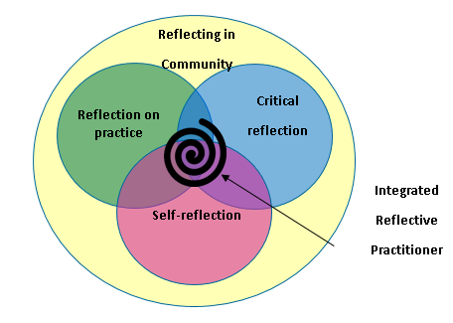
Integrated Reflective Practice
Leering, Michele. "Conceptualizing Reflective Practice for Legal Professionals." Journal of Law and Social Policy 23. (2014): 83-106. http://digitalcommons.osgoode.yorku.ca/jlsp/vol23/iss1/5

Slide 17
Trauma informed practice and organisational culture
All of what we have talked about is all really great in theory, policy etc but for it to have proper meaning it HAS to exist in your culture!!
Question: What role does leadership play in supporting trauma-informed practice and self care?

Slide 18
Part 3
Impacts of the work

Slide 19
Good news! You’re not a psychopath!!
Vicarious Trauma and Burnout
Working safely with survivors of trauma involves accepting that this work is emotionally strenuous and involves the unavoidable risk of vicarious trauma VT is also referred to as: “burn out”, “secondary trauma”, “feeling heavy” or “compassion fatigue”
https://aifs.gov.au/publications/feeling-heavy/what-vicarious-trauma

Slide 20
Good news! You’re not a psychopath!!
Vicarious Trauma and Burnout cont..
Deliberate acts of harm by one human against another are usually the most disturbing
VT and burnout are a NORMAL consequence of being an empathic being
i.e. Teams catch the moods of their clients, and they catch the impacts of their colleagues
http://www.lawcover.com.au/wp-content/uploads/2015/09/3324-The-Resilient-Lawyer_V7.pdf
Question: What are some of the common signs of burnout or vicarious trauma that you see in yourself or others?

Slide 21
Part 4
Wellbeing and Resilience

Slide 22
Wellbeing: apply mask to self first before helping others
We are our key tool in the work, so its important we look after ourselves so we can work to maximum effectiveness with others (the oxygen mask idea)
Staying well in the work will look different for everyone
Queensland Law Society has great Fact Sheets on the Culture of the Legal Profession, Optimal Functioning and Seeking Help – check them out!!
http://www.qls.com.au/For_the_profession/Love_Law_Live_Life

Slide 23
The Resilient Lawyer: The work of Robyn Bradey
The general meaning of resilience is derived from it’s Latin roots ‘to jump or leap back’ which is the ability to recover from or adjust easily to misfortune, adversity or change
Things that can promote resilience include:
Staying connected to the bigger picture
Supportive relationships (in work and outside)
A break from certain kinds of matters so you can recharge
http://www.lawcover.com.au/wp-content/uploads/2015/09/3324-The-Resilient-Lawyer_V7.pdf
Have a look also at the great resources that Queensland Law Society has!!
http://www.qls.com.au/For_the_profession/Love_Law_Live_Life

Slide 24
The Resilient Lawyer: The work of Robyn Bradey cont…
Things the workplace can do:
Recognise and validate impacts for staff of the work;
Provide supervisions, mentoring and counselling;
Provide PD;
Celebrate skills and successes;
Value the work, the worker and the clients;
Manage workloads;
Enforce holidays and breaks;
Allow for rotation in duties…..
http://www.lawcover.com.au/wp-content/uploads/2015/09/3324-The-Resilient-Lawyer_V7.pdf

Slide 25
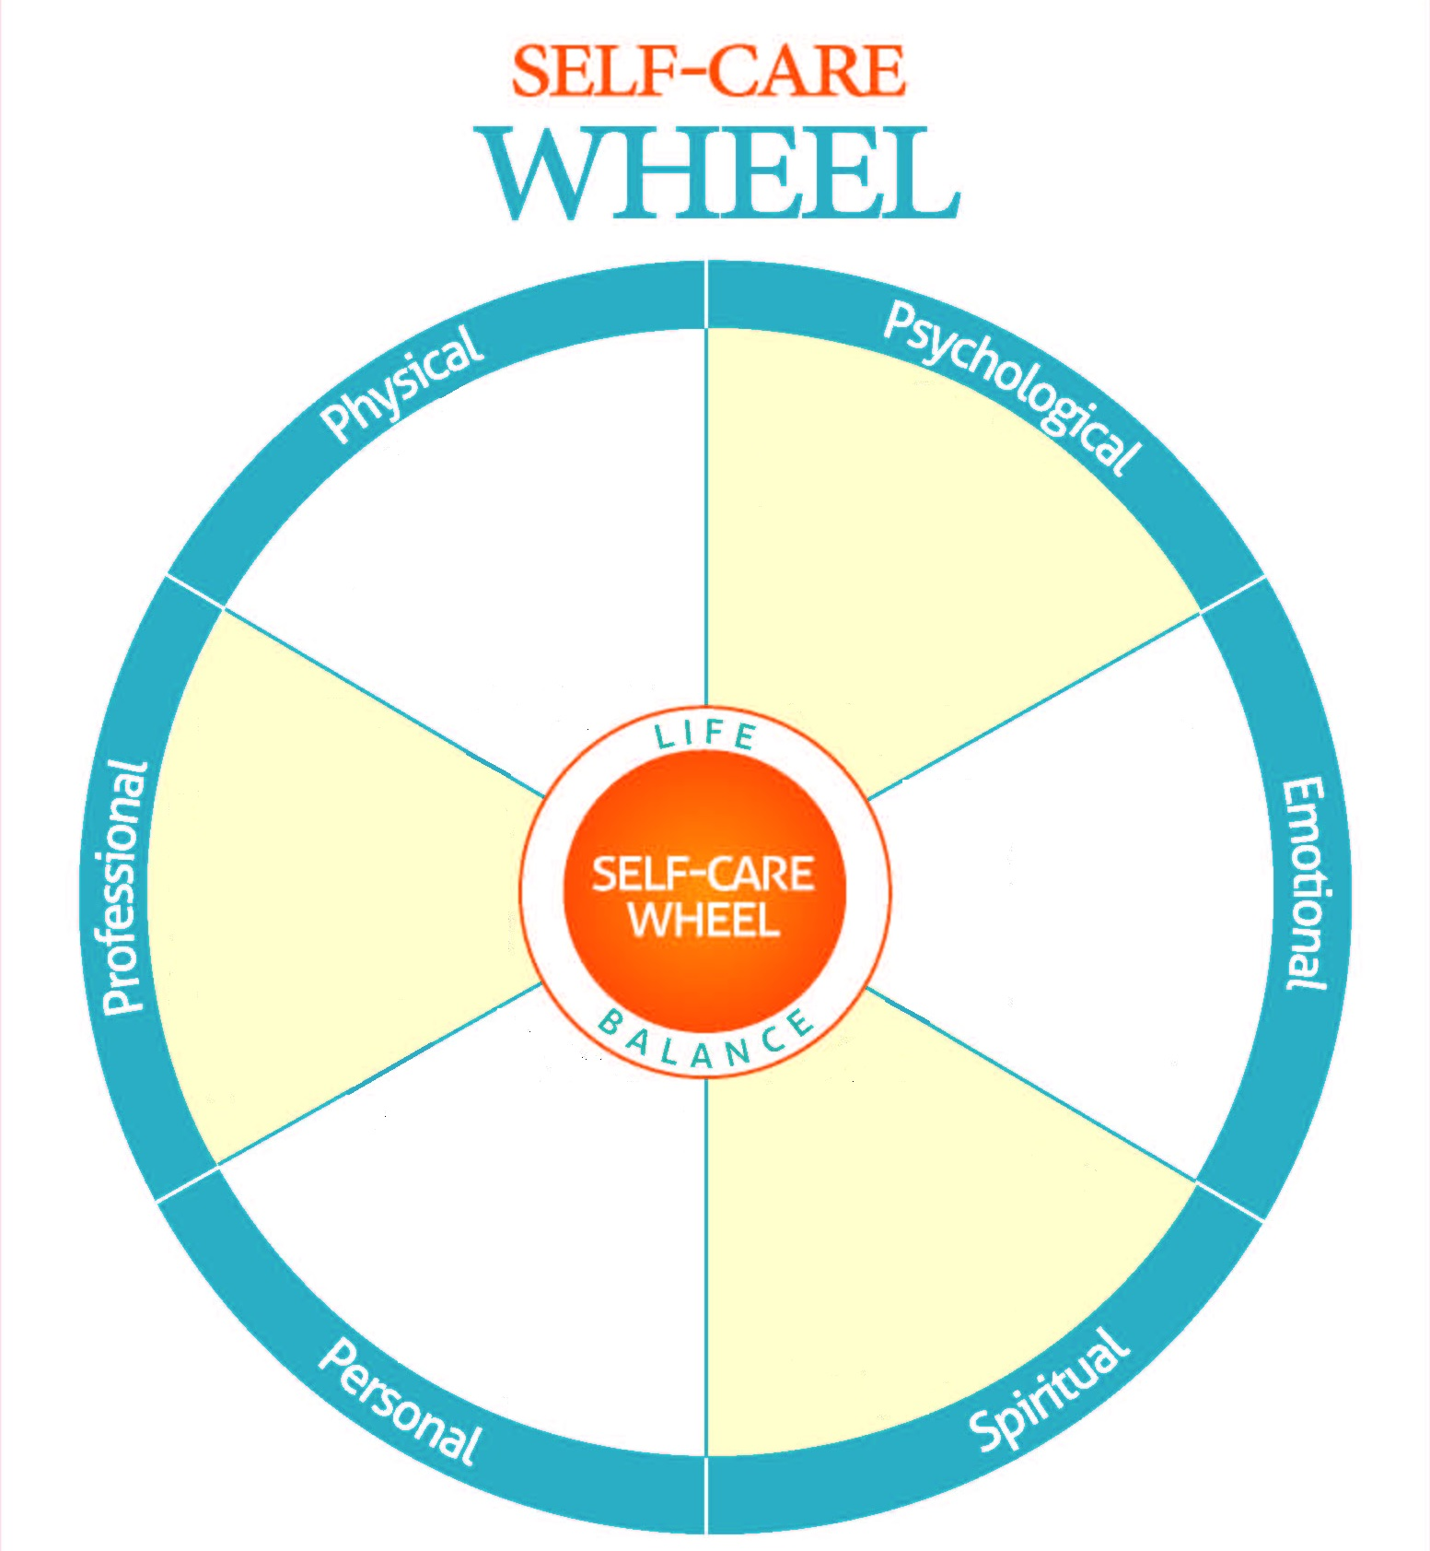
Self care planning – what does your wheel look like?

Slide 26
Some final thoughts
Stay connected to work that feels meaningful for you
Plan your holidays
Have an exit strategy in mind (you don’t HAVE to do this work)
Never underestimate the power of humour!! (or wine, or chocolate…. ☺)

Slide 27
Part 5
Any reflections or questions for us?
THANK YOU!!

Slide 28
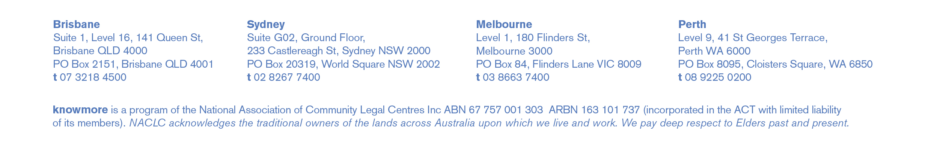
Contact Us
More than happy to help with any questions that you may have now or in future!
Ann Gummow
Managing Lawyer
07 3218 4500
ann.gummow@knowmore.org.au
FREECALL 1800 605 762
Web: www.knowmore.org.au
Amanda Whelan
Team Leader, Support Services
07 3218 4500
amanda.whelan@knowmore.org.au

