Slide 1
Legal Health Check Pathways for CLCs
CLCQ Webinar 22 February 2017

Slide 2
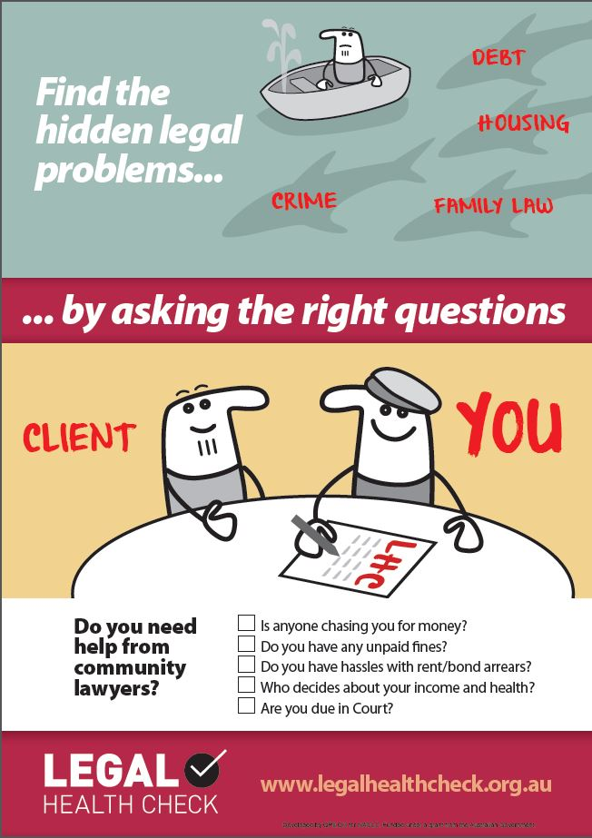
Presenter
Sue Garlick
Deputy Director
LawRight (formerly QPILCH)
deputy@lawright.org.au

Slide 3
Why are you here?
Does your CLC want to:
connect more effectively with local community or health organisations?
so that you can…
meet and assist the clients you want to help?
try to assist multiple-needs clients (“intersectionality”/multiple legal needs)
aka… intentional, effective connections with your chosen client group, by engaging with “trusted intermediaries”, “front-line workers”, “problem noticers”
regardless of… your connection style e.g. outreach/HJP/community connection/co-location/referral pathway etc….

Slide 4
LHC Resources Snapshot

Slide 5
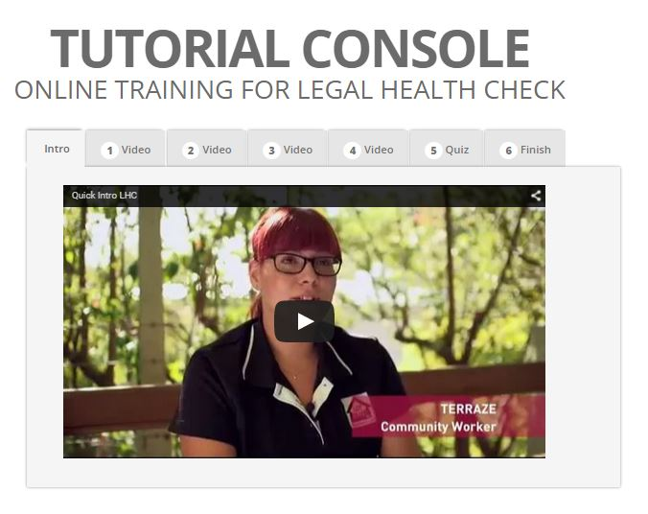
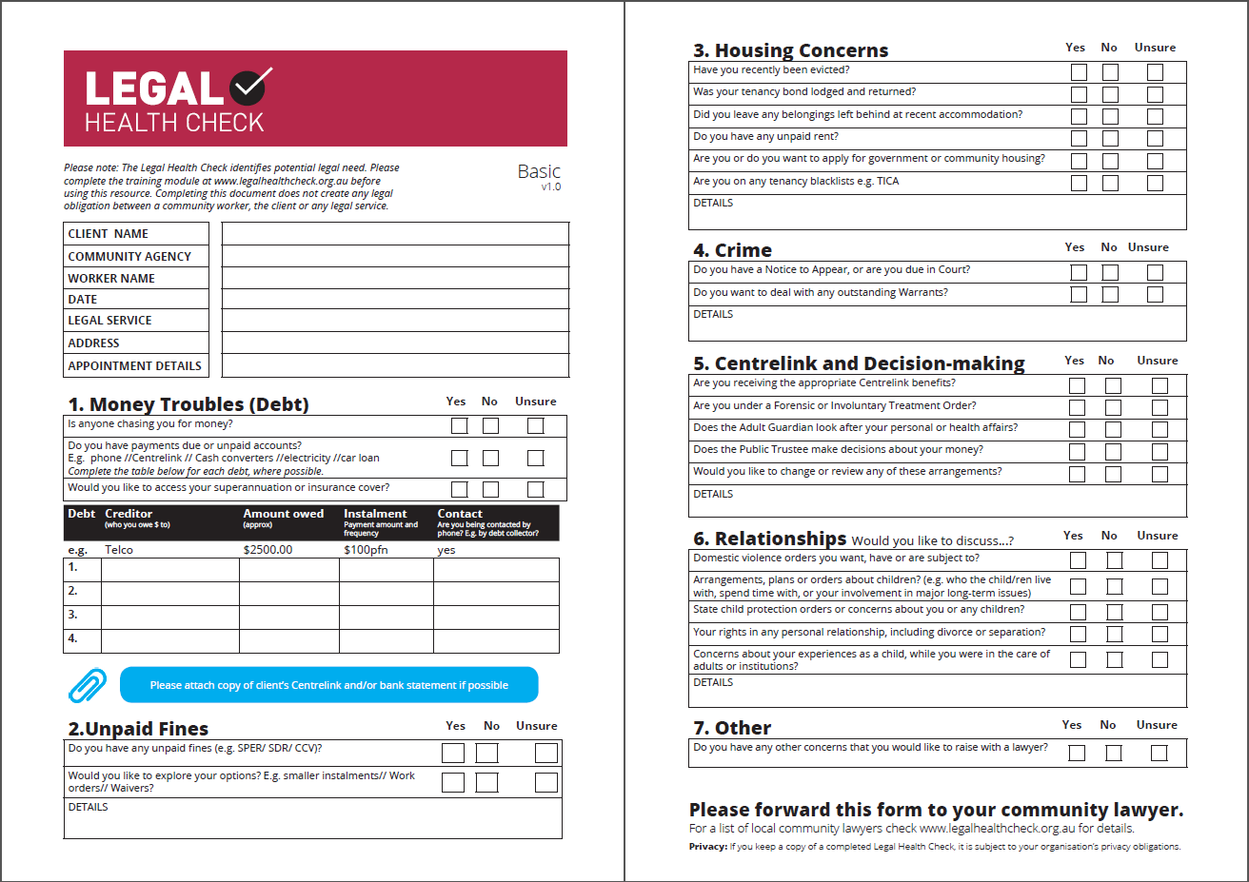
Existing LHC resources
www.legalhealthcheck.org.au
Legal Health Checks –Basic, Youth, Newly arrived, Housing, Mental Health
Four tutorial videos for community workers
Postcards, posters and FAQs
Jointly managed website- NACLC+QPILCH
40+ CLCs around Australia

Slide 6
Existing LHC resources: Quiz time

Slide 7
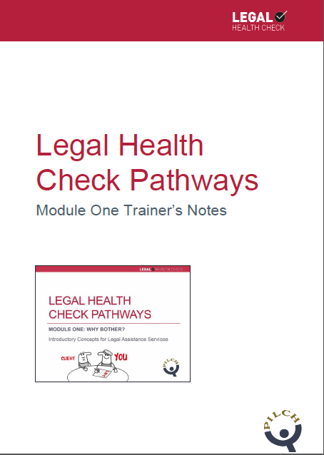
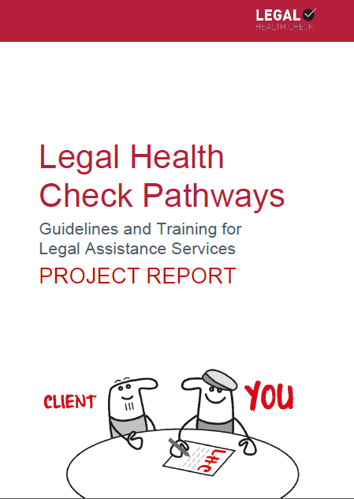
New resources
1. Evaluations of LHC in QPILCH settings and at 3 pilot sites:
Suncoast
TASC
ATSILS Cairns
2. Best practice guidelines
3. Training for legal services in two modules:
Why Bother?
Establishing and Maintaining a LHC Pathway
(Powerpoints and trainer’s guides)
All online at: www.legalhealthcheck.org.au

Slide 8
New Legal Health Check Pathways for Lawyers resources www.legalhealthcheck.org.au

Slide 9
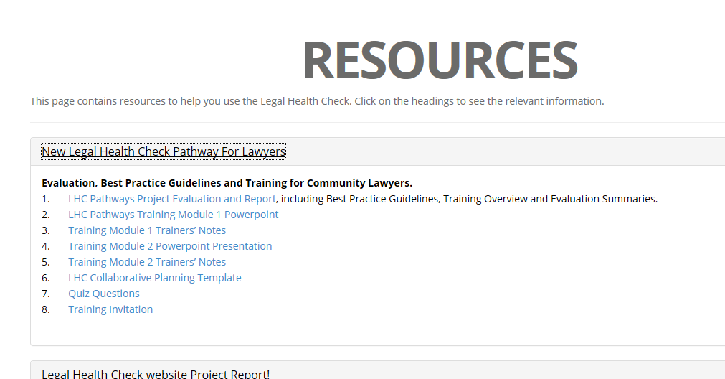
http://legalhealthcheck.org.au/legalhealthcheck/resources.html

Slide 10
LHC Pathway Snapshot

Slide 11
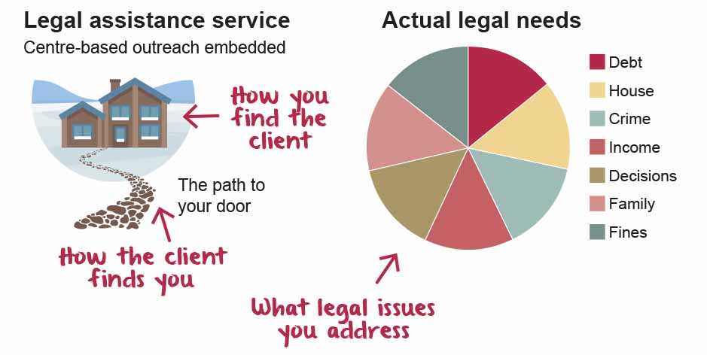
Three elements of legal service delivery

Slide 12
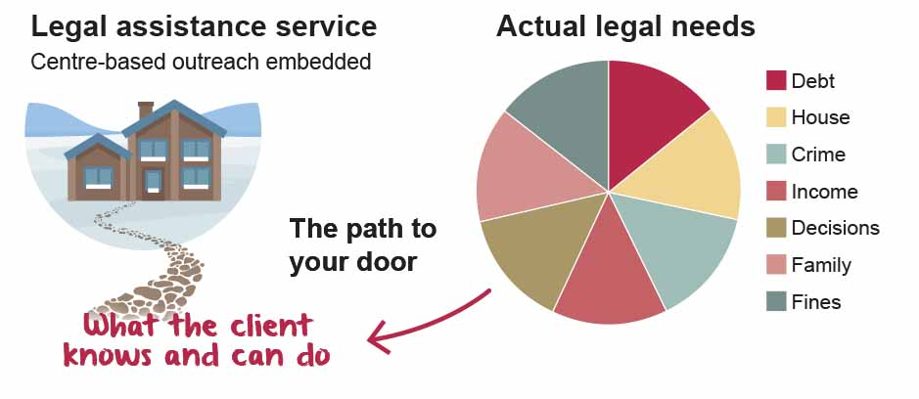
If you increase what the clients knows and can do: you widen the path to your door

Slide 13
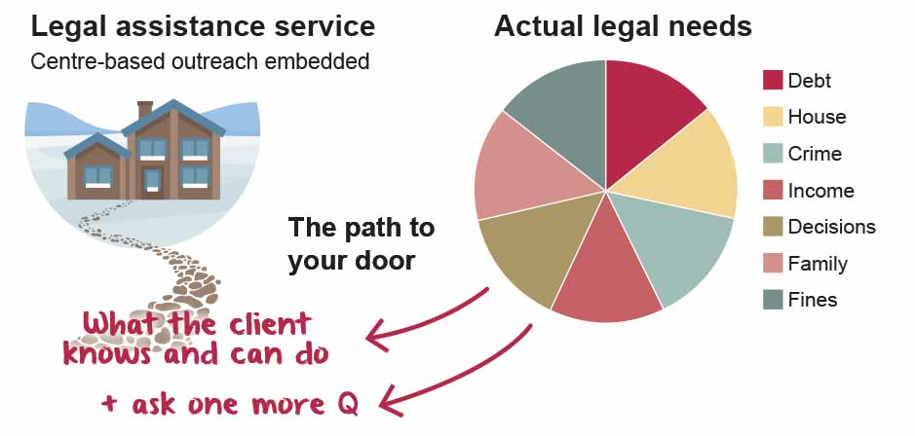
1. TARGETED: Ask one more question

Slide 14
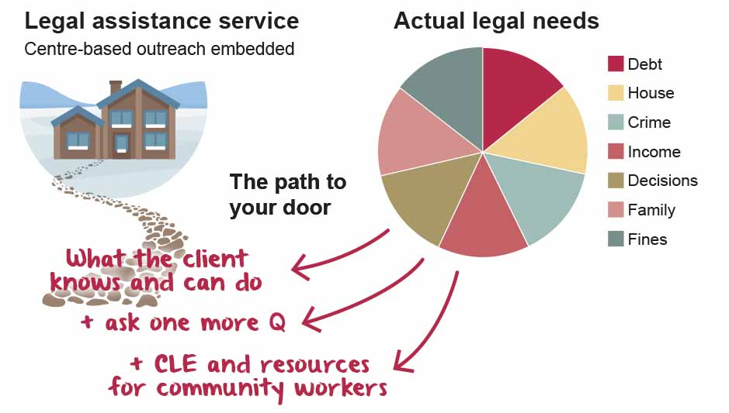
2.1. TIMELY and APPROPRIATE: Connect to community agencies (CLE)
Teach front line workers what legal needs of clients are and how you can help

Slide 15
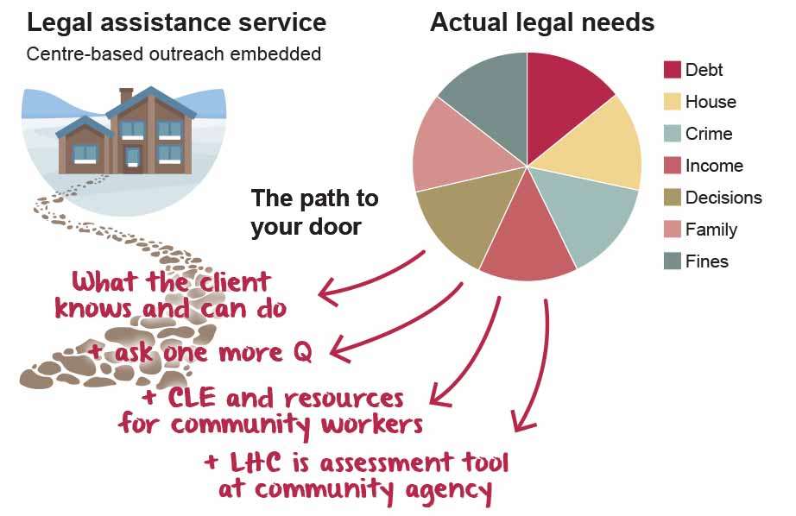
2.2 TIMELY + APPROPRIATE: Train community workers assess & refer legal need
LHC offers resources and CLE for workers to:
Give help
Get help
Reinforce help

Slide 16
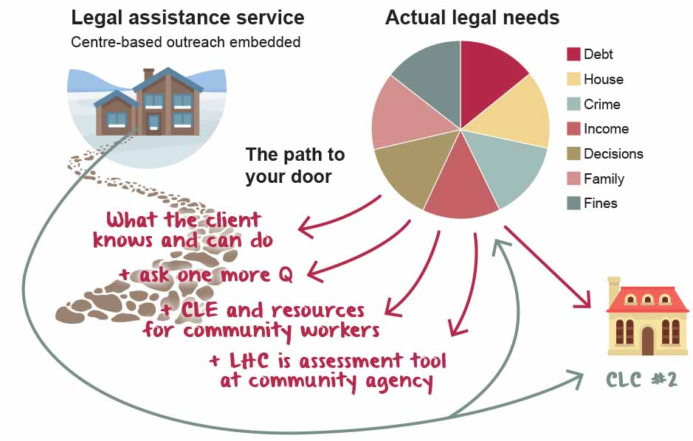
3. JOINED UP: Create a LHC Pathway

Slide 17
LHC Evaluation Snapshot

Slide 18
Evaluation Findings (phase one) 2015
Does the LHC help in QPILCH settings?
Good concept, good document and good questions
Works best if actually complete form (3.5 vs. 1.5 legal issues per client)
Appears to influence community workers to engage with legal service and prioritise support for client which influences favourable outcomes for clients
BUT – busy lawyers and busy community workers rarely use form (could be result of entrenched LHC “approach”)

Slide 19
Trial sites & stats
Sunshine Coast: SunnyKids Najidah and Cooroy Family Support Centre, Suncoast Community Legal Service Inc. and Legal Aid Queensland Maroochydore
Toowoomba: Red Cross HomeStay program and The Advocacy and Support Centre (TASC)
Cairns: Wuchopperen Women’s Child and Maternal Health Services and Aboriginal and Torres Strait Islander Legal Service Queensland (ATSILS).
82 clients had their legal needs diagnosed by a community worker, over 3 months
Clients had 3.05-3.61 legal issues each
34 clients were referred to the participating/paired legal service (other legal issues were handled in-house or referred to advocacy services, e.g. financial counselors)
14 clients attended an appointment with a lawyer.
4 clients had a community worker attend with them
Clients had a range of legal issues identified, with high levels of debts, fines, housing and familly issues faced by vulnerable clients:
 | DEBT | FINES (SPER) | HOUSING | CRIME | GUARDIANSHIP/CENTRELINK/DECISION MAKING | CHILD AND FAMILY/RELATIONSHIPS | OTHER ISSUES
SunnyKids. Number of clients N=18 | 9 (50%) | 3 (17%) | 11 (61%) | 2 (11%) | 2 (11%) | 14 (78%) | 2 (11%)
Red Cross. Number of clients N=162 | 52 (84%) | 13 (21%) | 13 (21%) | 4 (6.5%) | 1 (2%) | 9 (14.5%) | 3 (5%)
Wuchopperen. Number of clients N=2 | 1 | 0 | 1 | 0 | 0 | 0 | 2

Slide 20
Evaluation Findings (phase two) 2016
LHC training and referral processes:
increased referrals from community services to paired legal service
enabled the paired services to better understand each other and offer a better-integrated, more effective service for clients
Community workers who completed the LHC with clients identified more types of legal issues than they might otherwise have been aware of, or thought of as legal issues.
Lawyers less likely to refer to the completed LHC form supplied at referral by the community services. This seemed to relate to lack of awareness, as well as reluctance to open up discussion of legal issues to which the lawyer did not have the time to respond.
Collaboration would be improved by:
use of formal protocols, with clarity about referral processes and follow-up
built-in review and training needs identified
commitment of senior personnel of each agency to the agreement

Slide 21
Evaluation participants said…
From the pilot sites…..
“Our [legal] service recognises that we need to work more closely with community services. It’s a change in our mindset and the LHC is a great tool to assist this.”
“We had been working with a client for some time and had assessed the help she needed. After hearing about the LHC, but before any training, we thought we would try it out. We were amazed to find that our client had a lot of other financial debt issues she hadn’t ever mentioned before. It meant we were able to sort those out before they became worse”. (community worker)
“My client was fleeing from domestic and family violence with her three children. She and I filled in the Legal Health Check form together. Due to completing the LHC form, I identified that my client was named on the mortgage of the family home. She was therefore not eligible for government housing which placed her in an awkward situation. The solicitor was able to advise her of the most appropriate action to take in these circumstances.” (community worker)

Slide 22
LHC Best Practice Guidelines Snapshot

Slide 23
From the Project Report

Slide 24
LHC pathways How-to Snapshot

Slide 25
Healthy Relationship Process
Intentional meeting
Get to know you
Decide and Plan
Nurture
Review and change
Communication
Resources

Slide 26
1. Intentional meeting
Who are our clients and what do we do for them?
Communication: Choose a champion in each agency. Decide who else needs to meet informally before you make some dates for the next step in the process.
What legal needs do our clients have?
Has the community agency ever referred clients to the legal service, and how did that go?
Would it be useful to work together?
Resources: LHC website introductory video and postcards
Agree to view Legal Health Check resources training videos

Slide 27
2. Joint get-to-know-you session/s
Introduction
Communication: Finalise a champion and a key contact person in each agency. Make some dates for planning sessions.
Why do we want to work together
Legal Health Check resources, incl. evaluation findings
Professional differences
Resources:
LHC website four training videos
Copies of Basic LHC and LHC posters
Module One and LHC evaluation findings
Champions in each agency
Concerns

Slide 28
3. Decide and plan
Which LHC?
Communication: Finalise Joint LHC, Joint referral protocol and distribute to all staff.
Community worker spectrum
1. Completing LHC when/who/how?
2. Connecting client
3. Supporting the client
Legal service spectrum
1. What will you do
2. What will you refer?
3. What will you communicate?
Resources:
Service Spectrums. Joint LHC, example protocol,
Joint LHC = Collaborative Service Planning Template
Referral protocol incl. client consent, phone calls

Slide 29
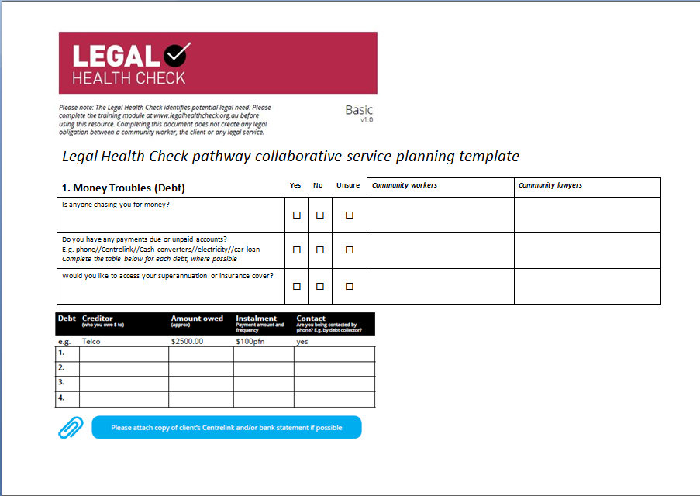
Joint LHC: Collaborative Service Planning template

Slide 30
Example referral protocol/flow chart
Community worker completes LHC with client
Community worker (with client present) phones legal service, makes appointment, clarifies issues referred, supporting docs required
LHC emailed with supporting docs to legal service
Conflict check completed and communicated
Client attends legal service, with or without community worker
Legal service follows up with community worker – outcomes, next steps, other referrals
Legal service logs data, reviews LHC and triarges other legal issues
REFERRAL CHECKLIST
Client consent
Client and worker details
Appointment details
LHC with referred issues circled
CONTACT DETAILS
Community agency
Legal service 1
Legal service 2

Slide 31
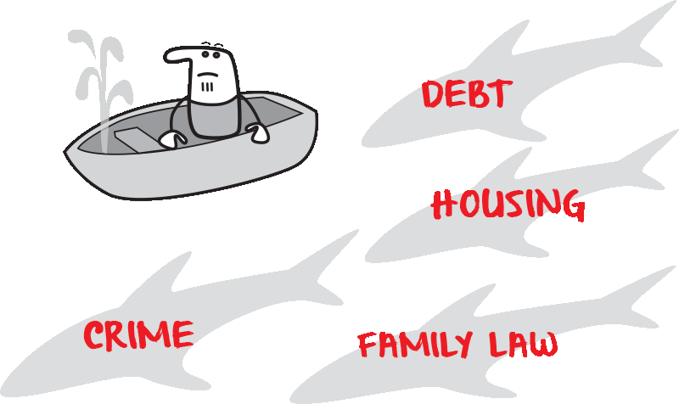
4. Nurture
Follow up with community worker after appointments
Meet for coffee at other agency
Update and distribute the referral template/flowchart
Plan to meet quarterly to review
Update contact details regularly
Introduce new workers to other agency
Share newsletters
Tell stories together at events /in media
Think about law reform and systemic responses
Encourage community workers to attend legal appointments

Slide 32
5. Review and change
Follow up with community worker after appointments
Identify training needs for better processes
Identify improvements in referral processes
Are you using the most appropriate LHC?
Identify and plan legal information training needs
Identify and plan client care training from community/health workers
Identify alternative legal referral points
Would an outreach or phone clinic work better?
Review and share data

Slide 33
LHC Pathways Experiments

Slide 34
LegalPod - LawRight
Purpose built legal service
Connect to community agencies –mutual and on-going training and meetings
Develop referral pathways
Client specific LHC
Induct face-to-face lawyers and on-going training
2012 QPILCH research project confirmed high coincidence of homelessness and child protection systems (up to 88%); AND
* Highly disconnected demographic
*no relevant legal service
*multiple unrecognised legal needs
*unresolved legal needs had high impact on future well-being
Clients have up to 9 legal issues initially
Others emerge over time (4 years of service)
Workers increase knowledge of appropriate referrals
Attempt client-direct CLE
Basic Rights +YAC +YFS+TQ

Slide 35
Wuchopperen (Aboriginal Health Service at Cairns)
Multiple consultation with Wuchopperen stakeholders
Specific LHC and referral pathway developed
Training for all stakeholders
Indigenous lawyers
QIFVLS+TQ+ATSILS
Many Wuchopperen clients attending HPLC in Cairns
High needs ATSI clients have multiple, unrecognised legal needs addressed as part of health
What could an ATSI LHC look like?
Requests from other indigenous health services

Slide 36
NT Legal Aid
Experiments with the LHC at Minjilang Healthy Lifestyle Festival (on Croker Island, NT)
Use of Legal Health Check postcard in outreach legal clinics
From a presentation at Legal Aid CLE Working Group about the NACLC Legal Health Check project to…
What could a NT version of the Legal Health Check look like?

Slide 37
Experiments –what about you?
What do you currently offer your clients*?
Which community service do your clients connect with?
Which LHC is relevant to your clients?
What other legal services should be involved?
What is one change you could make…to make it easier for your clients to find you?
*prospective or existing

