Slide 1
INTRODUCTION TO PROPERTY SETTLEMENTS
Peel community legal service community legal education
Part B
Notes:
Welcome to Part A of the Introduction to Property Settlements series
Caris Tysoe, Peel Community Legal Services

Slide 2
What will be covered?
From Part A
Windfalls
Jurisdiction
Part B
Pathways to reaching a property settlement
Agreement: Options
Pre-Action Procedures
Consent Orders
Commencing Proceedings in the FCWA
Fees and Service
Injunctions
Responding to an Application
Court Process

Slide 3
WINDFALLs
If a party received an inheritance, gift, windfall, or compensation payout during the relationship…
If many years ago, will likely become part of the asset pool
If recent, might be returned to the party whose side it came from
Inheritance
Lottery wins

Slide 4
JURISDICTIONAL REQUIREMENTS FOR DE FACTO RELATIONSHIPS
In order to obtain orders from the FCWA relating to property, the court must be satisfied that:
Separated on or after 1 December 2002; and
One of the parties is/was living in WA on the day the application for orders is made; and
Both parties resided in WA for at least 1/3 of the de facto relationship
OR
Substantial contributions (financial, non-financial, homemaker/parent) were made by either partner in WA

Slide 5
JURISDICTIONAL REQUIREMENTS FOR DE FACTO RELATIONSHIPS
Example:
A and B had a 9 year de facto relationship
$100,000 in A’s super
$15,000 in B’s super
3 years of the relationship in WA
Remaining 6 years of the relationship in QLD
A and B separate
A moves back to WA after separation
Questions:
If A applies in WA for court orders B will not be able to receive a super split?
Is this just and equitable?
Is there anything stopping clients from forum shopping?
Can matters in WA be transferred to the FCA or the Federal Circuit Court?

Slide 6
JURISDICTIONAL REQUIREMENTS FOR DE FACTO RELATIONSHIPS
In order to obtain orders from the FCWA relating to property, the court must be satisfied that:
Separated on or after 1 December 2002; and
One of the parties is/was living in WA on the day the application for orders is made; and
Both parties resided in WA for at least 1/3 of the de facto relationship
OR
Substantial contributions (financial, non-financial, homemaker/parent) were made by either partner in WA
A is living in WA on the day the application is made
The parties resided in WA for 3 of the 9 years

Slide 7
JURISDICTIONAL REQUIREMENTS FOR DE FACTO RELATIONSHIPS
Example:
A and B had a 9 year de facto relationship
$100,000 in A’s super
$15,000 in B’s super
3 years of the relationship in WA
Remaining 6 years of the relationship in QLD
A and B separate
A moves back to WA after separation
Questions:
If A applies in WA for court orders B will not be able to receive a super split?
Is this just and equitable?
Is there anything stopping clients from forum shopping?
Can matters in WA be transferred to the FCA or the Federal Circuit Court?

Slide 8
JURISDICTIONAL REQUIREMENTS FOR DE FACTO RELATIONSHIPS
Family Court Act 1977 (WA)
44. Transfer of proceedings to another court — FLA s. 45(2)
(1) Without limiting section 43, if in the exercise of its jurisdiction it appears to the Court or to the Magistrates Court that it is in the interests of justice, or of convenience to the parties, that the proceedings before it be dealt with in another court, the Court or the Magistrates Court, as the case may be, may, on its own motion or otherwise, transfer the proceedings to the other court.
(2) A transfer under subsection (1) may be made on the application of any party to the proceedings.
[Section 44 amended by No. 25 of 2002 s. 53; No. 59 of 2004 s. 95.]
Division 4 deals with the transfer, staying and dismissal of proceedings

Slide 9
OVERVIEW: PATHWAYS TO REACHING A PROPERTY SETTLEMENT
Permanent relationship breakdown
Negotiate out of court (‘pre-action procedures’)
‘Walk away’
Get consent order approved by the Court
No agreement
No negotiation out of court for certain reasons
Go to Court
NOT legally BINDING
BINDING
Reach agreement
Go to court
Binding Financial Agreement
Legally BINDING, but, less control over what the Court may order
Additional requirements and necessary legal costs
Legally BINDING, but, less control over what the Court may order

Slide 10
Agreement: options
‘Walk away’
Get consent order approved by the Court
NOT legally BINDING
BINDING
Reach agreement
Binding Financial Agreement
Additional requirements and necessary legal costs

Slide 11
No Agreeement: Overview of the process
Pre-action Procedures
Dispute Resolution
Letter of Negotiation
Application to the Court
Form 1: Initiating Application
Court
Duty of Disclosure
Form 13: Financial Statement
Affidavit
Procedural Hearing
Conciliation Conference
Readiness Hearing
Trial

Slide 12
No agreement – Pre-ACTION Procedures
Dispute Resolution – s 60(I) Certificate
Writing a Letter of Negotiation to the other party setting out the claim and exploring options for settlement
Complying with the Duty of Disclosure
See FCWA Brochures:
Financial Cases Brochure 2; and
Duty of Disclosure in Family Law Cases

Slide 13
before dispute resolution
Get organised – Keep a file (or the like) containing:
List of assets/liabilities and their estimated values
Latest tax return, bank and superannuation statements etc
Collate copy of all documents sent/received
List of what is agreed upon and what is not
Organise everything chronologically and in sections

Slide 14
Letter of negotiation
Letter should set out:
“Without Prejudice Save as to Costs”
Background of relationship and contributions
List of assets and liabilities and estimated values
Settlement proposal
Request for disclosure/provision of disclosure
Time in which to respond

Slide 15
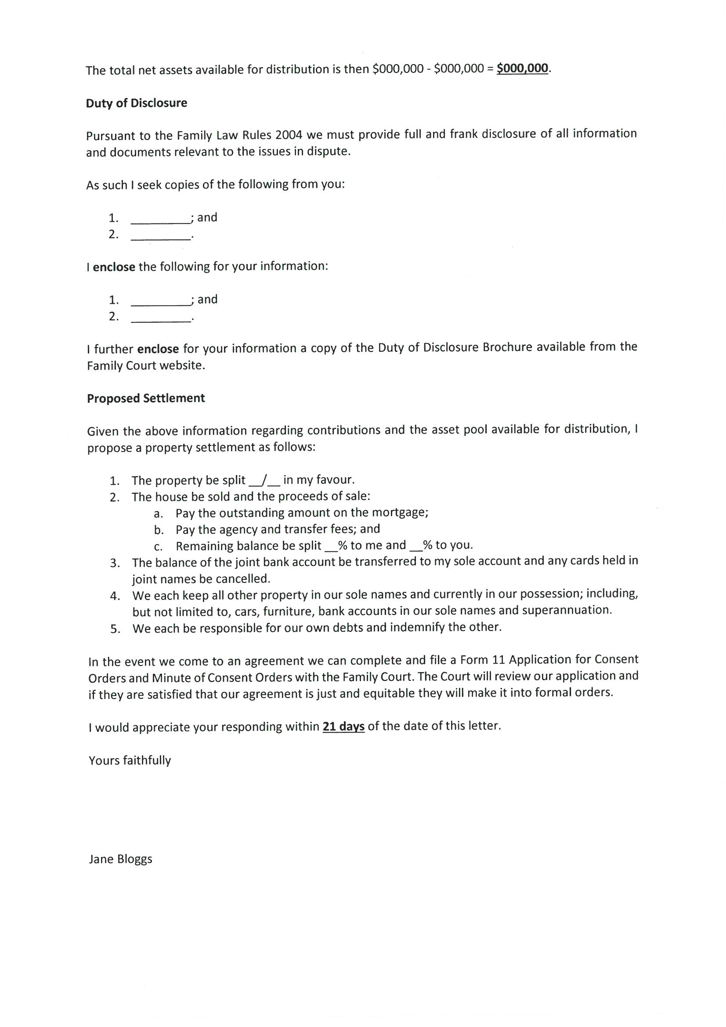
Sample letter of negotiation

Slide 16
DISCLOSURE
Must exchange documents, including:
3 most recent tax returns
Current bank statements
Superannuation documents
Etc.
Best to exchange ASAP
But must be done at least two days before the first court event

Slide 17
Rules relating to disclosure
Subsidiary legislation for the FCWA includes:
Family Court Rules 1998
Family Court Regulations 1998
Family Court Rules 1998 ss12, 13 & 13A
Family Law Rules 2004 Part 13.1

Slide 18
failure to provide financial disclosure
Non disclosure is a common complaint
Sending the letter we listed earlier which requests specific documents will help
Commence proceedings and seek an order that the other party provide the necessary documents
If still no disclosure…

Slide 19
When the negotiation letter fails
Write a further letter to your former partner setting out:
“Without Prejudice”
Issues in dispute
Orders that you will be seeking
Genuine offer to resolve
A time within which they should respond
> 14 days away
Always keep copies of letters/documents sent

Slide 20
Exemptions from pre-action
Urgency
Family Violence
Allegations of Fraud
One party has refused to negotiate
Time limit close to expiring
Same matter has been in the Court over the last 12 months

Slide 21
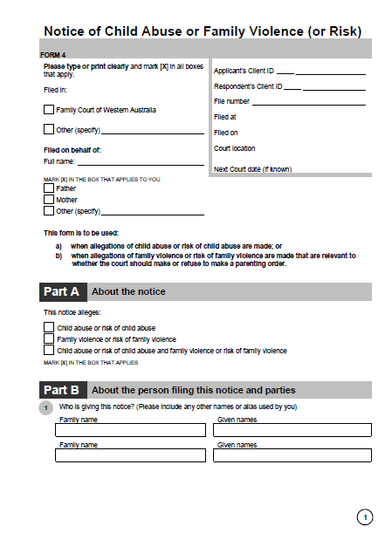
FAMILY VIOLENCE – Form 4
Further info about what constitutes Family Violence is available in the information sheet attached to Form 4
Download Form 4 from the FCWA website

Slide 22
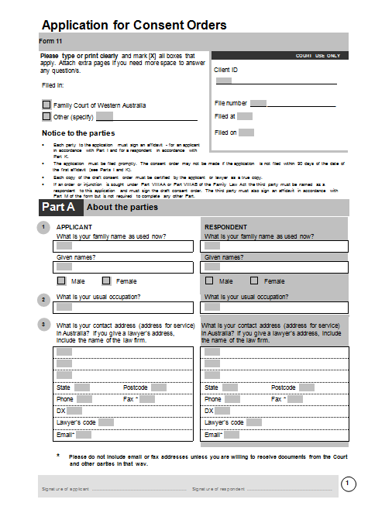
consent orders - Form 11
Don’t forget Part E!

Slide 23
Part e – minute of consent orders
Parties must attach a draft set of consent orders (otherwise known as a Minute of Consent Orders) to a Form 11. There is a form that can be used on the FCWA website.
In the minute of consent orders the parties set out what they have agreed.
This might include agreement about the following:
Sale of property
Transfer of land or interests
Cash payments
Retention of property

Slide 24
Minute of consent orders

Slide 25
Consent orders – exampleS
Example 1 – sale of house and splitting the money
1. The applicant and respondent shall cause the property situated at (address), and being more particularly described as (land description as shown on the Certificate of Title) to be placed on the market for sale at a price and on conditions to be agreed between them.
2. The proceeds of sale of the property to be disbursed as follows:
In adjustment of rates and taxes;
In payment of the expenses of sale including real estate agent’s commission;
In payment of any monies required to secure discharge of any encumbrances registered against the title to the said property; and
The balance be divided in proportions _% to the applicant and _% to the respondent.

Slide 26
Consent orders – examples …
Example 2 – transfer of interest in land
1. The applicant/respondent transfer his/her right, title, and interest in the property situated at (address) and being more particularly described as (land description on the Certificate of Title) to the respondent/applicant absolutely.
Example 3 – assets other than land
1. The applicant and respondent each retain the motor vehicles and furniture and household contents presently in their possession or control.

Slide 27
No agreement: commencing proceedings
All the relevant forms are on the FCWA website
There are also kits on the website which can assist clients
A Duty Lawyer is available on Level 3 of the FCWA

Slide 28
Applying for property orders
To commence proceedings in the FCWA, clients must file:
Form 1 Initiating Application
Form 13 Financial Statement
Affidavit in Support
It is best to type the forms, although they can be neatly handwritten (except affidavits)

Slide 29
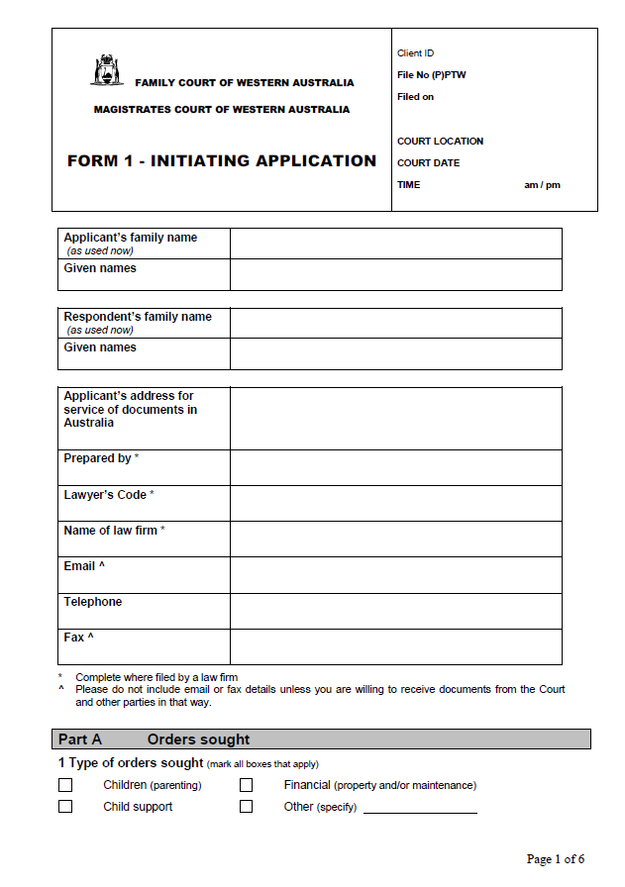
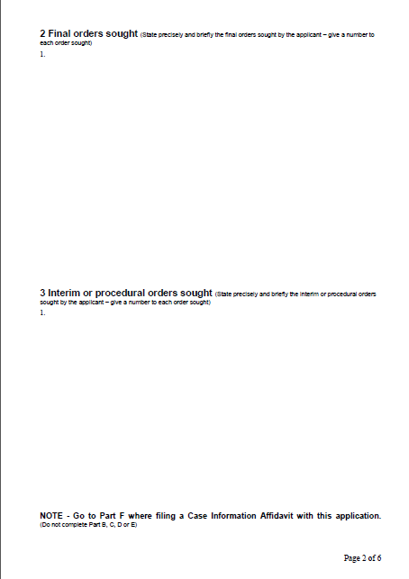
Form 1

Slide 30
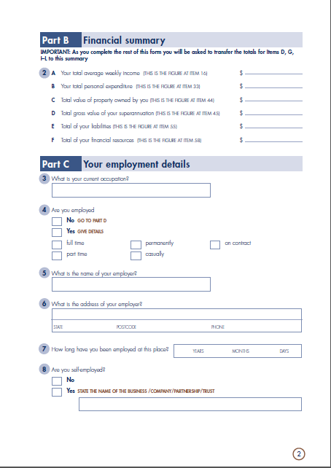
Form 13

Slide 31
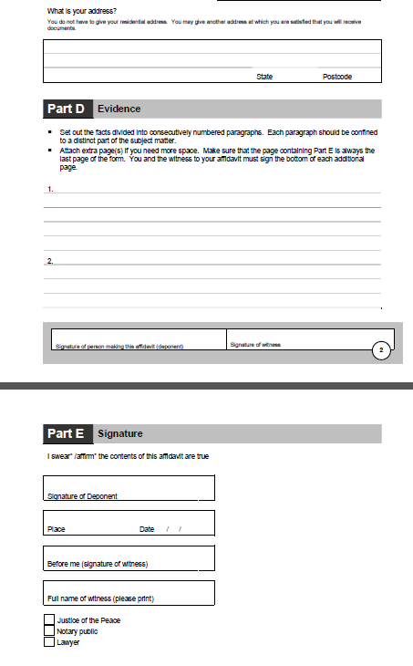
Affidavit

Slide 32
In the affidavit
The client’s evidence
Must be sworn or affirmed before a JP or lawyer
Should only contain factual and relevant information
Must be to the point. No waffling!
Formatting requirements:
Typed
Numbered paragraphs
Each paragraph = one fact/event
Good to use subheadings

Slide 33
Affidavit body – example
I, JANE MARY BLOGGS, of 1 This Street, Mandurah in the state of Western Australia, Home Duties, swear this affidavit in support of my application for property orders.
I was born on 1 January 1960.
I met the respondent JOE JOHN BLOGGS born 2 February 1960 (Joe) in late 2004.
On 10 October 2006, Joe and I started living together in a de facto relationship.
….

Slide 34
AFFIDAVIT Example – What’s wrong here?
On 10 October 2006, Joe Bloggs and I started living together in a de facto relationship.
Property Owned Prior to De Facto Relationship
On 2 March 2004, I purchased an apartment at 1/123 Fake Street, Mandurah, 6210 for $250,000. A copy of the Certificate of Title is annexed hereto and marked “A”.
Prior to our relationship Joe Bloggs only owned his car. Several years before we got together he owned $45,000 of shares that he inherited from his Pop, but he was an idiot and sold them and wasted all the money on going out and other silly things.
Property Accrued During Relationship
On 15 April 2009, Joe Bloggs and I purchased 321 Example Street, Mandurah, 6210 as tenants in common for $420,000. A copy of the Contract for Sale of Land is annexed hereto and marked “B”.
Contributions During Relationship
For the whole period we lived together I was responsible for all house duties, including all cooking, cleaning and garden maintenance. Joe Bloggs was useless and lazy. His mum always used to do everything for him so he never learnt any life skills.
Joe Bloggs’ brother’s wife, Jane Bloggs, told me that during our relationship, Joe Bloggs was gambling and losing large amounts of money when he went out with his brother.

Slide 35
AFFIDAVIT Example – What’s wrong here?
On 10 October 2006, Joe Bloggs and I started living together in a de facto relationship.
Property Owned Prior to De Facto Relationship
On 2 March 2004, I purchased an apartment at 1/123 Fake Street, Mandurah, 6210 for $250,000. A copy of the Certificate of Title is annexed hereto and marked “A”.
Prior to our relationship Joe Bloggs only owned his car. Several years before we got together he owned $45,000 of shares that he inherited from his Pop, but he was an idiot and sold them and wasted all the money on going out and other silly things.
Property Accrued During Relationship
On 15 April 2009, Joe Bloggs and I purchased 321 Example Street, Mandurah, 6210 as tenants in common for $420,000. A copy of the Contract for Sale of Land is annexed hereto and marked “B”.
Contributions During Relationship
For the whole period we lived together I was responsible for all house duties, including all cooking, cleaning and garden maintenance. Joe Bloggs was useless and lazy. His mum always used to do everything for him so he never learnt any life skills.
Joe Bloggs’ brother’s wife, Jane Bloggs, told me that during our relationship Joe Bloggs was gambling and losing large amounts of money when he went out with his brother.

Slide 36
Filing court documents
All documents get filed with the FCWA Registry in Perth in person or by post. Attach a cover letter when posting.
Time limits for filing can apply – be aware of them.
You file the original documents and a photocopy for each party involved. Along with a copy of the Marriage Certificate and the filing fee or exemption application (also file a copy of the Certificate of Title if property’s involved).
If the Court accepts your documents they will return the photocopies with the Court stamp on. The hearing date will be written in the top right hand corner.
If there are any problems with your documents you’ll receive a ‘requisition letter’ setting out what needs to be addressed.

Slide 37
Court Fees
Divorce Application (Form 3) | $865 ($290 reduced fee)
Initiating Application (Form 1) | $330*
Response (Form 1A) | $330*
Application for Consent Orders | $160**
Conciliation Conference Listing Fee | $380*
Fixing of Trial Date (per day) | $605* (Magistrate) / $825* (Judge)
*You may be entitled to an exemption from paying fees due to financial hardship or having a concession card. Check on the FCWA website.
** Only exempt where both qualify for exemption.

Slide 38
SERVING FILED DOCUMENTS
Once the client has received the filed documents back from the Court they will need to ‘serve’ a copy on the other party.
There is a ‘Service of Documents Kit’ available on the FCWA website that explains what they need to do.
If they are unable to serve the other party they may need to apply for substituted service.

Slide 39
Responding to an application
Form 1A Response to Initiating Application
Form 13 Financial Statement
Affidavit in Support

Slide 40
Court Process once application filed
Procedural Hearing
Conciliation Conference
Readiness Hearing
Callover/Trial
See Financial Cases Brochures 3-5 on the FCWA website for more information about each step

Slide 41
Attending court - Court etiquette
Arrive early and report to the court officer
Refer to the judicial officer as ‘your Honour’ (Judge/Magistrate) or ‘sir/ma’am’ (Judge/Magistrate/Registrar)
Stand when talking to the judicial officer
Do not talk over the judicial officer or the other party
Bow to the front of the court when entering and exiting the court room if the judicial officer is present
Ensure your phone is turned off before entering
Do not take food or drink in
Do not take children in with you – there is a child care service available at the Perth Family Court
Minimum neat casual dress

Slide 42
Court room layout
Judge/Magistrate
Associate
Respondent
Applicant
Seating
Court Usher

Slide 43
Injunctions
In some situations a client may need to apply for orders to prevent the other party from taking certain actions.
Scenario A:
A has been caring for the children at home, while B has been working
A moved out after separation with the children
The family home is in B’s name
A has noticed that the family home was recently listed online for sale
Scenario B:
C and D have separated
Both are still living in the family home
C cares for the children and D works
D is refusing to move out – D says D was the one paying the mortgage so D should get to stay
D is becoming more aggressive towards C in an attempt to convince C to move out

Slide 44
Injunctions: Preserving Property
Scenario A:
A has been caring for the children at home, while B has been working
A moved out after separation with the children
The family home is in B’s name
A has noticed that the family home was recently listed online for sale
Concerns with this scenario
Requirements:
Existing or potential claim
Danger of claim being defeated or prejudiced
Injunctions: FLA s114 (1) Marriage
FCA s235A De facto

Slide 45
Injunctions: Exclusive occupation
Scenario B:
C and D have separated
Both are still living in the family home
C cares for the children and D works
D is refusing to move out – D says D was the one paying the mortgage so D should get to stay
D is becoming more aggressive towards C in an attempt to convince C to move out
Concerns with this scenario
Injunctions: FLA s114 (1) Marriage
FCA s235A De facto

Slide 46
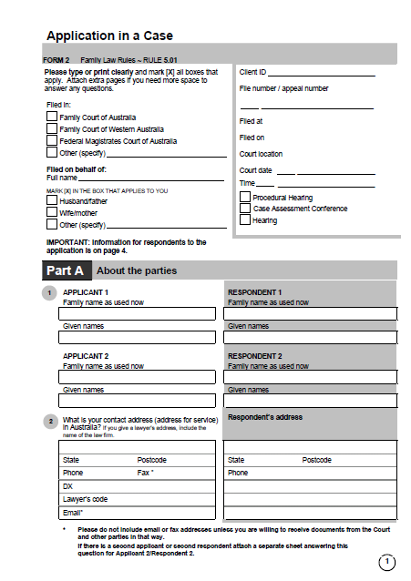
Applying for further Interim orders
Once proceedings have started you can amend the orders you sought if things change.
To do so you need to file a:
Form 2 Application in a Case
Affidavit in Support
Certificate of Conferral

Slide 47
Responding to further interim orders
Form 2A Response to Application in a Case
Affidavit in Support
Certificate of Conferral

Slide 48
REMEMBER…
The client can still negotiate and settle with the other party at any point up to their trial commencing.
If they do settle, they need to file consent orders!

Slide 49
USEFUL RESOURCES
Family Court of WA website: www.familycourt.wa.gov.au
Kits – Forms – Brochures
Kits
Prescribed Forms
Non-prescribed Forms
Brochures
Legal Aid WA website: www.legalaid.wa.gov.au
Information about the Law
Legal Aid Services
Publications
Youtube Videos https://www.youtube.com/user/WhenSeparating/videos

