Slide 1

So you want to be a migration agent?
Bruce Wells
Robert Lachowicz
www.rails.org.au
education@rails.org.au
CLCQ Webinar 14 March 2017

Slide 2
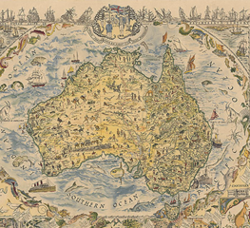


Acknowledge First Peoples
Map: ‘Patriotism and Resource’ Margaret Spilhaus 1920

Slide 3
What we’ll cover
Refugee and Immigration Legal Service (RAILS)
Becoming a registered migration agent
Overview of Migration law
Migration Program
Some key areas
    Refugees permanent/ temporary; family reunion; family violence; cancellations; over stayers; students, 457 visas
Working with refugee clients and interpreters
Networking
Questions.

Slide 5
Migration Agents Registration Authority
Migration Agents regulated by Part 3 MA: “Migration Agents and Immigration Assistance”
The Office of MARA regulates the migration industry:
- s.287 Register of Agents;
- s.317 General power
s.316 - Functions of MARA
(a) deal with registration applications
(b) monitor conduct of registered migration agents
(c) investigate complaints re immigration assistance
(d) take appropriate disciplinary action

Slide 6
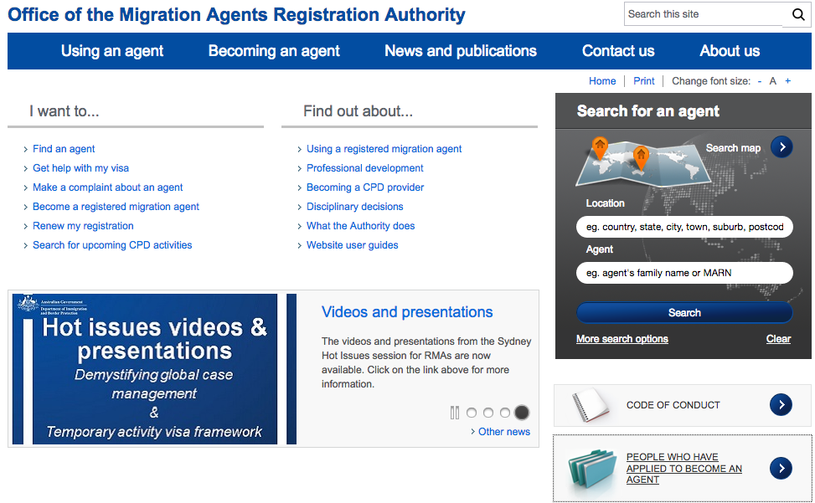
www.mara.gov.au

Slide 7
Registration
Applicant must be an Australian citizen, permanent resident or New Zealander with special visa [s.294]
Must be person of integrity, fit & proper [s.290]
Applicant must either hold prescribed course or has prescribed qualifications [s.289A]
Prescribed course is the Graduate Certificate course & prescribed qualifications is legal practising certificate [ reg 5]
Note: the Independent Review of MARA 2014 recommended that lawyers be removed from the regulatory scheme that governs migration agents such that lawyers cannot register as migration agents; and are entirely regulated by their own professional bodies.

Slide 8
Costs
Application for registration
$160 not for profit agent $1760 – for profit agent
Repeat registration $105 and $1595
LEGENDcom –Compulsory Library
Subscription costs (Non Profits) $420 + $345 per secondary licence
CPD
Lawyer’s Practising Certificate or Graduate Certificate

Slide 9
Role of Migration Agents
Advocacy and role similar to that of lawyers
A person gives immigration assistance if the person uses knowledge or experience in, migration procedure to assist a visa applicant [s.276]
s.280: a person who is not a registered migration agent must not give immigration assistance (criminal penalties)
Lawyers can give ‘immigration legal assistance’ without being registered (i.e. re court proceedings or where it’s not about preparing a visa application or review application)

Slide 10
Migration Agent Responsibilities
Code of Conduct – Professional responsibilities
Must undertake CPDs - s290A, Reg 6 (MARA regulation easing in 2018)
Must have Library (LegendCom)
- Subscription costs (Non Profits) $420 + $345 per secondary licence
Must advise PI insurer of expansion of coverage – added risks
Get VEVO - Visa Entitlement Verification Online (VEVO)

Slide 11
Migration Law
Migration Act 1958 – structure & framework for controlling immigration - source of power
Migration Regulations 1994 – procedural mechanism on how power to be administered – gives criteria for visa classes and subclasses
Case law – Federal Circuit Court, Federal Court, High Court
Ministerial Directions s.499 gives Minister power to make directions, which must be consistent with the MA and MR
Gazette Notices - Act and Regs may contain provisions which allow new information to be listed quickly in a Gazette authorised by the Minister.
PAM and MSI – policy, not legally binding. It’s DIBP interpretation of the law as guidance for their officers

Slide 12
Structure of Migration Act
Part 1: Preliminary
Part 2: Control of Arrival & Presence of Non Citizens
Part 3: Migration Agents & Immigration Assistance
Part 4: Offences Relating to Decisions Under Act
Part 4A: Obligations relating to identifying information
Part 5: Review of Decisions
Part 6: Migration Review Tribunal (repealed by TAA* 2015)
Part 7: Review of Protection Visa Decisions
* Tribunals Amalgamation Act

Slide 13
Structure of Migration Act
Part 7AA: Fast Track Review Process in Relation to Certain Protection Visa Decisions
Part 8: Judicial Review
Part 8A: Restrictions on Court Proceedings
Part 8B: Costs Orders where proceedings have no reasonable prospects for success
Part 8C: Reports on Persons in Detention for More than 2 Years
Part 8D: Civil Penalties
Part 8E: Investigation Powers relating to work-related offences and provisions
Part 9: Miscellaneous

Slide 14
Migration Regulations
Part 1: Preliminary
Part 2: Visas
Part 2A: Sponsorship Applicable to Div 3A of Part 2 of the Act
Part 3: Immigration Clearance & Collection of Information
Part 4: Review of Decisions
Part 5: Miscellaneous
Schedules (1-12)

Slide 15
Migration Regulations – Main Schedules
Schedule 1: Classes of Visas
Schedule 2: Subclasses of visas
Schedule 3: Additional Criteria applicable to Unlawful Non-Citizens & Certain BV Holders
Schedule 4: Public Interest Criteria
Schedule 5: Special Return Criteria
Schedule 8: Visa Conditions

Slide 16
Migration Regulations – Other Schedules
Schedule 5A: Evidentiary Requirements for Student Visas
Schedule 5B: Evidentiary Requirements for Student Visas – Secondary Applicants
Schedule 6: General Points Test – Qualifications & Points
Schedule 6A: General Points Test – Qualifications & Points
Schedule 6B: General Points Test – Qualifications & Points (General Skilled Migration Visas)
Schedule 7: Business Skills Points Test – Attributes and Points
Schedule 8: Visa Conditions
Schedule 9: Special Entry & Clearance Arrangements
Schedule 10: Prescribed Forms
Schedule 11: Memorandum of Understanding
Schedule 12: Exchange of Letters

Slide 17
Schedule 2 – Categories of visa subclasses
0XX bridging visas
1XX permanent visas available from overseas
2XX refugee and humanitarian visas available from overseas
3XX temporary visas available from overseas which allow holder to apply for permanent once arrive in Australia
4XX temporary resident visas
5XX student visas
6XX visitor and medical treatment visas
7XX humanitarian concern, temporary protection, transit and border visas
8XX permanent visas available in Australia
9XX electronic travel visas and visas for diplomats

Slide 18
Schedule 2 - Standard Subclass Criteria Format
XXX.1 Interpretation
XXX.2 Primary criteria
XXX.21 Criteria to be satisfied at time of application
XXX.22 Criteria to be satisfied at time of decision
XXX.3 Secondary criteria
XXX.31 Criteria to be satisfied at time of application
XXX.32 Criteria to be satisfied at time of decision
XXX.4 Circumstances applicable to grant
XXX.5 When visa is in effect
XXX.6 Conditions
XXX.7 Way of giving evidence

Slide 19
Legislative Pathway to Visa
s.29 - Minister may grant non-citizen a visa
s.30 – Visa may be temporary or permanent
s.31 – Classes of visas and criteria may be prescribed
Classes - Schedule 1, and some set out in Act
Criteria – Schedule 2 (common ones – health, public interest)
s.45 – Must apply for a class of visa
s.46 + reg 2.07 + Schedule 1 = Valid visa application
Bars on valid applications - s.46A (UMA), s.48A (previously refused or cancelled), safe third country + TSH visa)

Slide 20
Review
Parts 5- 8 Migration Act
AAT Refugee and Migration Division (previously MRT and RRT)
  Within 21 days of notification except 28 days for Protection visas and 7 days if in detention
  Offshore applications – within 70 days (+ 21 for deemed notification)
  s.501 character Cancellation – request revocation within 28 of notification
  s.116 General Cancellation - 7 days
  Bridging visa – 2 days if in detention and can apply for 5 more
IAA – fast track review for UMAs – 21 days
Judicial review – 35 days
Note Part 8B: Costs Orders where proceedings have no reasonable prospects for success

Slide 21
PERMANENT MIGRATION PROGRAM
Skilled
Migration
Humanitarian Migration
Family Migration
13,750
(18,750 in 2018)
60,000 (approx)
2016 figures
130,000 (approx)
Temporary visas
visitors, students, temporary workers
2015 – 1.2 million temp visas plus 0.7million NZ visa holders

Slide 22
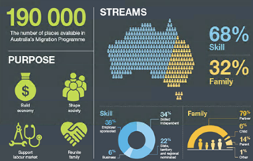
Permanent Migration Program
DIBP
2015/16 figures

Slide 23
Permanent Visa Options
Skilled
Migration
Refugee and Humanitarian Program
Family Migration
Refugee/humanitarian visa offshore (200–204)
Immediate Family of some RSHP holders
Protection visa onshore - authorized arrivals (PV 866)
Temporary Protection visa onshore -unauthorized arrivals - (TPV 785 + SHEV 790)
Partner
Fiancée
Dependent & adopted child
Orphan relative under 18
Remaining relative
Aged dependent relative
Carer
Parent
Skilled / business
High demand skills
Good English

Slide 24
Refugee/Humanitarian Visas
Refugee/humanitarian visa offshore (200–204)
  Subclass 200 – Refugee
  Subclass 201 – In-Country Special Humanitarian
  Subclass 202 – Global Special Humanitarian
  Subclass 203 – Emergency Rescue
  Subclass 204 – Woman at Risk
Protection visa onshore - authorized arrivals (subclass 866)
Temporary Protection visa onshore - unauthorized arrivals - (TPV 785 + SHEV 790)
201 and 203 very rare

Slide 25

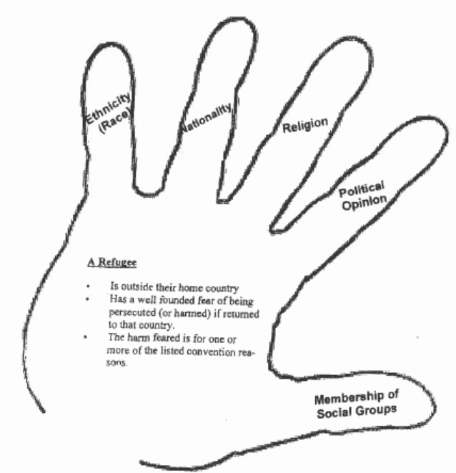

Slide 26
‘Refugee’ codified
[5H] (1) For the purposes of the application of this Act and the regulations to a particular person in Australia, the person is a refugee if the person:
is outside the country of his or her nationality (or former habitual residence) and, owing to a well-founded fear of persecution, is unable or unwilling to avail himself or herself of the protection of that country

Slide 27
‘Persecution’ codified
5J(1) For the purposes of the application of this Act and the regulations to a particular person, the person has a well-founded fear of persecution if:
(a) the person fears being persecuted for reasons of race, religion, nationality, membership of a particular social group or political opinion; and
(b) there is a real chance that, if the person returned to the receiving country, the person would be persecuted for one or more of the reasons mentioned in paragraph (a); and
(c) the real chance of persecution relates to all areas of a receiving country.
5J (4) If a person fears persecution for one or more of the reasons mentioned in paragraph (1)(a):
(a) that reason must be the essential and significant reason, or those reasons must be the essential and significant reasons, for the persecution; and
(b) the persecution must involve serious harm to the person; and
(c) the persecution must involve systematic and discriminatory conduct.

Slide 28

Non-citizen
In Australia
‘The Minister has substantial grounds for believing that, as a necessary and foreseeable consequence of the non-citizen being removed from Australia to a receiving country, there is a real risk that the non-citizen will suffer significant harm’ which means being subject to:
  arbitrarily deprived of life
  death penalty
  Torture
  Cruel or inhuman treatment or punishment
  Degrading treatment or punishment

Slide 29
Process for Onshore Protection Application
(authorized entrant)
Lodge form 866 with statement and evidence. Pay $35 fee if not in detention
Biometrics and medicals
Departmental interview
  AFP and security assessment
Decision – permanent residency or refusal
If refused – can seek review: Refugee Division of AAT
  within 28 days; or if in detention within 7 working days of notification.
AAT may affirm original decision or remit for further processing
If original decision is affirmed – Judicial review
Ministerial discretion – s. 417
Possible repeat applications (s 48B)
Departure (Community Assistance Support program, IOM)

Slide 30
Heavy onus on protection visa applicants
It is the responsibility of the non-citizen to specify all particulars of his or her claim to be such a person and to provide sufficient evidence to establish the claim (s5AAA)
DIBP will refuse if applicant refuses or fails to establish identity, nationality or citizenship, without reasonable explanation (s91W)
DIBP must draw unfavourable credibility inference if no reasonable explanation is given why new claims have not been previously raised (s 423A)

Slide 31
Resolving the Asylum Legacy Caseload Act 2014
Protection and Other Measures Act 2015
Re-introduction of Temporary Protection Visas (TPV)
Introduction of Safe Haven Enterprise Visas (SHEV)
Fast-track assessments and IAA
Codifying Refugee Convention obligations
Stronger removal power
Babies of UMAs parents deemed UMAs
Increase in Humanitarian program

Slide 32
Unauthorised Maritime Arrivals
People who arrived by boat August 2012 onwards.
May have been initially in detention centres but are now in the community
A few may have been at Nauru or Manus
Most clients tend to have come from:
  Iran or Iraq (including Arabs and Kurds),
  Sri Lanka (Tamils)
  Afghanistan (Hazaras)
  Sudan or Somalia
  Myanmar, Vietnam
  Some may be stateless
They often have connections with settlement support agencies

Slide 33
Unauthorised Maritime Arrivals - Applications
The Minister has lifted the application bar for most UMAs and invited them to apply for a Temporary Protection visa (TPV) or a Safe Haven Enterprise visa (SHEV) in Australia.
UMAs are now expected to lodge an application for a TPV or a SHEV UMAs who have not received an invitation to apply letter are not prevented from lodging an application.
DIBP says failure to lodge a visa application and maintain contact with us will be taken as an indication that an UMA no longer intends to seek protection in Australia. This can affect their support services, including income support and their Bridging visa.
UMAs who do not lodge a TPV or SHEV application are expected to leave Australia

Slide 34
Fast Track Review
No hearing. Review on papers only. Automatically referred to IAA by DIBP (no review if ‘manifestly unfounded’ – urgent judicial review if this happens)
Have 21 days from when case referred to IAA by DIBP (usually 2 days) to comment on the decision. Not mentioned in rejection letter.
IAA may get new info it considers relevant. It can invite new info from anyone by writing, phone or interview, but does not have duty to accept any new info from applicant
New info considered only if IAA believes there’s ‘exceptional circumstances’ and:
Info was not and could not have been provided to Immigration before decision; or
it is credible personal info which was not previously known and may have affected consideration of the claims
IAA must invite applicant to comment on the new ‘exceptional circumstances ‘ info only where the info could be used as a reason for refusing the fast track applicant.

Slide 35
TPV / SHEV - Similarities
Same work, study, social security and healthcare conditions
can work, get Centrelink benefits, Medicare, job seeker assistance and short-term counselling for torture and trauma
Children under 18 can attend school.
People 18 or over can access the Adult Migrant English Program, but can’t get Commonwealth-funded subsidies for other study.
Same family reunion, travel and citizenship conditions
can’t bring family members to Australia
can’t visit your home country. If you do you will lose your visa.
can travel to other countries and return to Australia only if you get written permission from the Minister before you leave.
can’t get citizenship

Slide 36
TPV / SHEV - Differences
TPV is given for 3 years and a SHEV for 5 years.
TPV holder at the end of 3 years can only apply for another TPV or a SHEV.
SHEV holder can apply for another TPV or SHEV and also some other types of visas, including some permanent visas if they meet ‘SHEV pathway’ conditions.
With each new application for a TPV or SHEV, you must prove again that the government still owes you protection.

Slide 37
SHEV Pathway to other visas
If you’ve applied and been granted a SHEV, and then you or a family member work or study in a regional area for 3 ½ years, this gives a pathway to apply for some skilled/family/student visas apart from another TPV or SHEV.
During that 3 ½ years you or a family member must have been:
employed in a regional area (full time, part time, temporary, casual or seasonal) and not received Centrelink Special Benefit payments, or
enrolled and physically attending full-time study in regional Australia, or
a combination of the above work and study.
The 3 ½ years does not have to be continual. Different work/study periods can be added to make up the 3 ½ years. If you don’t reach 3 ½ years during the first 5 years then if you apply and get a second SHEV you can add work/study time from that to make it up to 3 ½ years.

Slide 38
Visas for which holders and certain former holders of safe haven enterprise visas may apply
Item | Visa subclass
1 | Subclass 132 (Business Talent)
2 | Subclass 143 (Contributory Parent)
3 | Subclass 186 (Employer Nomination Scheme)
4 | Subclass 187 (Regional Sponsored Migration Scheme)
5 | Subclass 188 (Business Innovation and Investment (Provisional))
6 | Subclass 189 (Skilled—Independent)
7 | Subclass 190 (Skilled—Nominated)
8 | Subclass 402 (Training and Research)
9 | Subclass 405 (Investor Retirement)
10 | Subclass 416 (Special Program)
11 | Subclass 445 (Dependent Child)
12 | Subclass 457 (Temporary Work (Skilled))
13 | Subclass 476 (Skilled—Recognised Graduate)
14 | Subclass 489 (Skilled—Regional (Provisional))
15 | Subclass 570 (Independent ELICOS Sector)
16 | Subclass 571 (Schools Sector)
17 | Subclass 572 (Vocational Education and Training Sector)
18 | Subclass 573 (Higher Education Sector)
19 | Subclass 574 (Postgraduate Research Sector)
20 | Subclass 575 (Non‑Award Sector)
21 | Subclass 580 (Student Guardian)
22 | Subclass 801 (Partner)
23 | Subclass 802 (Child)
24 | Subclass 804 (Aged Parent)
25 | Subclass 820 (Partner)
26 | Subclass 835 (Remaining Relative)
27 | Subclass 836 (Carer)
28 | Subclass 837 (Orphan Relative)
29 | Subclass 838 (Aged Dependent Relative)
30 | Subclass 858 (Distinguished Talent)
31 | Subclass 864 (Contributory Aged Parent)
32 | Subclass 884 (Contributory Aged Parent (Temporary))
Reg 2.06AAB Visas
SHEVs can apply for
range of skilled and family visas if they satisfy the ‘SHEV Pathway’. This list can change

Slide 39
TPV or SHEV?
Asylum seekers need to consider:
their ability to live, work and study in a regional area
availability of support services in regional area
how likely is it they or a family member will qualify for a Reg 2.06AAB visa in 4-5 years (range of family, skilled, student visas). Also criteria may have changed then.
Skilled visas depend on factors such as age, English ability, work history and level of education. The rules are very tight and unless the rules change many asylum seekers would not be able to satisfy the rules.

Slide 40
UMA’s seeking assistance
    UMA’s may be:
    already assessed as having protection obligations;
    at IAA for merits review under new Fast Track System (or at AAT for some who arrived before Fast Track System) ;
    finally determined (double negative)
    UMA’s may want advice about:
    Refusal of visa application and referral to IAA
    judicial review
    where their application process is
    SHEV Study/work requirements
    Change of visa conditions (address, family status)

Slide 41
RAILS Unrepresented Asylum Seekers Project
Established to provide legal assistance to unrepresented asylum seekers who arrived in Australia by and who will not be provided with government-funded legal assistance
UAS Project is entirely funded by private donations from within the community
Private funding currently only covers a full time lawyer 2 days per week plus support staff
It relies on assistance from volunteer solicitors and migration agents to interview clients and prepare statutory declarations

Slide 42
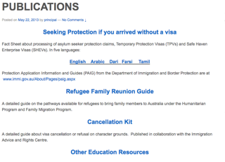
Asylum Seeker / Protection Visa Fact Sheets
www.rails.org.au/publications
www.immi.gov.au

Slide 43
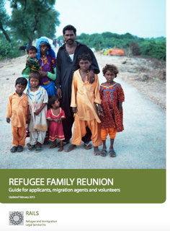
Guide to Refugee Family Reunion www.rails.org.au/publications

Slide 44
REFUGEE FAMILY REUNION
Humanitarian
Program
Family Migration
Program
Open to anyone on a 200-204 range visa.
Prospects of success depend on priority issues:
Family connection
Type of visa you hold
Those on 866 or former UMA lowest priority till citizenship
SHEV/TPV cannot propose – as is a temporary visa
Partner
Fiancé
Dependent child
Adopted child
Orphan relative under 18
Parent (Contributory)
Parent (Non- contributory)
Remaining relative
Aged dependent relative
Carer

Slide 45
Woman at Risk - Limits on Sponsoring
204 visa holder (Woman at risk) can’t sponsor under family migration program a spouse or fiancée within 5 years of visa grant, if on the date sponsor got her visa the applicant was:
  her spouse and the relationship wasn’t declared; or
  a former spouse but was divorced or permanently separated from her
Can’t sponsor more than 2 spouses in a lifetime and must be 5 years apart – though can waive this in compelling circumstances (e.g. partner dies or abandoned children, new relationship is long term (over 2 years) or there are children)

Slide 46
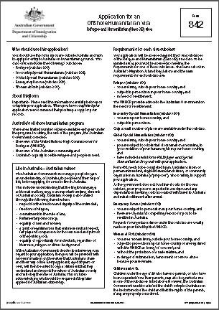
Forms
Form 842 application– all applicants over 18 sign
Form 681 proposal– proposer signs
Form 956A - for correspondence from Immigration to be sent to you the proposer. All applicants over 16 must sign, as well as you.
Form 80 – requested later by Immigration for applicants 16 or older

Slide 47
TPV/SHEV holders family reunion
Holders of TPV/ SHEV are temporary visas and can’t sponsor or propose family members.
Those who arrived as a UMA after 13 August 2012:
cannot propose under the SHP program their immediate family member or anyone.
IF they get a SHEV and then a permanent visa after satisfying the SHEV pathway, then can then sponsor under the family migration program, but have lowest priority until they get citizenship, unless special compelling circumstances (Direction 72).
Visa 866 holder have the same low priority until they get citizenship, unless compelling circumstances

Slide 48
Family Violence and Migration Act
Generally, a person who has obtained an Australian visa because of a married or de facto relationship must be sponsored by their partner for two years before they can obtain permanent residency.
Three exceptions:
  Domestic and family violence
  Child of the relationship where both parents have ongoing responsibilities for child/children
  Death of sponsoring partner

Slide 49
Where FV/child/partner deceased exceptions apply
SUBCLASS | PARTNER DECEASED | DV/FV EXEMPTION | CHILD
300 prospective marriage (applicant)
300 (holder - not married)
300 (holder – married) |  See cl 820.211(7) |  See cl 820.211(8), (9)
309 (applicant) assume you’re overseas
309 (holder)/100 (applicant) |  See cl 100.211(3) |  See cl 100.211(4) |  See cl 100.211(4)
100 (holder) | N/A | N/A | N/A
820 (applicant) |  See cl 820.221(2) |  See cl 820.221(3) |  See cl 820.221(3)
820 (holder)/801 (applicant) |  See cl 801.221(5) |  See cl 801.221(6) |  See cl 801.221(6)
801 (holder) | N/A | N/A | N/A

Slide 50
Family Violence definition
Reg 1.21(1) Interpretation, Migration Regulations 1994 (Cth)
  ‘relevant family violence means conduct, whether actual or threatened, towards:
    (a) the alleged victim; or
    (b) a member of the family unit of the alleged victim; or
    (c) a member of the family unit of the alleged perpetrator; or
    (d) the property of the alleged victim; or
    (e) the property of a member of the family unit of the alleged victim; or
    (f) the property of a member of the family unit of the alleged perpetrator;
  that causes the alleged victim to reasonably fear for, or to be reasonably apprehensive about, his or her own wellbeing or safety.’
Can have judicial or non-judicial evidence of FV

Slide 51
CHANGE OF CIRCUMSTANCES
Client is obliged to notify DIBP about changes of circumstances – relationship ended
Applicant must inform DIBP if they change address for 14 days or more.
Abused applicant should inform DIBP that they experienced family violence in the relationship.
PO box address is sufficient if the client stays in a refuge
Do not at this stage provide information about the temporary protection order or DVPO application

Slide 52
Genuine and continuing relationship
Applicants seeking to rely on the special exception provisions after the relationship has ceased must also establish that the relationship was of a genuine and continuing nature until the relationship ended.
In determining whether the requisite relationship existed, the decision maker must consider
  all of the circumstances of the relationship, including:
    financial aspects of the relationship,
    nature of the household,
    social aspects of the relationship and
    nature of the persons’ commitment to each other
Issues relating to genuineness must not be referred to an independent expert.

Slide 53
Partner visas - example
Applying from outside Australia:
Subclass 300 – Prospective Marriage
(temporary)
Client plans to marry their Australian fiancé(e)
Subclass 820 – Partner
(temporary)
Client:
travels to Australia
then marries their Australian partner while the subclass 300 visa is valid; and
then makes an application (in Australia) to stay in Australia.
Subclass 801 – Partner
(residence)
Client is still in a relationship with their Australian partner two years after first applying for subclass 820 visa.
OR
Subclass 309 – Partner
(provisional)
Client and their Australian partner:
  are legally married; or
  intend to marry in the near future and prior to migration; or
  have been in a de facto relationship for at least the entire 12 months prior to the date of application.
Subclass 100 – Partner
(migrant)
Client is still in the relationship with their Australian partner two years after first applying for the subclass 309 visa.

Slide 54
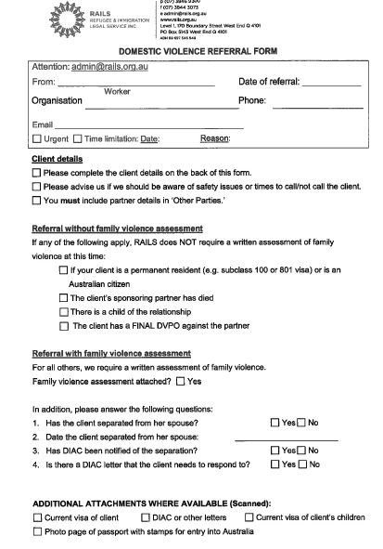
Family Violence
RAILS Referral

Slide 55
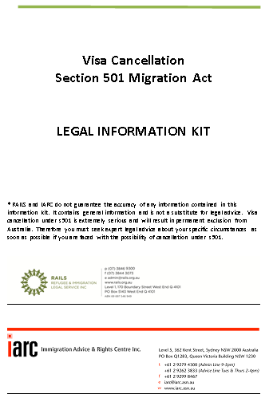
The Cancellation Kit

Slide 56
Cancellation of Visas – s 501 Character
The Migration Amendment (Character and General Visa Cancellation) Act 2014 inserted additional grounds on which a person will not pass the character test.
Amendments also allowed for Mandatory visa cancellation without notice for people in prison who fail the test.
The effect is to render people ‘unlawful non-citizens’ following cancellation.
They are then required to request that the cancellation be revoked to avoid deportation.
Parolees with cancelled visas are detained in immigration detention centres.

Slide 57
Cancellation of Visas – s 116 General
Subject to ss 116(2) & (3), the Minister may cancel a visa if satisfied that:
  s 116(1)(a) - Any circumstance that permitted the grant of the visa no longer exists
  s 116(1)(b) - Its holder has not complied with a condition of the visa
  s 116(1)(c) - Another person required to comply with a condition of the visa has not complied with that condition
  s 116(1)(d) - If its holder has not entered Australia or has entered but has not been immigration cleared – would be liable to be cancelled under Subdivision C (‘incorrect information given by holder’) if holder had so entered and been immigration cleared
  s 116(1)(e) - The presence of its holder in Australia is, or would be, a risk to the health, safety, or good order of the Australian community
  s 116(1)(f) - The visa should not have been granted because the application for it, or its grant, was in contravention of the Act or of another law of the Commonwealth.
  s 116(1)(fa) – (applicable only to students)
  s 116(1)(g) – a prescribed ground for cancelling the visa applies to the holder

Slide 58
When can visa be cancelled?
Section 117(1) provides that, subject to s 117(2), a visa may be cancelled under s 116:
Before the visa holder enters Australia
When the visa holder is in immigration clearance
When the visa holder leaves Australia
While the visa holder is in the migration zone.

Slide 59
Other cases
Over stayers - now unlawful, any visa possibilities onshore or offshore, getting Bridging visas to make arrangements to leave
Students – not fulfilling visa conditions re attending and passing courses, working beyond 20 hours/week, changing study institutions
People working with no work conditions on visa
Employers exploiting visa holders
457 visas – sponsor not complying with visa obligations re pay, accommodation, Visa holder changing employers

Slide 60


Working with Clients
Stereotypes are often shallow…
… and ignore more complex realities

Slide 61
Refugee / Asylum Seeker clients - Trauma
Post Traumatic Stress Disorder (PTSD) affects ability to cope. It causes fear, avoidance, sensitivity, irritability, inability to sleep well, panic attacks, physical pains, preoccupation with and reliving of the events.
These reactions can hinder memory and concentration and can lead to credibility issues when telling a story.
Helping traumatized people tell their stories can retraumatise them
There are support services for people suffering the effects of torture or trauma.
Some people avoid seeking help from a therapist because of cultural views and experiences.
Key Service - Queensland Program of Assistance for Survivors of Torture and Trauma (QPASTT) www.qpastt.org.au

Slide 62
Refugee / Asylum Seeker clients - Trust
Building trust is crucial and spending more time and effort may be necessary
Refugees may fear authority and not trust government officials or lawyers.
Refugee women are vulnerable to sexual abuse during flight. They may have been persecuted by harsh laws and cultural practices. They may be suspicious/fearful of strangers.
Some men come from cultures that find dealing with western women difficult. They can seem rude when they may be in fact vulnerable

Slide 63
Client’s Trauma - Credibility
Traumatic experiences including torture may impact upon a number of aspects of an Applicant’s case including the timeliness of an application, compliance with immigration laws, or the consistency of statements since arrival in Australia. They may also impact adversely on an Applicant’s capacity in providing testimony of such events.”
(AAT Guidelines on Credibility)
Some clients don’t show stress externally. Some will be better able to deal with stress and tell their story better than others
  “Reaction to particular stress depends a lot on people’s individual vulnerability, on the meaning they attribute to situations, whether they have experienced previous traumas and the amount of support they have had.”
  ( AAT Guidelines on credibility)

Slide 64
When and Which Interpreter?
In assessing English ability, questions such as: "where do you live?", "how long have you been in Australia?", "do you have children?", "where do you work?" and so on tend to be of the sort the person is often asked, and to which they can generally respond in English anyway. This may not be a reliable basis for assessing the person's capacity to give evidence and respond to questions and cross-examination in English (Kirby P in Adamopoulos v Olympic Airways SA (1991) 25 NSWLR p 78).
Ask what client’s preferences are….
  A client may not be comfortable with an interpreter from another ethnic or political group
  A client may prefer a male/female interpreter
  A client may prefer an interpreter not from Queensland (possible when using a telephone interpreting service)

Slide 65
Tips using interpreters
Arrange positions to direct communication with the client- place the interpreter to the side
Explain the purpose of the interaction, that you will ask questions and write/record what is said.
Explain the role of the interpreter and that they have a code of confidentiality also.
Ask the client if they can understand the interpreter and that they should bring up any misunderstandings at any time.
Watch out for discussion between interpreter and client
Ask what the interpreter is saying to see if it is just clarifying or something more
He said…” etc may mean interpreter is paraphrasing rather than word for word response.

Slide 66
Tips using interpreters
Speak directly with the client. Maintain eye contact where appropriate.
While some explanation to client by interpreters may be needed, avoid long conversations between interpreter and client
Avoid private conversations between yourself and the interpreter
If control slips- stop straight away and re-establish ground rules
Give client enough time to answer questions.
Periodically check the client’s understanding of your questions and advice given

Slide 67
KEY CONTACTS - INTERPRETERS
Get an account through TIS/Legal Aid
Translating and Interpreting Service (TIS) – 131450 National Accreditation Authority for Translators and Interpreters (NAATI) – www.naati.com.au
Australian Institute of Interpreters and Translators (AUSIT) – www.ausit.org
Queensland Interpreting and Translating Service (QITS) – 07 3835 3777
On-Call Interpreters - www.oncallinterpreters.com

Slide 68

BUILDING OUR NETWORKS

Slide 69

Resources
LEGENDcom – Migration Agent’s Compulsory Library
  Subscription costs (Non Profits) $420 + $345 per secondary licence
  Training videos https://legend.online.immi.gov.au/LegendCom/Help/Pages/Help.aspx
Visa Entitlement Verification Online (VEVO)
Online service to check visa details and conditions. Must have client’s consent
http://www.border.gov.au/Busi/visas-and-migration/visa-entitlement-verification-online-(vevo)
Maritime Crew Visa (MCV) - Enquiry page - need passport details https://www.ecom.immi.gov.au/inquiry/query/maritimecrew/queryStatus.do
Electronic Travel Authority (ETA) holders - need ETA Reference Number https://www.eta.immi.gov.au/ETAS3/etas
www.rails.org.au
education@rails.org.au

