Slide 1
Client confidentiality
Dr Francesca Bartlett
TC Beirne School of Law, The University of Queensland

Slide 2
Why Such a Strong Client Right?
The privilege exists to serve the public interest in the administration of justice by encouraging full and frank disclosure by clients to their lawyers : Esso Australia Resources Limited v Federal Commissioner of Taxation at 64:
The rationale of this head of privilege according to traditional doctrine is that it promotes the public interest because it assists and enhances the administration of justice by facilitating the representation of clients by legal advisers. This it does by keeping secret their communications, thereby inducing the client to retain the solicitor and seek his advice, in encouraging the client to make a full and frank disclosure of the relevant circumstances to the solicitor: Grant v Downs (1976) 135 CLR 674

Slide 3


Slide 4
Legal sources - confidentiality
Contract (express or implied): O’Reilly v Commissioners of the State Bank of Victoria (1983) 153 CLR 1.
Equity: a fiduciary relationship demands a level of conduct exceeding the tortious duty of care – characterised as loyalty.
Professional Ethics: ASCR r 9; 2011 Barristers’ Rule r 108.

Slide 5
Common law definitions
Legal professional privilege-will cover most client information
But remember that advice given by a non-lawyer might not be subject to privilege
Confidentiality is defined with reference to what a reasonable person would consider is confidential in the circumstances (eg. medical records)

Slide 6
Fordham v Legal Practitioners Complaints Committee (1997) 18 WAR 467
Conducted a cross-examination involving facts learned during her representation of the former client
The Court found that:
her actions amounted to a breach of loyalty to her client irrespective of any breach of confidentiality;
her actions could have led a reasonable observer to conclude that she had indeed used confidential information to the detriment of her former client.
she had breached a duty not to adopt a position hostile to a former client in the same or a related matter.

Slide 7
ASCR
Rule 9
A solicitor must not disclose any information which is confidential to a client and acquired by the solicitor during the client’s engagement to any person who is not:
9.1.1 a solicitor who is a partner, principal, director, or employee of the solicitor’s law practice; or
9.1.2 a barrister or an employee of, or person otherwise engaged by, the solicitor’s law practice or by an associated entity for the purposes of delivering or administering legal services in relation to the client

Slide 8
What is confidential information?
All information about his or her affairs from the client learnt directly or indirectly in the course of a professional relationship
Legal Practitioners Complaints Committee v Trowell (2009) 62 SR (WA) 1 sets out extent of information covered:
  Information about client learned in relationship
  Information that would not have been learnt except for the relationship
  Confidential information obtained before the relationship
  Opinions formed by lawyer about client
Yunghanns v Elfic Ltd (SC Victoria 1998) - impressions of a former client

Slide 9
Whose confidentiality?
Usually owed to the client with whom the lawyer has a contractual relationship
Client can be person or corporation or government
‘Client’ defined in such a way as to probably include future client
‘Former client’ defined such as to include information received in a former retainer from another (non-client) party in r 10. This means that there may be a conflict for the lawyer.

Slide 10
Confidential information from the other side
If in court or other adjudicative proceedings, a lawyer receives confidential information about the other party, there is an implied undertaking to the court not to use it for an collateral purpose
Hearne v Street [2008] HCA 36 casts this obligation widely in terms of types of documents received through the court process (eg. documents from discovery; witness statements (not in evidence); seized documents from an order)
Cannot be waived by client or perhaps even owner

Slide 11
Duty Survives Retainer
Not expressly covered in ASCR but common law has regarded confidentiality as continuing after the end of the retainer
ASCR r 10 contemplates duties to keep confidential information of ‘former clients’
Persist even after the death of the client

Slide 12
The difficult case of wills
Confidentiality passes to the personal representative or successor in title of deceased
In contested probate, there is a difficulty about what can be revealed – may have to explain instructions for questions of validity
Daubney J in Re: the Public Trustee of Queensland (2012) had to consider whether to take wills from lawyer without request from testators. Lawyers as bailee of will.

Slide 13
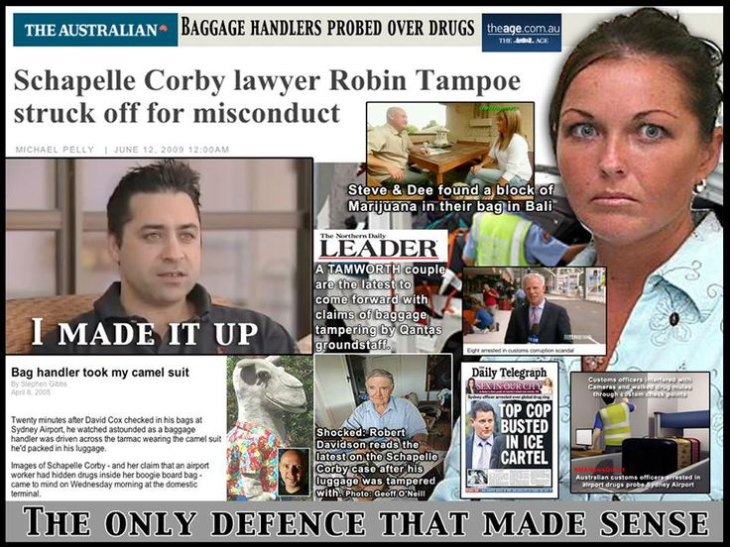
Legal Practice Tribunal v Tampoe [2009] LPT 14
Notes:
"It is fundamental to the relationship between solicitor and client that the legal practitioner will not reveal confidential information. It is hard to think of a more egregious breach than to do so on a national television program.“ Atkinson J

Slide 14
Inadvertent disclosure
Must take reasonable steps not to inadvertently release confidential information
Much concern about cyber threats and use of cloud
Make sure client files are secured including sending documents that cannot be mined for information (see also rules 30, 31)
http://lawcouncil.asn.au/lawcouncil/cyber-precedent-home

Slide 15
Exception 1:
Breach of Court Order
2011 Barristers Rule r 80.
A barrister whose client informs the barrister that the client intends to disobey a court’s order must:
(a) advise the client against that course and warn the client of its dangers;
(b) not advise the client how to carry out or conceal that course; but
(c) not inform the court or the opponent of the client’s intention unless –
  (i) the client has authorised the barrister to do so beforehand; or
  (ii) the barrister believes on reasonable grounds that the client’s conduct constitutes a threat to any person’s safety.

Slide 16
Exception 2: concern about future serious offence or injury
ASCR r9.2:
  A solicitor may disclose confidential client information if:
  9.2.4 the solicitor discloses the information for the sole purpose of avoiding the probable commission of a serious criminal offence;
  9.2.5 the solicitor discloses the information for the purpose of preventing imminent serious physical harm to the client or to another person.
2011 Barristers’ Rule:
r 81 - where a client threatens the safety of another, may ‘advise police or other appropriate authorities.’

Slide 17
Note permissive wording
‘May’ disclose in limited circumstances rather than ‘must’ disclose
Provides a reasonable excuse for disclosure ethically
Must look to other laws for requirements in certain cases

Slide 18
R v Butt, 2012 ONSC 4326
Criminal defence lawyer, Heather Pringle, drew praise from the court for revealing her client’s medical condition. Pringle’s client had pleaded guilty to sexual interference of a child and received a sentence of 14 days in jail (3 years suspended).
While waiting for the Crown’s appeal of the defendant’s sentence, Pringle learned her client was HIV positive.
After seeking legal advice, Pringle disclosed her client’s status to the Crown and the court, a move that led to HIV testing of the 12-year-old victim and the discovery that he wasn’t HIV positive.

Slide 19
QLS Ethics Centre advice
Ask the following:
What is the prospect that the potential harm will occur and is it imminent?
Are there other ways that the potential harm could be prevented?
Under what circumstances has the information been obtained?
How rational is the client?
Are you aware of any previous threats?
Is the client merely letting off steam?

Slide 20
Exception 3 and 4
Disclosure in the course of practice: ASCR, r 9.1 and 9.2.6; Barristers Rule r 108.
Disclosure to insurer: ASCR 9.2.6

Slide 21
Exception 5: seek advice
Obtaining advice: the solicitor may disclose information in a confidential setting, for the sole purpose of obtaining advice in connection with the solicitor’s legal or ethical obligations ASCR r 9.2.3.
This can be advice from other practitioners or a relevant body such as a law society
In Queensland, the Senior Counsellors scheme is a dedicated, free and confidential advice service: http://www.qls.com.au/Becoming_a_member/Member_benefits/Professional_benefits/QLS_Senior_Counsellors
Ethics rulings sometimes available

Slide 22
Exception 5: defending yourself
Permitted or compelled by law r 9.2.2: ie. warrant under legislation; trust account reporting.
In defending oneself in a disciplinary or civil matter, a lawyer may breach confidentiality under s 491 Legal Profession Act 2007.
Implied waiver (limited purpose) by client
Should warn client that lodging a complaint or action is a waiver
(Not an excuse to talk to the media about client’s affairs!)

Slide 23
Statutory warrants and notices
A statutory notice might be issued for client information from the ATO, ACCC, ASIC and liquidators
Check the legislative basis for the demand, check that all the client documents are compellable, take instructions from the client (although in some cases not allowed Crime and Corruption Acts)
Upcoming QLS webinar on Search Warrant Guidelines in May

Slide 24
Reporting child abuse or neglect
This varies around the country
Child Protection Act 1999 (Qld) – no mandatory duties imposed on lawyers except child advocate under Public Guardian Act 2014
Family Law Rules 2004 (Cth) – require full disclosure by a party and impose duty on solicitor to inform client must comply

Slide 25
Keeping things from our clients
This is generally unethical as we are expected to reveal our knowledge that relates to the client.
ASCR r 4 – act in best interest of the client
What about information from a psychiatrist about client that might be distressing or dangerous for the client?
ABA commentary suggests temporary withholding permissible

