Slide 1
Technology and design thinking for legal services
Jon Cina, Associate Director Access and Equity
Victoria Legal Aid
Notes:
Acknowledgement of traditional custodians
About us
About design thinking and technology
Why this matters to us
Opportunities we see
Share use cases that we are exploring
CLICK

Slide 2
Our vision:
A fair and just society where rights and responsibilities are upheld.
Our purpose:
To make a difference in the lives of our clients and for the community by:
resolving and preventing legal problems
encouraging a fair and transparent justice system.
Notes:
About us

Slide 4
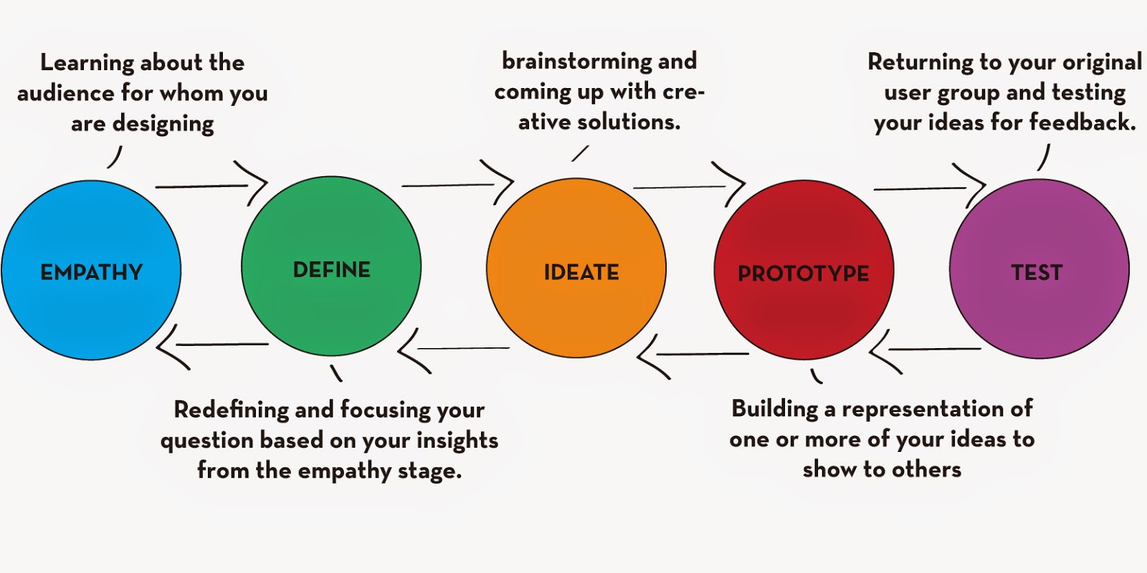
Design thinking
Notes:
What is design thinking

Slide 5
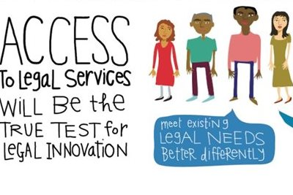
Notes:
Why is VLA actively pursuing design thinking and technology?

Slide 6
Opportunities
Identify
Contact
Take action
People assisted
Notes:
Opportunities we see
Let’s look at some examples
Legal Aid Checker
Document upload app
ORBIT
Handover

Slide 7
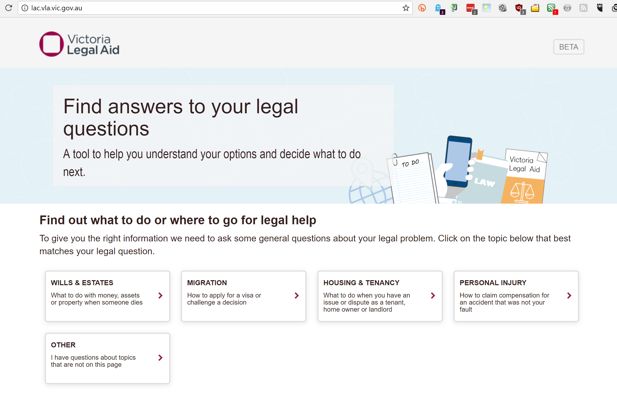
Legal aid checker www.lac.vic.gov.au
Notes:
Let’s look at some examples - Legal Aid Checker
What is it: structured information about legal problems & how to get help with them, based on decision-trees
VLA doesn’t assist with some types of legal problems.
Problem. Significant number of calls to the legal helpline are asking for help with those matters. Inefficient for callers and staff.
Solution to test. Use website to provide more relevant referral information to enable people to self-help, reduce out of scope calls. Faster and simpler service for people needing legal help;
Status. beta on public website, compiling feedback. Used approx. 500 times per month in first

Slide 8
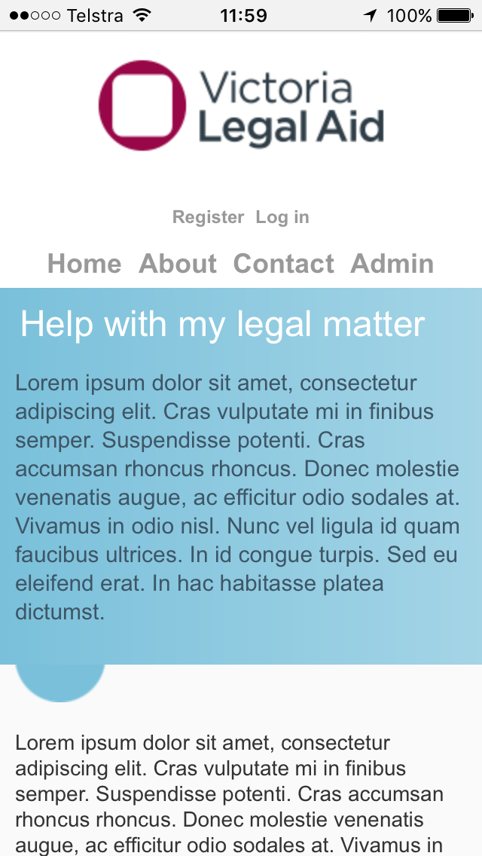
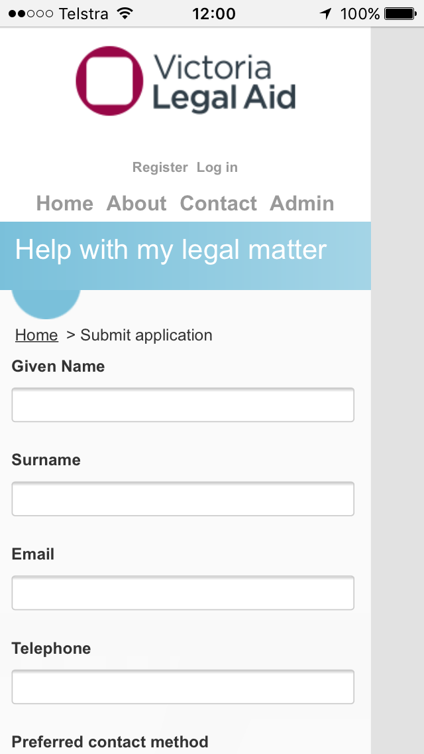
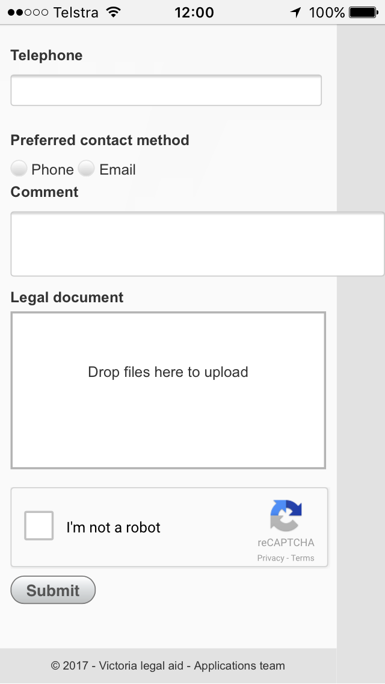
Document uploader https://selfhelppublic.vla.vic.gov.au/Public/Application.aspx
Notes:
Document uploader
What is it: website that people can use to send us information about their legal problem and how we can contact them
Significant number of calls are about documents that a person has in front of them. Charge sheets, infringements and letters from other gov agencies or parties’ lawyers.
Problem. Current system is inefficient for clients and staff. On phoneline, client can be waiting 8-10 minutes. Many notices are difficult for clients to navigate; it can take another 2-4 minutes to identify the issues that the documents raise for the client.
Possible solution. Use mobile phone to take picture of documents and send into legal helpline Q, with client details and contact preferences. LH reads material then calls/emails back.
Use tech and design thinking to reduce effort for clients, enable us to offer them a better service, allow us to use specialised staff on higher need / more complex issues.
Status First prototype built, shortly to begin testing with clients and staff (ie users).

Slide 9
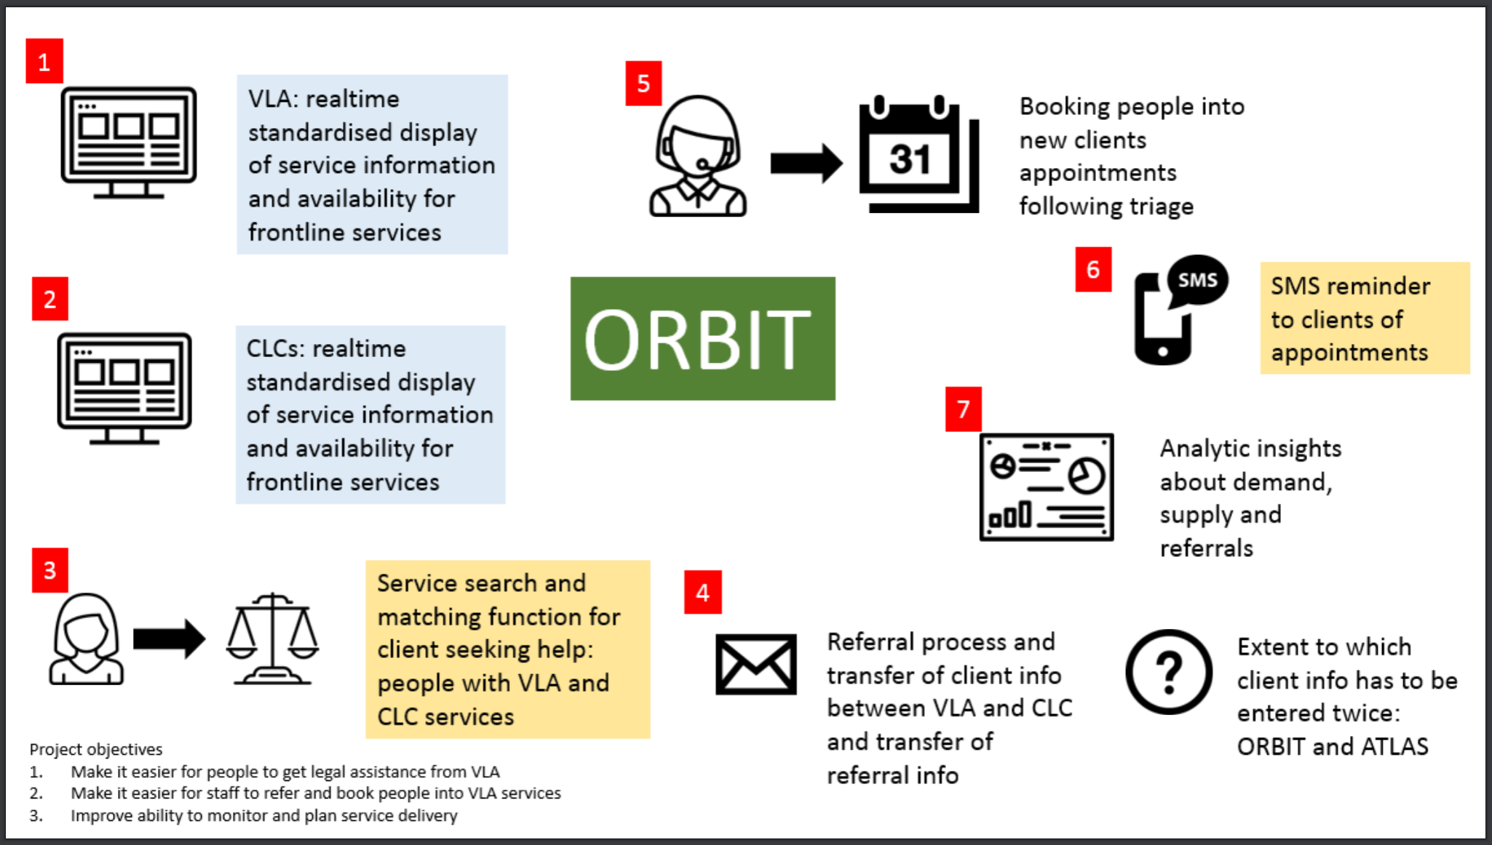
Online Referral and Booking Information Tool (ORBIT)
Notes:
Online referral and booking information tool
What is it: intake, triage and assessment technology tools to classify a legal problem, identify & refer/book people into matching services
People use our website, phoneline and contact with our offices to get help.
Problem. 1. Service information we use to help them is incomplete and inaccurate. 2. Two step appointment process. Both make it harder to help clients, meaning clients less likely to seek or obtain help. 31% of clients needed more than one attempt at contact by our staff to make an appointment booking following a referral; 12.5% of clients referred to an appointment service could not be contacted to make the booking.
A2J report highlighted the need for a better approach.
Recommendation 3.1 Improving the triage capacity of legal service providers and the courts
Victoria Legal Aid should lead work, in collaboration with other service providers, to improve referral pathways between service providers, courts, and tribunals. This work should include expanding access to online booking systems to community legal centres, improving the transparency of eligibility criteria across the legal assistance sector, and developing an online database of available services that can be accessed by service providers, courts, and tribunals.
Possible solution. Combine problem-identification, service-matching and appointment-booking into one process that’s available at VLA front door.
Phase 1: VLA offices (and poss pilot CLC/s) –staff identify suitable services, book client into VLA appointment
Phase 2: extended to CLCs – VLA and CLCs can book appointments into each other’ services
Phase 3: extended to public – public can identify legal need online, match service and book appointment
Status Prototype under constructions, shortly to begin testing with staff (ie users).
Related project
Handover CLC
Plenty of other examples here and overseas
FV application app
Mycase
Online guilty pleas
Family (Settify)
Tenancy (Joseph)
Infringements (FineFixer, DoNotPay)
Centrelink (GetUp)
Migration (reviews – RILC & lawapps)
….

Slide 10
More information, follow what we’re doing, share
www.legalaid.vic.gov.au
jon.cina@vla.vic.gov.au
@joncina_

