Slide 1
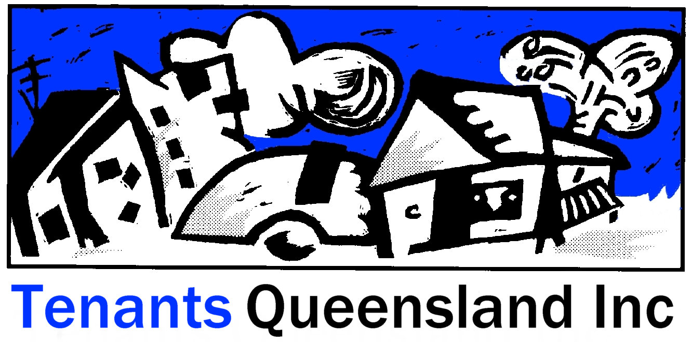
The Rental Vulnerability Index
CLCQ CONFERENCE, Gold Coast, May 2017

Slide 2
The RVI – why and how?
Prototype developed as a service planning tool for the QSTARS program
TQ appointed City Futures Research Centre, UNSW, Sydney as our collaborator
Conceived as a service planning tool, has a lot more to offer in the future
A project advisory group was convened to a assist the product development. RTA, CLCQ, DHPW, QSTARS providers.

Slide 3
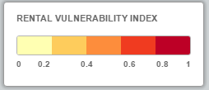
What is the RVI?
About the Queensland Rental Vulnerability Index
Background
An online mapping tool to help Tenants Queensland plan the delivery of tenant advisory services
Thirteen indicators of rental vulnerability are in two broad groups: 'housing indicators' and 'people indicators'.
Mapped at postcode level to provide an insight into the nature of the rental housing and people living in it.

Slide 4
What is Rental Vulnerability?
Definition:
‘the vulnerability of persons to problems that may make their rental housing unaffordable, inappropriate or insecure – and hence that may indicate a need for assistance from a tenants advice service.’
Similar to concept of ‘vulnerability to legal problems’ in legal needs research (Coumarelos, 2012, for Law and Justice Foundation) (but not limited to ‘disadvantaged housing’ and ‘housing problem’ types in that research).

Slide 5
The index, between 0-1, is representative of a concept of vulnerability defined through the 13 input variables
Principal Component Analysis, Analysis is iterative, until most of the variance in the data can be explained by the first principle component
This is a similar method used by the Australian Bureau of Statistics in compiling their SEIFA indices (ABS 2013).
Group | Indicator | Data source
People indicators | Tenants with disability | 2011 Census
 | Unemployed tenants | 2011 Census
 | Single parent tenants | 2011 Census
 | Indigenous tenants | 2011 Census
 | Young tenants | 2011 Census
 | Older tenants | 2011 Census
 | Low-education tenants | 2011 Census
Housing indicators | Rental stress | 2011 Census
 | New private tenancies affordable to low-income households | RTA, 2011 Census
 | Tenancy disputes (RTA) | RTA
 | Social housing (public housing and community housing) tenancies | Qld open data
 | Residential services | Qld open data
 | Manufactured home sites | Qld open data

Slide 6
https://cityfutures.be.unsw.edu.au/research/projects/queensland-rental-vulnerability-index/

Slide 7
Current use - Launching RVI, May 18 - service planning tool, particularly for Community Access Points - Upgrades will occur as data sets are updated. Future Use - Overlay service delivery information to compare need, demand and delivery

Slide 8
Thank you

