Slide 1
CLASS Project update
Community Legal Centres Queensland Conference
May 2017
Chris Dubrow
NACLC IT Project Manager

Slide 2
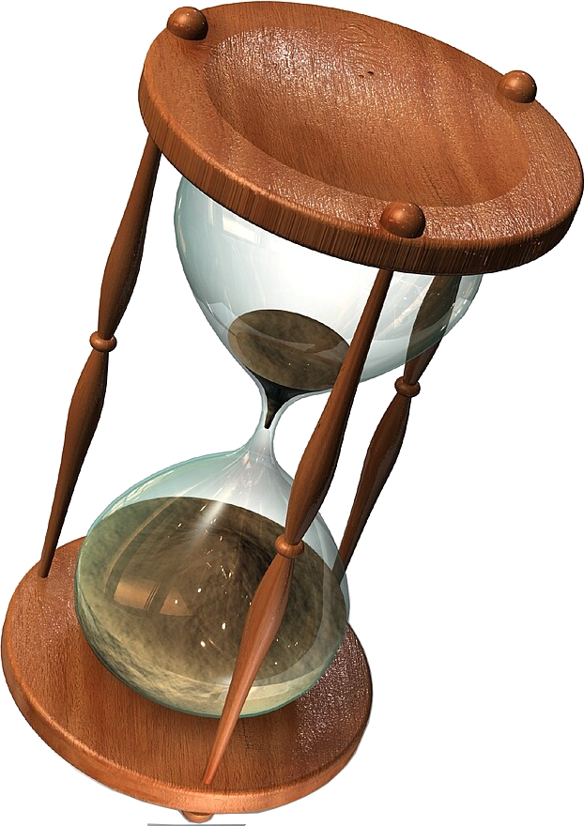
Current Timeline
Migration from CLSIS – Just Complete!
Training of Users – Ongoing
Training of Admins for advanced Customisation – Ramping up.
Reports – Coming soon – (later slide)
Final Release – Aiming for end of June
Final Release Training phase – July onwards
Notes:
CLSIS back up request – with Confidentiality agreement

Slide 3
Priority fixes
Performance / Speed
Reducing system Crashes / Wheel of Death
De-duping Worker accounts
Standard fields – customising / defaults / setting as Mandatory
Legal ‘Problem Type’ – National Review
Custom fields - easier management

Slide 4
Other Important Fixes
Triage – for existing clients
Services for the Community field fixes
Glitches: Screen Scrolling / Tab Glitch
VPN working but can be improved
Getting through the Backlog of Helpdesk Tickets

Slide 5
Incoming! - Reports
2 Stages of Reports Delivery:
Part 1 = Reports for Funding Bodies, Govt depts, SPMs etc. (almost ready)
Part 2 = Reports for Centres, e.g. Worker Reports, saved Searches (due Mid June)
Just had a quick look at Part 1 reports today, Demo site first - need testing, tick off.
Diagram next slide

Slide 6
Reporting
State and Federal Government – data de-identified restrictions remain
New Govt. slice/dice options
CLC requirements, current options plus advanced slice / dice
Individual CLC worker reports
General flexibility, export options
Notes:
Better use means better data
Export Options include fully working excel / csv / PDF

Slide 7
Incoming – Other features
Document Management (Clients, Services, Workers)
Client De-duping
Copying Service details (and Additional Parties)
Bulk Printing (All Actions and service, at once)
Improved User interface, colours etc
Interface with Emailers and Calendars etc

Slide 8
From Matters, Advices & Cases to CLASS Services
Notes:
The famous Page 3 table

Slide 9
Services for Individuals – Level 1
Discrete Assistance
Information
Referral
Legal Advice
Legal Task
Non-Legal Support

Slide 10
Services for Individuals – Level 2
Representation
Services
Dispute Resolution
Court / Tribunal
Other Representation

Slide 11
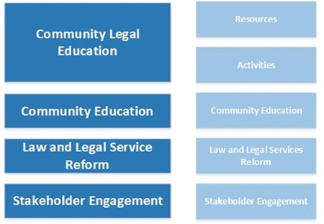
Services for the Community
Community Legal Education and Community Education Split
More detail, events, Online engagement
Projects retained

Slide 12
Further information
CLASS Documentation: http://confluence.classhelpdesk.org.au/
Helpdesk – Create a Ticket Via Confluence (Above) or email: naclc@classhelp.org.au Please include your name, centre, state and contact details.
CLASS helpdesk phoneline: 1300 484 498
CLASS Youtube channel Google NACLC CLASS Youtube
Contact me: Chris Dubrow – NACLC IT Project Manager chris_dubrow@clc.net.au

