Slide 1
Civil Legal Aid is a Best-Kept Secret that Needs to be Told
____________
Community Legal Centres Queensland Conference
Elizabeth Arledge
May 8, 2017
Notes:
Civil legal aid is a best-kept secret when it comes to ensuring fairness in the justice system and addressing some of our country’s most serious problems. We know that Civil Legal Aid generates positive results for communities, but most people in those communities are not aware.
Voices is working to change that.

Slide 3
VALUES are the foundation of any successful messaging.
Different people hold different values.

Slide 4
Where civil legal aid is concerned, the value that resonates most strongly is FAIRNESS.

Slide 6
Communication happens – with or without you.
Notes:
Communications – about your organization, your issue, your lawsuit – will happen with or without you. Ready or not. Information (accurate or not) is shared. Messages (yours or someone else’s) are conveyed. Impressions (helpful or harmful) are made. Results (good or bad) occur.

Slide 7
What is Voices for Civil Justice?

Slide 8
What is Voices for Civil Justice?
Voices mission is to use the awareness-raising power of the media to convey the vital role of civil legal aid in ensuring fairness in the civil justice system.

Slide 9
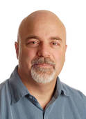
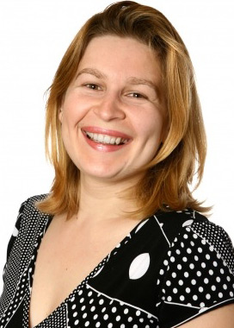
2013 RESEARCH RESULTS
36%
of voters have never heard of or cannot give an opinion of Civil Legal Aid
“I didn’t even know it was available”
“How would you find out about the Civil Legal Aid if you didn’t even know about it? How do they know where it is and what it is?”
Very
Favorable

Slide 10
Voices research found that when people learn what civil legal aid is, they feel it is important.
Believe it is important to ensure everyone has access to legal help or legal representation for civil matters
82%

Slide 11
Believe it is important to ensure everyone has access to legal help or legal representation for civil matters
82%
60%
Believe the POOR
have a difficult time
43%
Believe the MIDDLE CLASS have a difficult time

Slide 12
Civil legal aid is a best-kept secret when it comes to ensuring fairness in the justice system and addressing some of our country’s most serious problems.
This gives us an opportunity to educate.

Slide 13
9 Second Sound Bite
What to Highlight
Our Program Is Civil Legal Aid
Civil Legal Aid assures fairness for all in the justice system, regardless of how much money you have.
We Assure Fairness for all in the Justice System

Slide 14
Groups That Should Receive Civil Legal Aid:
Women who
are victims of domestic violence
Children
Veterans
Ill or disabled people
Seniors

Slide 15
Communication happens – with or without you.
Notes:
Communications – about your organization, your issue, your lawsuit – will happen with or without you. Ready or not. Information (accurate or not) is shared. Messages (yours or someone else’s) are conveyed. Impressions (helpful or harmful) are made. Results (good or bad) occur.

Slide 18
Words that Work
Civil legal aid
Fairness
Notes:
Civil legal aid is a best-kept secret when it comes to ensuring fairness in the justice system and addressing some of our country’s most serious problems. We know that Civil Legal Aid generates positive results for communities, but most people in those communities are not aware.
Voices is working to change that.

Slide 19
Extending the story

Slide 20
Innovation is newsworthy.

Slide 21
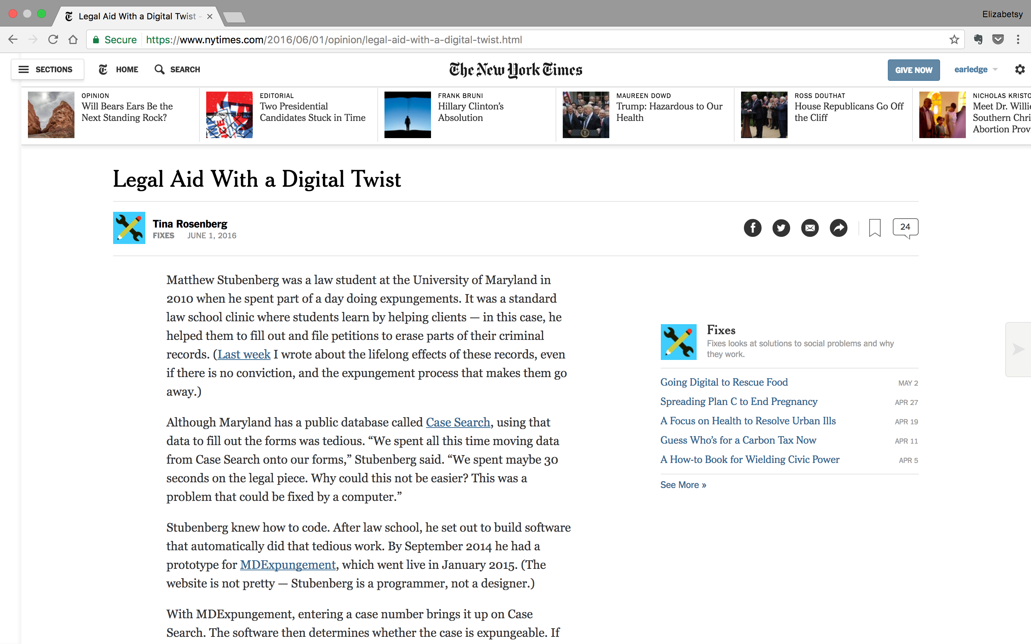
Civil Legal Aid is Innovative
Notes:
Civil legal aid is a best-kept secret when it comes to ensuring fairness in the justice system and addressing some of our country’s most serious problems. We know that Civil Legal Aid generates positive results for communities, but most people in those communities are not aware.
Voices is working to change that.

Slide 22
Civil legal aid - part of a bigger story
Notes:
This is how we got this story placed. We encourage reporters who are covering issues where civil legal aid is involved to include civil legal aid in their reporting. We look for opportunities in current news topics, such as unnacompanied children at the border, or in this case, eviction.

