Slide 2
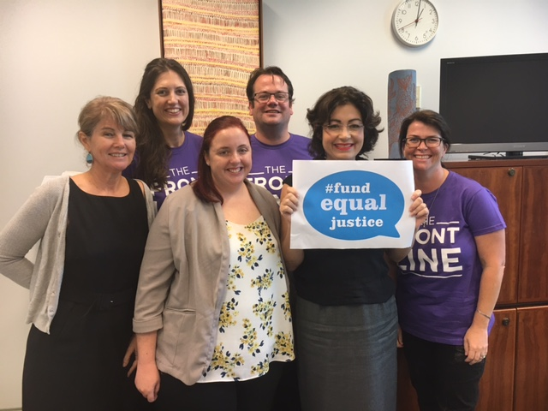
Fund Equal Justice
Our Message - The CLC sector needs its funding reinstated and an increase in base funding in order to continue to do its work in a sustainable way which also provides better job security for our members working in these vital services.

Slide 3
Campaigning to Fund Equal Justice
How it begins for our union –
Engage with our members
Workplace visits or contact with you
Mapping the industry and each workplace
Asking you to join our union
Working collaboratively with CLCQ support the campaign

Slide 4
Actions
CLCs we have contacted or carried out visits in 2017:
Aboriginal Family Legal Service Southern Qld Indigenous Corporation
ATSIWLS – North Queensland
Basic Rights Qld Inc
Bayside Community Legal Centre
Cairns Community Legal Centre
Caxton Legal Centre Inc
EDO Northern Qld Inc
Environmental Defenders Office (Qld) Inc
Gold Coast Community Legal Centre
Goondiwindi CLC (Care Goondiwindi Association Inc)
Junkuri Laka Community Legal Centre Aboriginal Corporation, trading as Mornington Island Community Legal Centre
NQ Women’s Legal Service Inc (TSV Office)
Nundah Community Support Group Inc
QAI – Qld Advocacy Inc
Refugee and Immigration Legal Service Inc (RAILS)
Robina CLC
South West Brisbane Community Legal Centre Inc

Slide 5
Visits continued
Suncoast Community Legal Service
The Advocacy and Support Centre
Tenants Qld
Townsville Community Legal Service Inc
Women’s Legal Service
YFS Legal
Youth Advocacy Centre
Community Legal Centres Qld
Yet to see:
Encircle Ltd (Pine Rivers Community Legal Service)
Prisioners Legal Service Inc
QIFVLS – Qld Indigenous Family Violence Legal Service
QPILCH – Old Public Interest Legal Clearing House
LGBTI Legal Service
Mackay Regional Community Legal Centre Inc
Moreton Bay Regional CLS (as Peninsula)
Hervey Bay Neighbourhood Centre Inc (Taylor St Community Legal Centre and Seniors legal and support services)

Slide 6
Membership and Mapping
Membership
90 members out of 330 staff
Action – Join our union today, remember your fees are tax deductible
Mapping
Mapping of sites and sector – we are half way there
Action – Assist with a workplace visit and/or a phone call, distribution of information

Slide 7
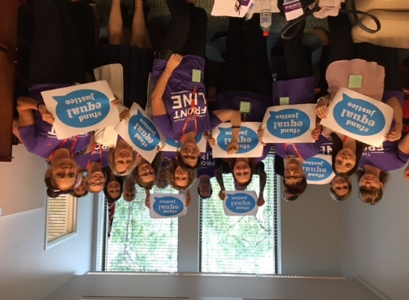
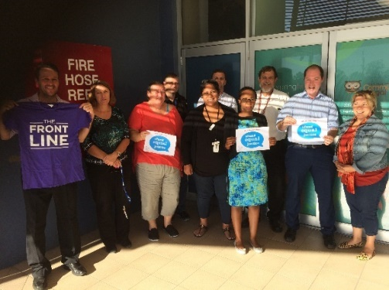

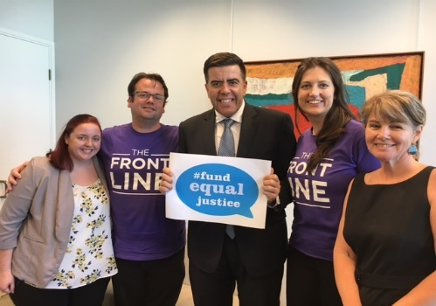

Actions to Fund Equal Justice
Visits at CLCs
Taking our message and the Frontline to Canberra
Billboard - Brisbane

Slide 8
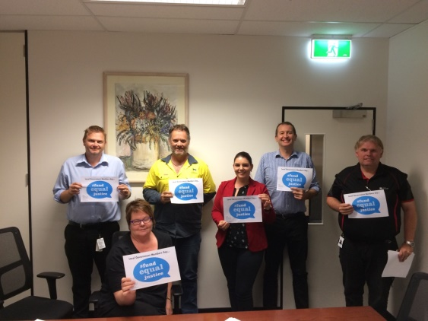
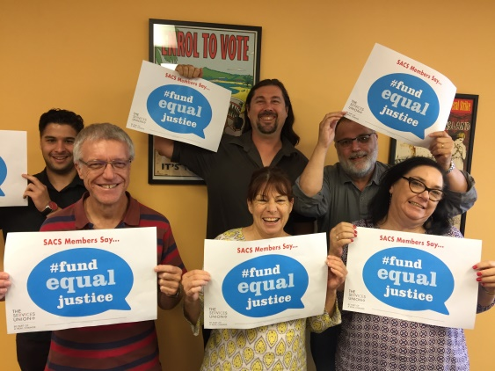
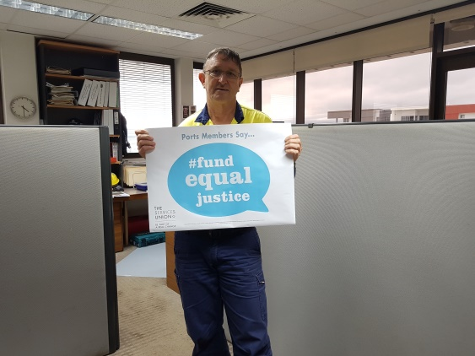
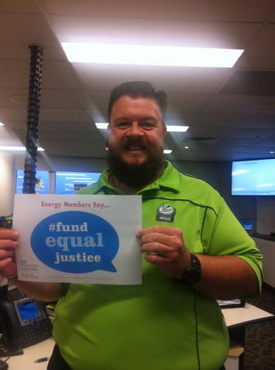
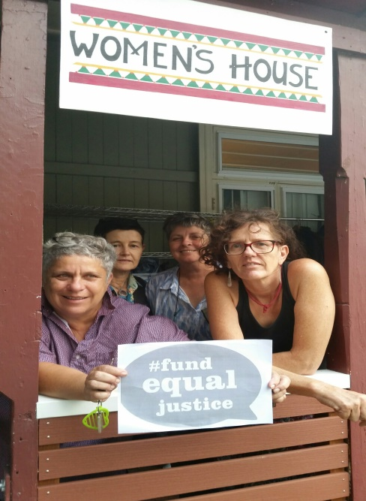
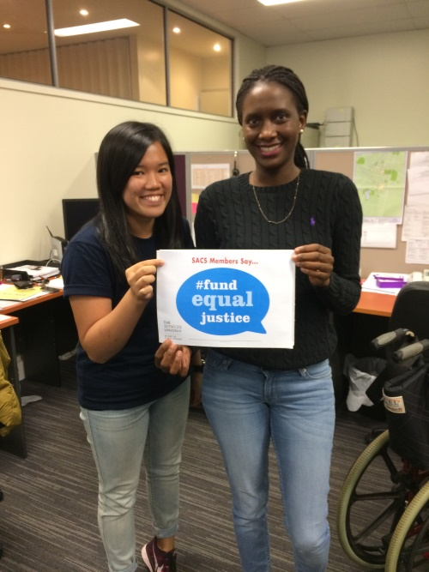
Sending our message our to our membership and across the union movement

Slide 9

Our Next Steps
Continue to lobby and work in partnership with CLCs to ensure Qld gets its fair share of funding and that funding is reinstated as quickly as possible to minimize disruption to service and to protect workers jobs
Continue to organize in CLC’s
Continue to work together to make the case for increased State and National investment in CLC’s work
Campaign for Quality Community Services including establishing Portable Long Service Leave for community sector and disability workers in Queensland

Slide 10
PLSL
PLSL for SACS workers
The sector is expanding at a rapid rate.
Our members are skilled practitioners but there is no workforce plan to attract and retain the skilled workers required to support people in need. We need to continue to build on union wins for the sector like our Qld and National pay equity decision.
As part of our broader Investing in Quality Services Campaign, The Services Union is campaigning for a scheme where you can carry your Long Service Leave entitlements with you as you move from employer to employer, or job to job within the sector.
We believe that the introduction of portable Long Service Leave will benefit you, your colleagues and the sector enormously.
This scheme will provide a decent break for experienced and dedicated working people as well as help attract a new generation of workers to the sector. There are also significant economic benefits for organisations, as leave liabilities are removed from their balance sheets and managed by an independent scheme.

Slide 11
Actions for CLCs and staff
Actions for PLSL Campaign
Participate in our survey as an employee today
CLCs and CLCQ to provide public support for Portable Long Service Leave for SACS employees

