Slide 2
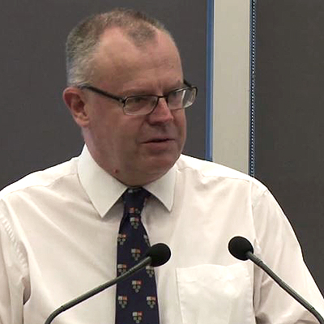
CLCs don’t have a constituency.
Productivity Commissioner Warren Mundy

Slide 3
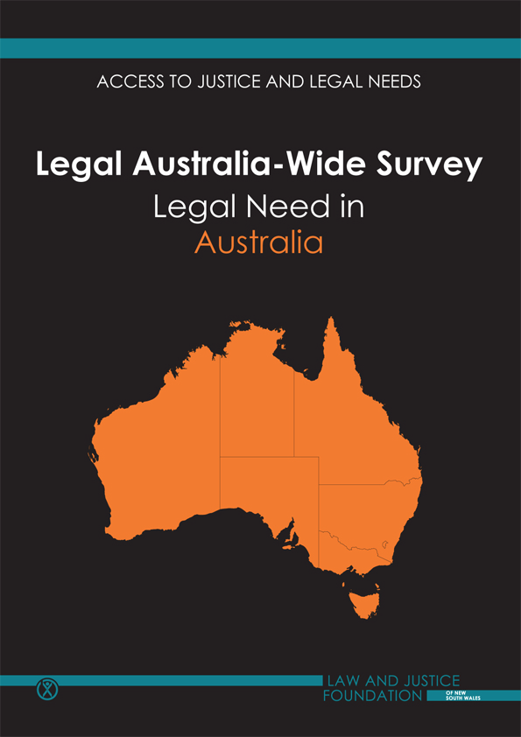
High awareness of Legal Aid (88%)
Moderate recognition of Aboriginal Legal Services (67%)
Low recognition of CLCs (36%)

Slide 4
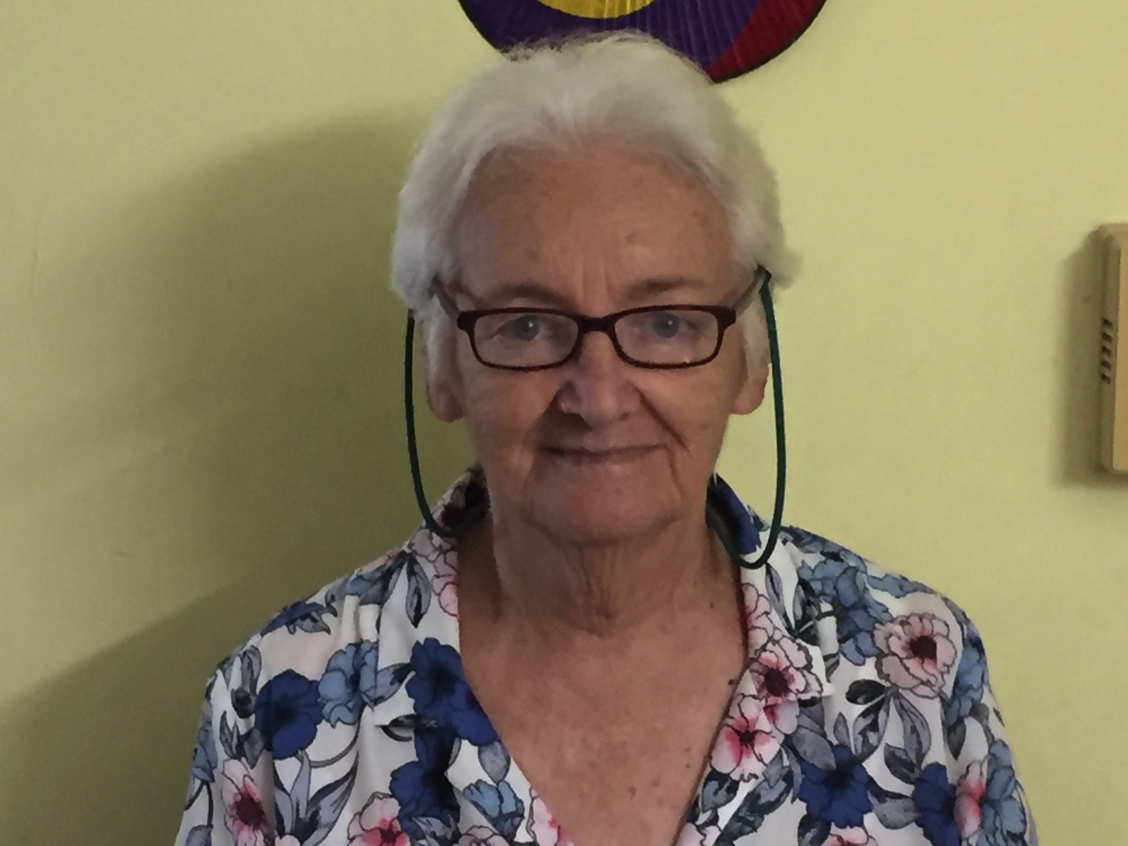
Aaron works at Legal Aid.
Aaron’s
Mum

Slide 5
Oh, actually Christine, I work for the Townsville Community Legal Service. We were fortunate with the CLC funding allocations.
Did you hear that Carolyn? Aaron’s Legal Aid hasn’t lost any funding.
Aaron, how did your Legal Aid office go with this Legal Aid funding cuts?
Oh, that’s good Aaron! I was just wondering if the Legal Aid funding cuts would affect you!
…
Yes, those Legal Aid funding cuts have been tough.

Slide 6
86

Slide 7
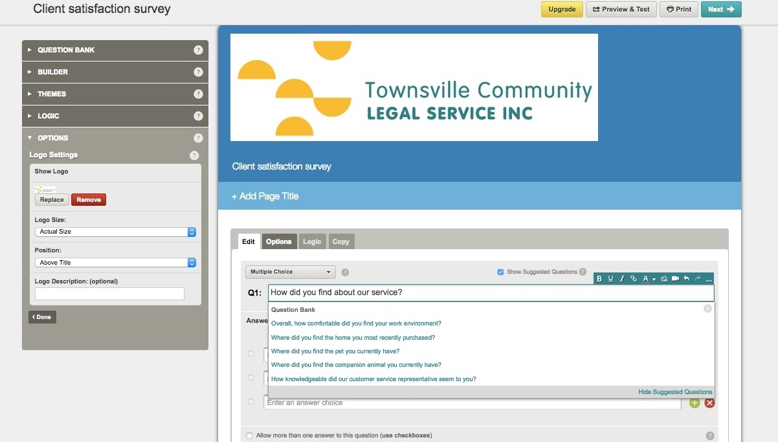
Design

Slide 8
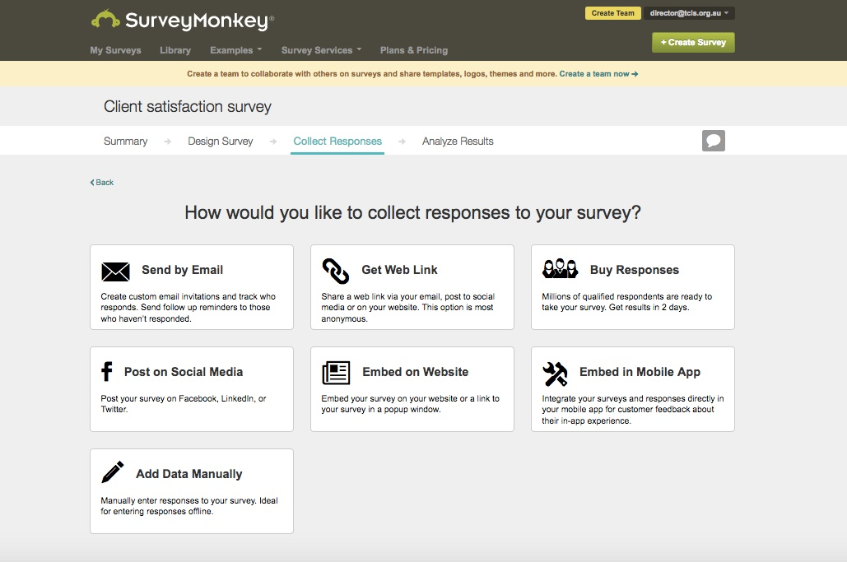
Collect

Slide 9
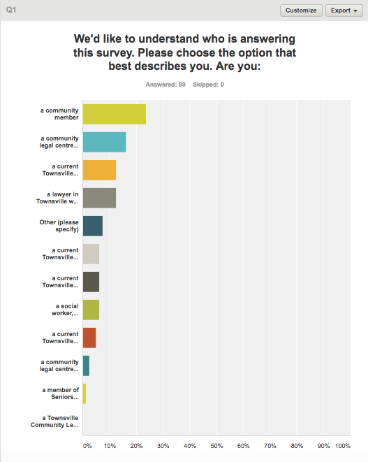
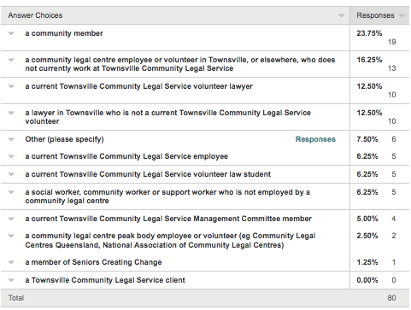
Analyse

Slide 10
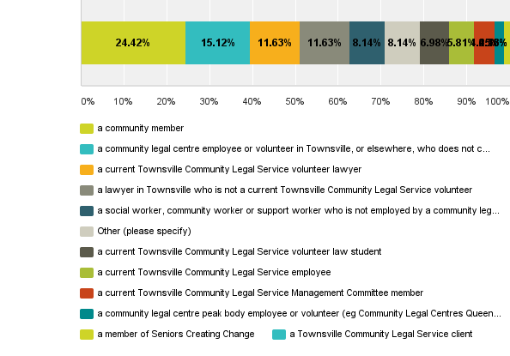
Q1: We'd like to understand who is answering this survey. Please choose the option that best describes you. Are you:

Slide 11
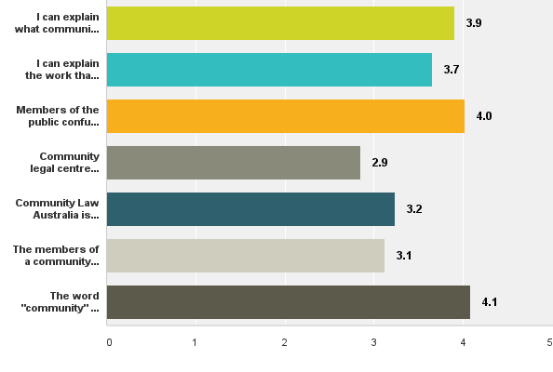
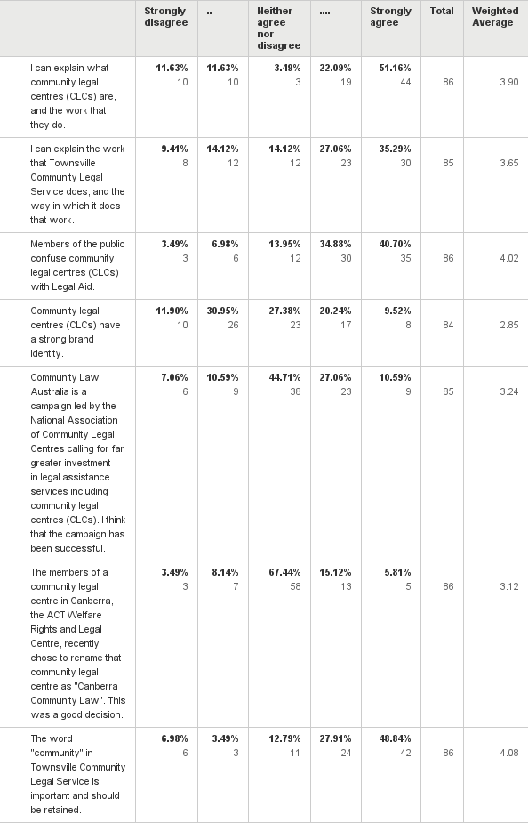
Q2: Please consider the following seven (7) statements, and respond on a scale between "strongly disagree" and "strongly agree". Some questions have blue hyperlinks for further reading if you are unfamiliar with a reference.

Slide 12
Fly, my pretty Survey Monkeys!
Fly!

