Slide 1
CQCLC
Partnering with Universities using clinical legal education opportunities to provide improved services to our clients – The Online Clinic.

Slide 2
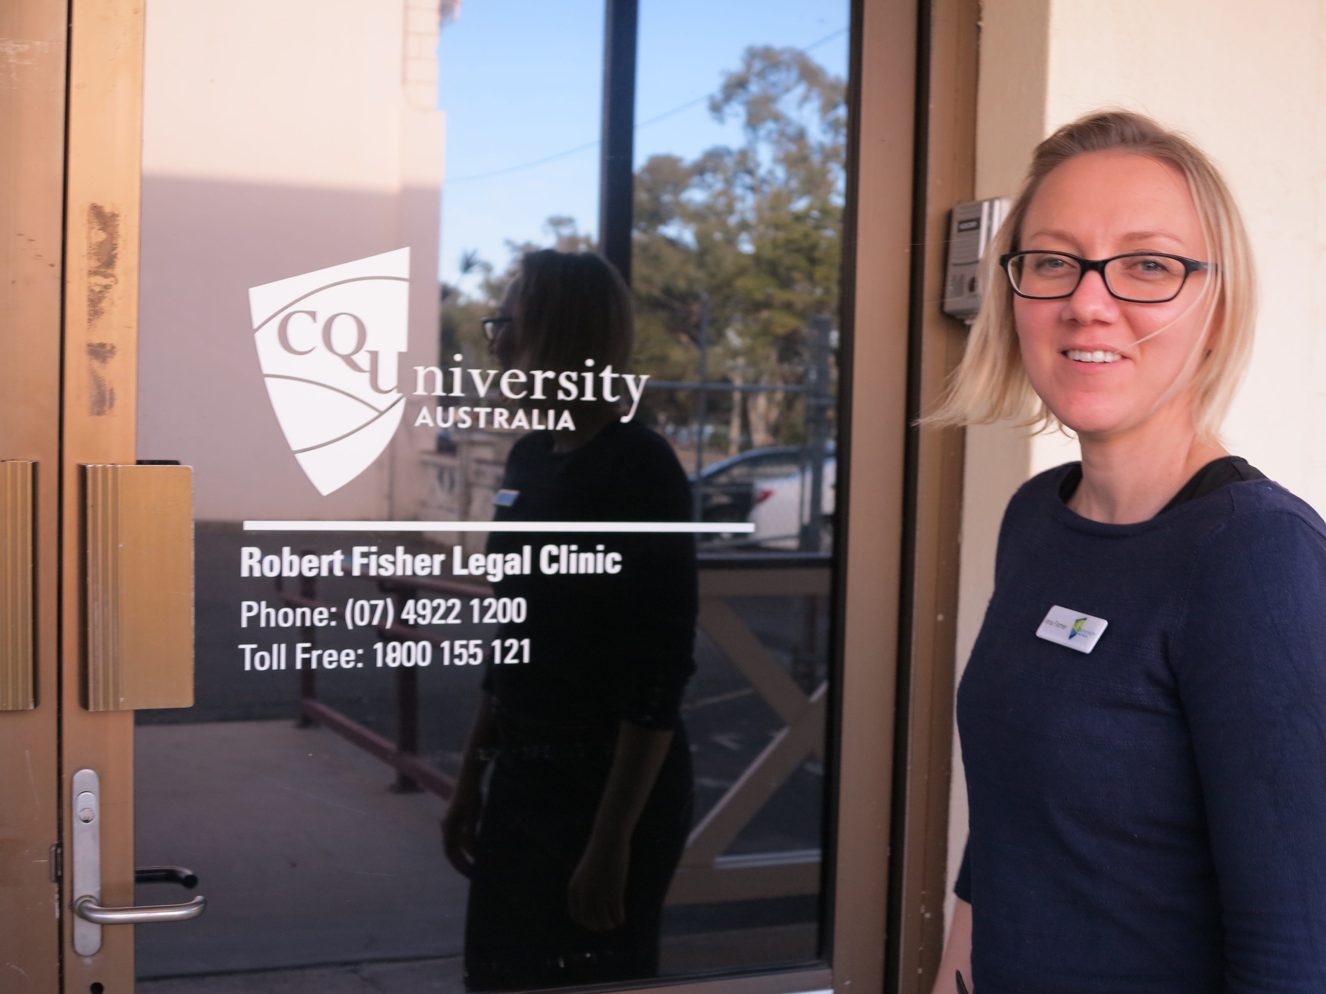
Partnering with Central Queensland University

Slide 3
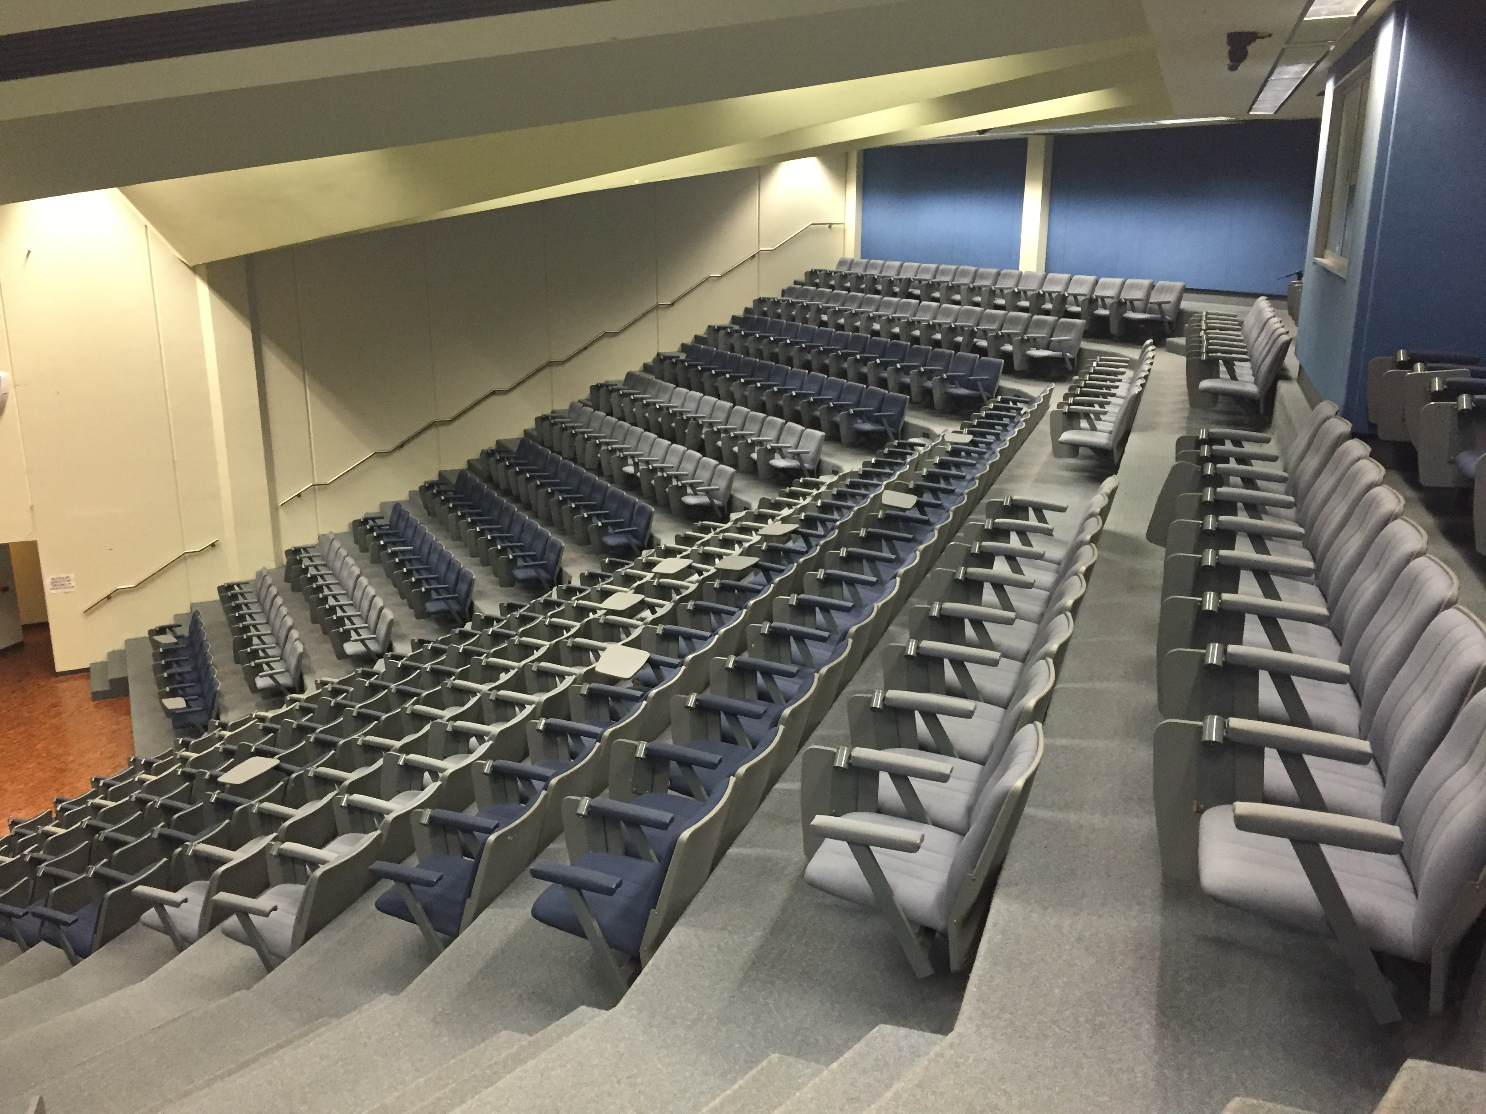
Demand for Student Placements

Slide 4
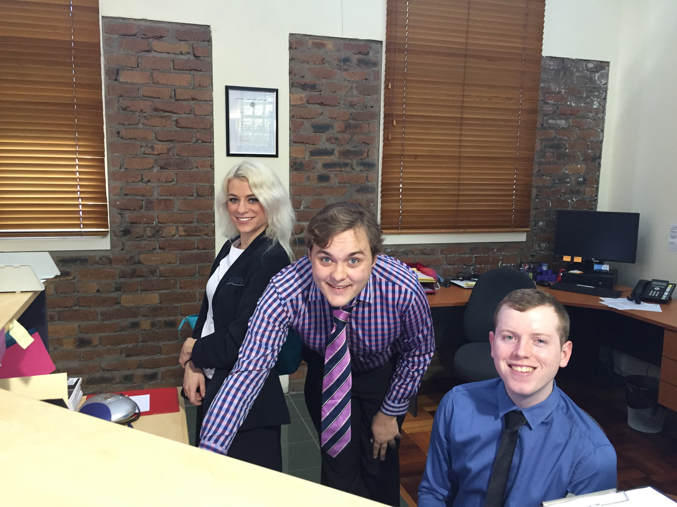
Incentives for CQCLC to Partner with CQU

Slide 5
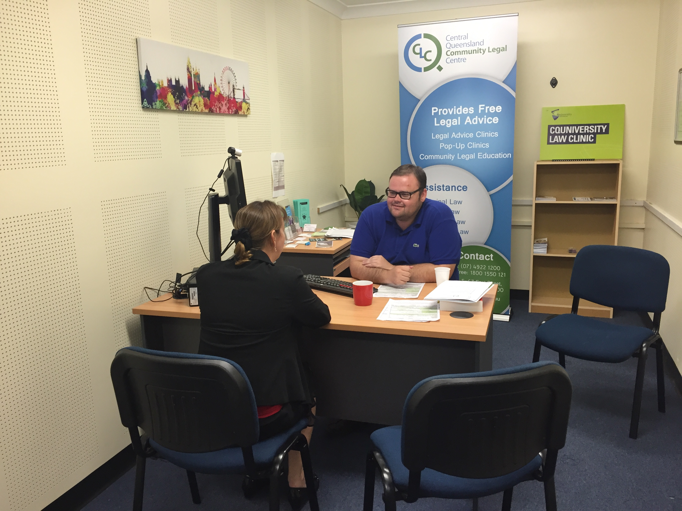
Concerns for CQCLC – Privacy & Confidentiality

Slide 6
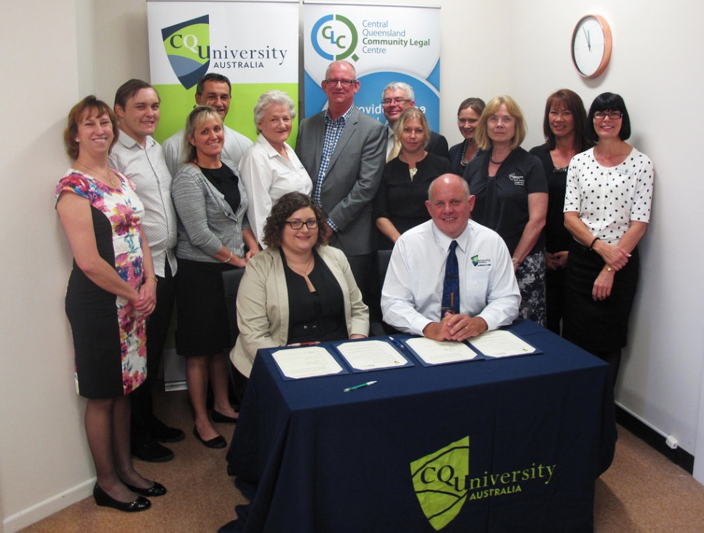
Meeting the Challenges – The Terms of the MOU

Slide 7
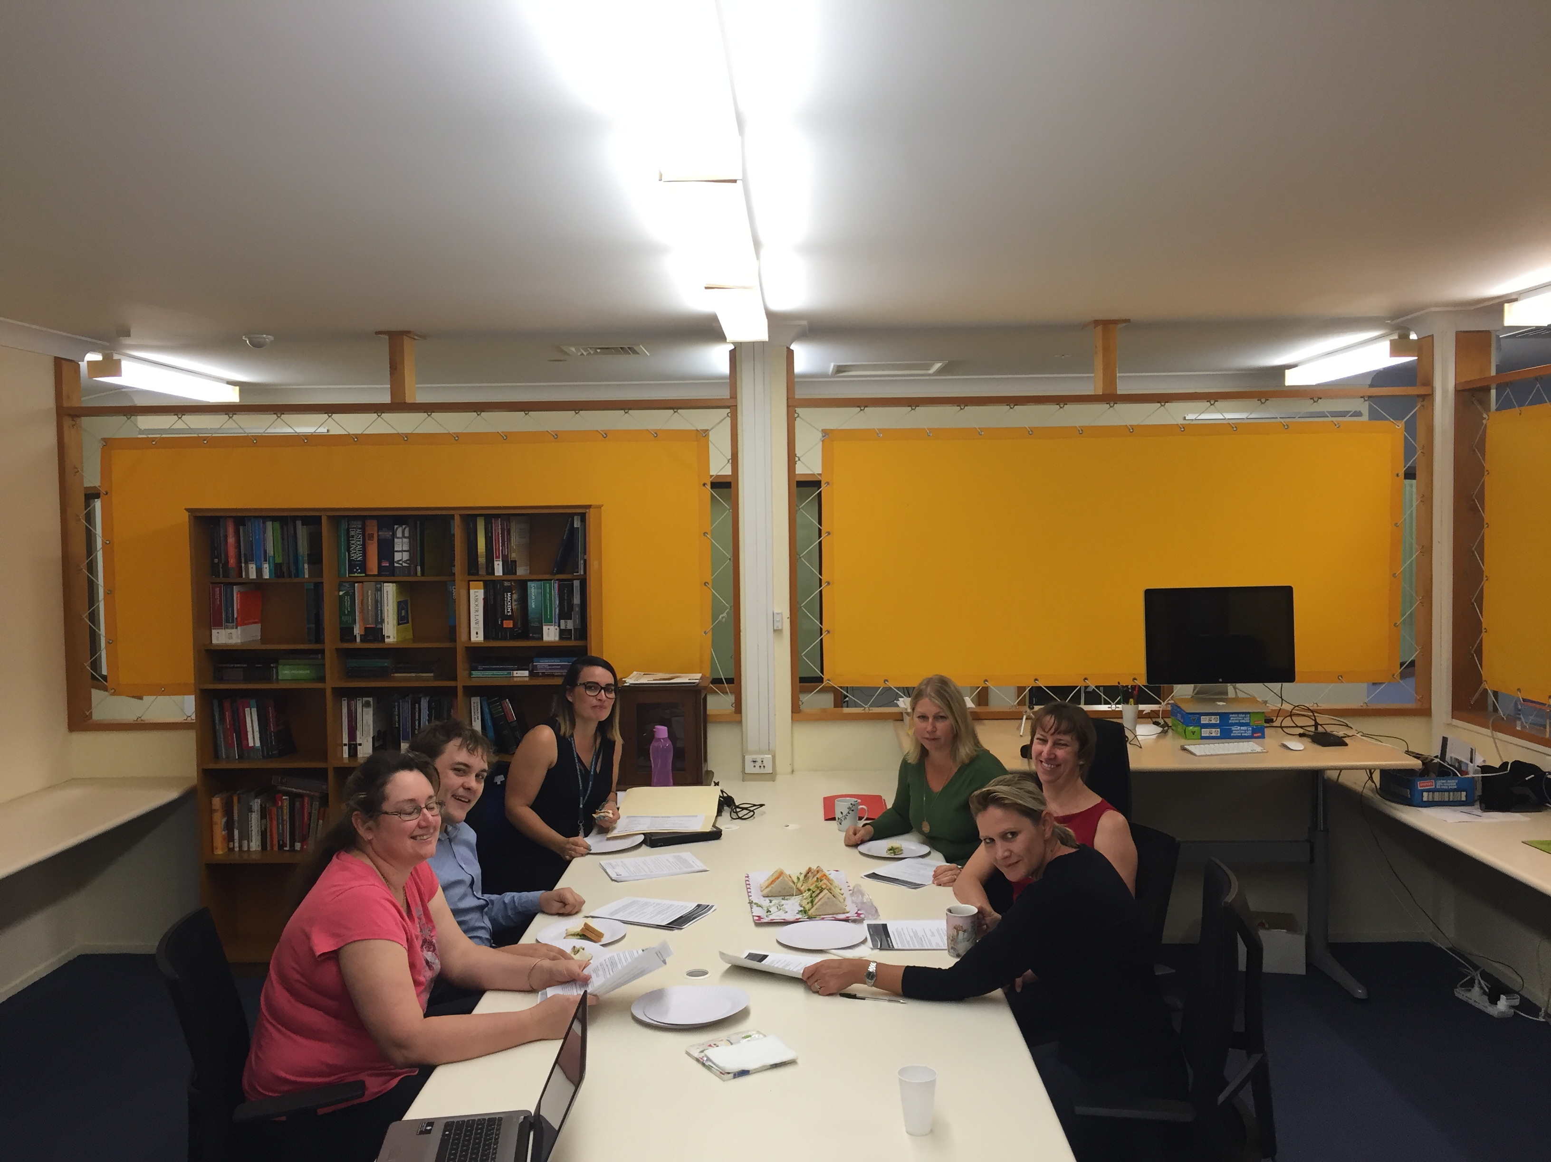
Pilot Program – Initial Outcomes

Slide 8
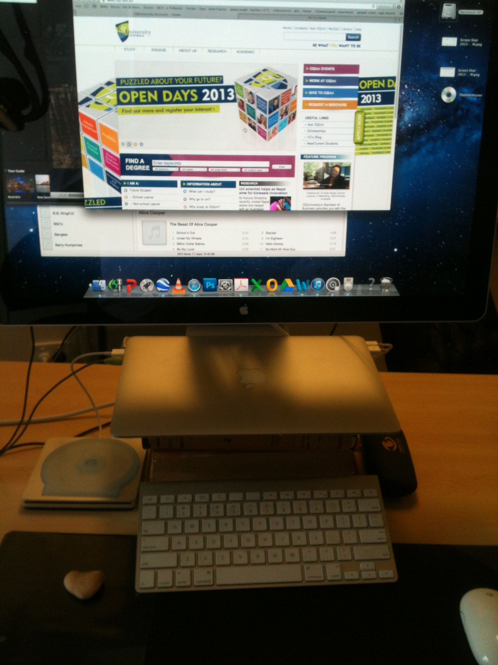
The Online Legal Clinic

Slide 9

What is Ahead for the CLC?

Slide 10
Questions?

