Slide 1
Employee Assistance Program
Community Legal Centres Queensland
Presented by Cathy Donovan

Slide 2
Core Elements of EAP Service
Employee Assistance
Program (EAP)
Manager Hotline
Critical Incident
Management Support
EAP+

Slide 3
Features of the EAP
A free and a voluntary service.
Short term counselling/coaching (face to face, telephone, online).
After hours phone support available for urgent/emergency issues.
For all employees and your immediate family.
4 sessions/hours per year.
A strictly confidential service which includes:
No names on reports and invoices
All OPTUM staff are bound by code of conduct
Written consent is required to release information
Never booked in same location/same time as work colleague

Slide 4
Why would I use the EAP?
Support you and your family through life’s milestones.
Relationships/marital problems
Dealing with terminal illness/grief
Troubled teens/elder care
Substance abuse/addiction/eating disorders
Depression/anxiety/stress
Work life balance
Workplace conflict/Communication
Retirement/Career path
Stressors with work
Starting a new job/Returning to work
Organisational change
Relationships/Responsibility at work
Personal
Work

Slide 5
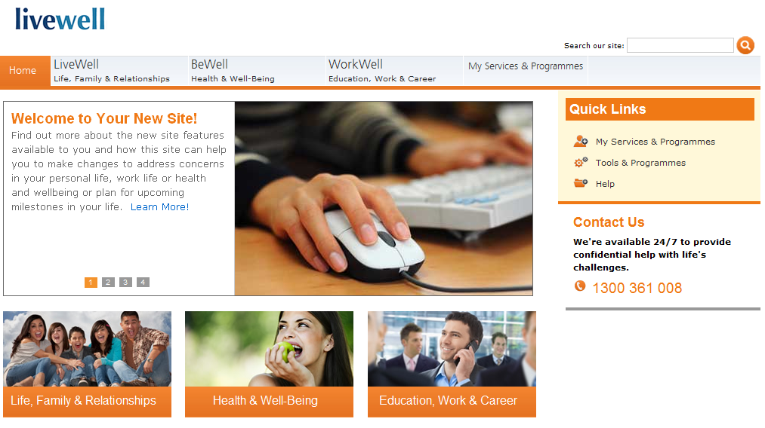
Introducing: Livewell
www.livewell.optum.com
Access Code
community1

Slide 6
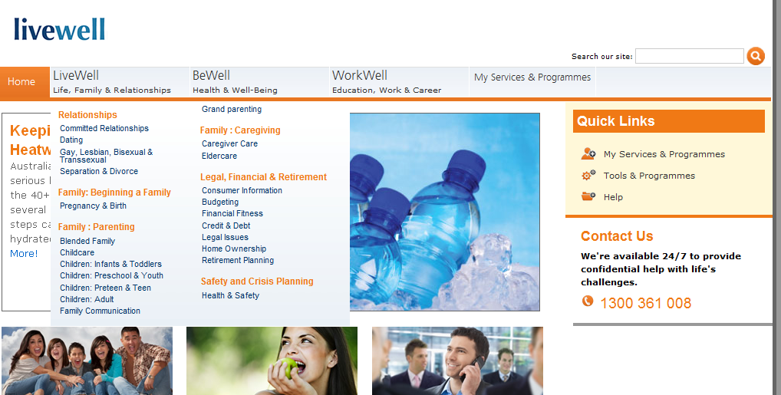
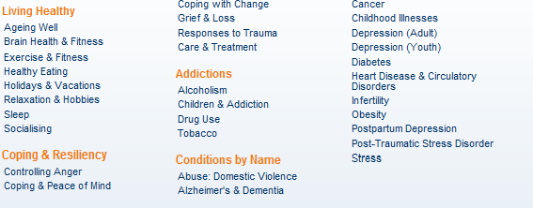
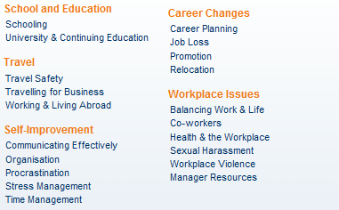
Member portal: Livewell

Slide 7
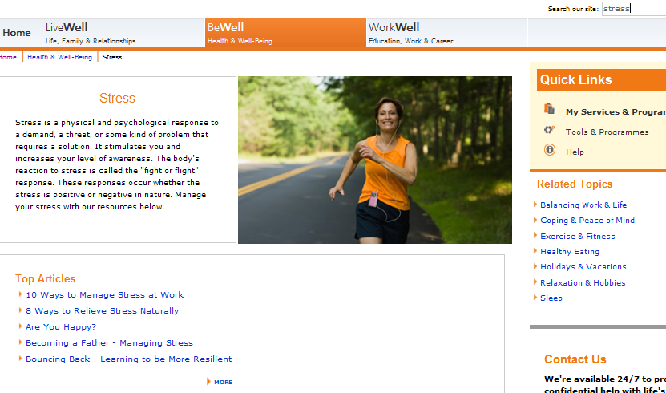
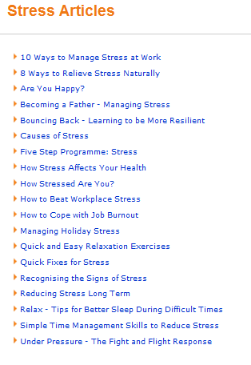
Member portal: Livewell

Slide 8
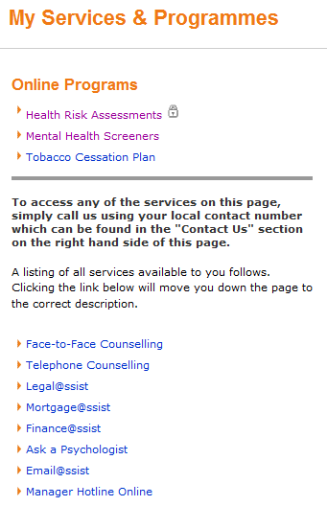
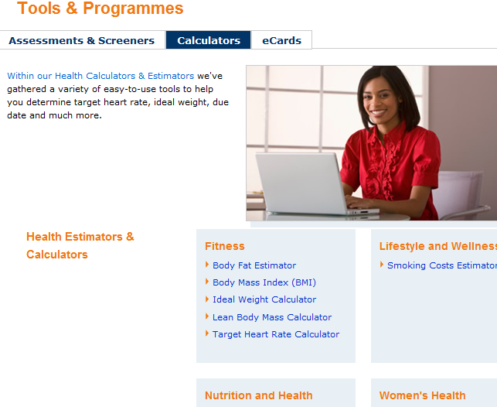
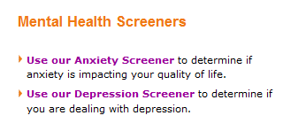
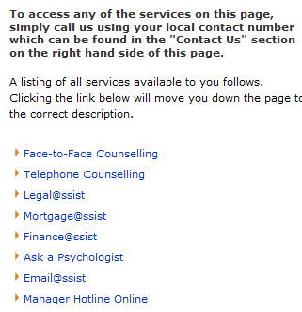
Member portal: Livewell

Slide 9
Manager Hotline and Additional Services

Slide 10
Manager Hotline
Telephone support service for Managers, Supervisors and Team Leaders to assist them in dealing with employee related difficulties..
Examples of issues raised by Managers
Responding to employee grief and trauma
Information on issues such as depression, anxiety & stress
Difficult employee behavioral issues (absenteeism, workplace conflict, anger management)
Change management issues
Difficult conversations and EAP referrals
This service is not intended to take the place of HR advice. It is an additional resource and support.
*.

Slide 11
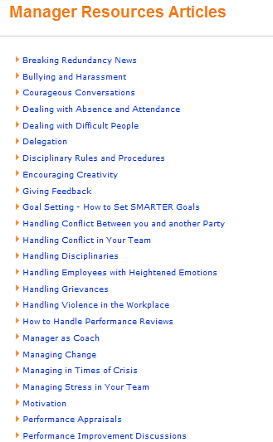
Member portal: Livewell

Slide 12
Trauma Services
If a sudden, traumatic event (critical incident) has occurred immediate support can be provided for those staff involved
Authorised managers can arrange counselling and/or support sessions
Workplace accident
Death of an employee
Sick employee
Threats and harassment from public

Slide 13
EAP + Services
Mediation
Springboard sessions
Workplace Support Services
Training Packages:
DV Awareness Training
Building Resilience
Navigating Change
Mental Health Training for Managers

Slide 14
Some EAP tips to remember
You can always keep the same counsellor
You can always change counsellor
Use the EAP early – don’t wait till crisis
Let Call Centre know if children are involved
Remind family members what support services are available for them
Use the EAP as a preventative

Slide 15
EAP…. Helping all of us with life’s challenges!
Contact information
Optum Health and Technology (Australia) Pty Ltd
1800 604 640
contactus@optum-au.com

