Slide 1


Evaluation workshop
CLCQ Conference
9th May 2017

Slide 2

About us
Purpose-led consultancy, founded in 2015 by 3 professionals with substantial experience and expertise in social, environmental and economic impact measurement.
We have worked with private sector, not for profit and government organisations of all sizes on program design, impact measurement, capacity building and monitoring & evaluation.
“We work with organisations to help measure what matters and convert best intentions into successful outcomes.”

Slide 3
What we’re covering today
Background and aims of the project
A quick look at ‘measurement’ theory and practice
Work and progress to date
Next steps

Slide 4
Background to the project
Commissioned by the Management Committee of CLCQ, overseen by a Steering Group, and facilitated by The Incus Group
The project is important to the viability and sustainability of the Queensland CLC sector as:
  Funding and other resources are allocated on evidence of need;
  There is increasing pressure on resources which requires CLC to make informed strategic decisions about service delivery; and
  Stakeholder communications and relationships at a CLC and sector level can be better informed

Slide 5
Background to the project
Aim is to build the capacity of Queensland CLCs to better measure and understand the outcomes of their work in the community within a shared sector outcomes framework.
  Build an evaluation framework and methodology that can be practically applied to the Queensland CLC context
  Establish and test a self-evaluation toolkit and resources to assist Queensland CLCs to undertake outcome evaluation on an ongoing basis
  Contribute to building a sector culture of measuring and reporting on outcomes and impacts.
The main purposes of the framework and toolkit are to:
  Understand and measure client needs and how they are being addressed
  Capture outcomes for clients and other stakeholders more systematically
  Effectively capture and communicate what works to funders and the sector
  Build the measurement and evaluation capacity of CLC’s and the sector

Slide 6
Why measure outcomes?
Organisations are operating within an increasingly competitive and sophisticated philanthropic and corporate investment environment. Funders as well as service users are keen to better understand the value of the services they support or rely on
Commonwealth and State governments are embarked on a range of new funding and contracting strategies, centred on achieving better value from public investment in services, focused on ‘impacts’ rather than ‘outputs’ …National Disability Insurance Scheme, Payment by Outcomes, Social Impact Bonds
Companies are increasingly moving away from pure philanthropy towards strategic community investment models that better align corporate responsibility and community programs with business priorities….. Social Return on Investment, Creating Shared Value

Slide 7
Why measure outcomes?
Organisations undertake outcomes measurement for several reasons:
  To understand, measure and report the value they are creating through their work
  To use that understanding to improve the quality of the services they deliver to their stakeholders and clients
  To lobby or advocate for change in public policy
  To make the strongest case for continuing and increased support from their funders and partners

Slide 8
Outcomes measurement
It’s looking at the bigger impact your organisation has on your clients, the broader community and other stakeholders
  Significant positive and negative changes (outcomes)
  Short, medium and longer term outcomes
  Direct and indirect (spill over) outcomes
  Target beneficiaries and other stakeholders
  Economic, social and environmental
There is no standardised or one-size-fits all framework or approach to guide outcomes measurement or reporting, but there are principles

Slide 9
Principles
Principle 1: Involve your stakeholders
Measure what matters from the perspective of your stakeholders – the people or organisations that have experienced change as a result of your activities.
Principle 2: Measure and understand the theory of change
Apply appropriate methods and resources to understand and then measure the change (positive and negative, intended and unintended)
Principle 3: Be accurate and credible by taking account of:
What would have happened anyway? (Deadweight)
How much did other organisations contribute to the change? (Attribution/Contribution)
Have the issues moved somewhere else? (Displacement)
Notes:
Could also include the following as principles:
Strike a balance between numbers and stories
Be transparent about both the investment and the value created

Slide 10
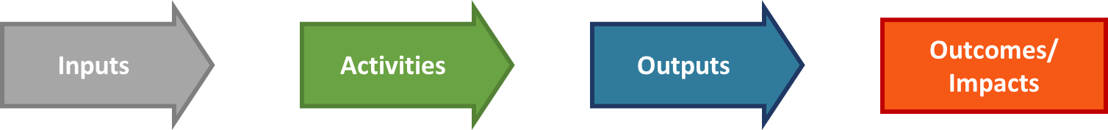
The theory of change
Inputs : the resources invested - cash, volunteer time, in-kind contributions
Activities: What the investment enables to happen – e.g. legal advice, casework, community education, client representation, partnership initiatives
Outputs: Usually quantitative (e.g. number of clients supported, sessions delivered, cases closed, submissions made)
Outcomes/Impacts : The change that occurs as a result of an activity (e.g. improved client personal/financial well-being, more efficient legal services, fairer legal outcomes, change in public policy

Slide 11
Progress to date
Steering group established to oversee the project
  Agreed terms of reference, working arrangements, methodology and implementation plan
Trial ‘sites’ agreed
  Townsville, BRQ and Nundah
Data collection and literature review
  Internal, external, International

Slide 12
Progress to date
Consultative workshop for CLC’s
  Discuss different operational models,
  Stakeholder mapping
  Review data collection, current and future
External stakeholder consultation
  8 interviews including Legal Aid, Appeals Tribunals, Dept of Justice, Community partners, Volunteer Lawyers
Draft Theory of Change
  developed in consultation with staff, community partners and collaborators in justice services, as well as drawing on local and international examples.

Slide 13
Key Evaluation questions
Clients
  To what extent have we made a difference to those we have serviced?
  To what extent have we serviced those most in need?
Community
  How effectively have we worked with community partners and other services?
  To what extent have we increased community understanding of legal rights and responsibilities?
Justice System and Services
  To what extent have we contributed to improved efficiencies in the justice system?
  To what extent has our case-work contributed to effective advocacy?
Pro Bono and Volunteer Lawyers
  To what extent are we increasing knowledge and capacity in the legal sector?

Slide 14
Theory of Change
The CLC Theory of Change is also built on a number of assumptions:
  Client-focused work has both immediate and longer term impacts
  Clients want results, and also to be empowered
  Providing information empowers people and communities
  Rights will be valued and defended
  Other agencies want to form alliances and advance common agendas
  Other organisations have the capacity, skills, ability and willingness to collaborate
  Justice services are expecting measurable outcomes from their engagement with the sector
  Increased understanding of social justice issues leads to fairer outcomes

Slide 15
Theory of Change

Slide 16
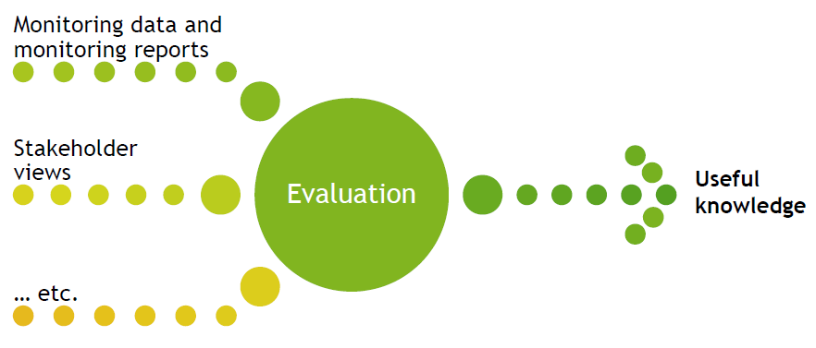
Evaluation Toolkit Components
CLASS data
Ongoing collection at all CLCs
Client / external stakeholder Survey
Developed during Project
Periodic Data collection
Case Studies
CLC Specific Projects
Internal Evaluations

Slide 17
Monitoring - key points to note
Principal function is to advise stakeholders of program performance, and identify of deviations from targets
To perform this function well, monitoring must be:
  Ongoing
  Referenced to agreed performance criteria
Monitoring typically focuses on:
  Activities and processes (Provision of training, court appearances, information provision)
  Outputs (# of advices provided, # of CLE trainings)
Notes:
WHAT ARE THE MOST RELEVANT PIECES OF DATA IN CLASS THAT CAN INFORM EVALAUTION OD CLCS

Slide 18
Evaluation – key points to note
Principal function is to inform policy and program development and implementation, and enable sound decision making
Evaluation forms judgments on the state of affairs, merit and worth of a program
  State of affairs: What is occurring
  Merit: The intrinsic quality of something (in absolute or relative terms)
  Worth: The value of something in a particular context (contributing to the sector and for stakeholders)
The word ‘judgment’ can be challenging. In program evaluation:
  We form judgments about programs, not people
  Judgments can be positive, negative, or mixed
  We are using our judgment, not passing judgment
Notes:
We are using our judgment, based on the consolidated sources of information (NOT JUST WHAT WE SEE)

Slide 19
Evaluation – key points to note
Evaluation conclusions have both a factual and a normative aspect
  Factual: Identifying that something is the case
  Normative: Reaching a view as to merit and/or worth
To perform these functions well, evaluation must:
  Be planned and systematic
  Form a sophisticated understanding of its subject matter
  Develop explanations for the state of affairs
Which means that evaluation…
  Often involves more intensive effort than monitoring, in both data collection and analysis
  Is usually conducted periodically or episodically, not continuously

Slide 20
Next Steps
Finalise the draft toolkit:
  Guidance notes
  Templates for Client surveys, Partner interviews, ProBono and Volunteer Lawyer surveys
  Appropriate data collection protocol (Collection methods and frequency)
Work with pilot CLCs to test it, providing guidance and support on:
  Extracting appropriate data from CLSIS/CLASS to inform evaluation questions
  Stakeholder consultation and engagement (Case Studies, non CLASS reporting etc.)
  Collating, analysing presenting results
Review pilot findings with Steering committee:
  Present findings and feedback from the pilot
  Clarify specific issues in relation to toolkit development and future rollout
Work with CLCQ to:
  Produce Training Material and ‘User guide’ based on pilot feedback
  Agree the roadmap and timetable for rollout
Notes:
WHAT CAN WE REALISTICALLY PULL FROM CLASS REPORTING TO EVIDENCE
Survey Monkey – output will be RAW data in excel which INCUS will collate and present as a snapshot of results per for each CLC in pilot

