Slide 1

Assisting your clients with payday loans and consumer leases
26 June 2017
Lachlan Edwards
Worker Advice Line
Phone: 9602 3326
Rural access: 1300 881 020
advice@consumeraction.org.au
www.consumeraction.org.au

Slide 2
Welcome and Introductions

Slide 3
The bigger picture
Business models targeting vulnerable consumers and financially exploiting them
Protections exist but are rarely accessed by the consumers who need them most
Regulation isn't enough to protect them
Alternative products not always readily accessible
Law reform possible but not yet.

Slide 4


Pay day loans

Slide 5
Shirley’s payday loans
Shirley is single mum, referred by a local family violence support agency. She has joint debts with her violent ex-partner. She only receives Centrelink. As you go through her financial statement you discover she has been taking out pay day loans since leaving her ex-partner, about 12 months ago, from Pay Day Lender. She tells you she goes into Pay Day Lender whenever she needs more money, every two to three months or so,or when big expenses like rego come up.

Slide 6
Shirley's case
Shirley brings in the loan papers for her last loan. You see the following:
Loan amount: $1000
Establishment fee: $200
Monthly fees: $40 (total $80)
Fortnightly repayments: $320
Term: 8 weeks / 4 fortnights
Total repayments: $1,280
Equivalent interest rate: 278%

Slide 7
Shirley's case
Lets consider:
What laws help Shirley?
What kind of legal outcome can Shirley seek?
What options does Shirley have?

Slide 8
Types of short term loans

Slide 9
Payday loans
(Small Amount Credit Contracts)
What is a SACC?
$2,000 or less
16 days to 12 months
Max costs
  20% establishment fee
  4% monthly fee
  200% for total default fees

Slide 10
Right to request documents
She has a right to receive:
Loan contract (including any insurances)
Statements of account
Unsuitability assessment
Payout figure

Slide 11
Is the loan responsible?
The pay day lender must make an assessment to ensure the loan is not unsuitable
To do this, they need to make reasonable enquiries about Shirley’s:
  financial circumstances
  requirements and objectives
Then they must verify financial information

Slide 12
Is the loan responsible?
The loan will be unsuitable where:
  at the time, it was likely Shirley could not afford to repay it or not without 'substantial hardship'
  it did not meet her requirements and objectives

Slide 13
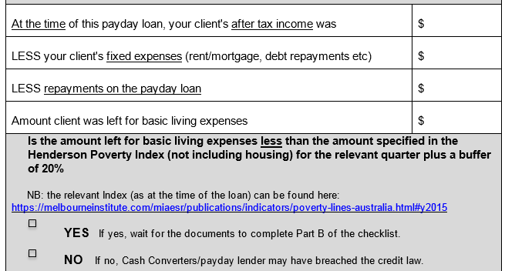
Could Shirley afford it?

Slide 14
Defining requirements and objectives
Could be:
maximum amount of credit
timeframe
purpose and benefit sought
particular features or flexibility
Source: FOS Approach to Responsible Lending; ASIC Regulatory Guide 209

Slide 15
SACC-specific laws
Requirements since 1 March 2013:
Bank statements: Lender must obtain and consider 90 days’ worth
Maximum repayment: 20% of income
(if Centrelink more than 50% of income)
  Presumed unsuitable if:
    two or more SACCs in previous 90 days
    in default under existing payday loan

Slide 16
What outcome could Shirley get?
Refund of fees/charges
Waiver of debt
Calculating damages:
= total repaid minus total received

Slide 17
Shirley's options
Get the documents
  Consider loans within the last 6 years
Assess affordability
Challenge loans or seek hardship variation by way of letter to lender
Complaint to CIO/FOS
Complaint to ASIC

Slide 18
Outcome in Shirley's case.
Shirley’s story:
The documents reveal that Shirley took out 62 payday loans over last 6 years
They were unaffordable. On a responsible lending claim.
Damages = $18,303.23 (total repaid) minus $13,028.00 (total money she received)
Shirley's refund = $5,275.00

Slide 19




Rent-to-Buy & Consumer Leases

Slide 20
Shirley’s story continued
Shirley has moved and left some items with the violent ex.
To deck out her house, she goes to Big Rental and gets a fridge & washing machine on Rent Try Buy for $2. Shirley thought this was the owner of the items if she paid all along and then $2 at the end.

Slide 21
Shirley’s story continued
  About 2 years later she remembers that her contract should be at an end.
  She has struggled all along.
  She calls Big Renter who says she has to make an offer to buy the fridge and washing machine.

Slide 22
Shirley's story continued
Shirley brings in the paperwork which is a one page contract. It shows:
  Shirley must make 52 fortnightly payments of $165
  Shirley must pay in total: $8,580
  After 2 years, she can buy 'similar goods' for $2, or make an offer to buy the goods she has had at her home. If she does neither, she must keep paying the rental amount.
  She figures out that the goods would have cost $3,900 if bought up front.

Slide 23
Shirley's story continued
Lets consider:
What laws help Shirley?
What kind of legal outcome can Shirley seek?
Where options does Shirley have?

Slide 24
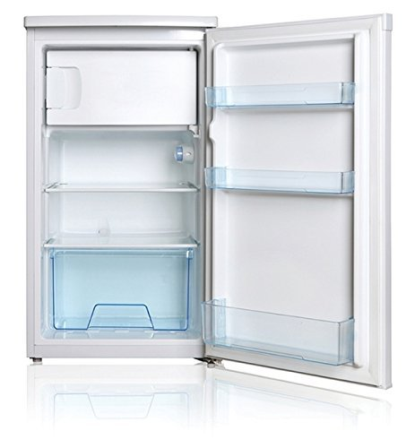
Is this a consumer lease?
Contract for the hire of goods with no right or obligation to own
Costs more than the cash price
Specifies a term that is more than 4 months
No limit on the fees that can be charged.

Slide 25

What laws help Shirley?
Unsuitable (irresponsible lending)
Unjust or unconscionable contract
Unfair contract term

Slide 26
What might Shirley get?
Keep goods +
  receive refund/compensation
  no more to pay
Return goods +
  receive refund/compensation
  no more to pay
New payment arrangement & total

Slide 27
What can Shirley do?
Get the documents
Identify the issues and consider:
  How much has she paid?
  Does she want to keep the goods?
  What kind of outcome could the law provide?
Complaint letter to rental company
Complaint to CIO/FOS
Complaint to ASIC

Slide 28
Session review
Remember the SACC - specific laws
More than just hardship – irresponsible lending arguments can help you get better outcomes for your clients
  May help get refund on current and old loans
  May help bolster arguments for a waiver
Systemic problem? Report to ASIC
We want to hear your clients’ stories!

