Slide 1
Helping Clients Who Owe Money
Brian Kerr
Financial Counsellor
6 June 2017
E-mail questions to
preethi@consumeraction.org.au

Slide 2
Learning Outcomes
During this session you will learn about:
The different ways a financial counsellor can help you
How to deal with utility debts
How to deal with debt collectors
Payday loans and better alternatives for your clients

Slide 3
Who are financial counsellors?
  Provide information, support and advocacy to those in financial difficulty
  NOT financial planners!
  Free, confidential and independent
  Available in every State and Territory

Slide 4
How can an FC help you?
Identify financial options
Advocate or negotiate for clients
Facilitate access to grants, concessions and dispute resolution
Provide information

Slide 5
Why you should consider an FC
Resolves financial difficulties
Avoids legal action
Avoids bankruptcy
Improves mental wellbeing

Slide 6
What is the National Debt Helpline?
Telephone based financial counselling service
NDH service exists in every State and Territory

Slide 7
How do we help clients who owe money?
Formulate a plan
Assess needs and provide referral
Holistic approach
Emotional support
Got a question?
Email preethi@consumeraction.org.au

Slide 8
Utility Debts
Threat of disconnection
Don’ts:
  DON’T use credit cards
  DON’T get a payday loan

Slide 9
Utility Debts: What to Do
Find the more affordable and appropriate plan
Negotiate payment plan or delay
Identify inefficient appliances
Check discounts, concessions and grants eligibility
Go to the Ombudsman

Slide 10
When Debts Go Unpaid
Clients come into contact with the debt collection industry
Possibility of negotiating a payment arrangement with the debt collector

Slide 11
Debt Collection: A Story
  Charlie has been unable to keep up the repayments on his personal loan.
  Eventually, a debt collector contacted Charlie, threatening legal action if he didn’t pay his debt immediately.
  Charlie proposed a repayment plan of $100 a week. The collection agency said they couldn’t accept any less than $200.
  Charlie went to see a financial counsellor, who contacted the debt collection agency on Charlie’s behalf.
  The financial counsellor was able to negotiate a repayment plan.

Slide 12
Dealing with Debt Collectors
  Be cooperative
  Be honest about your financial position
  Figure out what you can afford
  Confirm repayment plan in writing
  Keep records
  Keep the debt collector updated

Slide 13
Can they do that?
  Debt collectors should not:
  Use or threaten physical force
  Remain on client’s property
  Use harassment, verbal abuse of overbearing behaviour
  Call or visit excessively
Got a question?
Email preethi@consumeraction.org.au

Slide 14



Payday loans

Slide 15
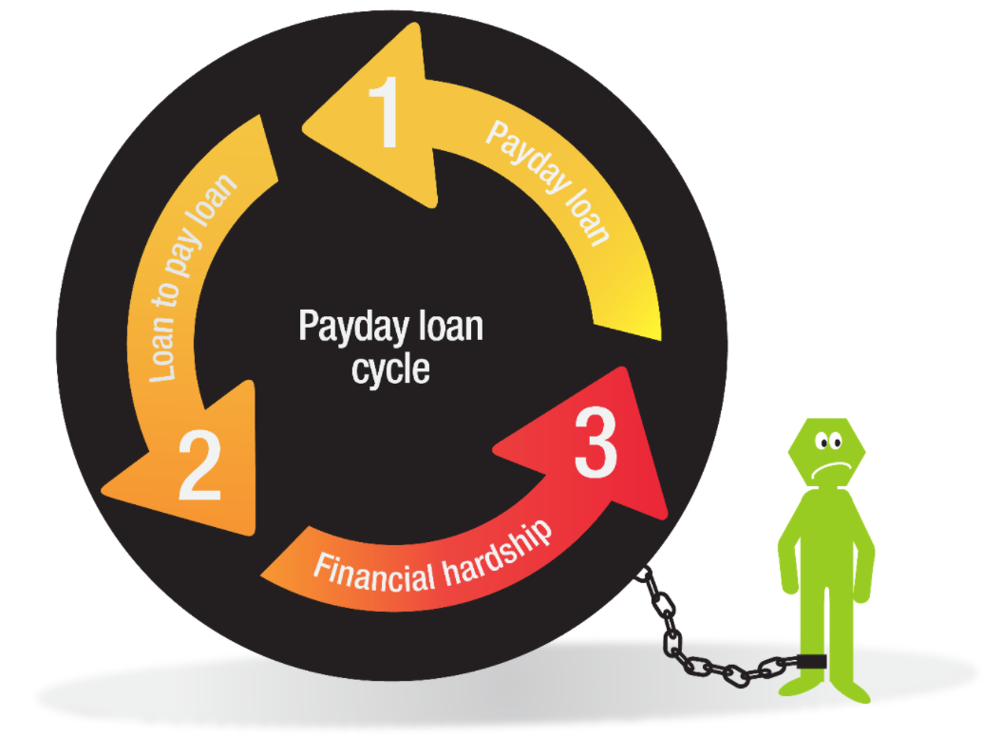
The payday loan cycle

Slide 16
What is a payday loan?
  Personal loan from $500 to $2000
  Unsecured
  Repaid between 16 days and 1 year
  Loan repayments deducted on payday
  Limits on fees apply

Slide 17
Example of a payday loan
Amount borrowed: (max $2,000)
Length of loan: (min 16 days, max 1 year)
Amount Borrowed = $1000
Length of Loan = 6 months
Amount borrowed:$1,000.00
Establishment fee: (20% of amount borrowed)$200.00
Monthly fees: (4% each month)$480.00
Total to be repaid:$1,680.00
Fortnightly repayments: (26 payments)$64.62
Fees are set at the maximum a payday lender can charge.

Slide 18
Legal obligations on lenders
Responsible lending requirements
  Ability to pay back the loan
    Centrelink recipients: repayments must not exceed 20% of income
  Suitability of the loan
Lender should be asking for bank account statements and other documents

Slide 19
Alternatives to payday loans
  Avoid payday loans!
  Other options:
    No Interest loans
    Centrelink advance payments
  Call the National Debt Helpline (1800 007 007) for more options

Slide 20
Questions
Send an e-mail to preethi@consumeraction.org.au

Slide 21
Talk to a financial counsellor!
National Debt Helpline
1800 007 007
http://www.ndh.org.au/

