Slide 1
Supported decision-making in wills and powers of attorney
Notes:
Begin by acknowledging the traditional owners of the land that we are meeting on and pay my respects to their elders past, present and emerging refer to the preamble of the ACT Human Rights Act: -

Slide 2
Overview
What?
An overview of the resource
Why?
Enduring power of attorney as an alternative to guardianship
Wills – exercising choice and control, overcoming the laws of intestacy
How?
Looking at how the resources were developed, what they look like and how they work in practice

Slide 3
What?
We have developed three documents that aim to help people to understand what an enduring power of attorney and will is
Our audience is people with intellectual and cognitive impairments
The resources have been designed to be used with a supporter – using supported decision-making to assist people to choose their own substitute or supported decision maker
Notes:
Disability Law Queensland was engaged by Mamre Association to develop a resource to help people with intellectual and/or cognitive impairments to understand what wills and enduring power of attorney documents are.
Mamre is a disability service provider (Brisbane based)
Disability Law Queensland is a non-profit law firm with Mamre as sole shareholder

Slide 4
Why? Enduring power of attorney
The human rights of people with impaired decision-making capacity…
Everyone should be equally recognised before the law
Everyone has the right to autonomy
Everyone should be free to make their own decisions
Notes:
Article 12 of the Convention on the rights of persons with disability provides that people with disability should be equally recognised before the law and retain legal capacity on an equal basis to those without disability. Underpinning the Convention is the understanding of disability as arising from a person’s interactions with their environment – not just their impairment. Article 5 provides the right of non-discrimination – reading these provisions together the Convention imposes a duty on states to ensure that support is provided to people with disability to allow them to exercise their capacity.

Slide 5
Why? Enduring power
Increasing numbers of applications are being made for guardianship and administration in Queensland because of the barriers to people maintaining and exercising their right to make their own decisions
[see Office of the Public Advocate “Decision-making support in Queensland’s guardianship system: An Issues Paper” Feb 2014]
Notes:
Pave the Way (a program of Mamre’s) has worked with families who have family members with disability for over 12 years. Consistently families are asked to justify their role as an informal decision-maker or supported decision-maker. Challenges are posed for example by banks, utility companies, phone companies – hampering the ability of families to set their loved one up with an independent life.

Slide 6
QCAT is able to make an order
Impaired capacity
A decision needs to be made OR the adult is likely to do something that places them at risk
Without appointment the needs of the adult will not be adequately met or their interests not protected
Notes:
G and A should not be applied for routinely where an adult has impaired decision-making capacity. QCAT must be satisfied of three things:
lack of capacity;
decision to be made/risk to adult or others;
needs /interests not met without formal appointment.
So if a person has impaired capacity and the person’s family are adequately able to assist that people and their needs are met and interests are protected an order will not be made.
QCAT is bound to follow the law just as others are. Must follow the general principles in the GAA Act – including principle that an adult’s decision-making should be interfered with to the least extent possible.
Not sufficient that parent wants to be formally appointed to make things easier. We’ve had cases where parents have been told by the banks – become a guardian. If an adult’s interests can be protected and their needs met with informal support – eg. co-signatory on bank account – then there is no need for a formal appointment.
Guardianship places significant limitations on a person’s ability to enjoy their human rights – they loose the right to make their own decisions.

Slide 7
Why?
Appointing a person of their own choosing to make decisions for them
Detailing how the power should be exercised (for example including a condition requiring the attorney to speak to the principal about all decisions)
Expressing any wishes they have in relation to particular matters

Slide 8
Why? Wills
People (regardless of their disability) have a right to decide who to leave their possessions to
Many people with disability are unhappy with the result of laws of intestacy
Statutory wills are an expensive option – usually only considered where there is a substantial estate
Notes:
EG: bad results from laws of intestacy
Single Mums – 50/50 to parents where there is no partner or children
People who have lost contact with their families due to (for example) relinquishment as a child – no provision for friends

Slide 9
How?
Idea is to develop the capacity of clients with intellectual impairments by providing information in a way they understand
Leveraging the support of a person close to the client – given that they will be skilled in communicating with the client
Will not be suitable for all clients
Notes:
Has been developed within the context of our service where many of our clients needing these services come to us through their parent’s or other family members seeking succession planning advice – our clients are usually from supportive families
It would be a great project to try to use the resource with service providers who are supporting more disconnected people to ensure that these clients also have the opportunity to develop and exercise their capacity

Slide 10
How?
Undertook desktop research relating to best practice in supported-decision making tools and resources and reviewed existing resources that explained wills and enduring power of attorneys
Reviewed existing resources that explain the legal obligations of lawyers and attorneys in relation to both the execution of the documents and ongoing obligations;
Reviewed our own files where we had assisted clients with intellectual impairments to prepare wills and enduring powers of attorneys

Slide 11
How?
Developed the content of the resources – three resources – one for supporter, one explaining EPoAs and one explaining wills
Tested the draft resources with a number of clients with intellectual impairments and their supporters (the consumer group) – incorporated their feedback and comments
Obtained feedback from a DLQ lawyer who had not been involved in developing the tool but who used the draft tool with the consumer group
Sought feedback from stakeholders – received and incorporated feedback from The Office of the Public Advocate, ADA Australia, Carers Queensland and the Australian Centre for Health Law Research

Slide 12
TAA DAA!
Wills and enduring power of attorney – a guide for supporters
An enduring power of attorney – a guide for decision-makers
Wills – a guide for decision-makers

Slide 13
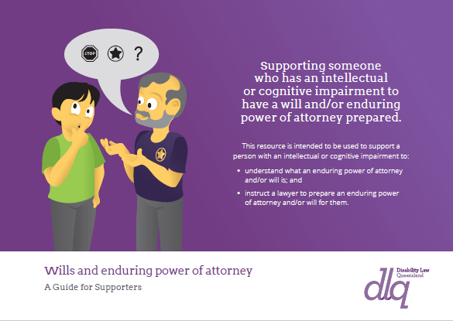
1. Wills and enduring power of attorney – a guide for supporters

Slide 14
2. An enduring power of attorney – a guide for decision-makers

Slide 15
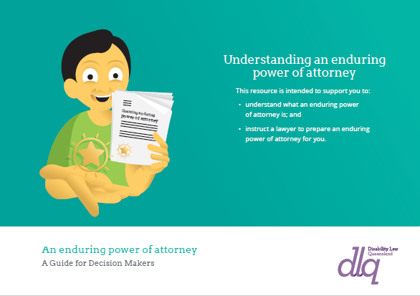
3. Wills – a guide for decision-makers

Slide 16
Resources that should be used in conjunction with our resources…
Office of the Public Guardian “Guidelines for Witnessing Enduring Documents”
Queensland Advocacy Incorporated’s
“Queensland Handbook for Practitioners on Legal Capacity”
ADA has developed resources to assist attorneys to understand their obligations and responsibilities

Slide 17
Get a copy of our resources
Will be available on our website
We can send a print version if you email me at director@dlq.org.au

